Slide 1
WEEK 6

Slide 2
90

Slide 3
Week 6: Benchmark 3 Week
SPRING HALF-TERM
Week 1: RWS7
Week 2: RWS7
Week 3: RWS8
Week 4: RWS8
Week 5: Exam Review Week
Week 6: Benchmark 4 Week
EASTER
Week 1: RWS9
Week 2: RWS9
Week 3: RWS10
Week 4: RWS10
Week 5: Review Week
SUMMER HALF-TERM
Week 1: Benchmark 5 (End of Year Test)
Week 2: Benchmark 5 Feedback
Week 3: Students 1-2-1 Week and Predicted Grades
Week 4: RWS11
Week 5: RWS11
Week 6: RWS12 Introduction
SUMMER HOLIDAYS

Slide 4
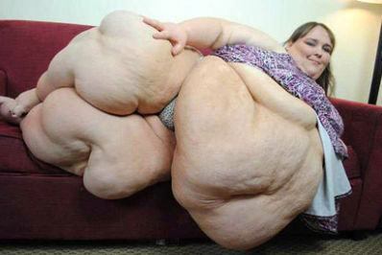
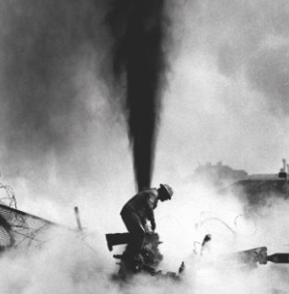
RWS7 and 8: MICROECONOMICS Externalities and Public Goods as a Market Failure (MARKET FAILURE = Allocative Inefficiency)
Week 6: Benchmark 3 Week
SPRING HALF-TERM
Week 1: RWS7
Week 2: RWS7
Week 3: RWS8
Week 4: RWS8
Week 5: Exam Review Week
Week 6: Benchmark 4 Week
EASTER
Week 1: RWS9
Week 2: RWS9
Week 3: RWS10
Week 4: RWS10
Week 5: Review Week
SUMMER HALF-TERM
Week 1: Benchmark 5 (End of Year Test)
Week 2: Benchmark 5 Feedback
Week 3: Students 1-2-1 Week and Predicted Grades
Week 4: RWS11
Week 5: RWS11
Week 6: RWS12 Introduction
SUMMER HOLIDAYS
RWS7 = Externalities in Consumption (Merit and Demerit Goods): Economics of Health
RWS8 = Externalities in Production: Economics of the Environment
EASTER
RWS9 = Public Goods
RWS10 = Inequality and Poverty

Slide 5
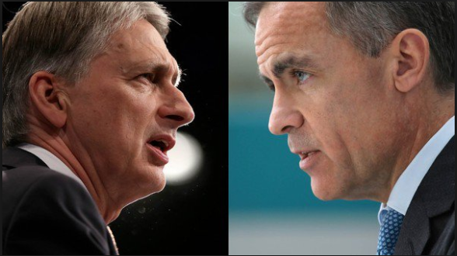
RWS7 and 8: MACROECONOMICS Government Policy and International Economics
Week 6: Benchmark 3 Week
SPRING HALF-TERM
Week 1: RWS7
Week 2: RWS7
Week 3: RWS8
Week 4: RWS8
Week 5: Exam Review Week
Week 6: Benchmark 4 Week
EASTER
Week 1: RWS9
Week 2: RWS9
Week 3: RWS10
Week 4: RWS10
Week 5: Review Week
SUMMER HALF-TERM
Week 1: Benchmark 5 (End of Year Test)
Week 2: Benchmark 5 Feedback
Week 3: Students 1-2-1 Week and Predicted Grades
Week 4: RWS11
Week 5: RWS11
Week 6: RWS12 Introduction
SUMMER HOLIDAYS
RWS7 = Demand Side Policies (Fiscal and Monetary Policy)
RWS8 = Supply Side Policies (Free Market and Interventionist)
EASTER
RWS9 = International Economics (Exchange Rate Systems)
RWS10 = International Economics (Advanced Balance of Payments)

Slide 6
PREP HOMEWORK (for first lesson w/b 25th February)
Just under 2 weeks plus a cover lesson so 3.5 hours for MICRO and 3.5 hours for MACRO
ALL DETAILS WILL BE ON GOL
2 Weeks of Homework = 9 to 12 Hours
1 Cover Lesson = 1.5 Hours
TOTAL: 10.5 to 13.5 Hours before Monday 25th February
PREP HOMEWORK…. 7hrs to 9 hrs (aren’t I nice!?)
40 Mins: MACRO ESSAY (40 Minutes)
3-4 Hours: MICROECONOMICS BOOKLET: Introduction to Obesity and ‘Marginal Analysis’ for ‘Consumption Externalities’
3-4 Hours: MACROECONOMICS BOOKLET: Introduction to Government Policy and the Financial Crash of 2008 for ‘Demand Side Policies’

Slide 7
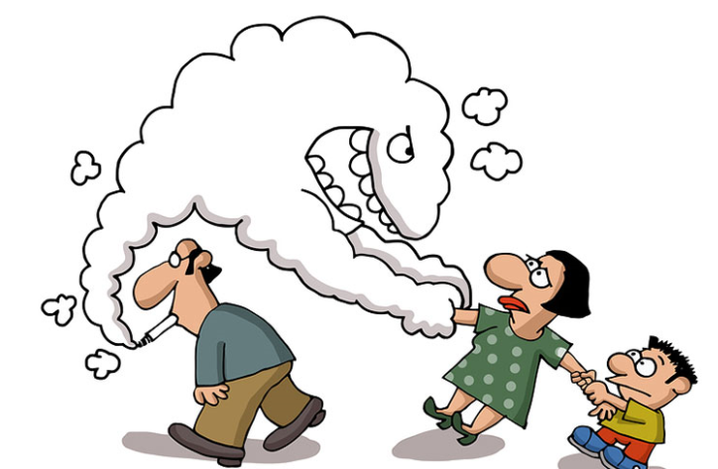
MICROECONOMICS: RWS7 – Consumption Externalities Introduction to Externalities
Consumption and Production
What is an externality?
Smoking a cigarette example
Pretty flowers example
Positive and negative externalities
Why are externalities a market failure = Mis-pricing = allocative inefficiency

Slide 8
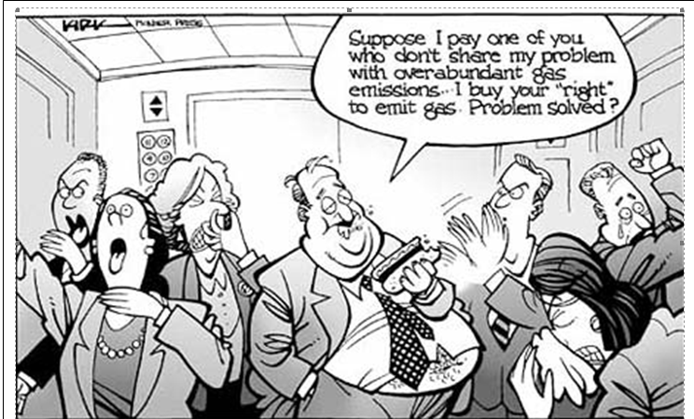
EXTERNALITIES EXERCISE
TASK: For each of these actions by economic agents, try to identify any possible externalities in these scenarios….
CONSUMPTION (by consumers/households)
Going to a nightclub?
Visiting the dentist regularly?
Eating a donut?
Gaining a degree?
PRODUCTION (by firms/producers)
Generating electricity through fossil fuels
Building electric cars
Planting lots of trees

Slide 9
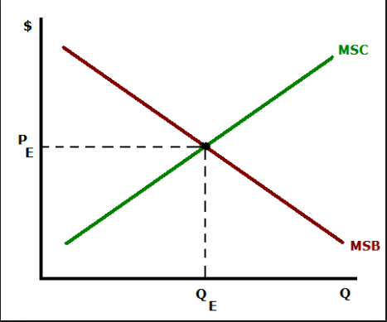
MICROECONOMICS: Modelling Externalities in Economics – Marginal Analysis
The concept of the ‘margin’
Cost and Benefit Analysis…
Marginal Social Costs and Benefits

Slide 10
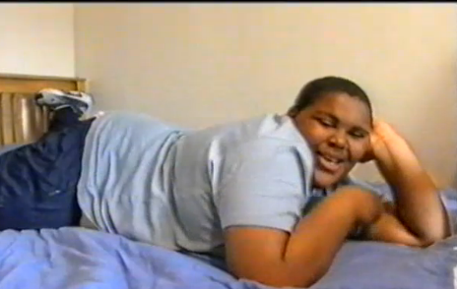
MARKET FAILURE: Context: Introduction to Health and Environmental Economics ALLOCATIVE INEFFICIENCY and mis-pricing of goods and services that are consumed (RWS7) and produced (RWS8) in a market.
QUESTIONS TO CONSIDER WHILST WATCHING THE VIDEO USING WORKSHEET
What is the market?
Why is this a market failure (think of externalities)?
Why is this not a market failure? Market Success?
How is the Government intervening in the market in the UK?
Is it successful?
Health Economics
Environmental Economics

Slide 11
 | CONSUMPTION Health Economics | PRODUCTION Environmental Economics (Degradation and Depletion of Natural Resources
What is the market
MF
MS
GI
GF

Slide 13
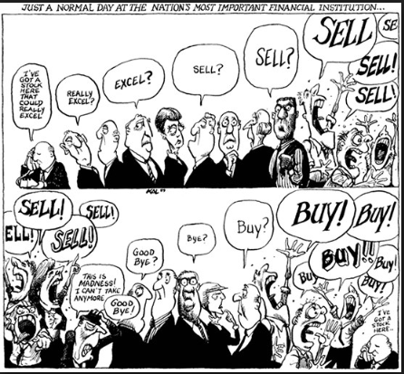
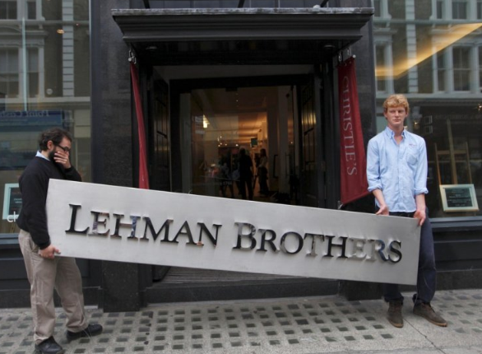
MACROECONOMICS: RWS7 – Demand Side Policies Introduction to Government Policy
Overview of the Area
Context: The Financial Crisis 2008
Credit Crunch?
Traditional Banking
Modern Banking (and financial derivatives)
Sub-prime mortgages
A perfect storm!

Slide 14
WEEK 1

Slide 15
30

Slide 16
Benchmark Back
Benchmark Back
A3 Review

Slide 17
PREP HOMEWORK Due for w/b 27th February 2017
MICROECONOMICS = 2 hours + 1 hour Class Time = 3 hours
Complete the worksheet on costs, benefits and externalities
MACROECONOMICS = 2 hours + 1 hour Class Time = 3 hours
Complete the worksheet on demand side policies introduction

Slide 18
90

Slide 19
Revision Worksheet 7 Summary
MICRO
Consumption Externalities (as a market failure)
[‘Merit and ‘Demerit Goods’]
Week 1 and PREP1
Market Failure (why is market allocatively inefficient?)
Market Success (why might the market not be allocatively inefficient? Even if it is, why might this not matter)
Week 2 and PREP2
Government Intervention (to solve the market failure)
NHS
Sugar Tax
Government Failure (because of the intervention)
MACRO
Demand Side Policies from the Government
[Fiscal and Monetary Policy]
Week 1
Define monetary and fiscal policy - what are these policies, who operates them and a brief history
Economic analysis - use AD/AS Macroeconomic equilibrium to explain the impact of demand side policies on the three macroeconomic indicators (Growth, Inflation, Unemployment). Also be aware of the impact on the 4th indicator (Balance of Payments)
Week 2
Post Financial Crash of 2008 - what was the role of demand side policies in helping the economy recover from recession?
Debates - the role of quantitative easing and the sustainability of debt
Evaluating the role of demand side policies in the macroeconomy

Slide 20
PREP Homework Micro (Consumption Externalities) and Macro (Demand Side Government Policies)
Check your answers with those in your groups
Where were there mistakes or misunderstandings? Can someone in your group explain them? If not, then write down questions for your group on a separate piece of paper
Read through the answers to the PREP homework and amend your work. Does the answers make your group questions clear? IF not then keep the question. If everyone is happy, delete the question
We will go through the remaining questions as a class

Slide 21
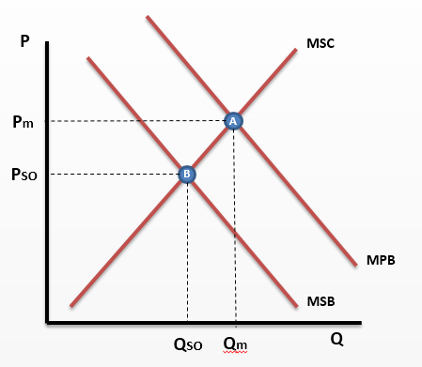
The consumer overconsumes sugary drinks in the market (Qm > Qso), causing allocative inefficiency. This is because the consumer is selfish and/or has imperfect information and will only take into account their private costs (MPC) and private benefits (MPB) and so the free market equilibrium is at A and not at the socially optimal (SO) of B. The MPC are greater than the full cost to society (MSB) which means the consumer is not taking into account the negative external benefits (effectively external costs or negative externalities) of their actions and over valuing the consumption. Costs to those around them such as looking after them when they suffer from Obesity and diabetes does not enter their mind. The impact on co-workers of time off sick from work due to obesity is also not taken into account. Therefore, we can say that the consumer is overvaluing the consumption activity of drinking a sugary drink. The resulting higher price consumers are prepared to pay is above the socially optimal (Pm>Pso). This provides firms with the incentive to increase their supply and overproduce to maximise their profits. Therefore the Government needs to intervene in the market to correct this market failure.
On the other hand the sugary drinks market isn’t failing because markets are self regulating with the production of sugar free drinks and healthier alternatives. Coca Cola have created products such as Coke Zero, to meet the new demand set by consumers for healthier alternatives. In this case the price equilibrium shifts, as demand for normal Coca Cola decreases and the demand for Coke Zero increases. Thus the price mechanism has solved the misallocation of resources. Therefore the government do not need to intervene because it is a personal choice, intervention would interfere in the free market. Secondly it is hard to put a monetary value upon the external costs of this activity - it is very hard to value the impact on co-workers etc. of absences. There the position of Qm ad Qso aren’t definite and could be closer.
2 - Please enter explanation here why the market for sugary drinks is failing here

Slide 22
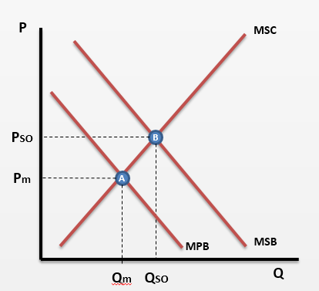
The consumer under consumes healthcare in the market (Qm<Qso), causing allocative inefficiency. This is because the consumer is selfish and/or has imperfect information and will only take into account their private costs (MPC) and private benefits (MPB) and so the free market equilibrium is at A and not at the socially optimal (SO) of B. The MPB is less than the full cost to society (MSB) which means the consumer is not taking into account the external benefits (positive externalities) of their actions and under valuing the consumption. The positive externalities or external benefits such as preventing the spread of contagious diseases or minimising the impact on others of absences from work due to sickness are not taken into account. Therefore, we can say that the consumer is prepared to pay too low a price for healthcare. The resulting lower price is below the socially optimal (Pm<Pso). This does not provide firms with the incentive to supply as much as Qso as the price is too low to maximise their profits at this production level. Therefore the Government needs to intervene in the market to correct this market failure.
In contrast this in not a market failure because the free market will respond and other markets will be developed to correct this failure. For example markets such as health fitness programmes like weight watchers which allow consumers who want to combat problems such as obesity which is a result of under consumption of healthcare. Also sport centres will also benefit with the increasing demand as obese people realise they have to make a change and adjust their preferences and therefore effect the price in the market to reduce the gap to make the consumption closer to Qso. Additionally, perhaps consumers are consuming what they need and it is hard to value the external benefits of underconsumption. Maybe the gap between Qm and Qso is less than is thought?
3 - Please enter explanation here for why the healthcare market is failing

Slide 23
Introduction to Cost/Benefit Analysis
£
What is society?
Economic Welfare, Price Equilibrium and Market Success
Marginal Analysis
Social Benefits (MSB) and Social Costs (MSC) and the Demand/Supply Model
Costs, benefits and externalities
CASE STUDY: Building HS2
= Supply Curve
= Demand Curve
Social Costs
Private Costs
External Costs
=
+
Social Benefits
Private Benefits
External Benefits
=
+

Slide 24
MSB and MSC Curves Marginal Social Benefit and Marginal Social Cost
INDIVIDUAL
SOCIETY
P
SOCIETY
MSC=S
P
P
MSB=D
MSB=D
Q
Q
Q
Law of Diminishing Marginal Utility
(Satisficing Effect)
Law of Diminishing Marginal Utility
(Preference Effect)
Law of Diminishing Returns
(Remember theory of the firm?)

Slide 25
WELFARE MAXIMISATION
£
= Supply Curve
Social Costs
Private Costs
External Costs
=
+
A
Social Benefits
Private Benefits
External Benefits
=
+
= Demand Curve

Slide 26
COST BENEFIT ANALYSIS EXERCISE
For each of these actions by economic agents:
Try to identify the costs and benefits. private and external costs and benefits
Are these costs and benefits “private” (i.e. affecting the individual in society) or “external” (i.e. affecting others around the individual in society)
CONSUMPTION (by consumers/households)
Listening to very loud music at 2 in the morning at your house party
Visiting the dentist regularly
Using a lift and farting with lots of other people in the lift
Planting pretty flowers in your front garden
Eating a donut
Gaining a degree
PRODUCTION (by firms/producers)
Burning fossil fuels to generate electricity
Building electric cars
Planting lots of trees

Slide 27
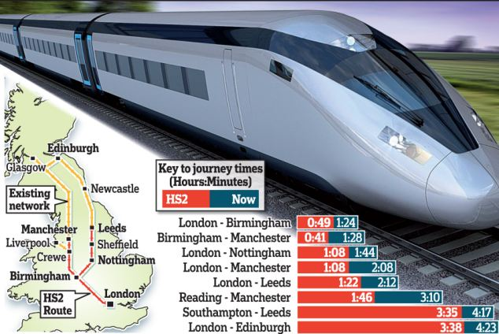
HS2 Case Study: Cost/Benefit Analysis
PRIMARY QUESTIONS:
List the most important cost/benefits of HS2 in your mind:
Private costs
Private benefits
External costs
External benefits
Try to place a value on each of these (I am fascinated to hear how you did it!). If you have got a number from elsewhere, try and estimate how they got to that figure.
SECONDARY QUESTIONS:
What are the advantages and disadvantages of cost/benefit analysis?

Slide 28
WEEK 2

Slide 29
30

Slide 30
RWS7: Consumption Externalities STARTER ACTIVITY - complete these exercises without using your booklet
Healthcare Consumption (with no Government Intervention)
Foods high in sugar and fat (with no Government Intervention)
SO = socially optimal outcome (Allocatively efficient)
m = where the free market will consume
Positive Externalities in Consumption
Draw on the graph the private benefits, external benefits and social benefits of this activity
Explain why this graph demonstrates market failure?
Negative Externalities in Consumption
Draw on the graph the private benefits, external benefits and social benefits of this activity
Explain why this graph demonstrates market failure?

Slide 31
Explanation as to why a market failure
P
MSC
Externality Diagrams
TASKS
Identify your ‘A’ and ‘B’ equilibrium (remember A is where we start from because people are selfish and B is where society wants the equilibrium to be)
Label each diagram with the PSO, QSO and Pm and Qm
Why is each market to the left failing (being allocatively inefficient? Refer to over/under production or consumption
Label the external benefits or costs which are not being taken into account by the market
MPB
MSB
Q
Explanation as to why a market failure
P
MSC
MPB
MSB
Q

Slide 32
RWS7: Consumption Externalities STARTER ACTIVITY - complete these exercises without using your booklet
Healthcare Consumption (with no Government Intervention)
Foods high in sugar and fat (with no Government Intervention)
SO = socially optimal outcome (Allocatively efficient)
m = where the free market will consume
Positive Externalities in Consumption
Draw on the graph the private benefits, external benefits and social benefits of this activity
Explain why this graph demonstrates market failure?
Negative Externalities in Consumption
Draw on the graph the private benefits, external benefits and social benefits of this activity
Explain why this graph demonstrates market failure?

Slide 33
PREP HOMEWORK Prepare for Debates
MICRO (2 hours)
Government Intervention to prevent obesity by correcting the following market failures:
Underproduction of healthcare (solution: NHS)
Overproduction of ‘fast foods’ (solution: A sugar tax)
MACRO (2 hours)
Government Policy Debates:
Monetary Policy: What is Quantitative Easing and has it worked in the UK?
Fiscal Policy: Is our national debt sustainable? Should the Government prioritise it’s reduction through Austerity?

Slide 34
LESSON
TODAY (and tomorrow)
Marginal Analysis and Welfare Theory: Externality Diagrams
Evaluating Market Failure for an essay point

Slide 35
90

Slide 36
Consumption Externalities (Merit and Demerit Goods) Market Failure leading to Obesity (over consumption of fast food and underconsumption of healthcare)

Slide 37
What are Externalities?
HOUSEHOLDS
3rd PARTY
EFFECTS
payment
goods
FIRMS

Slide 38
Externalities:
The Chemical Plant and Water Plant
PRIVATE
COSTS
EXTERNAL
COSTS
SOCIAL
COSTS
+
=
PRIVATE
BENEFITS
EXTERNAL
BENEFITS
SOCIAL
BENEFITS
+
=
EXTERNALITIES

Slide 39
ARCHIVE

Slide 40
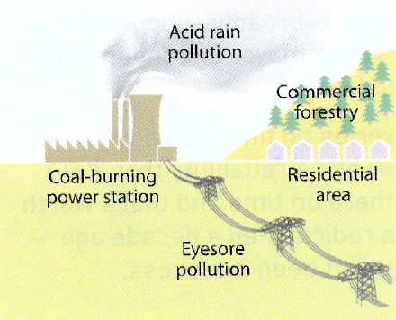
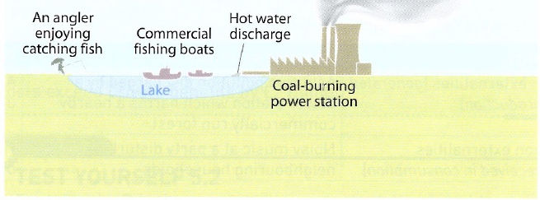
EXTERNALITIES….

Slide 41
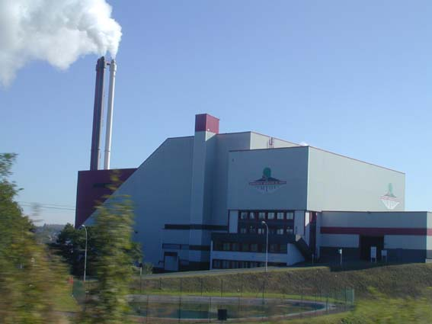
EXAMPLE (externality????):
An Incinerator

Slide 42
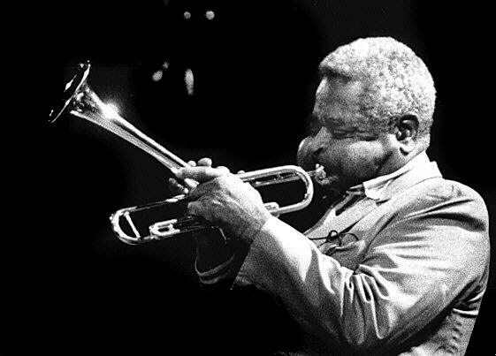
EXAMPLE (externality???):
Dizzy Gillespie – Trumpet Player

Slide 43
Driving from London to Cornwall
Summer Road Trip! Holiday for a week in Cornwall….
What are the private benefits and costs?
What are the external benefits and costs?
What are the most significant externalities that you are not paying for?

Slide 44
Why are externalities a market failure?
In a free market, costs should equal all benefits.
If there are external costs (externalities) on society which are not paid for by the consumer/producers activity then the market has failed because that AGENT IS NOT PAYING FOR THE TRUE COST
This can lead to ‘underproduction and ‘overproduction’
p
s
d
q

Slide 45
OVERPRODUCTION AND UNDERPRODUCTION
OVERPRODUCTION
Prices are too low
THEREFORE
We are producing too much (firms costs are low and they are able to produce more)
UNDERPRODUCTION
Prices are not high enough because a good is undervalued by consumers
THEREFORE
We are producing too little
(firms are not willing to supply)

Slide 46
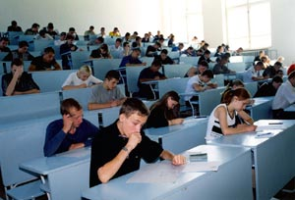
MERIT GOODS
UNDER PRODUCTION (we want more!!!)
in a free market

Slide 47
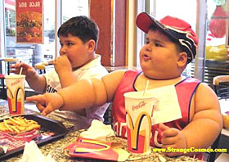
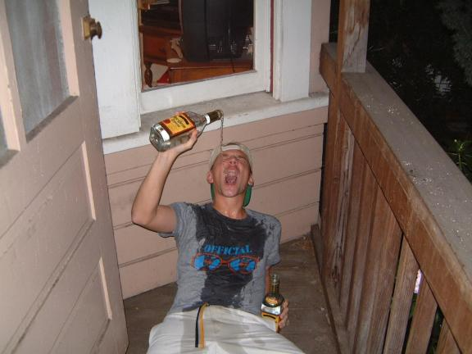
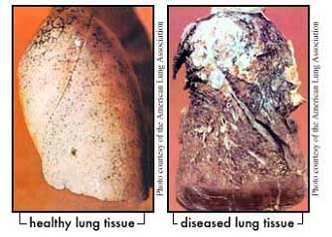
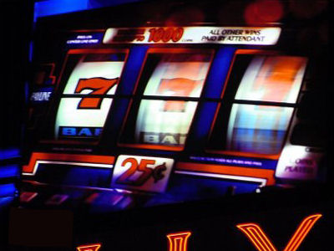
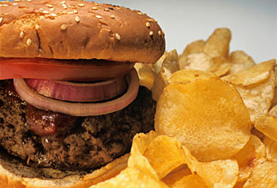
DEMERIT GOODS
OVER PRODUCTION (we want less!!!)
in a free market

Slide 48
P
MSC
MPC
P
MSC
Externality Diagrams
TASKS
Identify your ‘A’ and ‘B’ equilibrium (remember A is where we start from because people are selfish and B is where society wants the equilibrium to be)
Label each diagram with the PSO, QSO and Pm and Qm
Why is each market to the left failing (being allocatively inefficient? Refer to over/under production or consumption
Label the external benefits or costs which are not being taken into account by the market
MPB
MSB
MSB
Q
Q
P
MPC
P
MSC
MSC
MSB
MPB
MSB
Q
Q

Slide 49
P
MSC
MPC
P
MSC
Pm
A
PSO
B
PSO
B
Pm
A
MPB
MSB
MSB
QSO
Qm
Q
QSO
Qm
Q
P
MPC
P
MSC
MSC
Pm
A
PSO
B
PSO
B
Pm
A
MSB
MPB
MSB
Qm
QSO
Q
Qm
QSO
Q

Slide 50
WEEK 3

Slide 51
30

Slide 52
STARTER ACTIVITY (First 10 Minutes) - Microeconomics Use the whiteboards to answer the following questions:
TASK 1:
Draw an ‘externality diagram’ for a merit good (such as healthcare) and explain why there is a market failure
Let us now say the UK Government decide to correct this market failure by subsidising healthcare. What effect would that have on the equilibrium in your diagram? Does this solve the market failure?
TASK 2:
Draw an ‘externality diagram’ for a demerit good (such as foods high in sugar). Explain why there is a market failure
Let us know say the UK Government decide to correct this market failure by implementing a ‘sugar tax’. What effect would that have on the equilibrium in your diagram (draw it on)? Does this solve the market failure?
EXTENSION TASK:
EXTENSION: Draw another Merit Good ‘Externality Diagram’. What would happen to the equilibrium in that market if the Government intervened by making healthcare FREE at the point of use through an organisation like the NHS?
EXTENSION EXTENSION: Draw an externality diagram showing how a Government might justify banning a good like heroin. In other words where would the Qso need to be for the Government to make this claim?

Slide 53
HOMEWORK THIS WEEK AND LESSONS
HOMEWORK
2x Revision worksheets (RWS 7): “Consumption Externalities (Merit and Demerit Goods)” and “Demand Side Policies” (available on GOL)
LESSONS THIS WEEK
Lesson 1: MICRO/MACRO
45: MICRO - Can taxes and subsidies help to correct the market failure caused by consumption externalities
45: MACRO - What was the role of demand side policies in responding to the Financial Crash?
Lesson 2: MICRO
30: Debate 1
30: Debate 2
30: Essay Planning with Consumption Externalities
Lesson 3: MACRO
30: Debate 1
30: Debate 2
30: Report on the Budget 2017

Slide 54
90

Slide 55
FORMAT OF THE DEBATES
2 minutes: INDIVIDUAL RESEARCH
With your assigned ‘side’ to the argument, you need to individually cement your arguments into your heads
5 minutes: DEBATE
Each side needs to state their case and pick holes in the other argument
5 minutes: CONCLUSION
Have to agree on a conclusion.
If there is a disagreement, you need to ‘compromise’
8 minutes: CLASS FEEDBACK
One member of the groups states the position
One member supports this position
One member defends their position (from my attacks!)

Slide 56
DEBATE 1: Will the Government’s sugar tax for 2018 be successful in combatting obesity?
SUCCESSFUL
INTERNALISES THE EXTERNALITY: Consumer pays full cost of consumption activity. The price reflects the true costs of the activity.
REDUCED QUANTITY: Quantity consumed now at socially optimal point.
INCENTIVE TO FIRMS: To provide healthier choices
REVENUE: Tax revenue increases. Estimates of extra £1 billion to tax take. Plan to spend extra money on school sports.
SUCCESS ELSEWHERE: Working in Mexico to reduce consumption of sugary drinks.
FAILURE
REDUCTION IN QUANTITY? Inelastic demand might mean there is only a small reduction as firms can pass on costs to consumers. What if the level of taxation is too low?
JOB LOSSES: Damage large food companies and lead to greater unemployment? Also might lead to food companies shifting resources abroad?
POVERTY: Disproportionate impact on poorer households who perhaps rely on cheaper ‘fast food’? Arguably a ‘regressive’ tax
INEFFECTIVE: Effects only last for a year before consumers become used to the price changes
OTHER POLICIES BETTER? Banning advertising for children? Increase education in schools?

Slide 57
DEBATE 2: Has the NHS worked in combatting obesity?
SUCCESSFUL
INTERNALISES THE EXTERNALITY: Full benefits of action can now be realised due to being free. Allows greater consumption and means the socially optimal quantity can be consumed
EQUALITY: Allows those perhaps most affected to access free healthcare.
HEALTH CAMPAIGNS: Funding for this to encourage healthier lifestyles
FAILURE
SUSTAINABLE? Modelled projections suggest that indirect costs could hav risen from £148 million in 2006 to £27billion in 2015 for obesity-related illness. No incentive to cut costs as no profit motive? Are there ‘diseconomies of scale’ of such a large operation?
UNINTENDED EFFECTS: Free at point of use means there might be overconsumption of healthcare; adding to sustainability issue.
OBESITY RISING: 20% of children and 25% of adults are obese up 15% from 20 years ago. Concentrating on gastric surgery rather than more effective lifestyle interventions? Emphasis on the effects not the causes?

Slide 58
Assess the role of Government in combatting the problem of obesity in the UK (25 marks)
Get an A4 piece of paper and write the title above at the top.
INTRODUCTION (1/5 side of A4)
Define
Context
Route through the Essay
MAIN BODY (3/5 side of A4
Point 1: Should the Government be intervening at all?
As
Ae
Point 2: How might the Government intervene and will it be successful?
As
Ae
Point 3 (?) Another Government intervention for discussion?
As
Ae
CONCLUSION (1/5 side of A4)
State a position
Support your position
Defend your position
GROUPS
Write out an essay plan.
This is just in note form
Remember to include economic analysis (theory, diagrams and concepts) as well as real life applications to enhance your arguments which are supporting or evaluating your points

