Slide 1
SCHEME OF WORK
WEEK 1
WEEK 2
PREP HWK:
Climate Tax
International Agreements
Tradable Pollution Permits
30 MINUTES:
RECAP of consumption externalities and negative externality in production with obesity
90 MINUTES:
Production externality analysis and market failure linking it to climate change
RWS HWK:
30 MINUTES:
PR
90 MINUTES:
45

Slide 2
WEEK 1

Slide 3
30

Slide 4
RWS 8: Market Failure 3 - Production Externalities
TASK 1: Get out RWS7 for Collection (name on each RWS please)
THE BIG QUESTION FOR THIS WEEK
TASK 2: Can we blame ‘the market’ for global environmental issues?
In other words:
Define what ‘global environmental issues’ might mean?
Why might the market (what market!?) be causing the issues you identify above?
Evaluating this? Why might markets NOT be the problem? Can indeed markets SOLVE global environmental issues?
DISCUSS THESE IDEAS IN THREES, ready for a discussion

Slide 5
ECONOMICS A-LEVEL PATHWAY
MICROECONOMICS
RWS1-4: The Role of the Market (Success and Failure)
RWS5: The Role of the Government (Success and Failure)
RWS6: Market Failure 1 (Monopoly)
BENCHMARK 3 – Seen Timed Essay
RWS7: Market Failure 2 (Consumption Externalities – Merit and Demerit Goods looking at problem of Obesity)
RWS8: Market Failure 3 (Production Externalities looking at problem of the global environment)
BENCHMARK 4 – Unseen Timed Essay
MACROECONOMICS
RWS1-4: Macroeconomic Indicators and the Circular Flow of Income
RWS5: Aggregate Demand and Supply Curves
RWS6: Macroeconomic Equilibrium
BENCHMARK 3 – Seen Timed Essay
RWS7: Government MACRO Policy – Demand Side Policies
RWS8: Government MACRO policy – Supply Side Policies
BENCHMARK 4 – Unseen Timed Essay

Slide 6
Defining ‘Environmental Issues’ The Role of Economics in this Debate
Sustainability (economic)
Having resources today and resources tomorrow to maintain and improve economic growth (living standards)
Environmental Issues – Unsustainablity!
Degradation of the environment: CO2 emissions and climate change?
Depletion of the environment: running out of key natural resources such as oil and gas? Where will our energy provision come from?
Issues in the News:
VIDEO: Climate change/global warming etc.
VIDEO: Energy Provision? (including ‘peak oil’, nuclear, fracking?)?
Which markets can you attribute to these issues?
Why are they failing then?

Slide 7
Worst Carbon Emission Countries

Slide 8
UK Energy Sources

Slide 9
THE BIG QUESTION FOR NEXT WEEK RWS 8: Market Failure 3: Production Externalities
Can Government Intervention help solve the failures of the market?
In other words:
Defining 4 key interventions:
Climate tax (levy)
Subsidies for renewable and ‘clean energy’
International global co-operation on reducing CO2 emissions
Tradable pollution permits
DISCUSSION: Why would these be successful and why would they not?

Slide 10
PREP HOMEWORK w/b 20th March
Researcher A’s
GROUPS
Researcher B’s
GROUPS
MICROECONOMICS (up to 2 hours)
GOVERNMENT INTERVENTIONS TO COMBAT ENVIRONMENTAL ISSUES CAUSED BY MARKET FAILURE
Researcher A’s: Research Climate Tax (Levy) and Subsidies for renewable and clean energies. Complete your section of the A3 sheet.
Researcher B’s: Research Global International Co-operation and Tradable Pollution Permits. Complete your section of the A3 sheet.
MACROECONOMICS (up to 2 hours)
Complete the reading and worksheet on the UK’s productivity puzzle and possible solutions. This will help you take part in a debate and answer a key question.

Slide 11
90

Slide 12
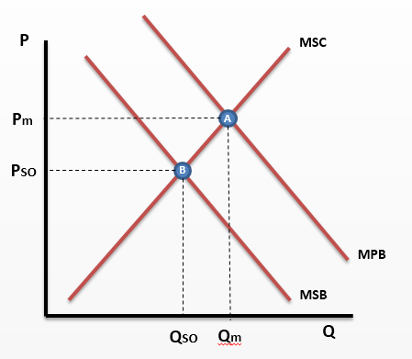
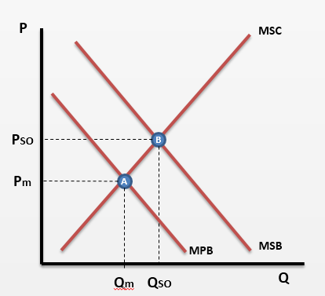
RWS 7: Consumption Externalities Externality Diagrams from the last RWS
DIAGRAM 1
DIAGRAM 2
RECAP QUESTIONS FOR CLASS ANSWERS
Where would we producing on these graphs and why in a free market?
Why is there a market failure on these graphs?
Why might we argue there is not a market failure?

Slide 13
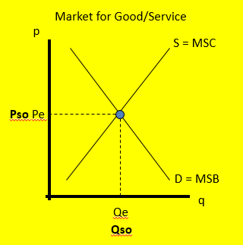
WELFARE ECONOMICS RECAP Welfare for Society is maximised where the MSB=MSC
Social Benefits = Private Benefits (to the economic agent - consumer) + External Benefits (Positive Externalities)
Social Costs = Private Costs (to the economic agent – firm) + External Costs (Negative Externalities)
MARKET: Electricity generation by firms burning fossil fuels
What are the Social Benefits?
Name some private costs? (i.e. costs to the firm of carrying out the production activity)
Name some external costs? (these are costs which are not taken into account by the firm)
What are the social costs of generating electricity by burning fossil fuels?
Welfare maximised at the equilibrium point
Pso = Pe = Pm
Qso = Qe = Qm
(Qm)
Perfect Pricing! Consumers are willing to pay a certain price for this good as it benefits them. Firms produce the good as the price gives them an incentive as they can earn revenue (and as long as costs are at least as much), they can earn profit.
Allocatively Efficient: The Socially Optimal Point of Production (and Consumption) of this Good

Slide 14
RW8: Externalities in Production Negative Externalities
The market we will be looking at is generating electricity by burning fossil fuels
TASK:
Try and draw an ‘externality diagram’ for this market to show negative externalities in production.
Identify your free market equilibrium and your socially optimal equilibrium.
Show on your diagram where the MSC, MPC and MEC are at the free market equilibrium.
Why does your diagram demonstrate a ‘market failure’ (highlight the area or areas of the graph that you would need to refer to to explain this).
What might the MEC or negative externalities represent in relation to this diagram?

Slide 15
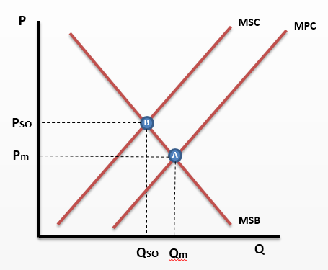
Negative Externalities in Production
GENERAL EXPLANATION:
Firms do not take into account the full social cost of their actions and over-produce at Qm. Society wants them to produce less at Qso.
These externalities are very common as firms want to maximise profits and therefore will often overproduce regardless of the effect on third parties (i.e. external costs which they do not pay for which is the difference between MSC @Qm and MPC @ Qm ). So for example, an electricity generating company might burn coal as it is cheap and plentiful. However the costs they are not paying for are the contribution to global warming in 50 years time! They are therefore not paying the FULL social cost of their actions and only their private (immediate) costs at MPC or Pm.
The private costs (MPC) of their production activities are deemed to be less than the social cost (MSC) and firms are producing too much at Qm, therefore the price is too low and too many consumers are demanding this product along the MSB or demand curve from equilibrium B to A. Therefore the over production has led to overconsumption (because the good is too cheap)
Ultimately, there is a deadweight loss of welfare to society of ABC. This means that society will be made better off overall if production is reduced as it will maximise welfare for both consumers and producers.
MSC @ Qm
C
MPC @ Qm =
WATCH VIDEO AND TAKE NOTES
(click on this box in full screen mode)
13 minutes

Slide 16
RW8: Externalities in Production Positive Externalities
The market we will be looking at is the market for renewable energies
TASK:
Try and draw an ‘externality diagram’ for this market to show positive externalities in production.
Identify your free market equilibrium and your socially optimal equilibrium.
Show on your diagram where the MSC, MPC and MEC are at the free market equilibrium.
Why does your diagram demonstrate a ‘market failure’ (highlight the area or areas of the graph that you would need to refer to to explain this).
What might the MEC or negative negative externalities (external benefit?) represent in relation to this diagram?

Slide 17
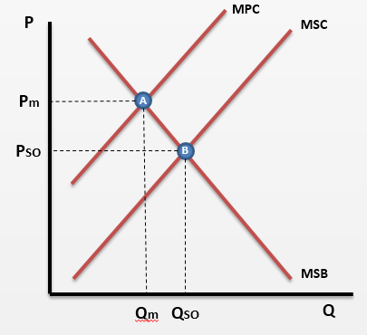
Positive Externalities in Production The most abstract (and therefore hardest externality)
GENERAL EXPLANATION
Firms do not take into account the full social cost of their actions and under-produce at Qm; they should be producing a Qso according to society.
These externalities are rare! Firms do not want to give away anything for free but sometimes it is hard not to produce something for someone to benefit without paying. For example, if a firm builds solar panels, it cannot capture the negative external costs (or external benefits - difference between Pm and MSB @Qm) of reduced CO2 emissions to a third party (i.e. the rest of society).
The private costs (MPC) to the firm are therefore deemed to be greater than the cost to society (MSC). This is because firms are not willing to supply extra (to MSC) as they cannot lower their costs without giving up profit. Since this is their primary aim, they are under producing from Qm to Qso in the market for societies preferences. Therefore the lack of production means the good is relatively too expensive for some and therefore there is underconsumption (because the good is too expensive)
There is a possible welfare loss of the triangle ABC (called the ‘deadweight loss’ of welfare). This is because, welfare to both consumers and producers could be increased if production moves from Qm to Qso
MPC @ Qm = Pm
MSC @ Qm
C
WATCH VIDEO AND TAKE NOTES
(click on this box in full screen mode)
12 minutes

Slide 18
RWS 8: Production Externalities Externality Diagrams Summary
DIAGRAM 1
DIAGRAM 2

Slide 19
EVALUATING Market Failure Theory? “Market Success Paragraph”
You have just spent 150-200 words explaining why firms are over producing as they are not taking into account the full social costs of their actions as they have imperfect information (or they just don’t care!). Therefore the good is produced at too low a cost which means the lower price encourages over consumption. To what extent is this correct however and what role might the free market still have in solving the issues associated with global warming? Three possible evaluations?
Issue with the theory: hard to value the externalities and to say that therefore energy production in this example is over produced.
Energy production leads to reduction in poverty TODAY and so carries significant benefits which could outweigh the costs associated with TOMORROW.
Equally, if consumers in the market value alternative energy sources enough, then the market will switch to these substitutes. It just takes time?

Slide 20
WEEK 2

Slide 21
30

Slide 22
RWS8 (Micro): Production Externalities
TO DO (First 10 Minutes):
Homework OUT
Complete the white box of tasks to the right in pairs using your MICRO PREP sheets
THIS WEEK
HOMEWORK: RWS8 (4.5 to 6 hours)
Complete Micro and Macro RWS 8 for collection
MONDAY: MICRO/MACRO
Hand back RWS 7
MICRO: Recap Production Externality Diagrams
MACRO: Recap SS Policies and Look at Fiscal Rules
TUESDAY: MICRO
Debating Government Interventions to eradicate market failure
THURSDAY: MACRO
Productivity Puzzle in the UK – Causes and Solutions?
Evaluating Supply Side Policies?
RESEARCHER A’s and B’s
TASK 1: Draw diagram for a market representing electricity generation using fossil fuels (e.g. oil/gas/coal) and then a diagram for a market representing electricity generation and renewable fuels.
TASK 2: Be able to explain why there is a market failure in both diagrams
TASK 3: Using the diagrams, explain how the particular government interventions you researched will help to solve the market failure?

Slide 23
Diagrams for Subsidies and Taxation Climate Levy and Subsidies to Firms with Green Energy Credentials

Slide 24
Diagrams for Regulation??? Global agreement to reduce emissions and tradable pollution permits

Slide 25
Diagrams for Regulation???

Slide 26
90

Slide 27
MICRO: GOVERNMENT INTERVENTION AND FAILURE Please get out your homework for me to inspect
GROUPS (4): With researchers A and B in different groups
INDIVIDUALLY IN SILENCE AS A STARTER (First 7 mins) – using scrap paper, try to use an externality diagram to explain how your two interventions would solve a market failure? No conferring - you will have the opportunity to share in a moment!!
HINT: Research A - you need two diagrams, one for negative and one for positive externalities to demonstrate your two interventions.
HINT: Research B - you only need to draw one diagram (negative externality). How might regulation affect your graph?
FOURS (5 mins) – check with someone else who researched the same two interventions as you and agree on a acceptable diagram.
CLASS FEEDBACK (20 mins) – A representative from each 4 needs to draw your agreed diagram on the board. We will then compare them and the rest of the group will be explaining the diagram.
GROUPS (4’s): With researchers A and B Together
FOURS (15 mins): Share the advantages and disadvantages of your interventions with each other. Fill in the remaining advantages and disadvantages boxes as your fellow students teach you the key arguments
FOURS (8 mins): Conclusions – for each intervention, reach a conclusion as a group. Be prepared to state a position, justify your position and then prepare to defend your position from possible attack (from me!)
CLASS FEEDBACK (15 mins): Random groups and people will be chosen to feedback

Slide 28
THE BIG QUESTION FOR LAST WEEK Market Failure 3: Production Externalities
Can we blame ‘the market’ for global environmental issues?
In other words:
Defining ‘global environmental issues’
Drawing externality diagrams (in production) to explain how markets can fail to allocate resources efficiently (i.e. under and over production of certain goods).
Evaluating these diagrams – can markets SOLVE global environmental issues?

Slide 29
THE BIG QUESTION FOR THIS WEEK RWS 8: Market Failure 3: Production Externalities
Can Government Intervention help solve the failures of the market?
In other words:
Defining 4 key interventions:
Climate tax (levy)
Subsidies for renewable and ‘clean energy’
International global co-operation on reducing CO2 emissions
Tradable pollution permits
Drawing externality diagrams (in production) to explain how these Government interventions can solve the market failures of allocative inefficiency (under and overproduction)
What are the possible Government failures of these interventions? Do they or have they worked?

Slide 30
STARTER ACTIVITY Externality Diagrams and Government Intervention
TASK 1:
DRAW (WHITEBOARD): Draw an externality (in production) diagram and show how a tax might correct the market failure in the fossil fuel market
EVALUATION: Government Failure
Can you come up with reasons as to why this might this not solve the market failure?
TASK 2:
DRAW (WHITEBOARD): Draw an externality diagram and show how a subsidy might correct the market failure in the renewables energy market
EVALUATION: Government Failure
Can you come up with reasons as to why this might this not solve the market failure?

Slide 31
GOVERNMENT INTERVENTION AND FAILURE
GROUPS (4): With researchers A
INDIVIDUALLY (5 mins) – using scrap paper, try to use an externality diagram to explain how your two interventions would solve a market failure?
FOURS (5 mins) – check with someone else who researched the same two interventions as you.
CLASS FEEDBACK (20 mins) – A representative from each 4 needs to draw your agreed diagram on the board. We will then compare them and the rest of the group will be explaining the diagram.
GROUPS (4’s): With researchers A and B
FOURS (8-10 mins): Share the advantages and disadvantages of your interventions with each other. Fill in the remaining advantages and disadvantages boxes as your fellow students teach you the key arguments
FOURS (8-10 mins): Conclusions – for each intervention, reach a conclusion as a group. Be prepared to state a position, justify your position and then prepare to defend your position from possible attack (from me!)
CLASS FEEDBACK (10 mins): Random groups and people will be chosen to feedback

Slide 32
THE BIG QUESTION FOR THIS WEEK RWS 8: Market Failure 3: Production Externalities
Can Government Intervention help solve the failures of the market?
In other words:
Defining 4 key interventions:
Climate tax (levy)
Subsidies for renewable and ‘clean energy’
International global co-operation on reducing CO2 emissions
Tradable pollution permits
Drawing externality diagrams (in production) to explain how these Government interventions can solve the market failures of allocative inefficiency (under and overproduction)
What are the possible Government failures of these interventions? Do they or have they worked?

Slide 33
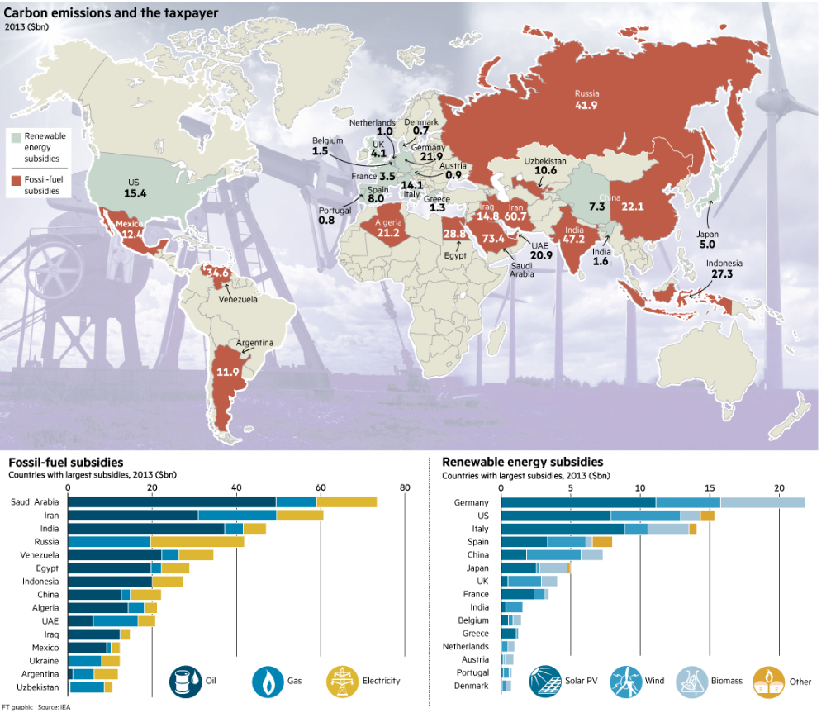

Slide 34
Carbon Tax
Benefits of Carbon Tax
1. Encourages alternatives. A higher price of carbon emissions will encourages firms and consumers to develop more efficient engines or alternatives to consuming carbon emissions. For example, with carbon taxes, it will be more efficient to develop hydrogen engines or solar power.
Itmight encourage more people to cycle or walk to work. This would have health benefits such as lower risk of heart attack.
This could make it more feasible to generate electricity from green sources (e.g. solar power). If we develop more green sources it will also make us less reliant on oil.
It will help make the transition to a post oil economy easier.
2. Raises Revenue. The revenue raised from carbon tax could be used to subsidise alternatives such as green electricity or the revenue raised could be used to repair the damage caused by environmental pollution.
3. Leads to a socially efficient outcome. It makes people pay the social cost and overcomes the excess consumption.
Problems of Carbon Tax
Production may shift to countries with no or lower carbon taxes. (so called ‘pollution havens’)
The cost of administrating the tax may be quite expensive reducing its efficiency.
Difficult to know the level of external cost and how much the tax should be.
Possibility of tax evasion. Higher taxes may encourage firms to hide carbon emissions.
If demand is price inelastic, the tax may have to be very high to reduce demand significantly. In the short term, firms may not feel they have many alternatives. Though other time, demand will become more elastic as more alternatives are generated.
Consumers dislike new taxes and often don’t believe that they will be ‘revenue neutral’. This is not an economic argument, but it is a political reality and explains why it is often difficult to implement.
A global carbon tax may curtail economic activity in the poor developing world because they can’t afford the small increase in energy costs, but the developed world may simply be able to pay. There may be need for a carbon tax to reflect different abilities to pay.
Notes:
The polluter pays principle (PPP) is a basic economic idea that firms or consumers should pay for the cost of the negative externality they create. The polluter pays principle usually refers to environmental costs, but it could be extended to any external cost.
In a purely free market, you would only face your private costs. However, for goods with negative externalities, there are additional external costs, e.g. damage to the enviornment. This means the social cost of some goods are greater than the private cost.
The polluter pays principle is simply the idea that we should pay the total social cost including the environmental costs. This requires some authority or government agency to calculate our external costs and make sure that we pay the full social cost. A simple example, is a tax on petrol. When consuming petrol, we create pollution. The tax means the price we pay more closely reflects the social cost.
The polluter pays principle is a way of ‘internalising the externality’. It makes the firm / consumer pay the total social cost, rather than just the private cost. (Social cost = private cost+ external cost)
The polluter pays principle is an important basis of international law. In 1972, the OECD wrote Guiding Principles concerning International Economic Aspects of Environmental Policies, stating:
“… the polluter should bear the expenses of carrying out the above-mentioned measures decided by public authorities to ensure that the environment is in an acceptable state.”
The polluter pays principle was incorporated into the 1992 Rio summit The declaration stated:
Principle 16: “National authorities should endeavor to promote the internalization of environmental costs and the use of economic instruments, taking into account the approach that the polluter should, in principle, bear the cost of pollution, with due regard to the public interest and without distorting international trade and investment.” (earth.org)
Polluter pays principle and property rights
The polluter pays principle requires either government intervention or the presence of clearly defined property rights.
If someone has access to a river, they can sue a chemical firm if they create a cost of pollution. For other goods, it is harder to define property rights. For example, the pollution from a car affects everyone in society and also other countries. In this case it is impractical to extend property rights to try and deal with the problem. The pollution faced by individuals is relatively low. In this case government regulation is the only effective method.
To ensure that the polluter pays, government intervention will involve:
Estimation of the external cost of the pollution.
Place a tax on good to make people pay the true social cost or they may require the firm to pay to clean up the costs they create.
To make sure a firm pays, money may need to be deposited as insurance against the worst case environmental scenario. Some environmental tragedies could cause the firm to go bankrupt meaning it can’t cover the full environmental cost.
Difficulties of implementing polluter pays principle
It can be difficult to measure how much pollution is produced, e.g. firms may try to hide the extent of their pollution.
It can be difficult to impose regulations or tax on firms from other countries. For example, when we contribute to global warming, the problem effects everyone around the world, but it can be difficult to create international agreements to impose penalties on those polluting.
Pollution havens. These are countries which have weaker environmental legislation and firms can escape taxes and regulations on pollution by shifting production to those countries.
Some costs are unexpected and occur after the event. e.g. in building nuclear power plant.
Administration costs of collecting information and implementing tax. For example, a few drunks late at night may make a lot of noise and disturb the neighbourhood, but it would be impractical to impose a tax on those who make noise after a hard-days night. Administration costs have prevented the extension of congestion charge to smaller cities like Manchester – even though in principle it would make economic sense to have a charge for those who cause the external cost of congestion.
The difficulties of implementing the polluter pays principle doesn’t undermine its validity. It just means in the real world it will be hard, if not impossible to get a perfect approximation of the external cost. As long as we get closer to the social cost, there will be an increase in economic welfare.
However, some may argue that certain types of environmental pollution are so bad they should just be banned rather than taxing them, e.g. it is immoral to pollute a river and therefore we shouldn’t allow it to occur even if the polluter does pay some financial cost.

Slide 35
Carbon Trading
Carbon trading is a system of limiting carbon emission through granting firms permits to emit a certain amount of carbon dioxide.
The amount of permits is decided by the government and then permits are given to firms depending on various criteria (such as how much output a firm produces)
With the permits, a firm can then buy and sell these permits in an open market. For example, if a firm wanted to emit more pollution it could be buy more permits. If it reduced its pollution emissions, it could sell its surplus permits on the market.
Benefits of Carbon Trading.
The argument is that firms are free to choose the most cost effective way of meeting permit requirement. For example, they have an incentive to develop better technology which limits carbon emissions. However, if the price of permits is low, they may decide to buy more.
Gradual reductions in Permits. The idea with carbon trading is for governments to gradually reduce the amount of available permits from year to year. Therefore, firms need to increasingly find more ways to reduce carbon emissions.
Arguments Against Carbon Trading
Complex. It can become complicated deciding how many permits to allow. For example when the EU introduced a system of carbon trading, in the initial period of 2005-07 the price of carbon permits were driven down to zero because the EU misjudged the amount of permits. However, any scheme will take a while to be effective.
Difficulty of measuring how much a firm is actually polluting.
Transaction costs involved in buying and selling permits.
Free Rider Problem. The problem of excess carbon emissions is a global problem. Therefore, there needs to be a global solution. If carbon trading is introduced in one country but not others, it may cause production to shift to countries without the scheme. Often countries don’t start carbon trading precisely for the fear other countries will be free riding on their efforts.
Carbon Tax may be more simple, transparent and easy to administer.
Carbon Trading may have a greater impact on those with low incomes and poor areas who have less flexibility to change their lifestyles.
Notes:
Readers Question: “the only viable solution to the problem of global warming is an international agreement that sets a ceiling to the world’s production of carbon emissions, by allocating a quota to each contry. The sum of the quotas being set equal to the agreed global maximum. countries should then be permitted to buy and sell their quotas”
In theory this scheme can provide a market based response to the problem of global warming.
It would require countries to agree on a global maximum of carbon emissions. This level would presumably be less than current and would provide the necessary target to reduce emissions and help prevent global warming.
If countries are given a quota, they would have an incentive to reduce carbon emissions. If they can pollute less than their quota they will be able to sell their quotas to other countries; if they pollute more then they will have the cost of buying more quotas.
This fiscal incentive should encourage the development of technology which leads to more efficient engines and reduces carbon emissions.
In theory it is also socially efficient. i.e. a firm can pollute more if it feels it is worth the cost of buying more carbon permits.
Problems of Carbon Trading Emission Schemes
How To Agree on Global Maximum? This would be difficult, as most countries would be reluctant to forsake growth in return for lower global emissions.
How to distribute quotas amongst countries. Should the quotas be related to the size of population? or should they be related to existing output. If it is related to existing output, many large countries with low GDP per Capita, like India, would get a relatively small amount of quotas. Some countries like China are growing very fast so would be wanting their quota to keep increasing.
Administration Costs of checking out carbon emissions.
Scope for falsifying statistics on carbon emissions. It might be possible for countries to emit more carbon than they admit.
How can the scheme be enforced? If China exceeded its quota what could we do?
There are many difficulties, but in theory it could help to provide a market based solution, with incentives for reducing pollution

