Slide 1
WEEK 1

Slide 2
90

Slide 3
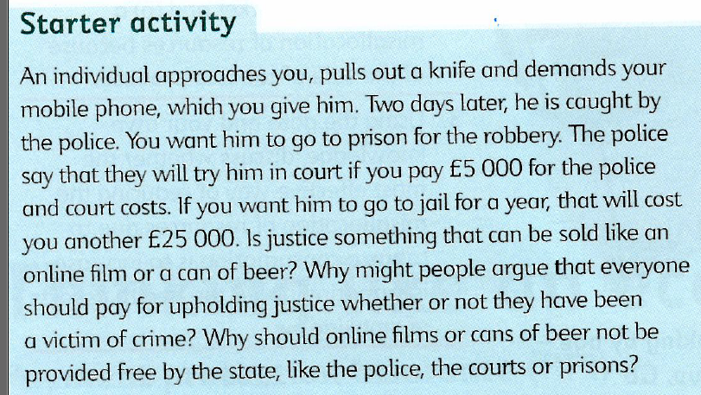
STARTER TASK: READ THIS EXTRACT AND ANSWER THE LIST OF QUESTIONS AT THE BOTTOM VERBALLY IN THREES WHILST I CHECK PREP HWK
Notes:
Points to discuss:
Who could afford £30,000 pounds?
By one person paying for this person to be put away, why would others benefit in society? If they benefit, should they pay?
Are people not ‘free riding’ on the actions of another?

Slide 4
ROADMAP to BENCHMARK 5, ARGs and Predicted Grades
Week 1
PREP HOMEWORK
MICRO (RWS9 on Public Goods): Complete Worksheet
MACRO (RWS9 on Exchange Rates): Complete Worksheet
TUESDAY – Review PREP Homework from Easter and start on Exchange Rates
THURSDAY - Benchmark 4 Back
Week 2
MON – Benchmark 4 Back and 1-2-3’s
TUE+THU: RWS 9
Week 3
TUE+THU: RWS9
Week 4+5
MON, TUES, THU+TUE: Preparation for Benchmark 5
HALF-TERM
Week 1: B5 (Monday and Tuesday) and RWS 10
Week 2: B5 BACK and RWS 10
Week 3:
1-2-1s (ARG and Predicted Grade)
RWS 10
Week 4: RWS 11
Week 5: RWS 11
Week 6: RWS 11
SUMMER HOLS

Slide 5
RWS#9: Missing markets: Public Goods MISSING MARKETS: ‘Public Goods’
TASK2 - are the following goods public or private in your view?
Ticket to Liverpool v Barcelona in the Champion’s League
Trident (Nuclear defence of the UK)
A large scale fireworks display in a local town
The Forth Road Bridge – a toll bridge
Pay per view television provided by Sky TV
Street lighting
The Police
Maintaining the Lake District?
TASK 1:
Review your PREP Homework within your 3’s….where you were unsure, what has everyone else put? Do you agree?
Any disagreements, call me over?
Missing Markets Market Failure
Private goods and Public Goods
Non-Excludability
Non-Rivalry
‘The Free-Rider’ Problem
What is the market failure with ‘public goods’?
Pure Public Goods = ‘Free riding problem’ = no production or over use (‘tragedy of the commons’)
Quasi Public Goods = Underproduction
Notes:
Pure public goods are also known as collective consumption goods
National Defence Systems
Sewage and Waste Disposal Systems
Lighthouse Protection
National Rail Safety Systems
Street Lighting
Firework Displays
Consumption by one individual or group does not reduce availability for others, so a price is difficult to set in a market context (non-rivalry).

Slide 6
Pure Public Goods? Why could we argue they are not a market failure?
Examples of agents ‘clubbing together’ to provide a good – therefore avoiding the ‘free rider’ issue:
Rich property owners funding flood defences of their Thames waterside properties
Rich property owners funding better roads in Beverley Hills
Technological change – making pure public goods into quasi public goods by removing the ‘non-excludability’ clause which then enables them to make the good more ‘rival’.
TV signals: Sky and Virgin Media able to scramble signals with new technologies. Therefore consumers cannot free ride.
Fish stocks in the sea: invention of radar could prevent ‘non-excludability’ of the sea if you have a big enough police force to detect and arrest illegal fishing. Therefore tragedy of the commons averted?

Slide 7
90

Slide 8
STARTER ACTIVITY: RWS 9 - Public Goods FIRST 10 MINUTES
15
NATURAL
PUBLIC GOODS
MAN MADE
PUBLIC GOODS
DRAW A VENN DIAGRAM (SEE TO THE RIGHT): What are the similarities (where the circles overlap) and differences (the areas that do not overlap) between natural and man-made public goods? Think about why they are failing in the market? What are the characteristics of them.
VERBALLY, COMPARE ANSWERS AND BE PREPARED TO CONTRIBUTE TO CLASS ON THE FOLLOWING QUESTIONS:
How do public goods relate to problems of climate change?
Why is fishing the seas of the world a good example of the ‘tragedy of the commons’?
To what extent do you agree in your groups that Coase’s Theorem would work with the fishing industry?
Notes:
BOTH: Non-rival and Non-Excludable = Free rider issue

Slide 9
Public Goods = Defining – Man Made and Natural = Market Failure = Free good means supply is eventually zero despite there being a demand for that good
15
Questions to answer:
Why are public goods considered a market failure?
Provide an example of a pure public good
How might the Government solve the market failure?
Why might it fail?
ASSESSING PREP HOMEWORK - End of the Line
Pure Public Goods = Non Excludable and Non Rival
MAN MADE
Street lighting, Defence of the UK, Police Force? Fire brigade? Sewage system perhaps?
NATURAL
The sea, the atmosphere etc.
Why are they a market failure? Because of the ‘Free Rider’ problem which eventually leads to zero supply even though the goods is wanted. Therefore it is a missing market.
This is because once provided…
Firms would not make any profit as they would not be able to charge a price (‘free riders’ due to non-excludability) and therefore they would not provide the good so therefore supply is zero.
It can lead to ‘tragedy of the commons’ where there is an abuse of the good and supply will eventually become zero.

Slide 10
Private and Public Goods Application TV Signals and the Role of Technological Change
Explain the difference between a ‘public good’ and a ‘private good’.
Why might the old way of broadcasting through generating TV signals (analogue) be classified as a pure public good?
To what extent are Sky satellite and Virgin Media cable services private goods though?
What role does technology play in terms of whether pure public goods exist do you think?
Is the BBC a market failure or a Government Intervention?
Increasingly, with the advent of SMART TV’s, viewers stream from the internet, TV programmes through Netflix and Amazon Prime. Also ‘Now’ are other competitors and ‘Disney’ are looking at launching a new streaming service as competitors.

Slide 11
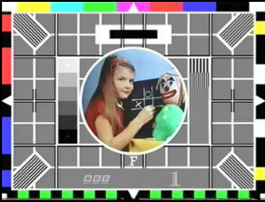
Private and Public Goods Application TV Signals and the Role of Technological Change
15
Explain the difference between a ‘public good’ and a ‘private good’.
Why might generating TV signals be classified as a pure public good?
To what extent are Sky satellite and Virgin Media cable services private goods though?
What role does technology play in terms of whether pure public goods exist do you think?
Is the BBC a market failure or a Government Intervention?
MAIN POINT: The BBC is not a public good, the TV Signals are….the BBC is the Government Intervention to solve the market failure. The market failure is to have no provision of TV signals by private firms as they would be unable to charge a prices as consumers would be free riding once it is provided (because the property of the good is non-excludable and non-rival).

Slide 12
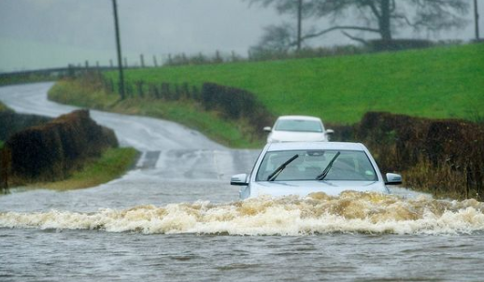
STARTER: Microeconomics Flood Defences as a Public Good
INSTRUCTIONS:
On a fresh piece of A4 paper, complete the essay plan to the right (ignore intro).
CONCLUSION: In your view, are the lack of flood defences a market failure or a Government failure? Write an answer with a justification
To what extent has the increase in flooding of the UK from 2010 until 2017 been a market failure or a Government Failure?
Point 1: Flooding has been a market failure because flood defences are a pure public good
As: Market Failure Arguments
Ae: Market Success Arguments
Point 2: Flooding has not been a Government failure because the Government have intervened through the Environment agency to provide defences such as the Thames Barrier etc.
As: Government Intervention Arguments
Ae: Government Failure Arguments

Slide 13
Flood Defences: The Conclusion? Market Failure or Government Failure?
Market Failure?
Missing Market: Not provided by the free market at all as once provided, consumers will free ride and therefore even though consumers want flood defences, they are not prepared to pay for them.
Underprovision: Are flood defences a quasi public good? Even if some communities club together, the ‘non-excludability’ clause will mean that it is hard to get enough funds to provide for everyone.
Government Failure?
Austerity? The Government since 2010 spent enough on flood defences
Moral Hazard Argument? Will agents continue to build houses in flood prone areas if they know the Government will simply pay for flood defences?
Inequality Issue? Do people who live near rivers and water have higher incomes as their property prices are higher? Government spending has an opportunity cost: more spending on flood defences means less spending on NHS? Should there be an expectation that high income earners should bail themselves out?

Slide 14
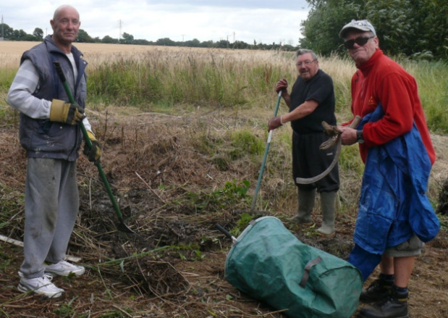
Evaluating Public Goods as a Market Failure Market Success Argument: Could public goods be provided by the free market?
Holland-on-Sea residents club together in bid to prevent future flooding 05 August 2015
A ditch and culvert was cleared in a mission to save homes after a number of residents in Keswick Avenue were forced to move out in June when heavy rainfall left them wading around in inches of water. In addition, a farmer removed vegetation from neighbouring fields while others stepped in to help residents do what they could to reduce the risk to their own homes and those nearby.
All debris generated on the day was gathered up and removed from the site by a lorry. Lynda McWilliams, cabinet member for wellbeing and partnerships at Tendring District Council, said it was a real team effort and would hopefully prove successful.
“The residents had asked for help following the problems they encountered in June and Essex Fire and Rescue along with Essex County Council’s flood water management team organised the initiative,” she said. “Tendring District Council’s emergency planning team and its engineering services department were also heavily involved and provided the equipment to undertake the task.
“It was good to see everyone – including the residents – playing their part to hopefully resolve the issue and end the residents’ misery when there is heavy rainfall.” She added that everyone was grateful to the farmer for playing his part and also allowing access to his land for the operation on Monday.
The vegetation was cleared from the ditch using a digger and the culvert was jet washed to allow the water to flow freely having previously been blocked.
Residents in Holland-on-Sea form a working part for flood defences

Slide 15
Evaluating Public Goods as a Market Failure TV Signals and the Role of Technological Change

Slide 16
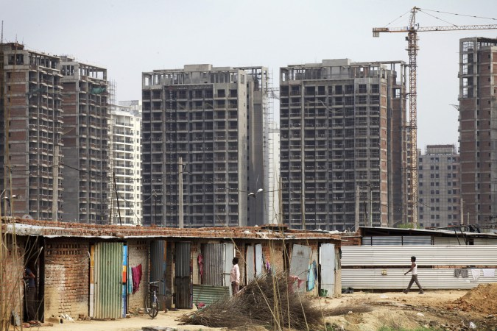
Evaluating Public Goods as a Market Failure Market Success Argument: Could public goods be provided by the free market?
15
Read the ARTICLE (but also available on GOL)
To what extent do the case studies in this article evaluate the idea that public goods are a market failure?
Read the article and highlight arguments for this idea
Re read the article and highlight arguments against this idea
Write a conclusion on the back of the article as to which arguments carry more weight in your view and why
On the back - also consider whether you think things like sewage disposal, police forces and fire fighters are ‘pure public goods’ or not?

Slide 17
WEEK 2

Slide 18
30

Slide 19
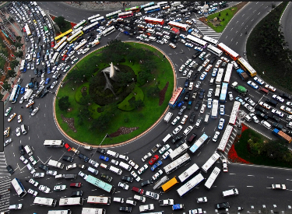
Environmental Economics Public Goods and an Absence of Property Rights (Tragedy of the Commons)
STARTER QUESTIONS:
Who owns the roads in the UK?
Why?
Is road congestion a market failure of Government failure then?
Why don’t the Government intervene and build more roads?
What else could they do?
If roads were privately owned, why might the market solve the problem of road congestion?

Slide 20
Types of Public Goods
Man-Made
Public Good
Naturally Occuring
Public Good
Quasi Public Good
ROADS
FLOOD DEFENCES
AIR, SEA etc.
Under provision by free market as cost of firms to make excludable is high = would lead to negative externalities (road congestion) or positive external benefits that are not catered for (i.e. NO road congestion)
No provision despite there being a need (demand) as once provided, consumers would ‘free ride’ as hard to exclude consumers from benefitting. Therefore firms cannot make a profit.
If non-rival and non-excludable, then no problems. It is a ‘free good’. However problem arises when this good becomes rival (i.e. fish stocks depleting, clean air etc.). Then there is a ‘tragedy of the commons’ where negative externalities are created (ultimate destruction of natural resource in future!). This is due to an absence of property rights (no one can sue another….!).
Market Failure?
Government Intervention?
Government Provision of Roads
Government Provision of Roads
Government Provision of Roads

Slide 21
30

Slide 22
60

Slide 23
Quasi Public Goods Road Congestion in the UK
DISCUSS AND TAKE NOTES ON THE FOLLOWING QUESTIONS
Why is road congestion a market failure?
Use public good theory to explain this
Use externality theory to explain this
Why might we argue that markets can solve the issue of road congestion?
Can you think of examples where private firms could provide roads?
How might the Government intervene to combat this market failure?
Government failures to these?
London Congestion Charge: ARTICLE
AA Boss idea: ARTICLE
British roads are the most congested in Europe according to a Nov 2016 study
M25 between junction 15 and 16 worst area in the country
40% of gridlock occurs in London area.
2014 - study showed that drivers in London spent an average of 82 hours per year in traffic jams (highest figure yet)
2012 - Congestion estimated to cost UK economy £4.3 bn per year

Slide 24
END

Slide 25
PUBLIC GOODS
(pure and ‘quasi’)
EXTERNALITIES IN CONSUMPTION
(merit and demerit goods)
EXTERNALITIES IN PRODUCTION
(a summary)
Why are public goods considered market failures?
The free market would not provide the good (or underprovide the good)
BECAUSE OF THE FREE RIDER PROBLEM
No one would demand (be willing to pay for) the good.
If no one is demanding the good, then firms will not be prepared to provide the good (why)
Why can the production of these goods be seen as a market failure?
Positive externalities = underproduction
Negative externalities = overproduction
BECAUSE OF IMPERFECT INFORMATION
Positive externalities: Producers cannot charge third parties who might benefit from their activities (possibly because they cannot identify them). Therefore they are reluctant to increase supply as the private cost of their activity is higher than the cost to society.
Negative externalities: they are not valuing the true cost of their actions and others are paying for some of the cost. Therefore production is too cheap and firms overproduce
Why are these goods seen as a market failure?
Merit = underproduced
Demerit = overproduced
BECAUSE OF IMPERFECT INFORMATION
Merit Goods: Consumers do not realise the benefits to society of consuming the good and so do not consume enough of the good
Demerit Goods: Consumers do not realise the costs to society of their actions and so over consumer the good

Slide 26
Market Failure: Partial or Full
Monopoly = allocative and productive inefficiency
Externalities = allocative inefficiency
Pure Public Goods = TOTAL allocative inefficiency

