Slide 1
WEEK 1

Slide 2
90

Slide 3
Benchmarks

Slide 4
WEEK 2

Slide 5
HOMEWORK
PREP Due for w/b 19th June
MICRO - Complete worksheet on Theory of the Firm Introduction
MACRO - Complete detailed essay plan on A4 page: Economic Growth
COLLECT
None

Slide 6
90

Slide 7
Benchmarks

Slide 8
30

Slide 9
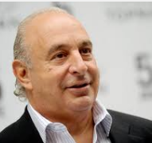
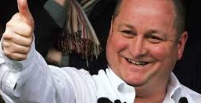
STARTER: Theory of the Firm
Philip Green
Richard Branson
James Dyson
Mike Ashley
C
INSTRUCTIONS: Discuss the following questions (make sure you have an answer for each one)
Who are A and B to the right and why are they controversial figures?
Who are the people C and D and why do they have much more positive images?
How do these four people relate to our topic?
Who is the odd one out and why?
A
D
B
Notes:
A - Philip Green of Arcadia Group (Private Ltd) ownded by Tabata Investments (owned by Philip Green’s wife Tina) which is based in Jersey (so no corporation tax) and Tina lives in Monaco (so now income tax). Pressure group associated with chasing people who avoid tax in this way claim the Green’s avoid paying £258 million in tax by doing this. In the news for famously giving a 1.2 billion dividend to Tabata Investments; largest single dividend in the UK. Allegedly used British Home Stores (BHS) to do this which led to the collapse of the business.
B - Ashley Green of Sports Direct (PLC) - Ashley has a majority shareholding in the company and is CEO. Founded from a small business and now owns Newcastle Football Club. Accused of exploiting workforce with zero contract hours. Sports Direct allegedly forcing pregnant women to work until they collapsed!!! Basically accused of providing poor working standards to employees. Cutting costs to maximise profit!
C - Richard Branson of the Virgin Group (Private Ltd)). Virgin group is a ‘holding company’ which does not produce it’s own goods but rather owns shares in subsidiary companies. Some of the subsidiary companies (like Virgin Media which are traded on the NASDAQ) are PLC’s. Branson only owns 10% of this company though but earns money from the ‘branding’ of Virgin. Estimated to be worth £3bn.
D - James Dyson - founder of Dyson. British made producer who until 2002 produced all vaccumm cleaning products in UK. More controversially, has outsourced to Malaysia and Singapore. Used his money to start various engineering foundation charities to encourage this in the UK
Who is the odd one out and why?
All our knights of the realm apart from Mike Ashley who owns Newcastle football club
Sports Direct is the only PLC; all the others are Private LtD’s

Slide 10
Theory of the Firm (RWS # 11) Evaluating the objectives of Firms?
WEEK 2-3
Types of Firm: Limited and Unlimited Liability, the difference between public and private limited companies…
The Role of the Shareholder: Short-termism and the Shareholder Spring of 2012
WEEK 4-5
Types of Market - the 2 extremes: Perfect competition .v. pure monopoly
Application: Does the internet help us achieve perfect competition?
Objectives of Firms: profit maximisation, satisficing, sales max, behavioural theories etc.
WEEK 6
Behavioural Economics: Introduction to Summer Work

Slide 11
 | # Owners | Control | Advantages | Disadvantages | Example
Sole Trader | 1 | The sole trader | Easy to set up Flexibility to change Ease of decision making Requires little capital or time to set up Owner takes all the profit | Unlimited liability Can be very stressful Limit to the amount of capital that can be raised Finance/loans can be relatively expensive | Plumbers Decorators Newsagents Builders
Partnership | 2+ | The partners | Ability to raise higher levels of capital Possibility of some specialisation Shared responsibilities Easy to set up | Unlimited liability (can now have limited partnerships however) All partners liable for debt Partnership dissolved on death of one of the partners Limit on the access to capital | Solicitors Architects Surveyors Estate agents Vets Doctors surgeries
Private Limited Company | 1-50 | Shareholder/s | Can raise larger sums of capital Limited liability Greater opportunities for specialisation | Can be costly and time consuming to set up May be more difficult getting credit Divorce between ownership and control? | Virgin group Dyson
Public Limited Company | 2+ | Shareholders | No limit to the amount which can be raised Ability to exploit economies of scale | Need minimum of £50,000 to set up Must publish annual accounts - adds to cost High degree of regulation Expensive to set up Divorce between ownership and control? Greater potential for problems with decision making - diseconomies of scale | Sports Direct Tesco British Airways Nike Nokia Microsoft BP GlaxoSmith Klein

Slide 12
WEEK 3

Slide 13
HOMEWORK
PREP Due for w/b 26th June
MICRO - Role of shareholders in the Firm: Reading/Documentary
MACRO - Watch Bruce Parry Video and complete worksheet
COLLECT
TofF Worksheet
INSPECT
Essay Plan

Slide 14
45

Slide 15
Benchmark Back
13:00 | Piers
13:20 | George
13:25 | Alex
13:30 | Jodie
13:35 | Jess
13:40 | Polly
13:45 | Beth
13:50 | Anna
13:55 | Hannah
14:00 | Michaela
14:05 | Kirsti
14:10 | Phoebe
14:15 | Jenny
14:20 | James
14:25 | Jack
14:30 | Alfie
14:35 | Fraser C
14:40 | Will
 | Jake
 | Fraser S
 | Jamie
 | Frankie
Read through marks and comments / Look at exemplar
A3 sheets
Write on the back a review of product and process
Think about an ARG: Review your grades and give yourself an ARG (Annual Review Grade) based upon the last three benchmarks with more weighting on your most recent one.
Three key targets you need to concentrate on for next year
Review your benchmark

Slide 16
45 90 90

Slide 17
MACRO GROUP ESSAY

Slide 18
WEEK 4

Slide 19
HOMEWORK
PREP Due for w/b 3rd July
MICRO (2 hours) – Write a detailed essay plan on one side of A4: Evaluate whether profit maximisation is always the most important objective of firms (25 marks)
MACRO (2 hours) - Watch ONE of the TWO documentaries below on Zambia and take notes on the main aspects of the documentary. What is the central message of the documentary? Evaluate the impact on the development of Zambia of these two case studies.
Glencore Documentary (‘Why Poverty? Stealing Africa’ http://estream.godalming.ac.uk/View.aspx?id=8677~4C~FdpIz6xw
When China met Africa: http://estream.godalming.ac.uk/View.aspx?id=7715~4u~vD7gUIN3
INSPECT
Micro notes on ‘Role of Shareholder’
Macro worksheet on Dongria Kondh

Slide 20
45:

Slide 21
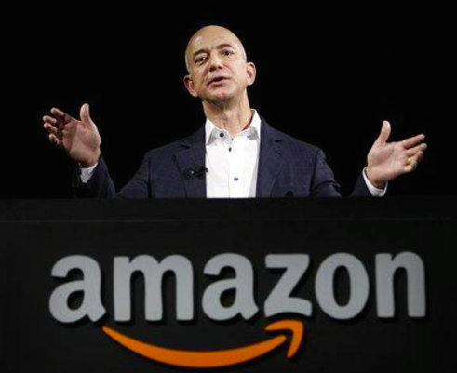
Behaviour of the Firm Types of Firms and the Role of the Shareholder
11 minutes group discussion and note taking;
10 minutes class discussion and note taking
Using your 2 PREP homeworks, in pairs write notes on the following questions:
Name one key similarity and difference between private and public companies?
What is the ‘divorce of ownership and control’ and try and list at least one reason as to why this might be good and bad for the firm?
Is it better for a firm to be a PLC or purely a Private Ltd in your view?
Given accusations of ‘short termism’, does British capitalism and the behaviour of firms need to change?
Other than the types of firm, what else might affect the behaviour (and so objectives of firms?)
Notes:
TYPES OF FIRMS: http://www.businessstudiesalevel.co.uk/Ownership%20and%20control%20of%20private%20firms.pdf
Firm
Good – specialism of manager, easier to raise finance,
Bad – principal-agent problem (principal = shareholder and agent = manager) & manager satisficing, investor apathy more likely? Larger firms have investors who are pension funds.
How do the owners of a large business know that managers work to build shareholder value? This lack of information is known as the principal-agent problem or the “agency problem".
In most businesses there are many different stakeholders. These include customers, managers, employees, shareholders, debt holders and the government

Slide 22
Some facts about firms in the UK What might these quotes tell us about the role of firms in our society?
“Executive pay has grown from 60 times that of the average worker to almost 180 times since the 1990s” BBC News website 2014
“It is rare that protesting shareholders (against high executive pay) are in a majority, having happened just six times since 2000 (most of these were in 2012)” BBC News website 2014
“The overriding message from Section 172(1) of the Companies Act 2006 is that companies ought to be run primarily for the benefit of shareholders.” GUARDIAN ARTICLE APR 2016
“In 1970, £10 of every £100 of profit was distributed to shareholders: today, under intense pressure from short-term owners, companies pay out £70.” WILL HUTTON IN THE GUARDIAN 2016

Slide 23
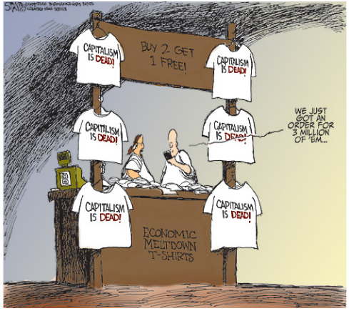
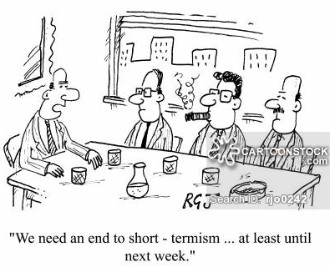
Plenary: Do you think British capitalism needs a change?
YES!
Is not UK capitalism dominated by big business who exploit workers and lower standards just for profit maximisation harming the economy?
Do shareholders have too much power in the firm and making profit becomes the main objective at the expense of other stakeholders?
Are shareholders too short-termist and create a scenario where they are just out for themselves at the expense of other stakeholders?
NO!
Does this selfish motive not create the best outcome for the firm, the consumer, the worker and society in general?
Does not the current system mean that business and entrepreneurs are vital to the development of the economy through jobs, investment and technological advances?
Cannot the recent failing of firms (e.g. BHS) be put down to effective capitalism and ‘creative destruction’ rather than a failure?

Slide 24
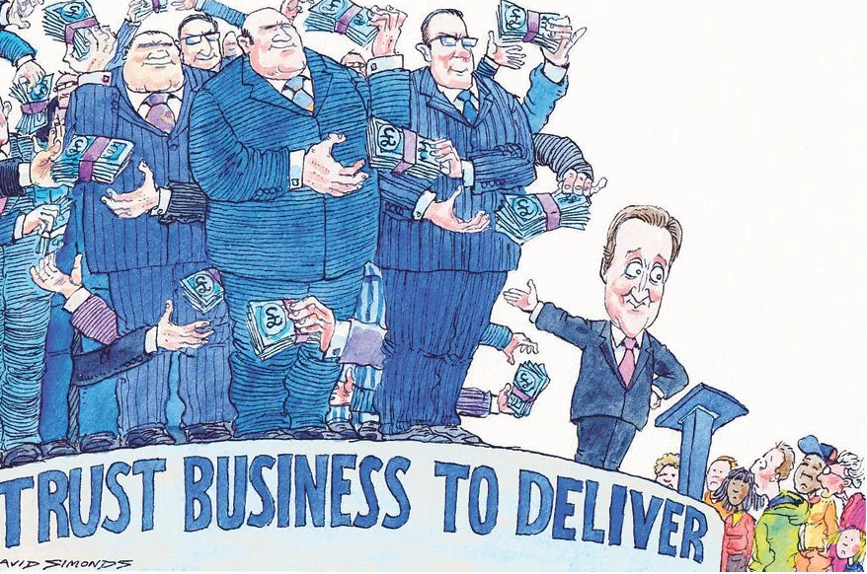
Objectives of Firms - which is the most important for firms?
Profit maximisation: pursuit of ‘short termist’ agenda (owner is the most powerful stakeholder)
Profit Satisficing: Managerial theories (motives) and ‘profit satisficing’ because of the divorce of ownership and control (manager is the most powerful stakeholder)
Stakeholder Capitalism (Consumers, Workers taken more into account?). This is sometimes called behavioural theory. (Consumers/Workers are most powerful stakeholder)
Ethical Considerations (some firms produce goods/services with an ethical priority which might mean they sacrifice short-term profits as costs are higher. (Owners are the most powerful stakeholder?)
Sales maximisation (maximising sales, perhaps at the expense of maximising profit to dominate a market. (owners/managers are the most powerful stakeholder)
Behaviour of firm depends on:
Type of firm
Market structure that firm is in

Slide 25
90:

Slide 26
Objectives of Firms - which is the most important for firms?
Profit maximisation: pursuit of ‘short termist’ agenda (owner is the most powerful stakeholder)
Profit Satisficing: Managerial theories (motives) and ‘profit satisficing’ because of the divorce of ownership and control (manager is the most powerful stakeholder)
Stakeholder Capitalism (Consumers, Workers taken more into account?). This is sometimes called behavioural theory. (Consumers/Workers are most powerful stakeholder)
Ethical Considerations (some firms produce goods/services with an ethical priority which might mean they sacrifice short-term profits as costs are higher. (Owners are the most powerful stakeholder?)
Sales maximisation (maximising sales, perhaps at the expense of maximising profit to dominate a market. (owners/managers are the most powerful stakeholder)
Behaviour of firm depends on:
Type of firm
Market structure that firm is in

Slide 27
Behaviour of Firms….(objectives) Determinants?
TYPE OF FIRM (public, private, unlimited liability?)
TYPE OF MARKET STRUCTURE THAT FIRM IS IN? (see below)
Less Concentration
More Concentration
PERFECT
MONOPOLISTIC
CONTESTABLE
OLIGOPOLY & DUOPOLY
PURE MONOPOLY
COMPETITION
COMPETITION
MARKETS
More competition
Less competition
MANY sellers
ONE seller

Slide 28
Growth of the Firm Internal and External Growth
10 minutes individually reading and highlighti;
5 minutes group discussions and highlighting;
10 minutes class feedback and note taking
Read the article on Jeff Bezo for 10 minutes (if time read the article on Sainsburys) and answer these questions by highlighting the article (feel free to take notes alongside):
Find examples of vertical, horizontal and conglomerate integration in these articles
Identify:
Something in these articles which you already knew?
Something which you did not know?
Something which you found interesting?
Notes:
TYPES OF FIRMS: http://www.businessstudiesalevel.co.uk/Ownership%20and%20control%20of%20private%20firms.pdf
Firm
Good – specialism of manager, easier to raise finance,
Bad – principal-agent problem (principal = shareholder and agent = manager) & manager satisficing, investor apathy more likely? Larger firms have investors who are pension funds.
How do the owners of a large business know that managers work to build shareholder value? This lack of information is known as the principal-agent problem or the “agency problem".
In most businesses there are many different stakeholders. These include customers, managers, employees, shareholders, debt holders and the government

Slide 29
Tertiary Sector
(Services)
Petrol Station
Petrol Station
Petrol Station
Pub
Pub
Pub
Secondary Sector
(Manufacturing)
Oil Refinery
Oil Refinery
Brewery
Brewery
PETROL
BEER
Vertical Integration in the Petrol Market
Vertical Integration in the Beer Market
Primary Sector
(Agriculture and Extractive Industries)
Oil Rig
Oil Rig
Farmer
Farmer
Farmer
Oil Rig
Horizontal Integration in the Petrol Market
Horizontal Integration in the Beer Market
Conglomerate Integration

Slide 30
What’s the point of perfect competition and pure monopoly as concepts?
Less Concentration
More Concentration
PERFECT
MONOPOLISTIC
CONTESTABLE
OLIGOPOLY & DUOPOLY
PURE MONOPOLY
COMPETITION
COMPETITION
MARKETS
More competition
Less competition
MANY sellers
ONE seller

Slide 31
Theory of the Firm (Essay Practice) The role of the internet in promoting competition
Discuss whether technological developments, such as the Internet, are making markets more competitive and making perfect competition theory more realistic (25 marks)
INITIAL DISCUSSION POINTS
How would you plan this essay? Can you use the old AS model here?
What case studies could you talk about?
What is your main economic theory or concepts for discussion going to be?
CASE STUDIES
Access the links below as a starting point (you will need headphones)
History of Amazon
History of Apple
History of Google
GROUP ACTIVITY
THINK: Individually write down a plan
SHARE: Speak to your group and share your ideas; try to write a group version
RESEARCH: In groups, write a group essay plan, using the resources on GOL
ASSESS: Look at my essay (available on GOL) when you have completed yours - how does it compare to yours?

Slide 32
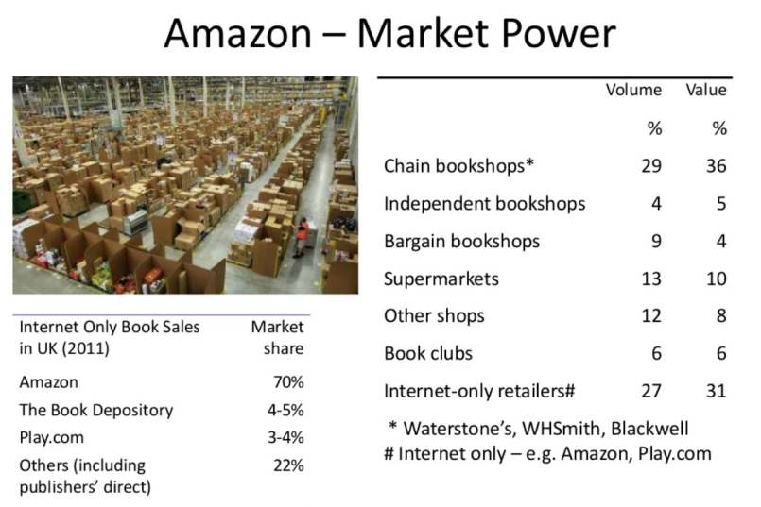
TASK: This is to be completed in PAIRS. Write a detailed A4 word processed. Make sure you fully research using the resources below. This must be word processed and not exceed 1 side of A4
(ESSAY 2) Discuss whether technological developments, such as the internet, are making markets more competitive and making perfect competition theory more realistic. (25 marks)
HINTS:
Amazon is a good case study to talk about: does the growth of Amazon support the idea of greater competition or not?
Remember the focus is on perfect competition theory and is a critique of it
Remember there needs to be a ‘DISCUSSION’

Slide 33
ESSAY 3: Discuss whether technological developments, such as the Internet, are making markets more competitive and making perfect competition theory more realistic (25 marks)
INTRO
Define perfect competition briefly - four assumptions, no profit (supernormal) in the long run
Define technological developments (internet) - maybe mention Amazon as an example with a brief history
Route through the essay – on one hand, companies like Amazon have started from zero but they are now becoming the dominant firms?
MAIN
P1: Assumption that many buyers and sellers with free entry and exit is happening more; therefore perfect competition is realistic
As: Lots of sellers; internet makes it easy for sellers to trade with people around the country. Also allows buyers to access many different alternatives or substitutes. [e.g. Amazon and partnership with smaller book providers/sellers and eBay bring together people from around the globe]. Companies like Amazon started small and have taken market share from the big companies (WH Smiths, Waterstones etc.) and this suggests that barriers to entry are minimal - no expensive overheads for shop space. Also Amazon are driving down the price of books and creating more competition in the market place.
Ae: Does Amazon now have monopoly power? Easiest company and most reliable? Does it have monoposony power; accusations that driving down the price of their suppliers; perhaps Monopsony argument in which case not more realistic [Amazon recent scandal with US book publisher]
P3: Assumption that perfect information - internet does create more information for both consumer and producer
As: price comparison websites allow consumers to see instant differences in prices….the internet is therefore delivering to consumer what they want [e.g Moneysupermarket.com]
Ae: Amazon’s brand means that the first port of call for many consumers is still Amazon. Familiar website, trusted against fraud. Is it perfect information or ‘Amazon information’? Also, for certain goods like clothes, would consumers prefer to visit a shop? Why - expertise of sales staff and ability to try on? Also, still a variance in prices between suppliers on the internet; perhaps suggests branding as well as other factors has dampened the idea of perfect information.
P3: Assumption that homogenous product - internet does not allow this to happen; therefore perfect competition is not more realistic
As: heavily branded goods still exist [e.g. Google search engine is considered to be a monopoly]
Ae: perhaps over time, goods will start to become more homogenous…e.g. smart phones are the same type of good although there maybe differences between each one?
CONC
Answer: Making markets more competitive for sure but not sure if making perfect competition more realistic
J1: Markets are more competitive because there is more information and the internet allows more entry to the market and the bringing together of buyers and sellers
J2: Not making perfect competition assumptions of homogenous goods and although some more information, not sure it is perfect. People still do not know all the technological advances of certain products and rely on sales people in shops

Slide 34
Market Structure and the Behaviour of Firms
Explain how firms in a perfectly competitive market alter the behaviour of firms as opposed to firms who maybe are a pure monopoly or have a degree of monopoly power in their market?

Slide 35
WEEK 5

Slide 36
HOMEWORK
PREP Due for w/b 03rd July
2x RWS 11
INSPECT
MICRO - Essay Plans
MACRO - Watch documentary on Zambia

Slide 37
90:

Slide 38
Objectives of Firms Essay Plans
Mark MACRO GROUP ESSAYS
Create essay plan from your essays

Slide 39
ESSAY 1: Evaluate whether profit maximisation is always the most important objective of firms (25 marks)
INTRO
Define the concept of a firm - private sector .v. public sector / idea of limited liability and PLC’s
What is profit maximisation and are there alternatives (addressing the idea of‘the most important’?)
MAIN
P1: Profit maximisation is the most important objective of firms because…
As: It ensures survival of the firm and further expansion. Technology, expansion etc. Equally, if the firm is a PLC, it prevents possible takeover. The firm must survive and there are examples of huge companies going bust or losing market share [Lehman Brothers, Enron, GM, Microsoft, IBM]
Ae: Is profit maximisation too vague? Concepts of short run profit maximisation and the problems of ‘short-termism’ and long run profit maximisation. Perhaps firms sacrifice short run profits to ensure long run profit? [e.g. Apple’s recent debt as it ploughs huge amounts of money back into the business or Tesco’s 2014 push by its managers to cheat due to the pressures of ‘short-termism]
P2: Profit maximisation is not the most important objective of firms because…
As: With PLC’s there is a divorce between ownership and control. This means that the owners only appoint managers. What results is a situation where the people in control of the business want to maximise their wages, benefits and bonuses and are less concerned about the profit of the company. [e.g. Equitable Life in the UK and Enron in the USA]
Ae: Ultimately though, there are ways around this with share options etc. to prevent managers from abusing their position. Also ultimately, a lack of quarterly profits means managers might face a take over and lose their job so they have an incentive to meet the needs of the owners (shareholders). Also recent growth of ‘shareholder activism’ [e.g. the so-called ‘Shareholder Spring’ in 2012 with Financial firms and huge renumeration packages’]
P3: Profit maximisation is not the most important objective of firms because…
As: there are alternative goals such as sales maximisation (brand awareness and to increase market share for smaller firms) [Asda and Walmart] / Ethical considerations (non-profit) - [Body Shop] / other considerations [Virgin Galactic]
Ae: The reason why sales maximisation happens is to gain monopoly power in the long run / ethical firms still need to turn a profit otherwise they will not survive [Body Shop taken over by L’Oreal]
As: Also, the question is too simplistic - no business is the same: behavioural theory [Manchester United] and depends on the size and market share of the company
CONC
Position: Profit is the most important objective of firms in the long run but maximisation is not necessarily the most important objective
Justification (Part 1): : Plenty of examples of firms making losses to gain market share. Must make profit in the long run to survive. Maybe new shareholder activism prevents the problem of divorce of ownership and control?
Justification (part 2): Whether firms wish to maximise these profits is a moot point as although even non-profit firms need a bit of profit to survive and expand, they may not be maximising them

Slide 40
ESSAY 2: Discuss whether the objective of profit maximisation becomes less important than other possible objectives as a firm grows in size (25 marks)
INTRO
Define the concept of a firm - private sector .v. public sector / idea of limited liability and PLC’s.
What is profit maximisation and what are the alternatives (e.g. sales maximisation, ethical considerations)
MAIN
P1: Profit maximisation becomes less important than other possible objectives as firms grow because…
As: More available finance and less risky and so able to take risks and pursue perhaps Sales maximisation in a new area rather than make profit [e.g.Virgin Galactic]. Also, larger firms might have more monopoly power and so have to worry less about maximising profit and can pursue more ethical goals [e.g. Microsoft and Bill Gates’s charitable ventures].
Ae: Profit maximisation is still important as large firms have still gone bust [ e.g. Enron, GM etc.] or lost market share [e.g. Microsoft to Google and Apple]. Also smaller firms may also start up for ethical reasons [e.g. Body shop] and smaller firms may take losses in the short run to maximise profits in the long run [e.g. Apple] and therefore profit maximisation might not be as important.
Ae: European-Japanese model suggests that long run profit maximisation is a priority.
Ae: Also, behavioural theory suggests that the size of the firm does not matter, it is which stakeholder has the most power in terms of the direction of the firm [e.g. the influence of fans with Manchester United]
P2: Profit maximisation becomes less important than other possible objectives as firms grow because…
As: As firms become larger (PLC’s) there tends to be a divorce between ownership and control. This means that the owners only appoint managers. What results is a situation where the people in control of the business want to maximise their wages, benefits and bonuses and are less concerned about the profit of the company. [e.g. Equitable Life in the UK and Enron in the USA]
Ae: Ultimately though, there are ways around this with share options etc. to prevent managers from abusing their position. Also ultimately, a lack of quarterly profits means managers might face a take over and lose their job so they have an incentive to meet the needs of the owners (shareholders). Also recent growth of ‘shareholder activism’ might mean that profits are still the most important thing for firms as they grow [e.g. the so-called ‘Shareholder Spring’ in 2012 with Financial firms and huge renumeration packages’]
CONC
Answer: No firm is the same and objectives can differ wildly depending on size, market share and the behavioural theory. Too simplistic to say there is a general rule
Justification: Enron, GM prove that firms must still have profit max as an important aspect. On the other hand, Virgin and Microsoft are taking great risks with some of the directions. No ‘one size fits all’.

Slide 41
ESSAY 3: To what extent is external growth, the best strategy for firms?
INTRO
Define external growth - perhaps talk about horizontal and vertical integration as well?
Alternatives - addressing the idea of it being ‘the best’? Internal growth with examples….
MAIN
P1: Firms growing by merger and takeover (external growth) is the best strategy for firms
As: Access/aqcuisition of another companies assets can lead to greater economies of scale , market power [Proctor and Gamble merging with Gillette, Amazon joining with Lovefilm, Google and Youtube] and greater technology at a greater speed.
As: Access to more finance as a bigger entity; more likely to be able to issue shares
Ae: Lack of management expertise potentially (especially if conglomerate merger/takeover) [Ford taking over Kwik Fit in 1999 and selling it again in 2003], the creation of diseconomies of scale as the firm grows too quickly [Research hints that there are little efficiency gains through mergers].
Ae: Government might stop you - lead to damage to brand [News Corporation’s takeover of BSkyB]
P3: Firms growing by internal growth provide a viable alternative
As: A more sustainable approach and has seen success in a number of companies [e.g. Apple, Subway in the UK, Poundland and BSkyB]
Ae: It can be too slow a process...if firms grow too slowly and do not satisfy shareholders, there maybe the threat of takeover [Apple are experiencing recent (2014) profit concerns from investors and large drops in share prices due to lower than expected sales. Other competitors are fighting back…perhaps Apple’s internal growth strategy allowed other firms to catch up?]
CONC
Answer: External growth is not the best strategy necessarily; a combination of external and internal growth is probably what is needed.
J1: Although external growth is useful for faster growth, this may become unsustainable if a company becomes too large but can be useful in attracting finance in the short run. Equally internal growth tends to lead to a more sustainable and manageable strategy for firms and has seen many successes in Apple, Poundland and Subway in the UK.
J2: Ultimately both forms of growth can lead to unsustainable levels of debt in terms of financing growth be it for the takeover of shares or to plough back into the company and the adoption of either strategy probably depends on the companies circumstances….to say that there is a ‘one size fits all’ rule in terms of external growth being best is probably too much of a simplification.

Slide 42
THE END
Thank you!

Slide 43
Theory of the Firm Basics Market structures and the role of competition
Key Economic Words:
Barriers to Entry - barriers preventing other competitors from entering the market
Internal Growth - Apple growing by debt and equity financing and investment in technology
External Growth - BT and EE merger where a company takes over or joins with another
Economies of scale - reductions in average cost as a result of increasing scale through bulk buying, technical, marketing and financial methods.
Diseconomies of scale - increases in average cost as a result of getting too big through maybe managerial or geographical reasons
Creative destruction - the destruction of certain businesses who might be inefficient and unable to compete to be replaced with more efficient competitors
25 MINUTE: Feedback in fours: Please complete the following tasks taking notes for tasks 3 to 7 for your Revision Worksheet on a separate sheet of paper.
Complete the worksheet on perfect competition
Complete the worksheet on barriers to entry
Why do economists like competition in markets? Write down at least two reasons
Is competition good in all cases? Write down at least two reasons as to why not.
Read one of the articles on the BT and EE merger using the skim reading techniques we started to develop
Using the economic theory you have learnt so far, is this merger desirable do you think? List arguments for yes and no
How else could BT and EE have grown as a firm rather than join forces?

