Slide 1
WEEK 6

Slide 2
HOMEWORK
PREP Due for w/b 26th June
MICRO - Essay Plans
MACRO - Watch documentary on Zambia
INSPECT
Micro worksheet on Role of Shareholders
Macro worksheet on Bruce Parry

Slide 3
90:

Slide 4
Behavioural Economics
Answer the following questions in the first 10 minutes
In the last 7 days the number of times I ….. Is…
Over ate _____________
Texted while driving ______________
Spent too much time on social media ________________________
Stayed up too late and felt tired the next day in College ___________________
Drank too much alcohol _______________________
Didn’t brush my teeth before bed ____________________
Lied _________________
Arrived late for something ______________________
Bought something I didn’t need _____________________
Said YES to something I should have said NO to __________________
Said something inappropriate and then regretted it __________________
Didn’t leave myself enough time to complete a piece of homework _________________

Slide 5
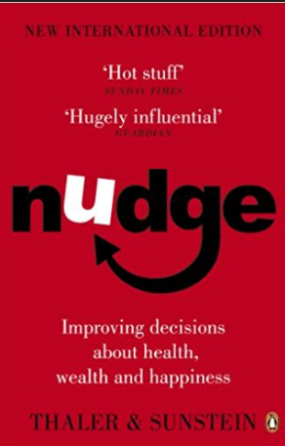
TODAYs LESSON
SUMMER WORK
Available on GOL under ‘Summer Work’
  Rationality: Humans or Econs?
  Neo-classical economics and the importance of the margin
  Behavioural Economics and information failures
  Choice Architecture and ‘Nudges’
Read parts of the ‘Nudge’ book by Richard Thaler and write a brief summary of Parts one and two
Complete the booklet on behavioural economics
OPTIONAL: Adopt a country and produce a Revision worksheet similar to the one on Zambia

Slide 6
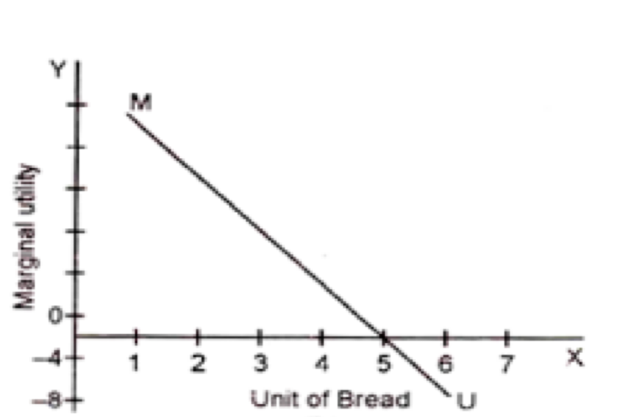
NEO-CLASSICAL ECONOMICS
The Importance of the ‘Margin’ in Neo-Classical Economics
Key Questions
What is neo-classical economics?
What does ‘marginal’ mean in Economics?
What does the graph to the left show?
Tasks
TASK1: Draw a second diagram by changing the y-axis to ‘TOTAL UTILITY’. What do you think it will look like?
TASK2: Draw this diagram to the left again (so a third diagram). Remember the analysis for why the average cost curve is the way it is (i.e. dimiishing marginal returns)? On this diagram draw a marginal cost curve (which is based on the same analysis.
TASK 3: On this third diagram, where should we producing and consuming in the Bread market and why?
TASK 4: How might behavioural economics challenge this neo-classical view of production and consumption?
Bread

Slide 7
BEHAVIOURAL ECONOMICS (form of market failure)
How might behavioural economics challenge this neo-classical view of production and consumption?
Information Failure (a lack of perfect information to make a decision)
Asymmetric Information (one agent having more info than another): Why will these examples lead to a misallocation of resources?
  Landlords who know more about their properties than tenants. For example, student tenants
  Mechanics know more about cars and the length of time it takes to make repairs than their customers
  The second hand car salesman who knows the full history of the car they are selling.
Bounded Rationality (limits of the human brain to process everything)How many times does a person wearing white pass the ball?https://www.youtube.com/watch?v=IGQmdoK_ZfY
Bias (Heuristics, anchoring, availability, confirmation, optimism)
FINAL TASK: How can we use ‘behavioural economics’ to challenge the assumptions on ‘neo-classical’ economics about the consumption and production of bread?
Notes:
Information Failure -

Slide 8
Choice Architecture and Nudges https://www.tutor2u.net/economics/reference/behavioural-nudges-in-action-1
Watch this video and make a note of all the possible examples of ‘nudges’ that have been made
Can you think of one other example that wasn’t mentioned in the video?

Slide 9
Criticisms of Behavioural Economics?
Does it replace neo-classical economics?
Criticisms
Nudges are too small to correct market failure
Problem with experiments (https://www.youtube.com/watch?v=UB1A62u9fBE&feature=youtu.be)
  WEIRD (Western, Educated, Industrialised, Rich and Democratic)
  Experiment constructs are artificial and do not have real consequences
  Tested people are often psychology students
  Evaluating these criticisms
  Increasingly, behavioural interventions are being tested outside of the laboratory. For example the growing use of randomised control trials in the field. Consider for example the work of Duflo and Banerjee in Poor Economics
  Developments in neuroscience are giving us a more complex understanding of brain behaviour and how we behave/choose in different situations.
  Behavioural economics is evolving quickly and is now less reliant on crude, simplistic experiments in labs
  Behavioural interventions (nudges) are probably best seen as a complement to rather than a substitute for standard policies when dealing with market failure e.g. most economists would favour the use of a carbon tax and/or stronger regulations in helping to cut carbon emissions in the long term
  Attention is also switching to market design / engineering as a way of addressing fundamental / chronic market failures. Consider for example the ground-breaking work of Nobel winner Al Roth in developing matching algorithms for kidney exchange.

Slide 10
THE END
Thank you!

Slide 11
Starter Question: Behavioural Economics
Read these definitions and understand them!
ALTRUISM: a selfless concern for the well-being of others. For example, giving to a charity would be an act of altruism.
UTILITY: We assume that consumers in economics want to maximise utility (satisfaction) and we can measure this using money
PROFIT: We also assume that firms want to maximise profits
Discuss these questions and have an opinion for a class discussion
Do you think that altruism exists? Are consumers maximising their utility and are firms maximising profits if they give away money for free to charities etc.?
Utility and profit maximisation are key economic theories which help to explain the supply and demand model amongst other things. Does the concept of altruism challenge these assumptions?

Slide 12
Behavioural Economics
A form of market failure?
VIDEO
Horizon - Introduction to how we make decisions
Behavioural economics is a branch of economics that seeks to understand the motivations and reasons behind individual decisions. In traditional economics there is a very basic assumption that individuals are rational utility maximisers. i.e. firms seek to maximise profits, workers seek to maximise income and levels of consumption.
Therefore many economics models are based on the idea that people will choose the action / good which maximises their utility (welfare)
However, this branch of economics leaves no room for irrational decision-making. This can include decisions based on fear or decisions based on altruism.
A-level students should recognise the basic concept of rational decision making as being ‘when individuals compare the costs and benefits of possible decisions and choose the one which maximises their personal net benefit’. It is usually, often implicitly, assumed that the individual has perfect information and has the ability to calculate and weigh up the consequences of each available choice.
Economic decision making is not just about having perfect information and ‘rational’ consumers and firms maximising their utility and profit.
“It is not from the benevolence of the butcher, the brewer, or the baker that we expect our dinner, but from their regard to their own interest.”
ADAM SMITH
Famous Economist 1776
Founder of modern economics

Slide 13
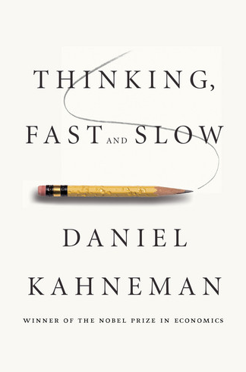
Some examples of behavioural economics
‘Bounded Rationality’: Rationality is impossible because there is a lack of information, a bias of information and a lack of time to make a fully informed decision….
‘Anchoring’: Predictable bias in decision making…a tendency to rely too much on one piece of information.
  E.g. charities - £10, £15 or £20
  E.g. buying a TV….first price you are given?
READ THIS WEBPAGE FOR A FULLER EXPLANATION (Especially anyone who missed the lesson)
http://www.aqa.org.uk/resources/economics/as-and-a-level/economics/teach/teachers-guide-individual-economic-decision-making
Notes:
http://www.aqa.org.uk/resources/economics/as-and-a-level/economics/teach/teachers-guide-individual-economic-decision-making

Slide 14
Behavioural Economics - Summer Work
Read the book ‘Nudge’ and create a 1 sided A4 summary
FAQ and solutions:
  QUESTION 1:
    Q: “Oh my god, I’ve only ever read one book. I’ll never be able to read this”…
    S: minimum of 15 minutes per day (get a stopwatch and time yourself).
  QUESTION 2:
    Q: “How am I supposed to summarise a whole book onto 1 A4 page…it’s impossible!”
    S: Draw a mindmap based on the chapters of the book and include an overview box as well. Read a chapter (perhaps underlining key areas) and then write a 50 word summary of that chapter, what it was saying etc. DO NOT take notes as you go along. Read a chapter, then write a summary.
WHY HAVE YOU GOT US TO READ THIS BOOK??
Behavioural economics
Government policy solutions - micro
Financial Markets and Financial Crisis - Macro
Great case studies and examples for your essay
Learning to read is good!

Slide 15
PART 1: HUMAN AND ECONS
PART 2: MONEY
Save more tomorrow
Naïve investing
Credit markets
Privatising social security: smorgasborg style
Biases and Blunders
Resisting Temptation
Following the Herd
When do we need a nudge
Choice Architecture
NUDGE
A book about behavioural economics
PART 3: SOCIETY
PART 4: EXTENSIONS AND OBJECTIONS
Prescription Drugs: Part D for Donating
How to increase organ donations
Saving the planet
Privatising Marriage
A dozen nudges
Objections
The real third way
The financial crisis of 2008

