Slide 1
INSTRUCTIONS Index Numbers
TIME TAKEN (45 minutes MAX)
Read the next powerpoint slide and then complete the questions and tasks on the last two slides.
Have a go! You may have the wrong answers or are not sure how to do it. But I want you to have an answer even if it is the wrong one.

Slide 2
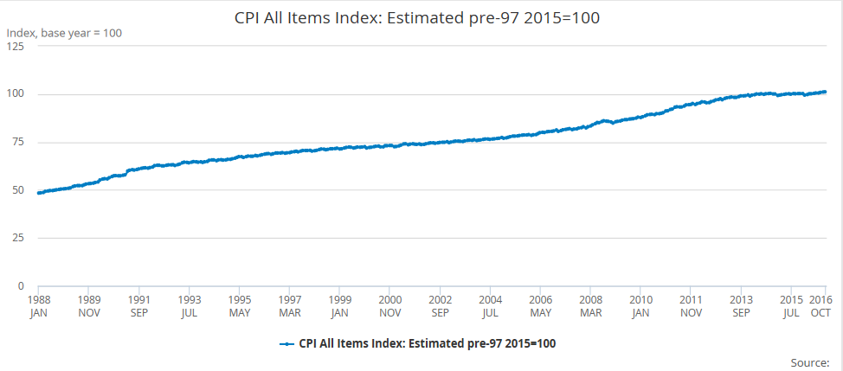
Understanding Index Numbers
Time series data are often expressed in terms of index numbers to make it easier to compare numbers
One year is selected as the base year and this is given a value of 100.
The output for other years is then shown by their percentage change from 100

Slide 3
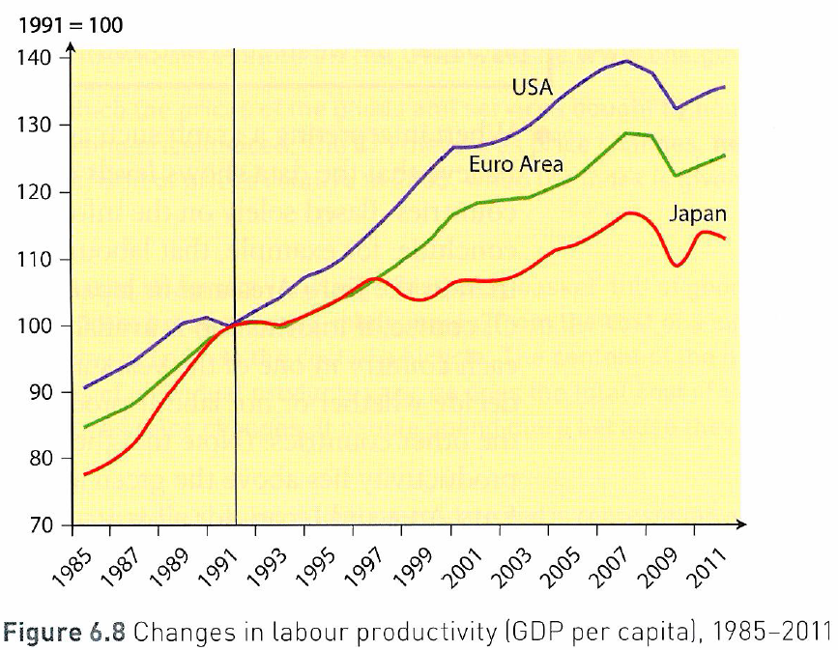
Understanding INDEX NUMBERS: How much do you know?
Index numbers are used to compare ‘relative’ numbers not ‘absolute’ numbers. They measure the rate of change over a period of time. They are usually calculated from a ‘base year’ which is given the value of 100 for ease of computation. Therefore if the base value is 100 and this increases to 105 in the following year, then this is a 5% increase. Equally if the rate of change falls from 100 in the first year to 93 in the second year, it is very easy to say there has been a 7% decrease.
TASKS TO COMPLETE:
Calculate the percentage increase in labour productivity from 1992 to 2011 in the USA just by looking at the graph.
Calculate the percentage increase from 2001 to 2008 for the USA.
Why would it be incorrect to say that the USA has had higher levels of labour productivity than Japan?
Is it true to say that it is at least possible that Japan could have higher levels of labour productivity than the USA?
Identify two significant points of comparison in the labour productivity of countries shown in Figure 6.8

Slide 4
Understanding INDEX NUMBERS: How much do you know?

