Slide 1
WEEK 4

Slide 2
30+90

Slide 3
Intro to Topic

Slide 4
TODAY: Macro RWS 4 – Price Levels
Why is it so important for Government’s to maintain the stability of price levels in an economy?
STARTER - Discuss the following questions based upon the class work from Monday in the first 5 minutes. NO LOOKING AT NOTES:
What are the three functions of money?
What is the ‘myth of barter’ advocated by some economists?
How would you define money?
Topics for today
What is money and ‘the price level’ in the economy?
Effects of an unstable price level: Inflation and Hyperinflation
  Germany
  Hungary
  Zimbabwe

Slide 5
RWS 4 - Weeks 4 and 5
MICRO – The Role of the Market
  The role of the market and efficiency (allocative and productive)
  Welfare economics – consumer and producer surplus
  The role of prices in the market (disequilibrium analysis)
  Introduction to “Behavioral Economics’ - challenging the assumption of ‘rationality’ of consumers and firms
MACRO – Price Levels
  The concept of money
  Importance of Stable Prices: The effects of Volatile Price Levels - Hyper Inflation (Zimbabwe, Germany, Hungary) and Deflationary Traps (Japan)
  Causes of changes in price levels
  Measuring price levels (CPI and RPI) and UK economic history
  Economic data of macroeconomic indicators - price indices etc.

Slide 6

RWS4 – PREP HOMEWORK
Due for inspection on Monday 26th Nov 2018
MICRO (2.25-3 hours): PREP (prepare for inspection)
  1-1.5 hour: Complete the reading and questions on the ‘role of prices’
  1-1.5 hour: Complete reading and worksheet on ‘Behavioral Economics’.
MACRO (2.25-3 hours): PREP (prepare for inspection)
  1.25 to 2 hours: Complete the reading and worksheet on ‘Deflation in Japan’.
  45 minutes max: Complete reading and questions on the concept of INDEX numbers; this was part of the GCSE Maths syllabus so you should of encountered it before.
ALL AVAILABLE ON GOL UNDER RWS4 FOLDERS IN MICRO AND MACRO SECTION

Slide 7
MACRO
Where does this fit in with the course?
Government Policies
(policies available to the Government to influence the economy – demand side tend to be short run strategies and supply side, long run)
Economic Analysis
(the economic theory to explain how government policy might affect the macroeconomic performance of the UK. Remember to label your axis on the graphs correctly)
UK Macroeconomic Performance
(how we judge how well an economy is doing)
Fiscal Policy
(changes in taxes and spending – the budget balance. The Government borrows money by issuing Government bonds
Consumption
(C)
Spending by households in the economy
Investment
(I)
Spending by firms in the economy
Government
Spending
(G)
Spending by the Government in the economy
Trade Balance
(X-M)
Spending by “foreigners” in the economy compared to us spending in “foreign” countries
ECONOMIC
GROWTH
(increase in GDP? GDP represents the total output that an economy is making. The higher the GDP, the more output and the better the standard of living in that country)
DEMAND SIDE POLICIES
Aggregate Demand
AD
The total amount of demand for resources in the economy
UNEMPLOYMENT
(number of people out of work – measured by the JSA number or through the ILO survey. There are different types of unemployment – structural, frictional etc. which you need to know about)
Monetary Policy
(mainly changes in interest rates – but also changes in money supply and exchange rates. Today the Bank of England has independence from the Government in setting interest rates)
AGGREGATE
DEMAND AND SUPPLY
ANALYSIS
Free Market Method
(removing Government intervention from the economy – e.g. reducing direct taxes and benefits to provide a greater incentive to enter work; privatisation to make markets more efficient etc.)
PRICE LEVEL
Inflation or Deflation (prices rising or falling? – we want to keep that stable – measured using the CPI. If price rise by too much, then people lose their ability to purchase goods and their standard of living will fall)
Aggregate Supply
AS
The total amount of resources in the economy
SUPPLY SIDE POLICIES
BALANCE OF PAYMENTS
(the balance of payments measures all the flows of money into and out of the economy. At AS the current account is all you need to know about – it measures the money flowing in terms of trade and income from foreign assets)
Interventionist Method
(increasing Government intervention into the economy – e.g. education and training, subsidies for research and development etc.)
Short Run
Aggregate Supply
(SRAS)
(short run changes in costs of production – e.g. higher import prices etc.)
Long Run
Aggregate Supply
(LRAS)
(quality and quantity of
labour and capital)

Slide 8
What is Money and ‘Price Levels’?

Slide 9
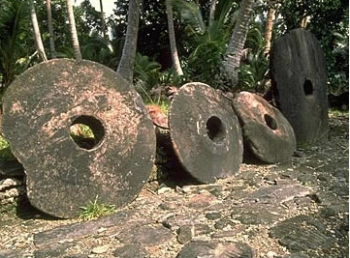
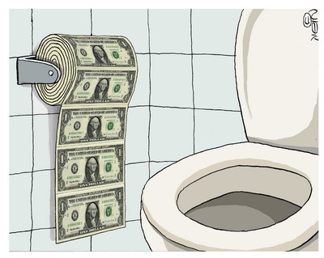
RWS4 (MACRO) - Price Levels
The concept of money?
Barter?
The History of Money in the UK – The Myth of Barter
The Island of Yap
My school friend Ed, our year 5 classroom and ‘Fiat Money’
TASK: What do all these stories and examples tell us about the single most important thing that defines whether something is ‘money’ or not?
What is Money? (not just a medium for exchange)
Medium of Exchange (Consume)
Store of Value (To save)
Unit of Account (To measure/compare)
A Gift Economy?
Credit Money?
Commodity?
Fiat Money?
Notes:
Ed Story
How money develops economies (social currency)
Danger of money as a driving social force in the economy if hyperinflation hits and the money supply is not controlled.
Class ‘transactions’ based on goodwill but you would only help out people you liked (friends).
Ed created ‘fiat money’….everyone in the class started to develop trust in this money
But suddenly everything had a value…want to borrow my pen…sure but it will cost you £20 Ed notes
Economic activity increased – specialized roles in accounting, legal and security!
Exchange rate started to develop…..when people ran out of goods to exchange for money, they
POSITIVES
Classroom transacitons increased (economic growth) and suddenly more choice because you could now trade with enemies as well as friends.
NEGATIVES
Every relationship started to become based upon
Fiat money only works if you control the money supply otherwise ‘hyperinflation’
Person who controls the money supply essentially becomes the sovereign! Hierarchy develops.
The money became a central focus for people….addiction!
YAP STORY
There's a tiny island called Yap out in the Pacific Ocean. Economists love it because it helps answer this really basic question: What is money?
There's no gold or silver on Yap. But hundreds of years ago, explorers from Yap found limestone deposits on an island hundreds of miles away. And they carved this limestone into huge stone discs, which they brought back across the sea on their small bamboo boats.
It's unclear if these stones started as money. But at some point the people on Yap realized what most societies realize. They needed something that everyone agrees you can use to pay for stuff.
And like many societies, the people of Yap took the thing they had that was pretty — their version of gold — and decided that was money.
A piece of stone money was really valuable; you wouldn't use it for some everyday purchase. You'd use it for something big — a daughter's dowry, say.
"If somebody was in real dire straits, and something happened to their crop of food or they were running low on provisions and they had some stone money, they might trade," says Scott Fitzpatrick, an anthropologist at North Carolina State University who is an expert on Yap.
One key thing about this money: It was really heavy. A big piece could weigh more than a car.
As a result, this very concrete form of money quickly made the jump to being something very abstract.
"They often talk about the stones themselves not changing hands at all," Fitzpatrick says. "In fact, most of the time they wouldn't."
So imagine there's this great big stone disc sitting in a village. One person gives it to another person. But the stone doesn't move. It's just that everybody in the village knows the stone now has a new owner.
In fact, the stone doesn't even need to be on the island to count as money.
One time, according to the island's oral tradition, a work crew was bringing was bringing a giant stone coin back to yap on a boat. And just before they got back to the island, they hit a big storm. The stone wound up on the bottom of the ocean.
The crew made it back to the island and told everybody what happened. And everybody decided that the piece of stone money was still good — even though it was on the bottom of the ocean.
"So somebody today owns this piece of stone money, even though nobody's seen it for over 100 years or more," Fitzgerald says.
This system, in the end, feels really familiar. If you go online to pay your electric bill, what's really changing in the world?
Some digits in your bank account get shifted around, along with some digits in the power company's bank account.
In other words, that stone money on the bottom of the ocean that you used to own now belongs to the power company.

Slide 10
What do we mean by ‘Price Levels’ in the Economy?
Inflation and Deflation
Inflation is the increase in the average price level of a ‘basket of goods’ in an economy (and the value of money decreases; is worth less)
Deflation is the decrease in the average price level of a ‘basket of goods’ in an economy
It is NOT when prices go up or down….you need to be specific to ‘average price levels’
CAR
ENERGY
AGRICULTURE
This box represents ‘an economy’
BANKING
HOUSING
GROCERY
What is Money…..(watch first 4m30s and take notes) – Click on LINK
Notes:
The average price level across the whole economy increasing – ‘a basket of goods and services’

Slide 11
Effects of Unstable Prices
HYPERINFLATION

Slide 12

COSTS OF INFLATION
Why are we so scared about inflation?
Erosion of savings
Collapse of financial system (so no more credit)
Loss of Life Savings
Economy becomes inefficient
‘Shoe-Leather’ costs to consumer of ‘shopping around’
‘Menu’ costs to firms of having to frequently change their pricing (vending machines etc.)
Uncertainty
Investment falling? Job loss?
Fall in currency = less imports and lower living standards
Hyperinflation
Breakdown in society
Causes panic in economies – people consume manically to begin with and hoard goods
Leads to the breakdown in the functions of money (medium of exchange). Revert to inefficient barter? No profits earned etc.
Fall in living standards
High prices mean consumers can buy less if their wages are not increasing

Slide 13
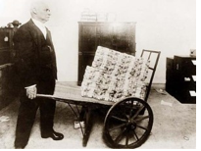
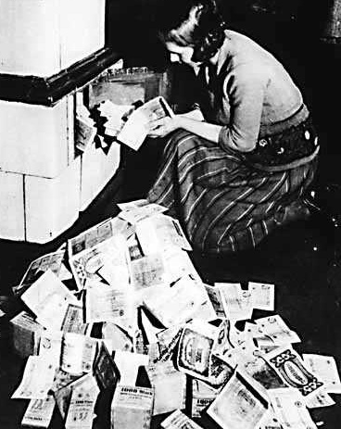

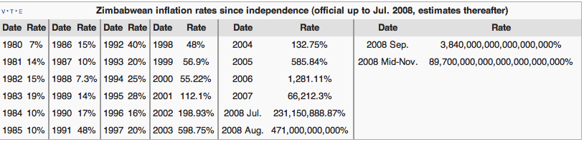
Cases of Hyperinflation
Germany 1920’s
TASK: Take notes on the following episodes in history
1920’s Germany (olly)
1946 Hungary (video)
2008 Zimbabwe (video)
Hungary 1946
JOEL’s COINS
http://www.joelscoins.com/exhibger2.htm
(“crazy” Joel)
What is Money…..(watch rest of video – 4m 30s to 8m15s) – Click on LINK

Slide 14
HISTORY OF PRICE LEVELS IN THE UK

Slide 15
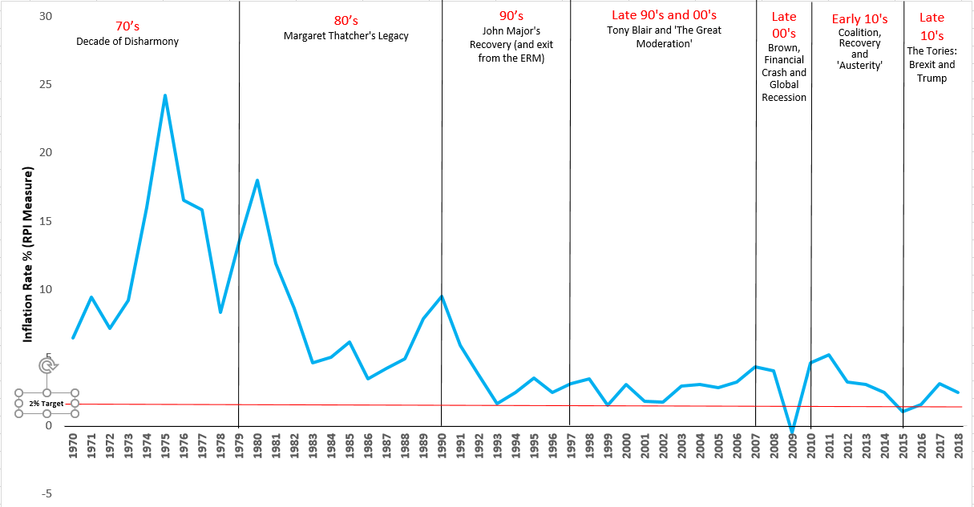
QUESTION TO DISCUSS:
What is the trend in the data since 1970?
Why do you think that since 1992, inflation has been very low, historically, compared to the previous years?
Do we need to worry about inflation anymore since it has been historically stable since 1992?
NOTES TO YOUR ANSWERS HERE:
SIGNIFICANT PERIODS IN ECONOMIC HISTORY
Barber Boom
1st Oil Shock
2nd Oil Shock
Lawson Boom
Housing Recession
Goldilocks Economy
Financial Crash
Austerity ‘Recovery’?
Anti-globalisation agenda (Trump, Brexit etc.)
1
2
3
4
7
8
5
6
9
Notes:
Describe this graph? What are the trends?
Answer the TASK

Slide 16

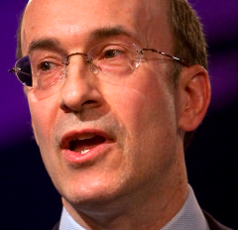
INFLATIONARY THINKING TODAY:
The Death of Inflation?
Why do some economists such as Kenneth Rogoff suggest that we should be very careful and still treat inflation as a threat?
Globalisation: Emerging economies such as India and China are fighting rising inflation as demand increases in their economy. US under Trump could start to see growing inflation as well with his economic policies.
Commodity prices: 2008-2011, rising food and oil prices and today there are inflationary pressures due to a weaker exchange rate. What about the threat of OPEC pushing up oil prices further?
Inflationary expectations increased: The Legacy of the Credit Crunch has resulted in the Bank of England Quantitative Easing (injecting more money into the economy)….is this causing asset bubbles in housing and company shares?
Central Bank Policy: Inflation targeting and central bank ‘credibility’ put to the test with the accusation that interest rates too low and this is what helped caused the financial crisis.
Why has the threat of inflation died according to some Economists like Roger Bootle? He thinks we should be more worried about deflation.
Globalisation: cheaper imports and cheaper labour (immigration). Technological advances: shipping, computers and internet increase productivity and lower costs. Deflationary pressures in Japan and Eurozone will start to affect us as well.
Commodity prices (oil, copper etc.) Since 2005, oil prices have reduced in price on average. They are lower today than they were back then
Inflationary expectations reduced: Government policy in the 1980’s helped to subdue inflationary expectations by Margaret Thatcher cutting spending and reducing the money supply. Also UK experience deflation for first time in 2009
Central Bank Policy: Inflation targeting since the early 1990’s by the Bank of England has given ‘credibility’ and controlled inflationary expectations
Which argument do you agree with the most and why?

Slide 17
WEEK 5

Slide 18
30

Slide 19
Effects of Unstable Prices
DEFLATIONARY SPIRALS

Slide 20
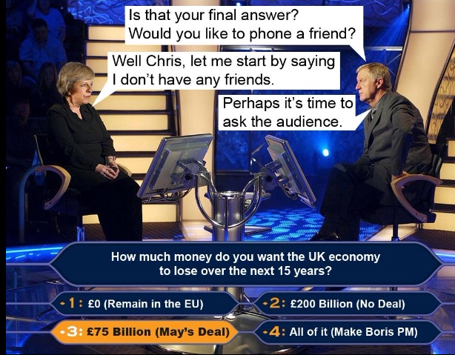
STARTER EXERCISE: MACROECONOMICS (RWS 4)
1st 7 Minutes…as you arrive complete the task below
TODAY: Final lesson on Price Levels
Deflationary impacts on an economy
Causes of inflation assess
Measuring inflation
Economic data – introduction to index numbers
TASK: No need to write down notes unless you need to…just discussions using your PREP HOMEWORK from last week and MON COVER WORK
Why is inflation considered to be ‘bad’ for society?
Why is deflation considered to be ‘bad’ for society?
What is your opinion to the idea that the UK will suffer from deflation in the next 5 years, thanks to BREXIT?
Why is deflation considered worse than inflation according to some?

Slide 21


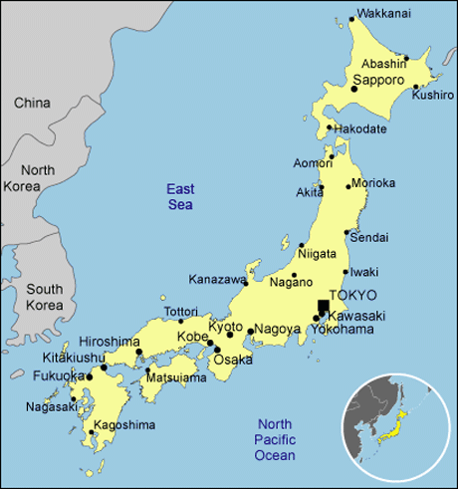
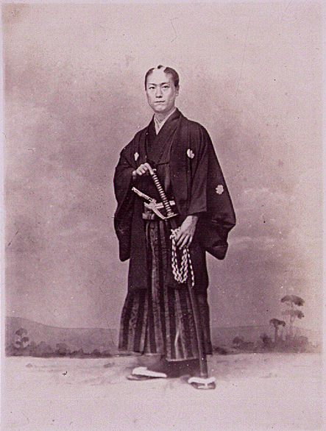
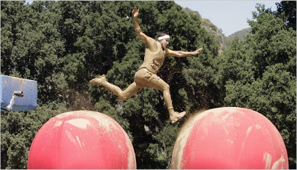

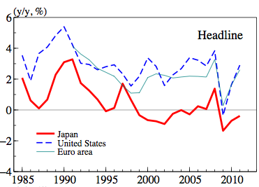
Deflation – Case Study of Japan
What happened in Japan?
The ‘Lost Decade’ (Late 1990’s to 2000’s): Caused by boom of the 1980’s
Negtive Effects in the short run = fall in growth and greater unemployment
“Delayed” consumption = less spending in economy
Increased value of debt = more bankruptcies and insolvency = higher unemployment
Costs for firms initially increases = wages of current workers effectively rise as value of money increases. Lead to ‘Real Wage’ Unemployment.
Solutions: Abenomics
Print money (‘Quantitative Easing’)
Government debt increases (Government’s cut taxes and increase spending to stimulate spending and investment)
Weaken the currency
Try to encourage more trade and remove Government regulations

Slide 22
Deflation in the UK? Are we the next Japan?
Systemic reasons for deflation in Japan can be said to include: | What is happening at the moment in the UK?
HOUSING (and other ASSET) PRICES INCREASING HUGELY: There was a rather large price bubble in both equities and housing in Japan in the 1980s (peaking in late 1989). The housing market then crashed and when assets decrease in value, the money supply shrinks, which leads to prices falling. | HOUSE PRICES AT THE MOMENT?:
IMPORTED DEFLATION: Japan imports Chinese and other countries' inexpensive consumable goods, raw materials (due to lower wages and fast growth in those countries). Thus, prices of imported products are decreasing. Domestic producers must match these prices in order to remain competitive. This decreases prices for many things in the economy, and thus is deflationary. | WHAT HAS HAPPENED WITH IMPORTS AND GLOBALISATION INTO THE UK OVER THE PAST 16 YEARS?
OVERLENDING: Banks lent to companies and individuals that invested in real estate (housing and commercial properties). When real estate values dropped because of a persistent positive output gap in the economy, these loans could not be paid. The banks could try to collect on the collateral (land), but this wouldn't pay off the loan (because of the falling asset prices). This restricted money in the economy and led to falling prices. | WHAT HAPPENED DURING THE FINANCIAL CRISIS
POOR PRODUCTIVITY: Sometimes poor productivity can actually cause prices to rise. However in Japan’s case, productivity was caused by a shrinking population and an ageing population. This meant the demographics of the country were becoming significantly older. This led to a reduction in output and less exports to other countries which created a fall in the total demand in the economy. | POOR PRODUCTIVITY IN THE UK TODAY?
ZOMBIE BANKS: Banks with a larger percentage of their loans which are “non-performing", that is to say, they are not receiving payments on them, but have not yet written them off, cannot lend more money and might go bust. Japanese people are afraid that banks will collapse so they prefer to buy gold instead of saving their money in a bank account. This likewise means the money is not available for lending and led to a fall in aggregate demand in the economy and thus led to deflation | HARDER ONE THIS. WHAT IS HAPPENING WITH BANKS IN THE UK IN THE LIGHT OF THE FINANCIAL CRISIS?

Slide 23
INFLATIONARY THINKING: 2010+ Deflation
TASK: Is Deflation so bad for the UK?
YES | NO
Deflationary spiral: consumption is delayed and savers are encouraged to increase their savings. So the economy grinds to a halt. Less tax revenue for Government’s as taxes fall. Japan lost over a decade! | Japanese did ‘lose a decade’ but consumers in Japan are learning to live with this and adjusting expectations as a result. Also the spiral has not yet kicked in for the UK.
Deflation means that those with debt have to pay back more whereas those with savings have more money. Problem in our debt ridden societies currently especially with growing global and national inequality | Recent deflationary pressures in the Eurozone and the UK have led to improved living standards and have come at a much needed time for households coming out of a recession. Falling prices can make economies more competitive which might help people in debt if they are able to earn more money.
Japanese experience should give warning as it is very hard to get out of a sprial (failure of Abenomics?). If interest rates are zero, then Government’s need to rely on fiscal policy which could lead to an even larger debt burden. Economists are still unsure what to do with an economy facing an entrenched deflationary spiral like in Japan | Or they could they print money to prevent this from happening?

Slide 24
CAUSES OF INFLATION

Slide 25

Theories of Inflation - Causes?
TASK: Note taking and clarification of learning….
Keynesian VIEW (1st year)
  DEMAND SIDE OF ECONOMY (Demand Pull) - excess demand in the economy; perhaps from excessive growth pushes up prices as too few goods. The opposite would happen for falling inflation or deflation.
  SUPPLY SIDE OF ECONOMY (Cost Push) - input prices are rising for firms (so costs of production are rising). Higher costs are passed on to the consumer with higher prices. The opposite would happen for falling inflation or deflation.
New Classical VIEW (2nd year)
  Monetarism (Quantity Theory of Money)
  Psychology of Inflation (Adaptive and Rational Expectations

Slide 26
UK Inflation History 1970 - 2016
RPI Measure
TASK: Annotate the graph to explain:
Explain whether this event is a demand or supply side issue with the economy? e.g. Barber boom meant inflation starting to rise and as high as 10% because of too much demand caused by the Government creating a boom with higher Government spending and cutting taxation before an election.
Why do you think that since 1992, inflation has been very low, historically, compared to the previous years?
Barber Boom
1st Oil Shock
2nd Oil Shock
Lawson Boom
Housing Recession
Goldilocks Economy
Financial Crash
Austerity ‘Recovery’?
Anti-globalisation agenda (Trump, Brexit etc.)
1
2
3
4
7
8
5
6
9
Notes:
Describe this graph? What are the trends?
Answer the TASK

Slide 27
90

Slide 28
UNDERSTANDING INDEX NUMBERS

Slide 29
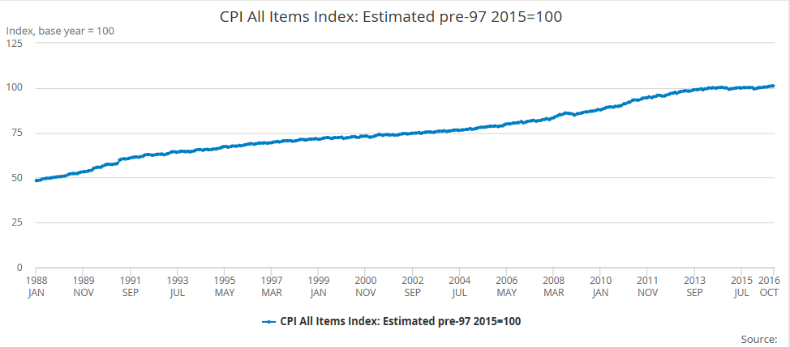
Understanding Index Numbers in General
Time series data are often expressed in terms of index numbers to make it easier to compare numbers
Measures relative numbers rather than absolute numbers
One year is selected as the base year and this is given a value of 100.
The output for other years is then shown by their percentage change from 100

Slide 30
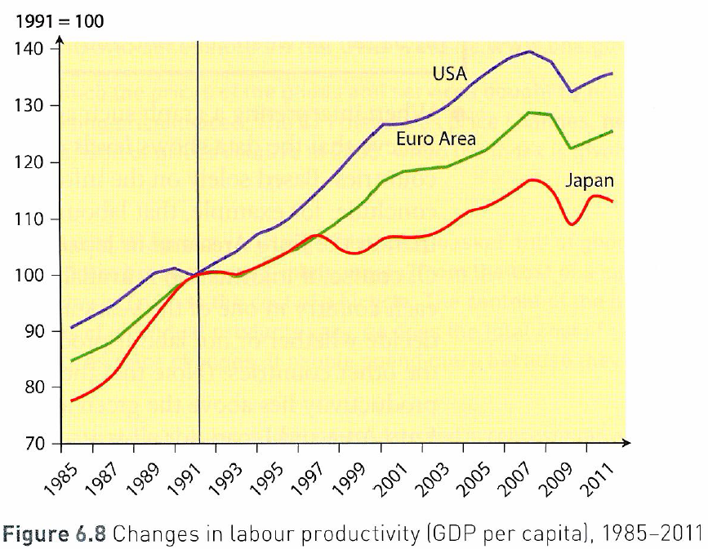
Understanding INDEX NUMBERS: How much do you know?
Index numbers are used to compare ‘relative’ numbers not ‘absolute’ numbers. They measure the rate of change over a period of time. They are usually calculated from a ‘base year’ which is given the value of 100 for ease of computation. Therefore if the base value is 100 and this increases to 105 in the following year, then this is a 5% increase. Equally if the rate of change falls from 100 in the first year to 93 in the second year, it is very easy to say there has been a 7% decrease.
TASKS TO COMPLETE:
Calculate the percentage increase in labour productivity from 1991 to 2011 in the USA just by looking at the graph.
Calculate the percentage increase from 2001 to 2009 for the USA.
Why would it be incorrect to say that the USA has had higher levels of labour productivity than Japan?
Is it true to say that it is at least possible that Japan could have higher levels of labour productivity than the USA?
Identify two significant points of comparison in the labour productivity of countries shown in Figure 6.8
Notes:
Calculate the percentage increase in labour productivity from 1991 to 2011 in the USA just by looking at the graph.
100 to 135 = 35% increase
Calculate the percentage increase from 2001 to 2008 for the USA.
2001 = 125
2008 = 133
6.4%
Why would it be incorrect to say that the USA has had higher levels of labour productivity than Japan?
Because the USA could have been starting from a lower base but increased more rapidly than Japan
All this shows is that the USA rose faster in terms of productivity from their base level than Japan
Is it true to say that it is at least possible that Japan could have higher levels of labour productivity than the USA?
YES – it could be but the graph compares rates of change not absolute change
Identify two significant points of comparison in the labour productivity of countries shown in Figure 6.8
All three increase (labour productivity is rising in each country on the whole)
Each country had a regression in productivity rates around 2007-2009. Although productivity higher than in 1991,

Slide 31
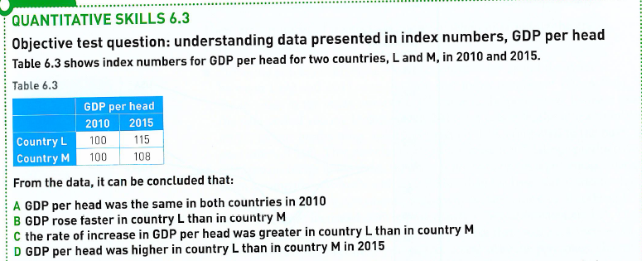
Understanding INDEX NUMBERS: How much do you know?
TASKS:
Why can it not be answer A and D?
Why can it not be B?
Why is it C?
Notes:
Why can it not be answer A and D
A - Because it is an index number. The GDP might be the same but it is unlikely. Rather both GDP’s in £’s have been converted into the number 100. Any changes in subsequent years are then based against this 100 year
D – Index change here measures the rate of change compared to the specific country. We cannot say that L is higher than M, we can only say that given it’s base GDP, country L expanded more quickly than M
Why can it not be B
B – table measures GDP per head but question asks about GDP!
Why is it C
C – rate of change was 15% in country L but only 8% in country M

Slide 32
MEASURING OF INFLATION

Slide 33
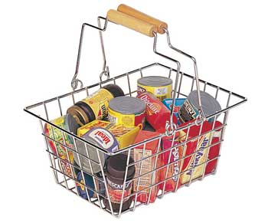
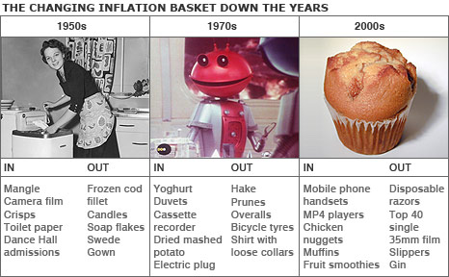
Measuring Price Levels
A Basket of Goods
CPI .v. RPI (Article on GOL to read for RWS)
CPI is the official measure of inflation in the UK since 2003. RPI is still used by Trade Unions when calculating wage increases.
They are both made up of a basket of goods which are given weights depending on their significance to the average UK household and they are turned into INDEXES. These weights and indeed what is in the basket will change depending on changes to trends (see graph below).
The CPI is meant to represent the whole of the UK (a broader sample) whereas the RPI takes into account the fact that students and pensioners might have differing spending habits from the rest of the population and excludes them
However, the CPI does not include some housing costs as they are thought to distort the statistic (such as mortgage interest payments and council tax)

Slide 34
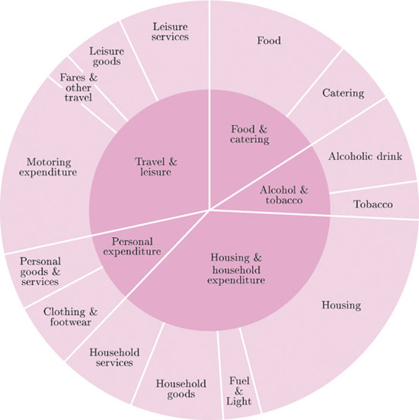
RPI
Measuring Inflation: Index Numbers and Weightings
CPI

Slide 35
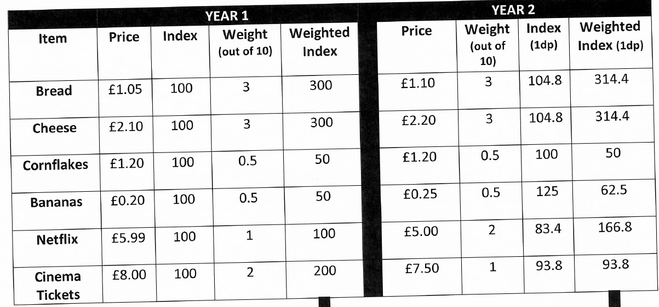
Calculating Weighted Index Numbers
Complete the Table

Slide 36
APPLICATION OF INDEX NUMBERS TO ECONOMIC DATA CONNECTED WITH PRICE LEVELS: Workers’ Wages and Economic Growth

Slide 37
INDEX NUMBERS APPLICATION
‘Real and Nominal’ Values: GDP
KEY WORDS:
Nominal value = the actual or ‘face value’ or ‘current price’
Real Value = value adjusted for inflation (or constant price)
TASK 1:
YEAR 1: If 100 million goods are produced at a price of £5 then GDP is £500m
YEAR 2: If 100 million goods are produced at a price of £ 6 then GDP is £600m
What has been the nominal increase in GDP, measured in pounds?
Have living standards increased? Why? Why not?
Calculate the price level as an index with year 1 as the ‘base year’ of 100. What is the index number for year 2?
What is the inflation rate between year 1 and 2?
What is real GDP in year 2 (with inflation taken into account?)
Equation:
Notes:
The price level in year 1 is 100
THEREFORE: Real GDP measures GDP at constant prices SO the increase in GDP in this example would be zero. The only reason for the increase in nominal GDP here is that prices have increased but the actual number of goods produced has stayed the same.
and in year 2 is 120 so inflation has increased by 20%

Slide 38
EXERCISE TO COMPLETE: Calculate the Real Growth Rate from 1985 to 1994
1985 GDP at Current Prices =$150 bn
1994 GDP at Current Prices =$300 bn
1985-1994 Inflation = 50% in that period
Q1: Calculate the index number for 1985 and 1994’s nominal GDP if 1985 is the base year?
Q2: Calculate the real GDP for 1994
Q3: Calculate the real growth rate from 1985 to 1994
Nominal or (money) GDP is GDP measured in terms of the prices operating in that year in which the output is produced. But this may not be an accurate reflection of how much goods and services the country is producing. This is because nominal GDP does not take into account inflation.
EXAMPLE 2: Calculate the Real Growth Rate from 2000 to 2001
2000 nominal GDP is £800 bn price index is 100
2001 nominal GDP is £864 bn price index is 105
Calculate the inflation increase:
ANSWER: (105-100)*100 = 5%
(ii) Calculate how much GDP would be worth in 2001 (in other words, the real GDP):
ANSWER: £864 x 100/105 = £822 bn
(iii) Calculate the real growth rate from 2000 to 2001
(822-800) / 800 *100 = 2.75%
Inflation Index in Base Year
Inflation Index in Current Year
Real GDP (£) = Nominal GDP (£) x
Notes:
Q1: What would the index be in 1985 and 1994?
100 in 1985 and 200 in 1994
Q2: Calculate the real GDP for 1994
Therefore real GDP = $300bn * 100/150 =$200bn
Q3: Calculate the real growth rate from 1985 to 1994
50 (200-150) / 150 *100 = 33.3%

Slide 39
INDEX NUMBERS APPLICATION
‘Real and Nominal’ Values: Wages
Real wages show the value of wages adjusted for inflation. Real wages are a guide to how living standards have changed.
For example, if nominal (actual) wages increased 5%, but inflation was 5%. This would mean the purchasing power of your wages had stayed the same. The net effect would be the same as a wage freeze (0% real increase)
However, if wages increase by 2%, and we have an inflation rate of 3%, your real wages is -1%. Prices have risen faster than wages, meaning you are worse off.
TASK:
Imagine, your wage went from £20,000 a year to a new level of £40,000 but inflation was running at 40% that year
Would you be better off? Why?
What is the new nominal wage that you will receive this year?
What is the real wage that you will receive this year?
Notes:
Suppose your annual salary went from £20,000 a year to £40,000 a year. Does that mean you are better off? Can you buy twice as many goods?
If there is zero inflation, if prices stay the same, then the answer is yes. With a doubling of income you can buy twice as many goods.
However, suppose the inflation rate was 40%. That means goods and services would be rising in price by 40%. Therefore, even though your nominal income has increased by 100%, it doesn’t mean you can buy 100% more goods. Your effective purchasing power has increased by 100 – 40 = You are effectively 60% better off.
If prices doubled and your income doubled. Your real income (effective purchasing power) would be exactly the same.
This same principle can be applied to National Income.
In the case of Zimbabwe, inflation has reached 100,000%. Therefore the Nominal value of output is rising very fast because the prices of goods are increasing. From a statistical point of view, it looks like nominal GDP is rising very fast. But, the reality is that living standards are falling because inflation is greater than the increase in nominal GDP

Slide 40
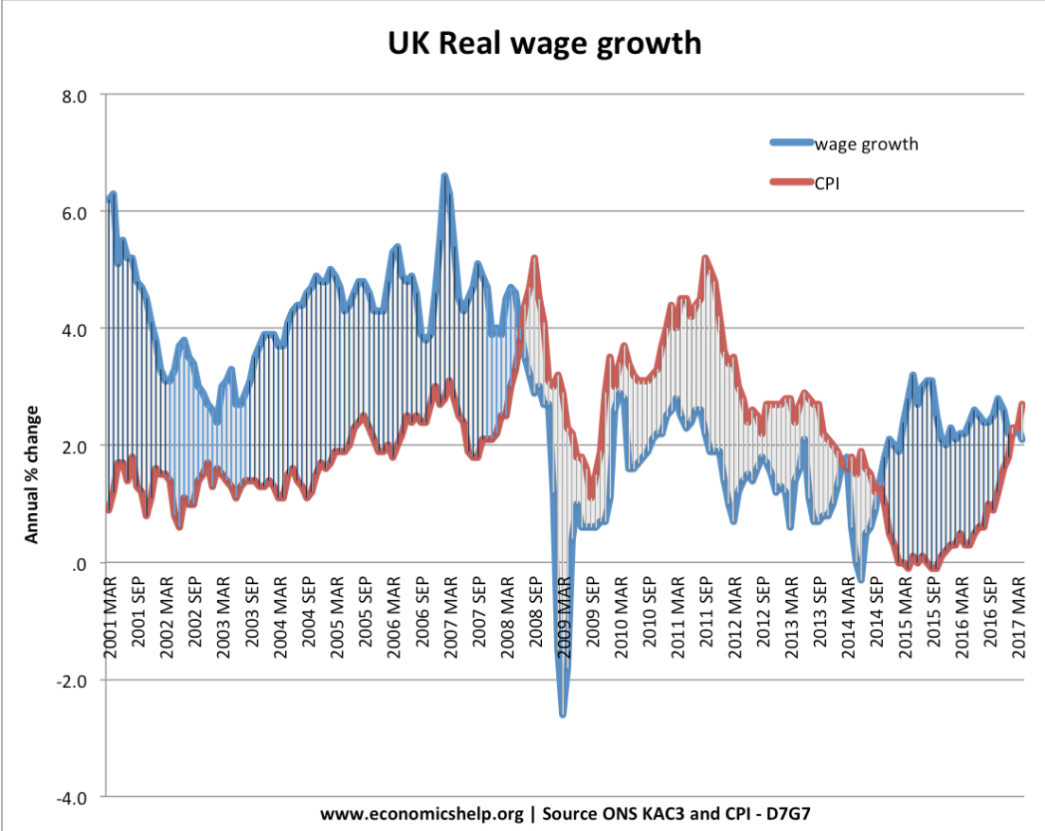
TASK: ANSWER THE FOLLOWING QUESTIONS USING THE GRAPH
How are real wages represented on this graph?
Describe what this graph tells us about real wages in the UK from March 2001 to March 2017?
Explain why the graph might follow these trends? (HINT: think back to what happened before 2008 and the financial crisis and what has happened since?
Notes:
Q1: What would the index be in 1985 and 1994?
100 in 1985 and 150 in 1994
Q2: Calculate the real GDP for 1994
Therefore real GDP = $300bn * 100/ 150 =$200 bn
Q3: Calculate the real growth rate from 1985 to 1994
50 (200-150) / 150 *100 = 33.3%

Slide 41
ARCHIVE

Slide 42
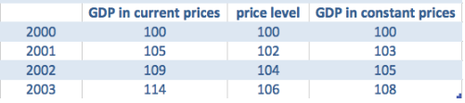
INDEX NUMBERS APPLICATION
‘Real and Nominal’ Values: GDP
KEY WORDS:
Nominal value = the actual or ‘face value’ or ‘current price’
Real Value = value adjusted for inflation (or constant price)
TASK: From 2000-2003 above in the table….
What was the increase in GDP at current market prices? Is this a nominal or a real increase?
What is the increase in inflation at this time?
How much more GDP has been created in reality once price changes are taken into account?
Why does the real GDP increase give a better reflection of actual living standards?
Notes:
What was the increase in GDP at current market prices? Is this a nominal or a real increase?
14% (100 to 114)
(2) What is the increase in inflation at this time?
6% (100 to 106)
(3) Why does the real GDP increase give a better reflection of actual living standards
Real figures are said to give a more accurate reflection of actual living standards.
If you have inflation of 100%, nominal GDP will double in a year. But, this nominal figure is misleading. Just because prices have doubled doesn’t mean you have doubled living standards.

