Slide 1
WEEK 7

Slide 2
HWK

Slide 3
Spring Half-Term Year 1: First 6 Weeks
Weeks 1 and 2
MICRO RWS#5: The Role of Government
Why might the market fail? The Morality of Capitalism?
What is the role of the Government in the market to correct the failure?
Why might the Government fail?
Weeks 3 and 4
MICRO RWS#6: Monopoly as a Market Failure
What is a firm and what are its objectives?
The concept of Economies of Scale
Monopoly and Monopoly Power in the Market
Government Intervention and Failure: Supermarkets Case Study
Weeks 5 and 6
Review Week and Benchmark
10 Multiple Choice and 25 Mark Essay
Weeks 1 and 2
MACRO RWS#5: Aggregate Demand and Supply in the Economy
Components of Aggregate Demand AD
Components of Aggregate Supply AS
Aggregate Demand and Supply Curves
Weeks 3 and 4
MACRO RWS#6: Macroeconomic Equilibrium Theory
Macroeconomic Equilibrium
Changes to Equilibrium from AD and AS
Policy Conflicts
Weeks 5 and 6
Review Week and Benchmark
10 Multiple Choice and 25 Mark Essay

Slide 4
Economics Homework For the 7th January 2019 (3.5 weeks away) Can be completed in class Monday and Tuesday = 2 possible hours
IMPORTANT IT NOTICE
Change your password before you break up to get access to GOL in case it expires over the Christmas break
MICROECONOMICS PREP (2.25 to 3hrs=3 to 4 45m):
1x30m Worksheet: ‘Morality of Capitalism’ (in class)
1-2 x45m - Worksheet: ‘Intro to Markets .v. Government’ (some completed in class)
2-3x45m - PREP WORK: Complete A3 mind map on agriculture and housing market context
MACROECONOMICS PREP (2.25 to 3hrs=3 to 4 45m):
4-5x45m Worksheet: Introduction to Aggregate Demand (some completed in class)
CURRENT AFFAIRS (ongoing):
Finish reading the Macroeconomics book by Tim Harford, read for a test in the first lesson back
Stay up to date over the Christmas break….Trump, Brexit etc.

Slide 5
30

Slide 6
30 Intro to AD and Worksheet

Slide 7
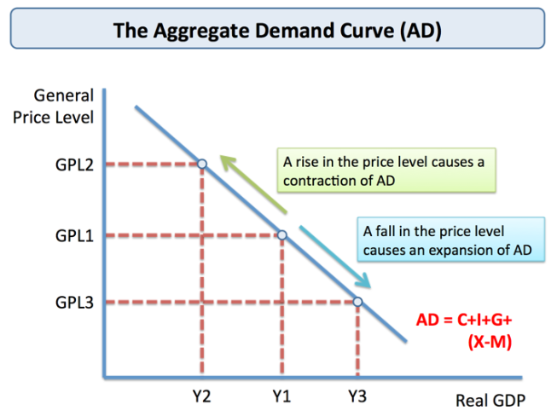
Aggregate Demand STARTER
Aggregate Demand and the Price Level - Why is there an inverse relationship?
As the price level rises consumers are less able to buy the items they want or need if their incomes stay fixed.
Effectively, the real value of people’s incomes fall.
If over the course of a year all prices rose by 10 per cent whilst your money income remained the same, your real income would have fallen by 10%
Notes:
https://www.cia.gov/library/publications/the-world-factbook/geos/uk.html
https://www.youtube.com/watch?v=GL-KHP-melk

Slide 8
DIFFERENCES BETWEEN MACRO AND MICRO MODELS
Price
Price Level
Quantity
Real GDP/
Real Output
National Income

Slide 9
Explain the difference between demand and aggregate demand
Microeconomics – DEMAND (the total number of consumers in a particular market)
p
p
p
p
MARKET
FOR CARS
D
D
D
etc.
q
q
q
Individual
Consumer 1
Individual
Consumer 2
Individual
Consumer 3
D
q
Macroeconomics – AGGREGATE DEMAND (the total number of market demand curves in the economy)
Price
Level
UK ECONOMY
p
p
p
D
q
D
D
etc.
q
q
UK
Car
Market
UK
MP3
Market
UK
Insurance
Market
AD
Real
National
Income
EXERCISE: What is the main difference between demand and aggregate demand, based on these pictures?

Slide 11
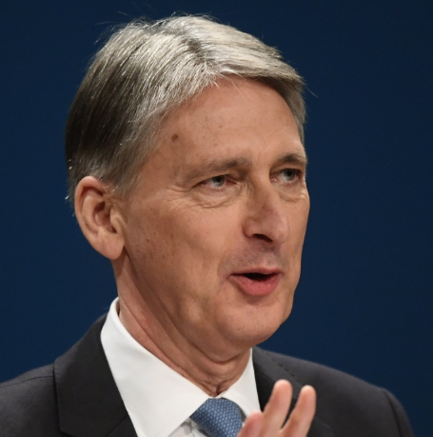
Introduction to Government Policy How does the Government control the demand in the economy?
DEMAND SIDE POLICIES
Fiscal Policy (HM Treasury)
Running the ‘BUDGET’ through:
Collecting Taxes
Spending Money in the Economy (Government Spending)
Monetary Policy (Bank of England)
Interest rate changes
Quantitative Easing
QUESTIONS FOR DISCUSSION
What could the Bank of England do to interest rates if they wanted to boost aggregate demand?
What could the Chancellor of the Exchequer do
Under what circumstances might a Government wish to increase AD and under what circumstances might a Government wish to decrease AD?

Slide 12
WEEK 1

Slide 13
HWK

Slide 14
30

Slide 15
45

Slide 16
45

Slide 17
WEEK 2

Slide 18
HWK

Slide 19
RWS 5 HWK (4.5 to 6 hrs) Due for Monday 21st January 2018
RWS5 The Role of Government (MICROECONOMICS) Key Terms: Market Failure, Government Intervention, Government Failure
MICROECONOMICS (2.25 to 3 hrs)
The Role of Government
MACROECONOMICS (2.25 to 3 Hrs)
Aggregate Demand and Aggregate Supply
All resources, instructions and powerpoint on GOL!

Slide 20
90

Slide 21
45
Notes:
15: Starter Activity and Homework Check
30: Presentations and Clarification
4x5 = 20 Minutes (1 minute read through 1 minute presentation 2 minutes Q+A)
10 Minutes as a class
30: Multiple choice
15:

Slide 22
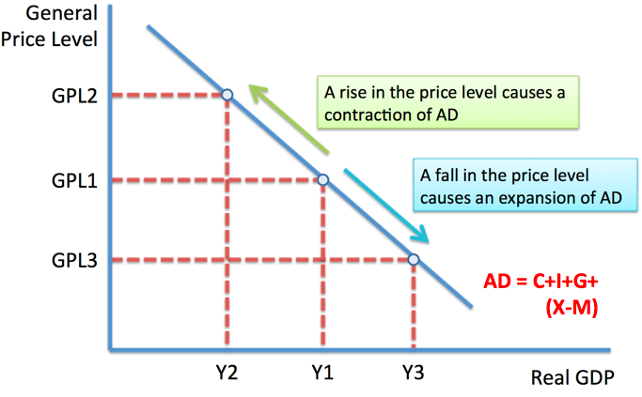
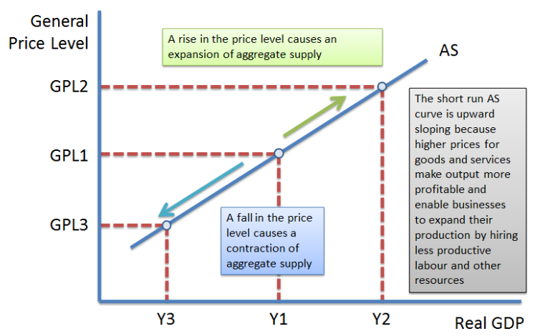
STARTER EXERCISE What is Aggregate Demand?
3
1
SRAS
TASK 1: Swap your sheets with everyone and make sure they are in order of the white box
TASK 2: Draw the following five diagrams in your notes (entitled ‘AD and AS Analysis)
Draw a diagram to show the effect of a price level change on an AD curve
Draw a diagram to show an increase in the AD curve (on it’s own)
Draw a diagram to show the effect of a price level change on an SRAS curve
Draw a diagram to show the effect of a shift to the left in the SRAS curve
Draw a diagram to show the effect of a shift to the right with an LRAS curve
TODAY: Why does the AD and AS Curve Shift?
AGGREGATE DEMAND (AD)
Households? [C]
Firms? [I]
Government? [G]
Foreign Countries? [X-M]
AGGREGATE SUPPLY (AS)
SRAS
LRAS
GOVERNMENT POLICY TO AFFECT AD
Monetary Policy (Central Bank)
Interest Rates
Quantitative Easing (Money Printing)
Fiscal Policy (Treasury)
The ‘Budget’ – tax and spend…

Slide 23
TASK: Share your ideas RE the determinants of AD and AS
5 Minutes EACH component:
1 Minute Individual Reading
1 Minute Presentation from the Author
2 Minute Group Q+A
1 Minute Teacher-Led Q+A
AGGREGATE DEMAND (AD)
Households? [C] = 1
Firms? [I] = 2
Government? [G] = 3
Foreign Countries? [X-M] = ODS
AGGREGATE SUPPLY (AS)
SRAS and LRAS = 4

Slide 24
Consumption
Consumption
INCLUDES SPENDING ON:
(1) non-durable goods
PERSONAL DISPOSASBLE INCOME
(2) durable goods
(3) services
CONSUME
SAVE

Slide 25
Consumption (C)
https://www.youtube.com/watch?v=d8ppULbw0ck
Determinants of C:
Consumer income
Changes in income tax
Consumer confidence
Wealth
Interest rates
Availability of credit
“Consumer expenditure on goods and services which includes the demand for ‘durables’ and ‘non-durables”

Slide 26
Consequences of Consumption for the Economy
Changes in total consumer demand impact directly on aggregate demand and the rate of short term growth
Sustained growth in consumption will lead to:
An expansion in real national output (providing that short run aggregate supply can meet the higher demand)
Increased profits for suppliers / producers – responding to signals from the price mechanism
Increased tax revenues for the government (I.e. from VAT)
An increase in the demand for imported products (which has a negative impact on the UK balance of payments)
A possible rise in inflation if there is excess demand in economy

Slide 27
CONSUMPTION FACTS
Consumer spending is the largest component of aggregate demand
Trend growth of household spending is 3% per year (in real terms (i.e. expressed at constant prices)
Composition of total household spending:
Most spending goes on services (e.g. transport, communications and a range of household services)
10% on food
7% on tobacco and alcohol
7% on clothing
11% on consumer durables (including household appliances & vehicles)
Consumption Trends
Late 1980s – strong (unsustainable) consumer boom (Lawson Boom)
Early 1990s – recession hit consumers hard – increase in saving and less consumption (Housing Recession)
1993-1999 – sustained growth of consumption but well down on late 1980s
1999-2008 - consumer boom fuelled by debt as credit becomes more available in banks etc. and cheap imports because of Globalisation (Goldilocks Economy)
2008-2015 - initial recession (financial crash) and then arguably delayed recovery of consumption
2015-2018 - boom again especially as we approach Xmas 2016 - number of households in debt is back to 2007 levels. But Xmas 2018? Retail in crisis?

Slide 28
Investment (I)
Changes in income tax
Page 8
Determinants of I:
Consumer spending
Business profits
Availability of loans
Interest rate
Changes in corporation tax
Subsidies
“Spending by firms on capital goods, used to produce goods and services”
http://www.tutor2u.net/economics/reference/the-accelerator-effect

Slide 29
Government Spending (G)
Page 11
“The sum of all spending by the Government”
“The Chancellor’s plans for taxation and Government spending over the coming year”
“When the Government spends more than it receives in tax revenue in a given year i.e. G > T”
“When the Government receives more tax revenue than Government spending in a given year i.e. G < T”
3 Types of G: Make notes on Page 15

Slide 30
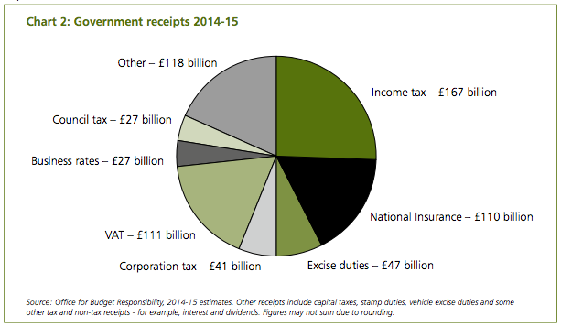
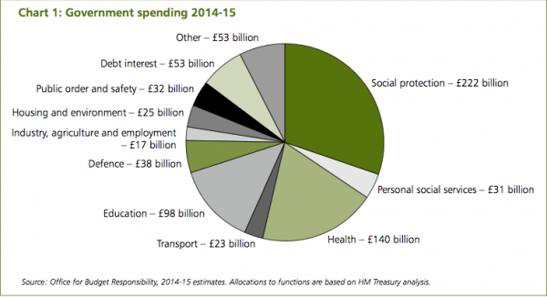
Page 11
http://www.tradingeconomics.com/country-list/government-debt-to-gdp

Slide 31
Budget Deficit: Benefits and Drawbacks
Page 13
Boost to AD (SR economic growth)
Allows spending on key public services
Boosting LR economic growth (increase productive capacity)
Use Govt money to solve ‘market failure’
Tax rises in future
Opportunity cost
Higher interest rates (‘crowding out’)
No one wants to lend you money due to lack of confidence (e.g. Greece)

Slide 32
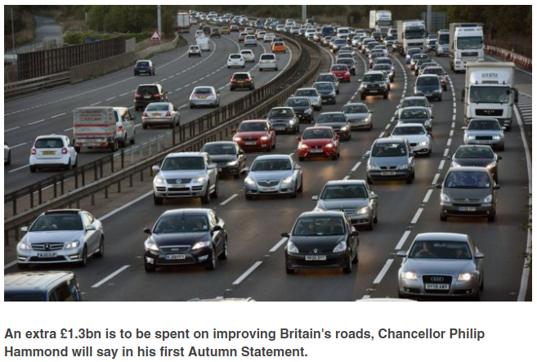
1. What type of Government Spending (G) is this?
2. Explain how this G can cause economic growth (SR and LR)
3. Are there any downsides to this spending?
Ext: Explain how this injection of £1.3 bn could lead to a ‘positive multiplier effect’

Slide 33
Net Exports (X – M)
Page 16
“The revenue gained from exports (X), minus the revenue spent on imports (M)”
Factors affecting Net Exports
Income (in the UK and abroad)
Exchange Rates (via interest rates)
Quality of Exports
“The value of one currency in terms of another”
SPICED WPIDEC

Slide 34
The multiplier and the accelerator….
MULTIPLIER
ACCELERATOR
I
GDP
Output
Income
Expenditure
GDP
Output
Income
Expenditure
IMPACT?
IMPACT?
I
G
X-M

Slide 35
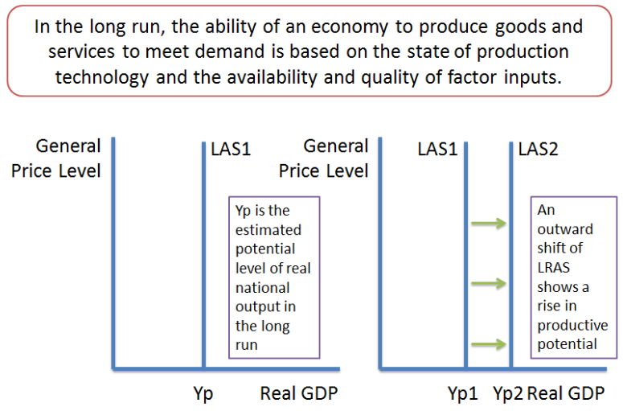
What is Aggregate Supply (AS)
Aggregate supply is the total value of goods and services produced in an economy. It shows the amount of goods that can be produced at different price levels.
The aggregate supply curve is related to a production possibility frontier because both show the productive capacity of the economy.
DIAGRAM 1: AS in the Short Run
DIAGRAM 2: AS in the Long Run
DIAGRAM 3: Relationships between SRAS and LRAS
Price Level
LRAS1
LRAS2
LRAS3
SRAS
SRAS
SRAS
SRAS
SRAS
SRAS
SRAS
SRAS
Real GDP

Slide 36
DIAGRAM 1: CLASSICAL SHORT RUN AGGREGATE SUPPLY (SRAS)
FACTORS AFFECTING COSTS OF PRODUCTION (SHIFTS THE SRAS)
Employment costs
Wages
NI tax
Productivity
Cost of other inputs
Cost of raw materials (commodities)
Exchange rates (SPICED / WPIDEC)
Impact of Government
Corporation tax
Pollution permits (carbon credits)
SRAS

Slide 37
DIAGRAM 2: CLASSICAL LONG RUN AGGREGATE SUPPLY (LRAS)
Activity: Explain how an economy can increase its LRAS…
Quantity of Capital = more investment in factories, machinery etc.
Quality of Capital = research and development
Quality of Labour = Greater education/training?
Quantity of Labour = population growth, immigration, more people deciding to work
http://www.tutor2u.net/economics/reference/the-output-gap

Slide 38
Diagram 3: Relationship between ‘Classical’ LRAS and SRAS
Price Level
LRAS1
LRAS2
LRAS3
SRAS
SRAS
SRAS
SRAS
SRAS
SRAS
SRAS
Real GDP

Slide 39
45

Slide 40
Multiple Choice Questions
INDIVIDUALLY: Complete the 13 MC Questions (13 Minutes)
GROUPS: Agree on your groups answers (7 Minutes)
SHARE – Class answers?

Slide 41
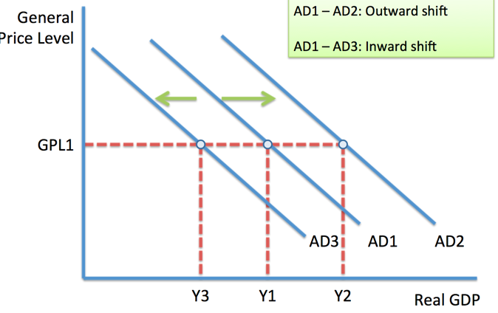
AGGREGATE DEMAND CHECK
C
I
G
X-M

Slide 42
Explaining how a change in a scenario may affect aggregate demand and output
A
B
C
D
Scenario:
A rise in interest rates
Increases in business confidence
Extra wages to public sector workers
A relative fall in the quality of UK goods
Changes in Component of AD
Consumption
Investment
Government Spending
Exports-Imports
Changes in AD
Increase
Decrease
Changes in Output
Increase
Decrease

Slide 43
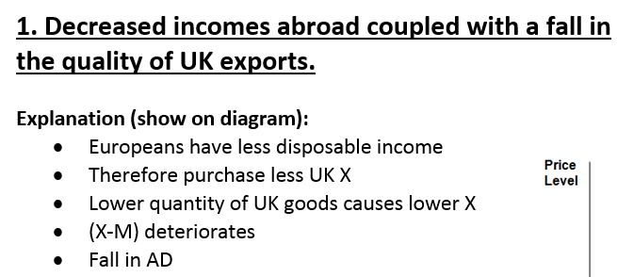
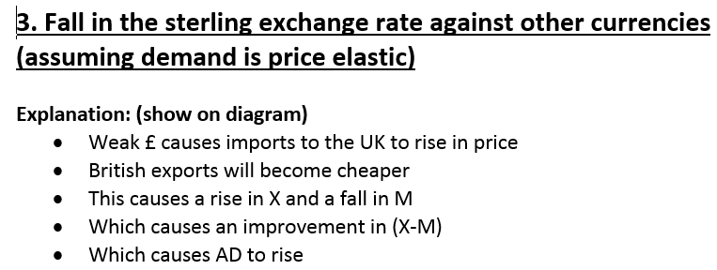

Slide 44
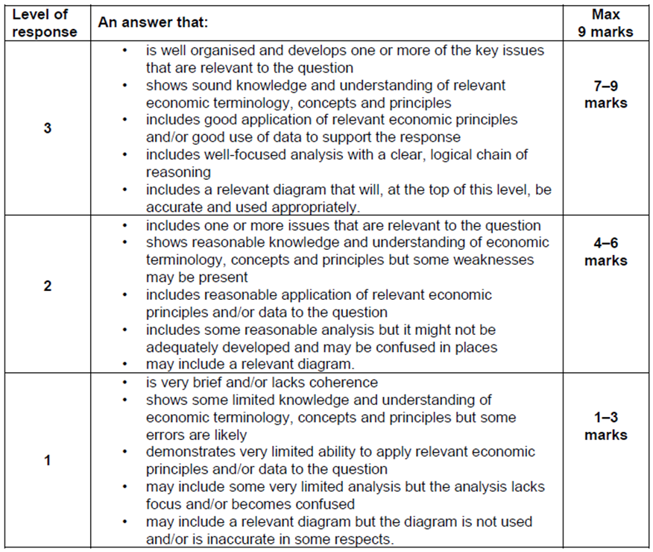
Exam Tekkers
“With the help of a diagram, explain why a fall in interest rates will lead to a rise in AD”
(9 marks)
Tekkers
2 points, 2 paras
Telegraph point
Explain point (6-8 chains of analysis)
Draw a diagram

Slide 45
Application of Aggregate Supply Productivity and Growth in the UK
Click on the Pictures to access the videos in full screen. Exception is PH article - this is in your booklets.
Channel 4 News Clip (4 Minutes)
Crash Course Economics (9 Minutes)
Philip Hammond Article

Slide 46
Final Questions on Aggregate Supply
What would happen in the following scenario’s to aggregate supply in the UK? You will need to decide what the effect might be in the short-run and long-run. Draw a diagram for each question:
The UK Government increase the minimum wage
Oil prices decrease
The UK Government spend money on improving education and providing subsidies for research based endeavours.
A no-deal BREXIT results in a sudden emigration of EU workers back to their home countries

Slide 47
END

Slide 48
EXTENSION?

Slide 49
AGGREGATE DEMAND AND SUPPLY
ANALYSIS
Write a FULL explanation for the following scenario’s: Include
the effect on AD and why this will happen
the effect the change in AD will have on total output in the economy
The effect of the multiplier
How the circular flow of income would react
Consumer confidence is at an all time low with the worldwide credit crunch and falling house prices
There has been a rising trade deficit in the UK
Investment spending in the UK falls
The UK Government increase benefits to low income working families

Slide 50
AGGREGATE DEMAND AND SUPPLY
ANALYSIS
A rising trade deficit results in the domestic economy (UK?) importing more goods than they are exporting. This will result in more money leaving the economy as households and firms reduce their aggregate demand in the economy as they are spending more of their money on foreign goods.
The lack of money heading to domestic firms will result in a fall in profits and a possible fall in output as the firm cuts it’s production.
The cut in production will mean firms will have less need for workers and may make redundancies. These unemployed workers will now have less income and will themselves reduce their domestic demand for goods and services with a fall in consumption, leading to a further fall in output. The de-multiplier effect has set in.
The circular flow of income will shrink as the box will become smaller as more money is flowing out of the economy and aggregate demand is falling, leading to a fall in total GDP or output.

Slide 51
EXERCISE #1
 | CONSUMPTION | DISPOSABLE INCOME
1957 | 171.6 | 169.1
1958 | 176.4 | 172.3
1967 | 227.4 | 234.6
1968 | 233.8 | 238.9
1977 | 275.2 | 284.1
1978 | 290.1 | 305.2
1987 | 381.4 | 385.2
1988 | 410.4 | 405.5
1997 | 489.3 | 525.7
1998 | 502.5 | 525.8
Using the data, draw a graph using EXCEL and explain the relationship between consumption and disposable income.
(i) Calculate the MPC and APC for 1958, 1968, 1978, 1988 and 1998.
(ii) What happened to saving during these years?

