Slide 1
WEEK 1

Slide 2
90

Slide 3
RWS6: Macroeconomic Equilibrium
The Short Run and Long Run
SHORT RUN EQUILIBRIUM
Price Level
LRAS
SRAS
STARTER: Have a go:
You know what these curves look like, so draw them together on a whiteboard, and identify where the ‘equilibrium’ might be:
  AD Curves
  SRAS Curves
  LRAS Curves
Unlike Microeconomics, in Macroeconomics, there are two types of equilibrium, the short run and long run….see if you can draw two diagrams, one showing ‘short run’ equilibrium and one showing ‘long run’ equilibrium.
DO NOT WORRY IF YOU STRUGGLE – HAVE A GO!!!!
P/L1
AD2
Y1
Real GDP
LONG RUN EQUILIBRIUM
Price Level
LRAS
SRAS
P/L1
AD2
Y1
Real GDP

Slide 4
RWS 6: Reminder of Next Two Weeks
Benchmark 3 in 3 weeks time on RWS5 and 6: 20 MC’s and 25m Essay (first one!)
MICRO: Market Failure 1 - Monopoly
Theory of the Firm Basics – Revenues, Costs and Profits
Why is Monopoly considered a market failure?
How can the Government intervene and will they succeed? (Regulation)
CASE STUDIES: Supermarkets in the UK
MACRO: Macroeconomic Equilibrium
Equilibrium in the long run and short run
Macro model and Economic Growth, Unemployment and Price Levels
Classical .v. Keynesian School of Economics
Government Policy Conflicts Introduction

Slide 5
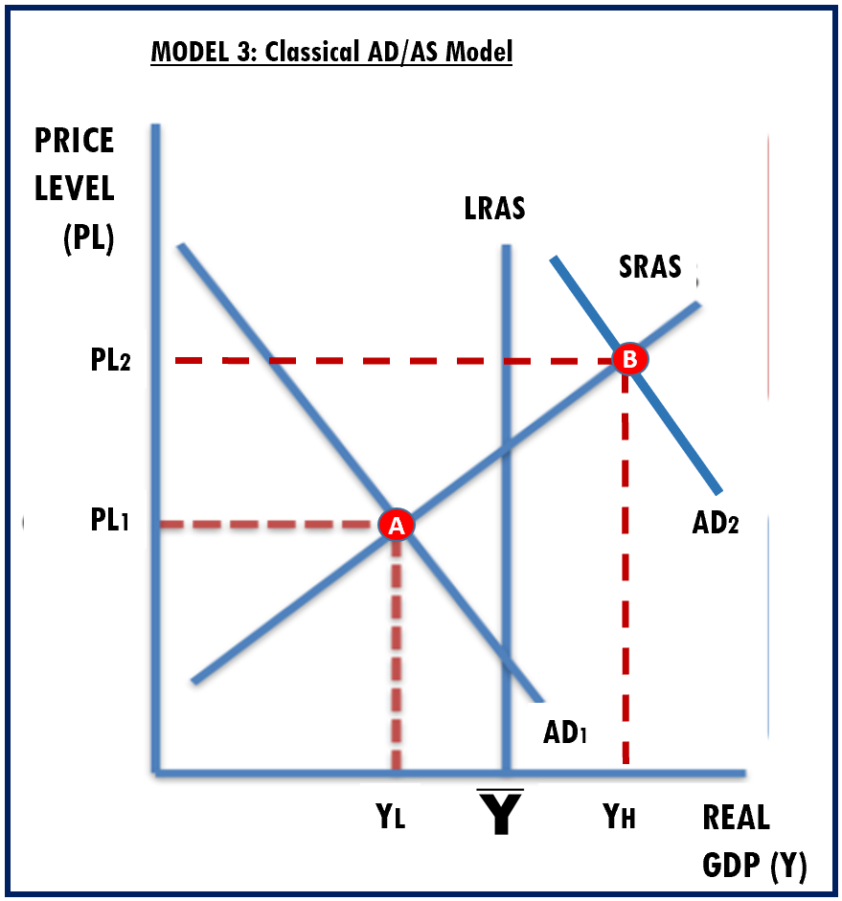
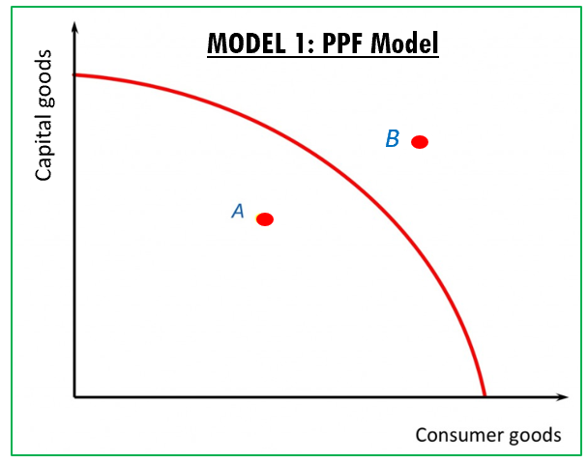
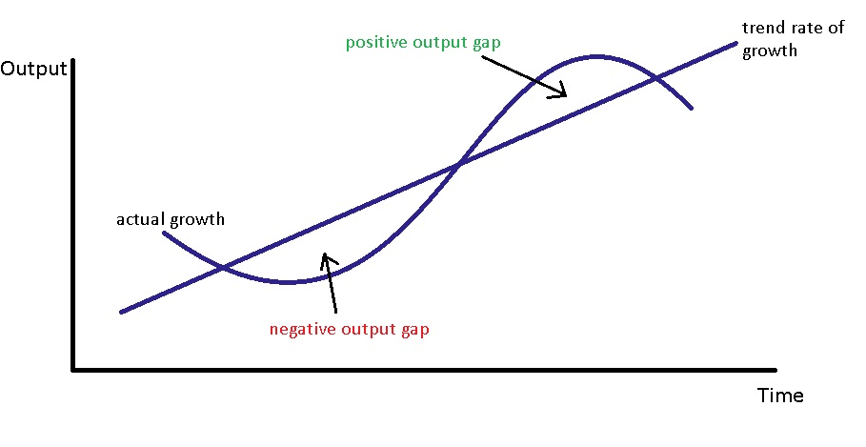
RWS6: Macroeconomic Equilibrium
3 Models to Show Macroeconomic Equilibrium
MODEL 3: AD/AS Model
Activity: Using Whiteboards:
Draw the graph
Identify these key terms on the graph by labelling X,Y and Z. You may need to alter the graphs for some of the letters
  X = Negative output gap
  Y = Actual growth
  Z = Positive output gap
How might you model trend growth on these diagrams?
MODEL 2: Economic Cycles Model

Slide 6
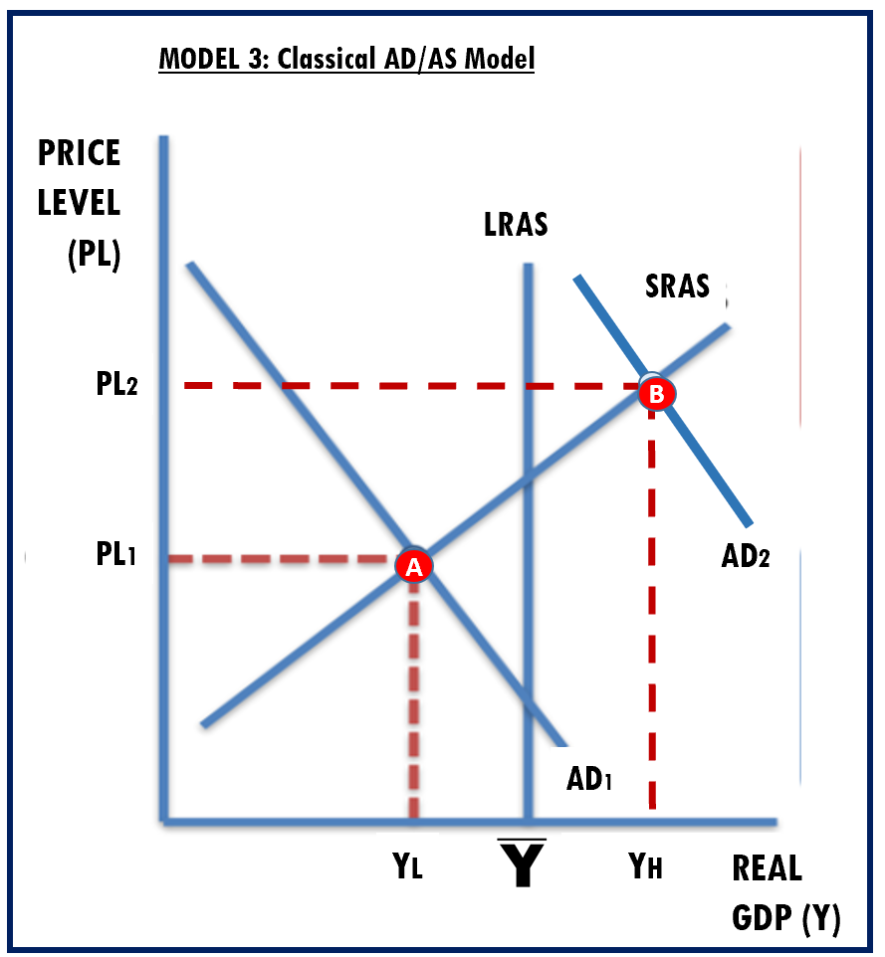
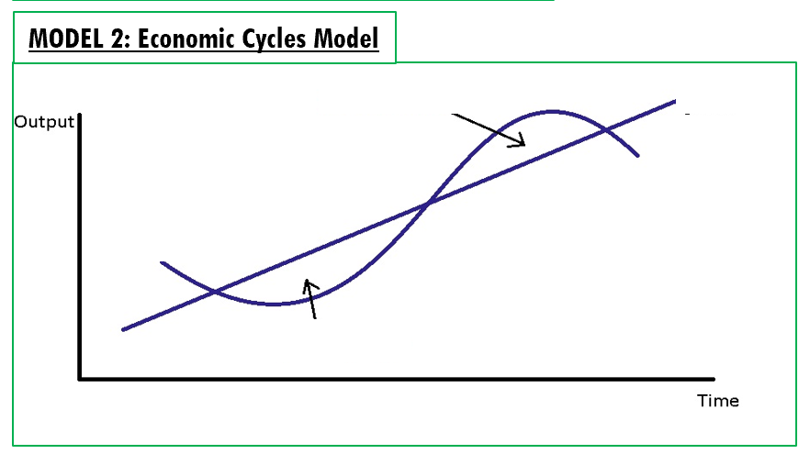
RWS6: Macroeconomic Equilibrium
3 Models to Show Macroeconomic Equilibrium
TASK: Complete the following questions
Identify on the diagrams ‘Negative Output Gap’ and ‘The Positive Output’ Gap
Identify on the diagram ‘Actual Growth’
Answer the question about ‘Trend Growth’ for each diagram
Explain how this diagram could show an increase in the ‘trend growth’ of an economy?
Explain how this diagram could show an increase in the ‘trend growth’ of an economy?
Explain how this diagram could show an increase in the ‘trend growth’ of an economy?

Slide 7
RWS6: Macroeconomic Equilibrium
The Short Run and Long Run – YOUR NOTES
DIAGRAM 1
Price Level
LRAS
QUESTION: Which diagram is in long run equilibrium and which diagram is in short run equilibrium and WHY? Use the space below to write your notes.
Diagram 1 is in short run equilibrium because the equilibrium is NOT on the LRAS. Although in the short run it will stay there, in the long run changes within the economy will mean it will naturally move back to the LRAS via a shift in the AD curve to the right (why?) or a shift in the SRAS curve to the right (why?).
Diagram 2 is in long run equilibrium because it is on the LRAS (or productive potential of the economy). It will stay there ‘forever’ unless there are changes in the short run.
QUESTION: How might we use AD/AS Diagrams to demonstrate:
Economic Growth?
Increases along the X-Axis by showing increases in Real GDP
Inflation and Deflation?
Up and down the Y-Axis (Vertical)…up suggests inflation and down suggests deflation
Unemployment?
A negative output gap might imply that not all of the economies resources are being used and there is ‘spare capacity’. Therefore there maybe households who want a job and cannot find a job. In fact, being at the LR equilibrium is often called ‘Full Employment’
SRAS
P/L1
AD2
Y1
Real GDP
DIAGRAM 2
Price Level
LRAS
SRAS
P/L1
AD2
Y1
Real GDP

Slide 8
RWS6: Macroeconomic Equilibrium
The Short Run and Long Run – YOUR NOTES
DIAGRAM 1
Price Level
LRAS
QUESTION: Which diagram is in long run equilibrium and which diagram is in short run equilibrium and WHY? Use the space below to write your notes.
QUESTION: How might we use AD/AS Diagrams to demonstrate:
Economic Growth?
Inflation and Deflation?
Unemployment?
SRAS
P/L1
AD2
Y1
Real GDP
DIAGRAM 2
Price Level
LRAS
SRAS
P/L1
AD2
Y1
Real GDP

Slide 9
Testing so far….Classical AD/AS Model, Equilibrium and Effects on Macroeconomic Objectives
In the following questions, “the effect” should focus on:
Whether a positive or negative output gap has been created
What the ‘explicit’ implications are for price levels (inflation disinflation or deflation) and economic growth (and how can you show this on the diagram) according to the AD/AS model
What might the ‘implicit’ implications for unemployment be? What could you say about unemployment even though it is not explicitly measured?
TASKS TO COMPLETE (answers on the right)
Draw an AD/AS diagram for the UK economy in long run equilibrium and show the short run effect on the economy from an increase in aggregate demand (you can make up a hypothetical reason as to why the AD curve is increasing).
Draw an AD/AS diagram for the UK economy in long run equilibrium and show the short run effect on the economy from a decrease in aggregate demand (you can make up a hypothetical reason as to why AD is decreasing but it has to be different from above!)
DIAGRAM – Task 1
DIAGRAM – Task 2
NOTE EXPLANATIONS ON EFFECTS – Task 1
NOTE EXPLANATIONS ON EFFECTS – Task 2

Slide 10
45

Slide 11
Modelling Economic Objectives using the Classical AD/AS Model
Economic Growth
  AD/AS Model .v. Economic Cycle Model and PPF Model
  Causes of economic growth (demand side and supply side)
Unemployment
  Negative output gap and short run equilibrium
  Concept of full employment and long run equilibrium
Price Levels
  Causes of inflation - demand pull and cost push
PAIRS USING WHITEBOARDS
Economic Growth TASKS:
SHORT RUN EQUILIBRIUM: Draw an AS/AD diagram and PPF diagram to demonstrate a negative output gap a positive output gap and actual growth as the economy returns to long run equilibrium.
LONG RUN EQUILIBRIUM: Draw another AS/AD diagram and PPF diagram demonstrating trend growth (what the economy should be growing at)
Price Level TASKS:
Draw two diagrams (and label them diagram 1 and 2) in short run equilibrium with a negative output gap and for each diagram, model the answer to these two causes of inflation.
Demand pull inflation: Boris Johnson’s stance on BREXIT on this month will arguably create more certainty for Firms about what BREXIT means. Therefore business confidence is rising. Why will this result in ‘demand pull inflation’ using diagram 1 and a reduction in unemployment?
Cost push inflation: Since June and the BREXIT vote, the pound has fallen. Explain why this might result in ‘cost push inflation’ and unemployment using diagram 2.

Slide 12
FULL CAPACITY, SPARE CAPACITY and OVER CAPACITY short run macro equilibrium
Price Level
LRAS
Price Level
LRAS
SRAS2
SRAS
P/L3
SRAS1
P/L2
P/L2
P/L1
P/L1
Price Level
LRAS
AD2
AD2
AD1
AD1
SRAS
Y1
Y2
Real GDP
Y1
Y2
P/L1
Y3
SPARE CAPACITY
OVER CAPACITY
AD2
Y1
Real GDP
FULL EMPLOYMENT?

Slide 13
FULL CAPACITY, SPARE CAPACITY and OVER CAPACITY short run macro equilibrium
Price Level
LRAS
SRAS2
P/L3
SRAS1
P/L2
Price Level
P/L1
LRAS
SRAS
AD2
AS
Keynesian
AD1
P/L2
B
Price Level
P/L1
A
Y1
Y2
Y3
AD2
OVER CAPACITY
AD1
Y1
Y
Real GDP
P/L1
A
B
AD1
AD2
Y1
Y
Real GDP

Slide 14
WEEK 2

Slide 15
90

Slide 16
RWS 6 (MACRO): Macroeconomic Equilibrium
“AD/AS PREP” - Changes to the Macroeconomic Equilibrium
STARTER ACTIVITY (First 15 Minutes in 4’s)
Check your RWS’s and read comments
Compare your answers to the PREP homework on ‘AD/AS PREP’. Identify areas of misunderstanding or areas you struggled with.
I will be wandering around, giving back RWS homeworks and checking your PREP homework for Micro and Macro.
THIS WEEK
HOMEWORK: Monday 4th February
4.5 to 6 Hours: 2 x RWS 6 (available on GOL)
Monday: Macroeconomics
45: AD/AS Macroeconomic Equilibrium Changes
45: Keynesian .v. Classical School of Economics
  What are the differences between the Keynesian and Classical (Hayek) Macro Schools of Economics
  Controversy: “We’re all dead in the long run” - Defining Equilibrium in the SR and LR – The Keynesian AS Curve
  Consensus: “Too much punch at the party…” - The Wage Spiral Theory
Tuesday: INSET DAY (Micro and Macro) – Ready for Thursdays Lesson
45 Minutes: Read the Government Intervention into the ‘Grocery Market’ through the CMA to prevent abuses of monopoly power by the Big 4 Supermarkets. Write a few sentences as to whether you think this intervention has been a success of a failure from the information given?
45 Minutes: CHECK the ANSWER SHEET on the AD/AS PREP and make adjustments to your PREP to ensure it is right (this might involve starting again for some of you)
Thursday: Microeconomics
Monopoly as a Market Failure (and Government Intervention)

Slide 17
RWS 6 (MACRO): Macroeconomic Equilibrium
“AD/AS PREP” - Changes to the Macroeconomic Equilibrium

Slide 18
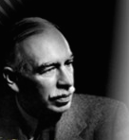
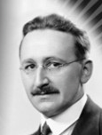
Keynes .v. Classicals: The Great Economic Debate
STARTER: Basic questions you should be able to answer based on your PREP homework and last weeks Classroom Learning
BASIC QUESTIONS
What is the difference between short run and long run equilibrium?
Which two economic indicators does the AD/AS model primarily compare?
Which is the third economic indicator which can be inferred by the negative output gap?
How do Keynes and Hayek think differently about how the Government should deal with ‘markets’ or ‘the economy’?
ADVANCED QUESTIONS
How did Keynes and Hayek differ in explaining why something like the 1929 Wall Street Crash or the 2008 Financial Crash would lead to persistent unemployment?
How did Keynes criticize Hayek’s approach to solving the unemployment problems of 1929?
How did Hayek criticize Keynes’ approach to solving the unemployment problems of 1929?
EXTENSION QUESTIONS
Hayek claimed that increased savings would lead to greater investment as banks etc would have more money for loans. However Keynes argued that is would lead to the ‘paradox of thrift’ which would make recessions worse? What does he mean?
Watch the VIDEO and try to sum up the differences between Keynes and Hayek
(7 Mins)
LINK

Slide 19
STARTER - CAUSES OF UNEMPLOYMENT RECAP
The following unemployment definitions are mixed up; you should be able to match the number to the letter. Only one number can be used with one letter.
Wage are too high which forces companies to sack workers to keep costs of production down
Workers are between jobs
Workers are choosing not to work because they are refusing to retrain or move, are lazy, or have unrealistic expectations of work.
Workers have been sacked because their skills are no longer needed either because of technological or industrial changes within the economy
Workers are being sacked but it is out of their control because the industry they worked for has collapsed and they would really struggle to move elsewhere.
Workers are being sacked because firms have to reduce their output due to a recession
VOLUNTARY
CYCLICAL (DEMAND DEFICIENT or KEYNESIAN)
REAL WAGE (CLASSICAL)
FRICTIONAL
STRUCTURAL
INVOLUNTARY
Notes:
1-c
2-d
3-a
4-e
5-f
6-b

Slide 20

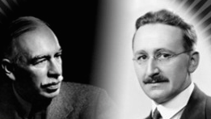
TODAY: Classicals .v Keynesians
Long Run Equilibrium Controversy (and consensus)!!!
TODAY
KEYNESIAN .v. CLASSICAL SCHOOLS OF MACROECONOMICS
CONTROVERSY - NEGATIVE OUTPUT GAP: Can long run equilibrium stay behind the LRAS for ever? The Keynesian AS Curve
CONSENSUS - POSITIVE OUTPUT GAP: Can equilibrium stay ahead of the LRAS for ever? Wage Spiral Theory.
What is the best way to grow the economy? Demand side or supply side policy?
Why do they ‘oppose’?
UK Economy
Price Level
LRAS
SRAS
P/L1
AD1
Y1
Real GDP

Slide 21

LONG RUN EQUILIBRIUM DEBATES: Keynesian and Classical Controversy
Debate 1: Can equilibrium stay behind the LRAS for ever? The Keynesian AS Theory
CONTROVERSY: Classical and Keynesian approach to unemployment and equilibrium in the long run: Whiteboards
1. CLASSICAL SOLUTION TO UNEMPLOYMENT
TASK: Draw an economy using an ADAS diagram in short run equilibrium with a negative output gap (representing unemployment). What would a classical economist argue would eventually happen to this short run equilibrium in the long run to return to full employment?
2. KEYNESIAN CRITICISM TO CLASSICAL SOLUTION OF UNEMPLOYMENT
TASK: Draw an economy using an ADAS diagram in short run equilibrium with a negative output gap (representing unemployment). What would a Keynesian economist say would eventually happen if there was no intervention?
EXTRA QUESTION TO CONSIDER: Because of ‘animal spirits’ (in other words consumer confidence), why did Keynes say that not only would we stay at the equilibrium but that the AD curve might start to fall back (shift to the left) making the output gap even worse?
3. KEYNESIAN SOLUTION TO UNEMPLOYMENT
TASK: Draw an economy using an ADAS Diagram in short run equilibrium with a negative output gap. Demonstrate what Keynes said Government’s should intervene to close the output gap back to long run equilibrium?
Why might Hayek criticize this approach? (think about why Keynes’ approach may be unsustainable.

Slide 22
LONG RUN EQUILIBRIUM DEBATES: Keynesian and Classical Controversy
Controversy 1: Can equilibrium stay behind the LRAS for ever? The Keynesian AS Theory
  CLASSICAL VIEW: Short run equilibrium will ultimately move back to the long run equilibrium (so be on the LRAS) through changes in SRAS. This is because market forces will ensure that costs of production will change to return to the LRAS as workers will accept lower real wages.
  KEYNESIAN VIEW: Short run equilibrium will not necessarily move back towards the LRAS. Therefore long run equilibrium does not need to be on the LRAS but can be behind it for long periods of time at “A”. Perhaps it would move back to the LRAS eventually but this could take an awfully long time and we may have all died by then! He even suggested that due to a lack of consumer confidence (‘animal spirits) caused by the persistent unemployment the AD curve might shift more to the left as consumers chose to save. Therefore he invented his own LRAS curve called the ‘Keynesian LRAS’ - see Diagram 2. This states that increasing aggregate demand to achieve growth would not lead to price increases (a criticism of Hayek’s towards Keynes’ ideas).
  SOLVING UNEMPLOYMENT: Classical economists think the Government should not intervene (unless it is to remove ‘rigidities’ in the labour market like Trade Unions). The market mechanism will return the long run equilibrium to the LRAS. Keynesian economists however feel the Government must intervene in the short run to grow the economy and generate unemployment because in the long run we are all dead and cannot wait for the ‘market’ to kick into action.
LRAS
Classical
AS
Keynesian
Price Level
Price Level
SRAS
P/L1
A
P/L1
A
B
AD1
AD1
AD2
Y1
Y
Real GDP
Y1
Y
Real GDP

Slide 23
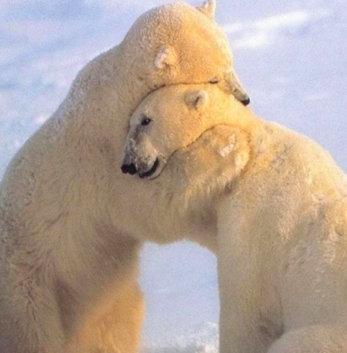
LONG RUN EQUILIBRIUM DEBATES Keynesian and Classical Consensus
Consensus 1: The AS is inelastic at it’s productive capacity? The Wage Spiral Theory
CONSENSUS: Why cannot we go past the LRAS in the long run?
Draw an economy using an ADAS diagram in long run equilibrium (include the SRAS as well).
Now imagine that the Government wishes to achieve economic growth through the demand side and so lowers income tax and raises Government spending, pushing the AD to the right creating a positive output gap
What do you think might happen on the diagram now with the SRAS curve if we assume that to increase beyond the productive capacity, firms have had to pay overtime to workers and the greater use of ‘capital’ has led to ‘depreciation’ of the tools, machinery and factories?
What has been achieved overall?

Slide 24
LONG RUN EQUILIBRIUM DEBATES Keynesian and Classical Consensus
Consensus 1: The AS is inelastic at it’s productive capacity in the LR? The Wage Spiral Theory
Shift in the AD curve due to an increase in consumer confidence
(e.g. the World Cup is on and people are more inclined to spend)
QUESTION:
Assume the UK economy is in equilibrium on the productive capacity of the economy. If consumer confidence increases because of a football world cup, using a AD/AS diagram, explain what would happen to output and prices in the short run AND the long run.
Price Level
LRAS
SRAS2
P/L 3
An increase in the price level has occurred. As more consumers wish to spend,
Output in the economy has risen from Y1 to Y2. However, the economy is using resources beyond it’s means (outside the PPF or LRAS).
Workers will be expected to work overtime for a while to produce the extra output, but eventually after higher wage demands, the SRAS will start to shift to the left as the costs of production for companies increases.
Output will fall from Y2 to Y3
The price level will continue to rise and ultimately, the increase in AD has not increased output in the long run but has only increased price levels (P/L1 to P/L3)
SRAS1
P/L 2
P/L 1
AD2
AD1
Y1
Y2
Real GDP
Y3
Y2

Slide 25
Keynesian and Classical Approaches to Solving Unemployment: A Recap
COMPLETE THIS EXERCISE WITHOUT USING YOUR NOTES
The UK recession falls into a large recession (like in 2008).
Draw a diagram to show what this might look like if you were Frederick Hayek? How would he recommend that the economy would recover?
Using another AD/AS diagram, explain how Keynes would argue against Hayek?
Using another diagram, explain why Hayek would argue against Keynes’ solution?

Slide 26
45

Slide 27
The Concept of ‘Policy Trade Offs’
When Government’s make decisions about how to deal with a recession, they often face ‘trade offs’. Some examples exist below:
Increasing AD via Government spending to reduce unemployment might lead to excessive inflation
Trying to reduce inflationary pressures via AD changes might lead to greater unemployment

Slide 28
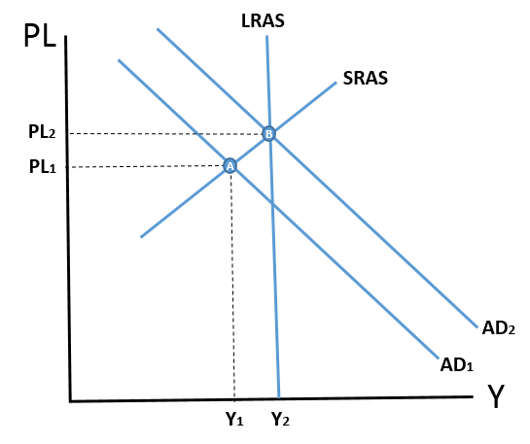
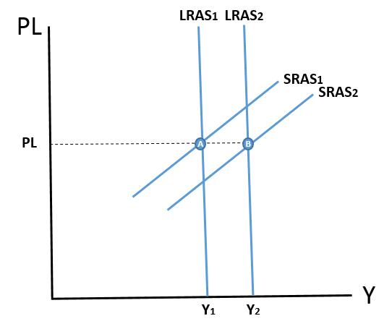
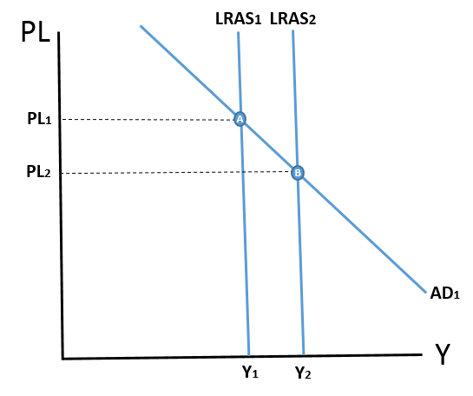
What is the best way to grow the economy?
Demand side or supply side growth?
For help with Q3
  DEMAND SIDE (SHORT RUN)
  SUPPLY SIDE (LONG RUN)
  Draw a diagram showing short run growth via the demand side
    What are the problems with demand side growth?
  Draw a diagram showing long run growth via the supply side
    What are the problems with supply side growth?
  Draw another AD/AS diagram and explain how economic growth might be achieved with stable prices? Have go!

Slide 29
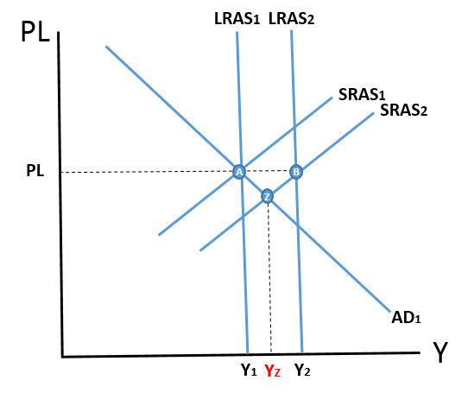
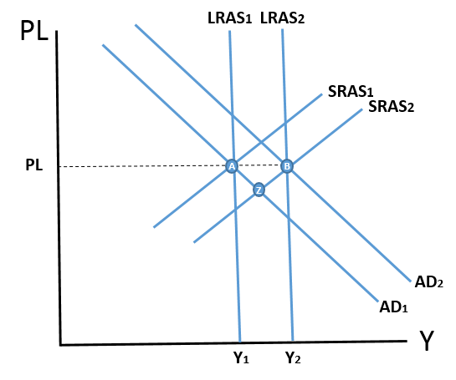
What is the best way to grow the economy?
Demand side or supply side growth?
  DEMAND SIDE (SHORT RUN)
  SUPPLY SIDE (LONG RUN)
  Draw a diagram showing short run growth via the demand side
    What are the problems with demand side growth?
  Draw a diagram showing long run growth via the supply side
    What are the problems with supply side growth?
  Draw another AD/AS diagram and explain how economic growth might be achieved with stable prices? Have go!

Slide 30
TRANSMISSION MECHANISM
WHAT WOULD HAPPEN TO THE UK ECONOMY IF THERE WAS A WORLD RECESSION?
Write down a written answer including a diagram to illustrate your answer.
(click to get an answer once you have done this)
DEFLATIONARY PRESSURES
AND A
DECREASE IN OUTPUT IN THE ECONOMY
WRITTEN ANALYSIS
DECREASE IN EXPORTS
I
UK EXPORTING FIRMS PROFITS FALLING
I
DEMAND FOR LABOUR DECREASES
I
UNEMPLOYMENT INCREASES
I
INCOMES FALL IN THE ECONOMY
I
SPENDING FALLS IN THE ECONOMY
I
UK FIRMS START TO LOSE PROFITS
I
ETC…..
DIAGRAMMATICAL ANALYSIS
EXPORTS ARE A COMPENENT OF AGGREGATE DEMAND
(AD=C+I+G+X-M)
THEREFORE IF EXPORTS DECREASE, AD WILL DECREASE TOO
Price Level
LRAS
SRAS
DEFLATIONARY
PRESSURES
P/L1
P/L2
AD1
AD2
Y2
Y1
Ŷ
Real GDP
DECREASE IN OUTPUT IN THE ECONOMY

Slide 31
TRANSMISSION MECHANISM
WHAT WOULD HAPPEN TO THE UK ECONOMY IF A TERRORIST ATTACK IN MANCHESTER HARMED CONSUMER CONFIDENCE?
Write down a written answer including a diagram to illustrate your answer.
(click to get an answer once you have done this)
DEFLATIONARY PRESSURES
AND A
DECREASE IN OUTPUT IN THE ECONOMY
WRITTEN ANALYSIS
Decrease in consumption due to uncertainty in the economy
I
UK firms lose sales and may reduce profit or make a loss, cutting back on planned investment
I
Demand for labour decreases
I
Unemployment increases
I
Incomes fall in the economy
I
Spending falls further in the economy – the de-multiplier effect begins
I
Etc…..
DIAGRAMMATICAL ANALYSIS
Consumption and investment are both a component of aggregate demand
(AD=C+I+G+X-M)
Therefore if consumption and investment decrease, AD will decrease too
Price Level
LRAS
SRAS
DEFLATIONARY
PRESSURES
P/L1
P/L2
AD1
AD2
Y2
Y1
Ŷ
Real GDP
DECREASE IN OUTPUT IN THE ECONOMY

Slide 32
EXERCISES
What would happen to the UK economy in the following situations?
There was a fall in income tax?
There is a world recession?
The price of raw materials increases?
Public sector workers receive pay increases
Hurricane Olly strikes the North Sea Oil Fields in Scotland
The dollar falls from $1.80 to £1 to $2 to £1
FOR EACH QUESTION:
Draw a diagram
Identify whether AD or SRAS is affected
Explain the “transmission mechanism” involved (which factor has been affected and why?)
What would happen to the price level (inflation) and the output (economic growth)

Slide 33
Production Possibility Frontier
Advanced Model: Representing Capacity in the Economy
    What does the AD, SRAS and LRAS represent?
    Which letter is the economy at in equilibrium?
    What might this point represent within the economy (gap between y and Y)?
    How might Government’s move from A-B
    What factors might move the economy from A to E?
    Can the economy be at D?
    Using an AD/AS diagram….
    Demonstrate economic growth as a result of expansionary fiscal policy
    Demonstrate the effects on inflation of this economic growth
    Demonstrate how unemployment might rise as a result of tight monetary policy
    What impact would higher oil prices have on macroeconomic indicators?
LRAS
Price Level
SRAS
(5) Demonstrate the effect of increases in education on long run economic growth
(6) Demonstrate the effect on the Haitian economy of a massive earthquake
B
PL
A
D
E
C
AD
y
Y
Real GDP (Output)

Slide 34
END

Slide 35
Where are we?
https://www.youtube.com/watch?v=d8uTB5XorBw

Slide 36
AD
(Aggregate Demand)
Define the factors causing a movement along and a shift in the aggregate demand and aggregate supply curves
Alistair Darling in his recent budget decides to spend more money on the NHS. Government spending has increased and the AD curve shifts to the right.
MOVEMENTS ALONG THE CURVES
P/L – Price Level
(e.g. inflationary or deflationary pressures)
Price Level
LRAS
SHIFTS IN THE CURVES
SRAS
C – Consumption
(e.g. spending by households)
I – Investment
(e.g. spending by firms)
G – Government Spending
(e.g. spending by Governments)
(X-M) – Exports - Imports
(e.g. the trade balance)
P/L2
An increase in the price level results from the extra demand for goods and services needed to implement the Government’s new spending plans.
The higher price level has persuaded many firms to increase their production to meet the new demand (represented by a movement along the AD curve)
Output in the economy has increased from Y1 to Y2
P/L1
AD2
AD1
Y1
Y2
Real GDP

Slide 37
Define the factors causing a movement along and a shift in the aggregate demand and aggregate supply curves
SRAS
(Aggregate Supply)
Price Level
Shift in the SRAS curve due to a rise in the costs of production for all firms in the economy
(e.g. because of an increase in the price of raw materials)
LRAS
SRAS2
SRAS1
MOVEMENTS ALONG THE CURVES
P/L2
Changes in the price level have caused a movement along the AD curve. In other words, inflationary pressures caused by the rise in costs for firms, has led to a fall in total demand in the economy.
Output in the economy has fallen from Y1 to Y2
P/L – Price Level
(e.g. inflationary or deflationary pressures)
P/L1
AD
Y2
Ŷ
SHIFTS IN THE CURVES
Real GDP
SRAS – Costs of Production
(e.g. taxation, wages, raw materials)

Slide 38
Define the factors causing a movement along and a shift in the aggregate demand and aggregate supply curves
LRAS
(Aggregate Supply)
MOVEMENTS ALONG THE CURVES
P/L – Price Level
(e.g. inflationary or deflationary pressures)
LRAS1
LRAS2
Shift in the LRAS curve due to better trained workers
(e.g. because of an improvement in the Government’s education policy)
SHIFTS IN THE CURVES
A fall in the price level have caused a movement along the AD curve. In other words, deflationary pressures caused by more goods and services being produced as a result of a more productive workforce, has led to an increase in total demand in the economy – consumers and firms are now able to by more products.
Output in the economy has risen from Y1 to Y2
LRAS – Quality and Quantity of Labour and Capital
(e.g. An extra factory would add to the quantity of capital and better technology would add to the quality of capital)
(e.g. More workers willing to supply their labour would add to the quantity of labour and better trained/educated workers would add to the quality of labour)
P/L1
P/L2
AD
Y1
Y2
Real GDP

Slide 39
AGGREGATE DEMAND
PRICE LEVEL
Factors affecting demand:
C = Consumption
I = Investment
G = Government Spending
X-M = Exports-Imports
AD
(Aggregate Demand)
REAL NATIONAL INCOME /
OUTPUT

Slide 40
AGGREGATE SUPPLY – short run
Factors affecting supply in the short run (movement along the curve):
(1) Price Level
Factors affecting supply in the short run (shift the curve):
Costs of production:
(1) Raw material prices faced by firms
(2) Wage rates faced by firms
(3) Taxation on firms
PRICE LEVEL
SRAS
(Short Run Aggregate Supply)
REAL NATIONAL INCOME /
OUTPUT

Slide 41
MACROECONOMIC EQUILIBRIUM – short run
EXERCISE:
Explain what will happen to economic growth and inflation by drawing a short run macroeconomic AD/SRAS diagram (use bullet points with a very brief explanation) for the following situations:
(1) An increase in consumer confidence
(2) An increase in income tax
(3) Rise in oil prices

Slide 42
AGGREGATE SUPPLY – long run
PRICE LEVEL
LRAS
(Long Run Aggregate Supply)
Factors affecting supply in the long run:
Improving resources in the economy – e.g. labour AND capital.
By improving the quantity (amount) and quality (productivity) of labour and capital, the productive capacity of the economy increase.
REAL NATIONAL INCOME /
OUTPUT

Slide 43
MACROECONOMIC EQUILIBRIUM – long run
PRICE LEVEL
LRAS
EXERCISE:
Explain what will happen to economic growth and inflation by drawing a LONG run macroeconomic AD/LRAS diagram (use bullet points with a very brief explanation) for the following situations:
(1) Extra education and training improves the productivity of workers
(2) A world war that destroys large parts of the UK
(3) Improvements in computer technology
AD
REAL NATIONAL INCOME /
OUTPUT

