Slide 1
WEEK 6

Slide 2
90

Slide 3
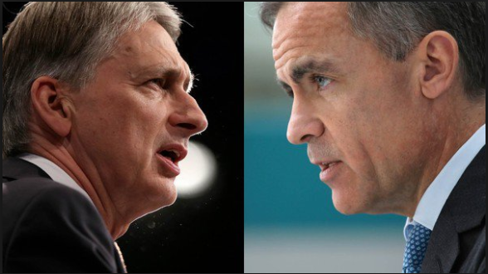
RWS7, 8 and 9: MACROECONOMICS Government Policy and International Economics
Week 6: Benchmark 3 Week
SPRING HALF-TERM
Week 1: Student 1-2-1 Week
Week 2: RWS7
Week 3: RWS7
Week 4: RWS8
Week 5: RWS8
Week 6: Exam Review Week
Week 7: Benchmark 4 Week
EASTER
Week 1: Student 1-2-1 Week
Week 2: RWS9
Week 3: RWS9
Week 4: Exam Review
Week 5: Exam Review
SUMMER HALF-TERM
Week 1: Mock Exam
Week 2: Mock Exam Feedback
Week 3: Students 1-2-1 Week and Predicted Grades
Week 4: RWS10
Week 5: RWS10
SUMMER HOLIDAYS
RWS7 = Demand Side Policies (Fiscal and Monetary Policy)
RWS8 = Supply Side Policies (Free Market and Interventionist)
RWS9 = International Economics (Balance of Payments and Exchange Rate Systems)
Notes:
5

Slide 4
STARTER: Introduction to Banking - How much do you know? As you arrive, write answers to the following tasks in the first 5 minutes using the worksheets on the desk…the questions get harder as they go down.
What is debt?
What is ‘interest’ and how does it relate to debt?
Why is debt ‘bad’?
Why is debt ‘good’?
Banks are firms that deal with debt? How do banks make profit?
What is the difference between a commercial and investment bank? Do you know?
TODAYS LESSON: Introduction to the Financial Crash 2007-08
Stage 1: The Concept of Debt
Stage 2: Bank Basics - how do banks make money?
Stage 3: Bank Advanced - how do banks use leverage on their balance sheets?
Stage 4: Causes of the financial crisis 2007-08

Slide 5
STARTER: Introduction to Banking - How much do you know? As you arrive, write answers to the following tasks in the first 5 minutes using the worksheets on the desk…the questions get harder as they go down.
What is debt?
What is ‘interest’ and how does it relate to debt?
Why is debt ‘bad’?
Why is debt ‘good’?
Banks are firms that deal with debt? How do banks make profit?
What is the difference between a commercial and investment bank? Do you know?

Slide 6
Stage 1: The Concept of Debt Buying and Selling Debt - Debt Packages
What are the “income streams” from debt?
Buying and selling debt
Notes:
Have a discussion about whether financial markets are positive in promoting development?

Slide 7
Stage 2: Bank Basics How do banks work?
How does a bank make money?
Issuing Loans
Selling ‘Debt Packages’
What is a balance sheet?
Balance sheet for Olly
Assets
House £544,000
Deposits in Bank £5,000
Car £5,000
Stuff I own £10,000
Pension £40,000
Total £604,000
Liabilities
House owned by bank £300,000
Credit Card Debt £1,000
Car Loan £1,000
Total £302,000
Equity £302,000
Total Liabilities & Equity £604,000
Balance sheet for Royal Bank of Scotland in 2008
Assets Millions
Balance at central bank £17,866
Treasury Bills/Bonds £18,229
Loans £1,048,710
Derivatives £337,410
Other £478,304
Total £1,900,519
Liabilities
Deposits by banks £312,663
Deposits by customers £682,365
Other £814,065
Total £1,809,093
Equity £91,246
Total Liabilities & Equity £1,900,519
Notes:
Have a discussion about whether financial markets are positive in promoting development?

Slide 8
Stage 2: Bank Basics - Magic Money! The importance of credit: Why is banking so important to the economy
LIABILITIES | ASSETS
£200 Total £200 Deposit from Saver 1 | £200 Total £160 Shares of Firm 1 £40 in Cash Reserve (20% of total Liabilities)
£360 Total £200 Deposit from Saver 1 £160 Deposit from Firm 1 | £360 Total £160 Shares of Firm 1 £128 Shares in Firm 2 £72 in Cash Reserve (20% of total Liabilities)
£488 Total £200 Deposit from Saver 1 £160 Deposit from Firm 1 £128 Deposit from Firm 2 | £488 Total £160 Shares of Firm 1 £128 Shares in Firm 2 £102.40 Loan for House £97.60 in Cash Reserve (20% of total Liabilities)
£590.40 Total £200 Deposit from Saver 1 £160 Deposit from Firm 1 £128 Deposit from Firm 2 £102.40 Deposit from Firm 3 | £590.40 Total £160 Shares of Firm 1 £128 Shares in Firm 2 £102.40 Loan for House £81.92 for……. £118.08 in Cash Reserve (20% of total Liabilities)
SAVER
Bank buys £160 worth of shares in Firm 1
FIRM 1
FIRM 1
Bank buys £128 worth of shares in Firm 2
FIRM 2
FIRM 2
Bank loans £102.40 to consumers to buy a house
FIRM 3
(House building Firm)
Household
FIRM 3
(House building Firm)
Bank uses £81.92 for…….
????????
Notes:
Have a discussion about whether financial markets are positive in promoting development?

Slide 9
Stage 2: Bank Basics - Magic Money! The importance of credit: Why is banking so important to the economy
LIABILITIES | ASSETS
£200 Total £200 Deposit from Saver 1 | £200 Total £160 Shares of Firm 1 £40 in Cash Reserve (20% of total Liabilities)
£360 Total £200 Deposit from Saver 1 £160 Deposit from Firm 1 | £360 Total £160 Shares of Firm 1 £128 Shares in Firm 2 £72 in Cash Reserve (20% of total Liabilities)
£488 Total £200 Deposit from Saver 1 £160 Deposit from Firm 1 £128 Deposit from Firm 2 | £488 Total £160 Shares of Firm 1 £128 Shares in Firm 2 £102.40 Loan for House £97.60 in Cash Reserve (20% of total Liabilities)
£590.40 Total £200 Deposit from Saver 1 £160 Deposit from Firm 1 £128 Deposit from Firm 2 £102.40 Deposit from Firm 3 | £590.40 Total £160 Shares of Firm 1 £128 Shares in Firm 2 £102.40 Loan for House £81.92 for……. £118.08 in Cash Reserve (20% of total Liabilities)
SAVER
Bank buys £160 worth of shares in Firm 1
FIRM 1
FIRM 1
Bank buys £128 worth of shares in Firm 2
FIRM 2
FIRM 2
Bank loans £102.40 to consumers to buy a house
FIRM 3
(House building Firm)
Household
FIRM 3
(House building Firm)
Bank uses £81.92 for…….
????????
Notes:
Have a discussion about whether financial markets are positive in promoting development?

Slide 10
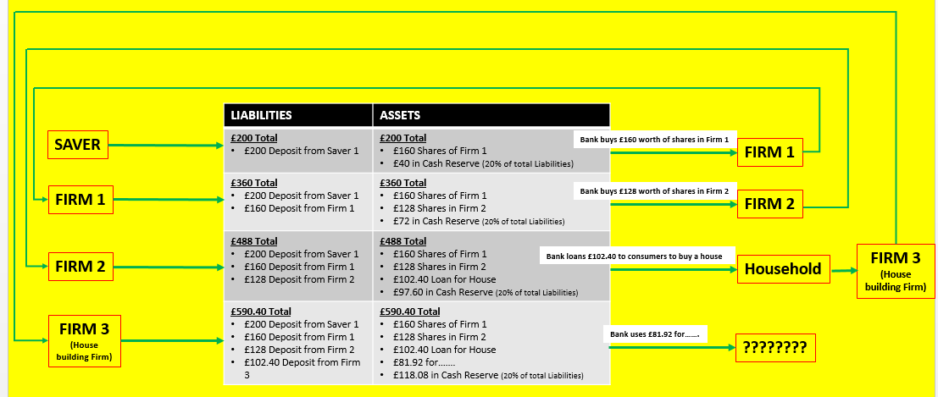
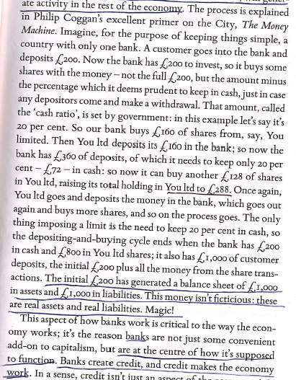
Stage 2: Bank Basics - Magic Money The importance of credit: Why is banking so important to the economy
MAGIC MONEY EXPLAINED
Notes:
Have a discussion about whether financial markets are positive in promoting development?

Slide 11
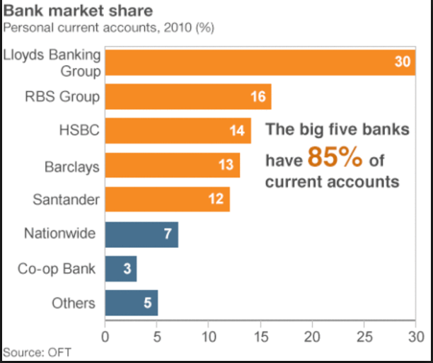
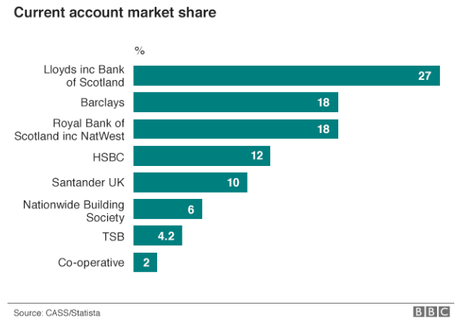
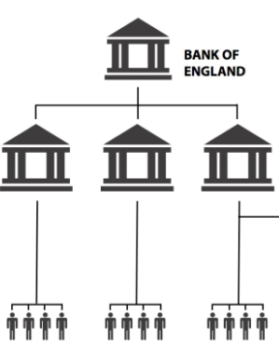
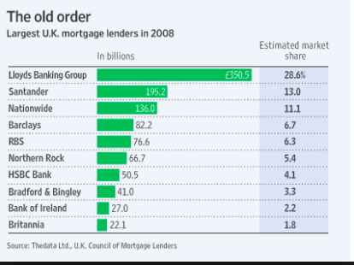
Stage 2: Bank Basics The Overall Banking System: The Role of the Central Bank and the UK Banking Market
2015
Deposits
PRIVATE BANKS
Deposits
Deposits
Deposits
SAVERS
Notes:
Have a discussion about whether financial markets are positive in promoting development?

Slide 12
Stage 3: Banks Advanced Bank Balance Sheets, Leverage and Zombie Banks
What is a balance sheet?
How do banks and business balance sheets differ?
Balance sheet for Royal Bank of Scotland in 2008
Assets Millions
Balance at central bank £17,866
Treasury Bills/Bonds £18,229
Loans £1,048,710
Derivatives £337,410
Other £478,304
Total £1,900,519
Liabilities
Deposits by banks £312,663
Deposits by customers £682,365
Other £814,065
Total £1,809,093
Equity £91,246
Total Liabilities & Equity £1,900,519
Balance sheet for Olly
Assets
House £544,000
Deposits in Bank £5,000
Car £5,000
Stuff I own £10,000
Pension £40,000
Total £604,000
Liabilities
House owned by bank £300,000
Credit Card Debt £1,000
Car Loan £1,000
Total £302,000
Equity £302,000
Total Liabilities & Equity £604,000
Notes:
Have a discussion about whether financial markets are positive in promoting development?

Slide 13
Stage 3: Banks Advanced Bank Balance Sheets, Leverage and Zombie Banks
APPLE 2008
Assets £30 Billion
Liabilities £12 Billion
Equity £18 Billion
Leverage 0.66 to 1
Under leverage - could pay off liabilities and keep business
What is 'leverage'? Extracting money from money!
Solvency and insolvency
Definition of Liquidity
What are Zombie banks?
OLLY
Assets £604,000
Liabilities £302,000
Equity £302,000
Leverage 1 to 1
Very safe = can pay off liabilities and keep assets
Banks Leverage as of 2008
Barclays 62 to 1
UBS 47 to 1
HSBC 20 to 1
Deutsche Bank 53 to 1
Lloyds TSB 34 to 1
RBS 20 to 1
If Olly Leveraged like this?
62 to 1 = £18,724,000 of Assets
RBS 2008
Assets £1900 Billion
Liabilities £1,809 Billion
Equity £91 Billion
Leverage 20 to 1
Borrowing 20 times more than can pay back without losing assets. Will only keep 91 billion which is very small for a large organisation like RBS
Notes:
Have a discussion about whether financial markets are positive in promoting development?

Slide 14
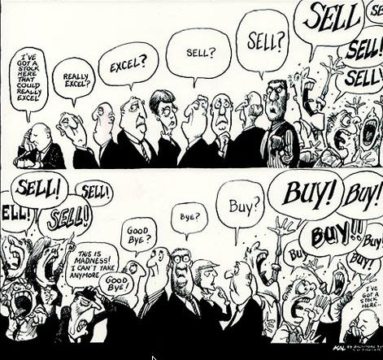
Stage 4: The Crisis of Credit The Causes of the Financial Crisis 2007-08
VIDEO1 - 11m
VIDEO2 - 9m
KEY TERMS
Derivatives (a financial instrument that derives it’s value from an underlying asset)
Sub-prime mortgages (loans to people who are high risk borrowers)
Leverage (borrowing money to make greater profit)
CDO’s = Collateral Debt Obligations (Mortgage backed derivatives)
CDS’s = Credit Default Swaps (insurance against derivatives going bad)
Financial Crash 2017? Documentary
Notes:
Class Exercise: 15
Watch Videos: 25
Write Notes: 15

Slide 15
WEEK 1

Slide 16
30

Slide 18
Stage 4: The Crisis of Credit The Causes of the Financial Crisis 2007-08
VIDEO1 - 11m
VIDEO2 - 9m
KEY TERMS
Derivatives (a financial instrument that derives it’s value from an underlying asset)
Sub-prime mortgages (loans to people who are high risk borrowers)
Leverage (borrowing money to make greater profit)
CDO’s = Collateral Debt Obligations (Mortgage backed derivatives)
CDS’s = Credit Default Swaps (insurance against derivatives going bad)
Financial Crash 2017? Documentary
Notes:
Class Exercise: 15
Watch Videos: 25
Write Notes: 15

Slide 19
WEEK 2

Slide 20
90

Slide 21
STARTER ACTIVITY (30) INSTRUCTIONS (In threes): First 10 minutes you will need to complete the two tasks below as there will be a classroom discussion afterwards and you may get picked upon! So make sure you are able to at least attempt an answer.
Compare your answers to the worksheet and write a “?” Next to areas where there are differences and you are not sure.
Make a list of all the possible advantages and disadvantages of using demand side policies to influence the economy
Advantage of Demand Side Policies
UNEMPLOYMENT CONTROL: (negative output gap): Boost the economy in the short run - good for emergencies like recessions or other sudden crashes
INFLATION CONTROL: Demand management - controlling AD is like controlling the reins of the economy! Can keep inflation under control.
Disadvantage of Demand Side Policies
POLICY CONFLICTS: Inflationary issues - wage spiral? Can be used for political purposes and not the good of the economy?
INCOMPLETE MODEL? Hard to know where we are on this graph? Inadequate data etc? Also multiplier leads to greater effects?
SUSTAINABILITY: Too much debt, liquidity trap etc.
UNINTENDED EFFECTS: ‘Fiscal Crowding Out’? ‘Credit Crunch’?
Notes:
LESSON PLAN
W190:
30: RECAP Booklet
30: Multiple Choice Questions and 9 Mark Question
30:
W230:
30: Response to the Financial Crisis
W290:
30: Monetary Debate
30: Fiscal Debate
30: Evaluating Monetary and Fiscal Policy

Slide 22
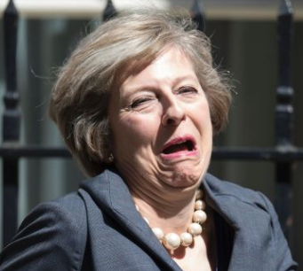
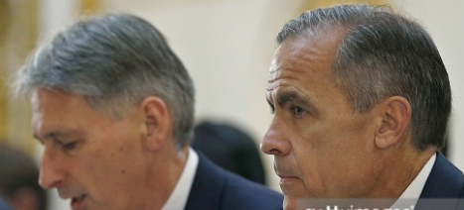
RWS7: Demand Side Policies By the end of the next three weeks
Week 1
Define monetary and fiscal policy - what are these policies, who operates them and a brief history
Economic analysis - use AD/AS Macroeconomic equilibrium to explain the impact on three macroeconomic indicators (Growth, Inflation, Unemployment). Also be aware of the impact on the 4th indicator (Balance of Payments)
Week 2
Post Financial Crash of 2008 - what was the role of demand side policies in helping the economy recover from recession?
Debates - the role of quantitative easing and the sustainability of debt
Evaluating the role of demand side policies in the macroeconomy

Slide 23
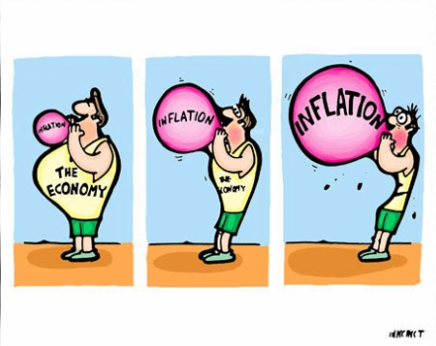
RWS7: Demand Side Policies By the end of these two weeks
TASK 1: Complete the multiple choice questions in 10 minutes
How is the balance of payments deficit different from the budget deficit
Remember higher incomes tend to mean an increasing balance of payments deficit - why?
TASK 2: Spend 10 minutes looking at your wrong answers in threes and working out why they were wrong
TASK 3: Attempt to answer question 03 (9 marker) in note form. What macroeconomic equilibrium analysis would you use (AD/AS diagram!) and why?

Slide 24
WEEK 3

Slide 25
30

Slide 26
Financial Crash Response from the UK Government
A3 SHEET GIVEN OUT IN CLASS

Slide 27
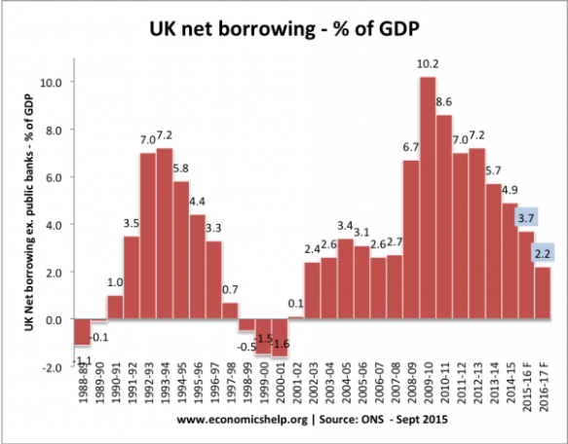
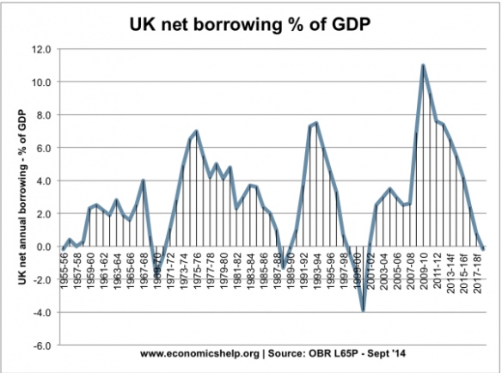
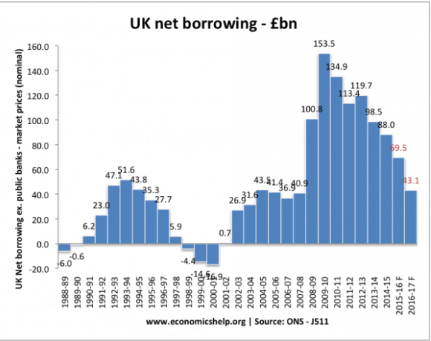
Notes:
http://www.economicshelp.org/blog/334/uk-economy/uk-national-debt/

Slide 28
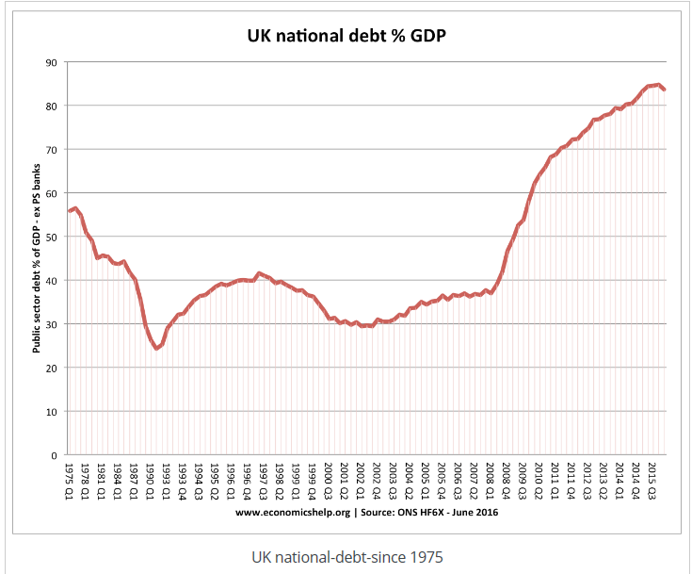
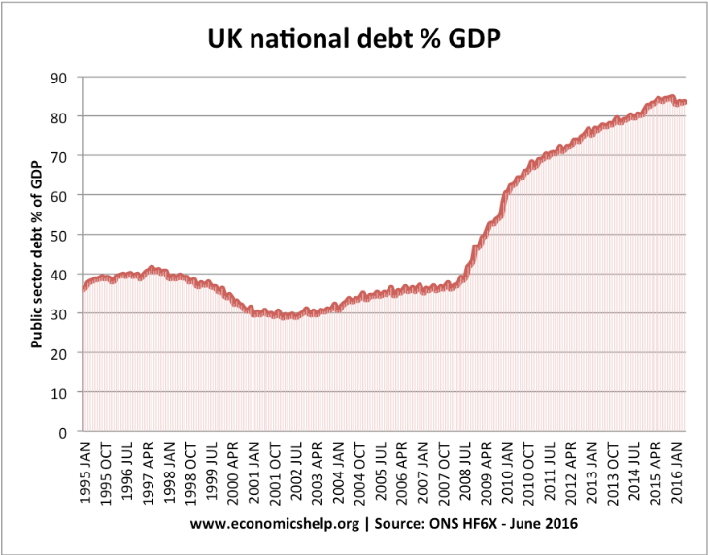
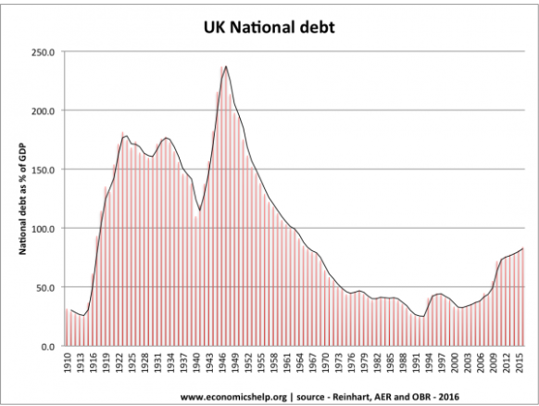

Slide 29
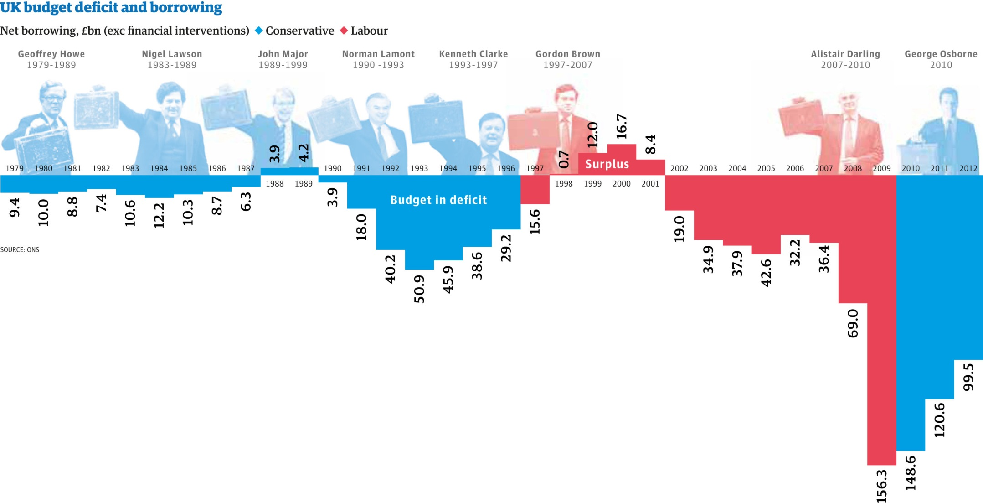

Slide 30
90

Slide 31
RWS7: Demand Side Policies By the end of these two weeks
Week 1
Define monetary and fiscal policy - what are these policies, who operates them and a brief history
Economic analysis - use AD/AS Macroeconomic equilibrium to explain the impact on three macroeconomic indicators (Growth, Inflation, Unemployment). Also be aware of the impact on the 4th indicator (Balance of Payments)
Week 2
Post Financial Crash of 2008 - what was the role of demand side policies in helping the economy recover from recession?
Debates - the role of quantitative easing and the sustainability of debt
Evaluating the role of demand side policies in the macroeconomy

Slide 32
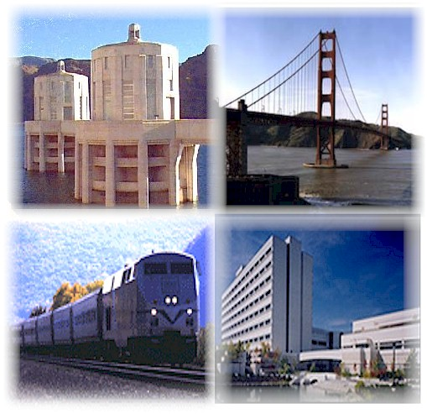
“Day to Day” and “Investment” Spending

Slide 33
Types of ‘Budget’ you might hear in the news
Cyclical .v. Structural Budget Deficit / Surplus
On the diagram on the left, using the theory of ‘Automatic Stabilisers’, would we be in a budget surplus or deficit or balance at each point?
2002-2007: Accusations of a structural deficit under Gordon Brown
Primary .v. Total Budget
Primary budget is the budget with the cost of borrowing taken out
Let us say that the Total Greek Budget is in a deficit of 10% and the cost of borrowing for the Greek Government (payments on interest) is high at 12%
What is the primary budget?
Greek economy: Running a 2 % primary surplus
GDP %
B
F
A
C
E
Time
D

Slide 34
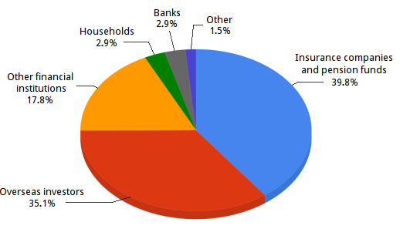
UK Government Borrowing
Government Bonds (Gilts)
Coupons, yield and
Bond markets and the price of bonds
Why are bond prices and yields inverted?
What does this mean for Government borrowing?

Slide 35
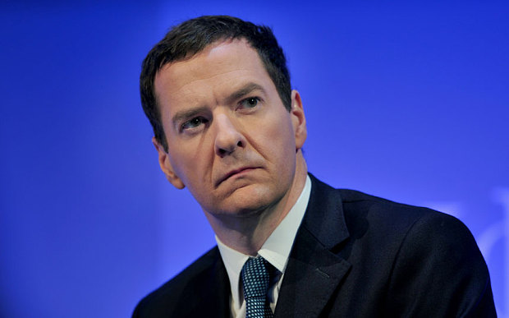
The Importance of Fiscal Rules
The UK Rules from various Chancellor of the Exchequer
1997-2007: Gordon Brown’s ‘Golden Rule’
2007-2010: Alastair Darling’s ‘Fiscal Stimulus’ through greater Government spending
2010-2016: George Osborne’s ‘Balance the Books’ through Austerity
2016-today: Philip Hammond: “Flexible Austerity”
Eurozone - Growth and Stability Pact
1992 to today: Deficit can be no more than 3% of GDP per year
QUESTIONS:
Why are fiscal rules so important?
Why might setting fiscal rules be a waste of time?

Slide 36
FORMAT OF THE DEBATES
2 minutes: INDIVIDUAL RESEARCH
With your assigned ‘side’ to the argument, you need to individually cement your arguments into your heads
5 minutes: DEBATE
Each side needs to state their case and pick holes in the other argument
5 minutes: CONCLUSION
Have to agree on a conclusion.
If there is a disagreement, you need to ‘compromise’
8 minutes: CLASS FEEDBACK
One member of the groups states the position
One member supports this position
One member defends their position (from my attacks!)

Slide 37
Quantitative Easing History
US (total: $3.7-$4.5 trillion)
QE1 – 2008: $1.7 trillion over 14 months to buy up CDO’s
QE2 – 2010: $600 billion to buy up Govt Bonds
QE3 – 2012-2014: $85 billion per month to buy up Bonds and CDO’s
UK (£375 billion)
2009 - £200 billion
Oct 2011 - £75 billion
Feb 2012 - £50 billion
July 2012 - £50 billion

Slide 38
DEBATE 1: Has the Bank of England’s policy of QE been successful?
SUCCESSFUL
BOOST AD: Interest rates can only do so much (liquidity trap). Increasing the money supply should shift the AD curve to the right and generate greater output.
Greater employment from 2010 to 2013. Bad effects of BREXIT referendum averted by cuts in interest rates and QE Extension.
Cheaper exports because of weaker exchange rate
Confidence boosted – the Bank of England are doing something.
DEBT CHEAPER: Buying Government bonds (debt) leads to an increase in price which means the ‘yield’ falls which means borrowing is cheaper for the Government.
NOT SUCCESSFUL
ASSET BUBBLE? Stockmarkets on the rise and house prices rising especially in the South East. Wealthier people have greater access to credit again. Sustainable in the long run?
DELAYED RECOVERY: After a promising recovery until 2010, from 2010-2013, economic performance still disappointing. Banks too cautious with lending and consumer/business confidence still low. Inflation higher in 2010-13 but output not.
WEAKER EXCHANGE RATE: Good for exports but commodity import prices have and are increasing.
FUTURE UNCERTAIN: QE is an untried policy! When QE ends will Bond market collapse? Will hoarding banks suddenly start lending and creating inflation?
RELIED ON BY COALITION GOVERNMENT 10-15: Reinforced their policy of ‘Austerity’ as they relied on monetary policy to boost the economy.

Slide 39
Quantitative Easing Will it work?
http://www.bankofengland.co.uk/monetarypolicy/pages/qe/default.aspx
RECOVERY –
GROWTH - UK economy hit 2.6% GDP growth in 2014. Also, claims that economy has had an extra 3% added to growth over this period
JOBS - Unemployment falling in the UK since 2010. Also falling in the US.
CONFIDENCE – Especially given Austerity, QE important to give firms and households hope that measures being taken to get out of the ‘Great Recession’
EXPORT BOOST – devaluation of currency might occur as investors sell pounds in anticipation of higher inflation.
GOVERNMENT BORROWING – cheaper as bond prices increase and yields fall.
INCREASED LENDING
Cost of borrowing falling as BofE buys up bonds and drives up the price of assets whilst yields (rates of borrowing) fall.
Government’s also face lower borrowing costs
BEATS LIQUIDITY TRAP
RECOVERY? –
‘MAC JOBS’ - New jobs created are part-time? Is the recovery delayed and just part of the natural economic cycle?
INEQUALITY – only benefitting wealthy individuals who own shares and bonds?
EXPORT BOOST? – Export growth has been very slow in the UK and the exchange rate has not fallen hugely and is in fact on the rise against other currencies (Euro and Dollar)
LACK OF LENDING: Complaints that small businesses and home buyers are unable to access loans
ZOMBIE BANKS – to ensure dodgy assets on the balance sheet match banks liabilities, many banks maybe officially insolvent. Therefore they are hoarding the extra cash to ensure their books balance
GOVERNMENT BOND FOCUS – criticisms that too much focus on buying Govt. bonds rather than corporate bonds which would have had a more direct impact for business and reduced the cost of borrowing
FAILED ELSEWHERE
Japan started in 2001 to combat deflationary spiral has not worked
US – similar issues to the UK
MORE DEBT – a system based upon banks lending even more money is not sensible in a debt riddled economy?
LONGER TERM PROBLEMS
INFLATIONARY EXPECTTIONS– What happens when the extra cash generated starts circulating more quickly? Danger of sudden inflation in the longer term? Increases volatility
STOCKPILE OF BONDS – what does the central bank do with all these assets? A firesale would result in bond prices crashing and yields increasing- cost of borrowing would soar.
ASSET BUBBLES – danger that QE just leads to asset bubbles in the housing market etc.

Slide 40
DEBATE 2: How sustainable is our debt? Should the Government prioritise it’s reduction?
PRIORITISE
UK A CREDIT RISK? Avoid a crisis similar to Greece. Debt now at 80% of GDP.
RESPONSIBILITY TO FUTURE GENERATIONS: Need to reduce debt otherwise future generations paying.
CROWDING OUT: Too much Government spending uses scarce resources which the private sector could be using. Leads to productivity issues for the UK.
DON’T WORRY
LOW COMPARED TO OTHER COUNTRIES: USA and Japan have much higher percentages of GDP in terms of Government debt.
REDUCTION = AUSTERITY: Counter intuitive in times of uncertainty (Trump, Brexit). Reduction in short term output because of AD shifts to the left.
WE ARE NOT GREECE: UK has a strong economy and historic legacy. Investors will still want to buy up our bonds.

Slide 41
Monetary Policy A useful tool for Government?
RESPONSIVE – Aggregate demand responds to changes in interest rates (interest rate elastic). Changes to interest rates tend to have instant effects on confidence within the economy
FLEXIBLE - it changes more frequently (monthly) than say fiscal policy. Also there are three policy levers – interest rates, money supply and exchange rates
INDEPENDENCE – Removed from Government influence leads to experts making the right decision for the economy and not reelection
GOLDILOCKS ECONOMY - Good way to control inflation. Death of inflation since 1990’s when interest rates and inflation targetting
POLICY CONFLICT – Controlling inflation leads to issue with unemployment, output and balance of payments
LEVERS ARE LIMITED
LIQUIDITY TRAP) – nominal interest rates cannot fall below 0% in reality and so there are limitations; see Japan and arguably UK and Eurozone currently?
MONEY SUPPLY - Problems with Quantitative Easing (banks unwilling to lend) and Money Supply. Issues with controlling money supply because it’s hard to define.
GEOPOLITICAL? Exchange rate manipulation can cause geopolitical issues as well.
LACK OF MICROECONOMICS: Microeconomic tools like fiscal policy.
ONE SIZE FITS ALL– Dual economy; a booming service sector .v. declining manufacturing leads to the need for different monetary policy. Equally, regional disparities (poor North .v. rich South).
TIME LAG – estimated to be 1 year on output and 2 years on price levels. Makes it very hard to use the policy and does this make it inflexible?
INDEPENDENCE? – How independent is the BofE? Governor still appointed by Government and still accountable to Govt.
FINANCIAL CRISIS and ASSET BUBBLE – Did the BofE keep interest rates to low in the lead up to the financial crisis? Led to asset bubble.

