Slide 1
SCHEME OF WORK
WEEK 1
WEEK 2
PREP HWK:
The UK Productivity Puzzle (1hr)
History of Supply Side Policies (1hr)
30 MINUTES:
What are supply side policies (and fiscal policies)
Interventionist .v. Free Market Supply Side Policies (pp 17-18)
90 MINUTES:
AD/AS Analysis and Supply Side Policies
Policy Conflicts using AD/AS Analysis
RWS HWK:
30 MINUTES:
PREP Assessment – Productivity Puzzle (AD/AS Exercise and Discussion)
90 MINUTES:
45: Evaluating History of Supply Side Policies
45: Essay Plan

Slide 2
WEEK 1

Slide 3
30+90

Slide 4
RWS 8: Supply Side Policies
THE BIG QUESTION FOR THIS WEEK
What are supply side policies and how do they effect the economy?
In other words:
Defining ‘supply side policies’ and ‘free market’ v ‘interventionist’ policies
Using AD/AS Analysis and PPF Analysis to describe the effect of supply side policies on the macroeconomy
Comparison with fiscal policy and the importance of fiscal rules

Slide 5
Defining SUPPLY SIDE Policies
Real life examples from 1980’s until Today
Coalition Government of 10-15 proposed a new HS2 project to build a high speed railway from Birmingham to London
Introducing the minimum wage in 1998 by New Labour (Tony Blair and Gordon Brown)
Changing the minimum wage to the living wage and increasing it by George Osborne in 2015
Cutting corporation tax – the Coalition Government cut this tax from 2010 to 2015 from 28% to 20%. Further plans from the Conservatives are to reduce it further to 17% by 2020 (and maybe down to 15%)
Cutting income tax – the Coalition Government cut the top rate of income tax (those earning over £150,000) from 50% of income to 45%
Margaret Thatcher passed legislation in the 1980’s which severely restricted the power of trade unions. The trade unions ability to fight for the rights and wages of it’s workers have been curtailed
Introduction of T-levels (technical equivalent of A-levels) by 2020 introduced in the 2017 Budget by Philip Hammond, the Conservative Chancellor
New Labour from 1997 to 2010 significantly increased spending on education and the NHS in their time in office
Cutting income tax – the Coalition Government raised the personal allowance of income tax (the amount of income that all workers do not have to pay tax on) from £6500 in 2010 to 11000 in 2016-17 and the plan is for it to increase to 12000 for 2017-18
Recent budget of 2017, pledged 16 million to develop 5G mobile phone technology and 200 million for local broadband networks
The Coalition Government cut welfare benefits by £17billion from 2010-2015 (most cuts coming from not increasing working age benefits in line with inflation with many being frozen or cut)
TASK: For each task, refer to all 11 examples to the right before moving onto the next task.
Classify each policy into free market or interventionist policies

Slide 6
Defining SUPPLY SIDE Policies
Free Market (or non-interventionist) v Interventionist
What do Supply Side Policies do to our economy?
Definitions RECAP (Two Political Kinds)
  Free market (non-interventionist) are policies which remove the influence of the Government – e.g. tax cuts
  Interventionist policies are direct interventions by the Government – e.g. spending on education and healthcare
Policies which affect the supply side of the economy (so the LRAS) by increasing the output of labour and capital through improvements in quality and quantity of these resources
Improve the productive capacity of the economy which impacts on macroeconomic indicators (how?):
  Economic growth increases Y1 to Y2)
  Deflationary pressures (PL falls) (or disinflation?)
  Unemployment? At productive capacity there is potentially 0 unemployment? Perhaps we can say that employment has increased as growth has? But then maybe the increase in output is due to technology changes only? Could we say that the economically inactive (not unemployment) has fallen? Or that there is more immigration to explain the extra employment?
  Balance of Payments (Current Account) may improve or may worsen….…(why? Think exports impact of price levels falling and import impact of potentially higher incomes for UK consumers….)
TASK: Draw this diagram in your notes and explain what impact a supply side policy might have on the diagram?
LRAS1
LRAS2
Shift in the LRAS curve due to better trained workers
(e.g. because of an improvement in the Government’s education policy)
A fall in the price level have caused a movement along the AD curve. In other words, deflationary pressures caused by more goods and services being produced as a result of a more productive workforce, has led to an increase in total demand in the economy – consumers and firms are now able to by more products.
Output in the economy has risen from Y1 to Y2
P/L1
P/L2
AD
Y1
Y2
Real GDP

Slide 7
Defining SUPPLY SIDE Policies
Real life examples from 1980’s until Today
TASK: For each task, refer to all 11 examples to the right before moving onto the next task.
Explain why they might increase the productive capacity of the economy (refer to the concepts of quantity and quality of labour and capital)
Can you evaluate why this might not work?
Coalition Government of 10-15 proposed a new HS2 project to build a high speed railway from Birmingham to London
Introducing the minimum wage in 1998 by New LAbour (Tony Blair and Gordon Brown)
Changing the minimum wage to the living wage and increasing it by George Osborne in 2015
Cutting corporation tax – the Coalition Government cut this tax from 2010 to 2015 from 28% to 20%. Further plans from the Conservatives are to reduce it further to 17% by 2020 (and maybe down to 15%)
Cutting income tax – the Coalition Government cut the top rate of income tax (those earning over £150,000) from 50% of income to 45%
Margaret Thatcher passed legislation in the 1980’s which severely restricted the power of trade unions. The trade unions ability to fight for the rights and wages of it’s workers have been curtailed
Introduction of T-levels (technical equivalent of A-levels) by 2020 introduced in the 2017 Budget by Philip Hammond, the Conservative Chancellor
New Labour from 1997 to 2010 significantly increased spending on education and the NHS in their time in office
Cutting income tax – the Coalition Government raised the personal allowance of income tax (the amount of income that all workers do not have to pay tax on) from £6500 in 2010 to 11000 in 2016-17 and the plan is for it to increase to 12000 for 2017-18
Recent budget of 2017, pledged 16 million to develop 5G mobile phone technology and 200 million for local broadband networks
The Coalition Government cut welfare benefits by £17billion from 2010-2015 (most cuts coming from not increasing working age benefits in line with inflation with many being frozen or cut)

Slide 8
SUPPLY SIDE Policies SUMMARY
Real life examples from 1980’s until Today
CATEGORIES OF SUPPLY SIDE POLICIES IN GENERAL
(Free Market or Interventionist?)
1. Privatisation. This involves selling state owned assets to the private sector. It is argued that the private sector is more efficient in running business because they have a profit motive to reduce costs and develop better services.
2. Deregulation This involves reducing barriers to entry in order to make the market more competitive. For example BT used to be a Monopoly but now telecommunications is quite competitive. Competition tends to lead to lower prices and better quality of goods / service.
3. Reducing Income Taxes. It is argued that lower taxes (income and corporation) increase the incentives for people to work harder, leading to more output.
However this is not necessarily true, lower taxes do not always increase work incentives (e.g. if income effect outweighs substitution effect)
4. Increased education and training Better education can improve labour productivity and increase AS. Often there is under-provision of education in a free market, leading to market failure. Therefore the govt may need to subsidise suitable education and training schemes. However govt intervention will cost money, requiring higher taxes, It will take time to have effect and govt may subsidise the wrong types of training
5. Reducing the power of Trades Unions This should a) increase efficiency of firms e.g. less time lost to strikes b) reduce unemployment ( if labour markets are competitive)
6. Reducing State Welfare Benefits This may encourage unemployed to take jobs.
7. Providing better information about jobs This may also help reduce frictional unemployment
8. Deregulate financial markets to allow more competition and lower borrowing costs for consumers and firms.
9. Lower Tariff barriers this will increase trade
10. Removing unnecessary red tape and bureaucracy which add to a firms costs
11. Improving Transport and infrastructure. Due to market failure this is likely to need govt intervention to improve transport and reduce congestion. This will help reduce firms costs.
12 Deregulate Labour Markets This is said to be an important objective for the EU to increase competitiveness. E.g. Make it easier to hire and fire workers.

Slide 9
Comparing Fiscal and Supply Side Policy
Read and understand the explanation below and answer the questions on the right
Similarities
Both can be linked to the 2 annual budgets
Both can involve changes to taxation and Government spending
Differences
Fiscal policy affects the demand of the economy in the short run and supply side policies affect the supply in the long run
Supply side policies may have more of a microeconomic focus
Some supply side policies are to do with legislation and the movement towards more of a free market
BASIC Questions:
Define fiscal policy and provide an example
Define supply side policy and provide an example
What is the difference between a free market and an interventionist supply side policy
SCENARIO Question:
George Osborne in April 2013, cut the top rate of income tax (anyone earning over £150,000) from 50% to 45%.
Using a diagram (AD/AS), explain the possible effect of this on the UK economy.
Is it a fiscal policy, supply side policy or both?
EXTENSION Question:
Gordon Brown increased education and health spending significantly in the period of 1997 to 2007.
Using a diagram (AD/AS) explain the possible effect of this on the UK economy.
Is it a fiscal policy, supply side policy or both?

Slide 10
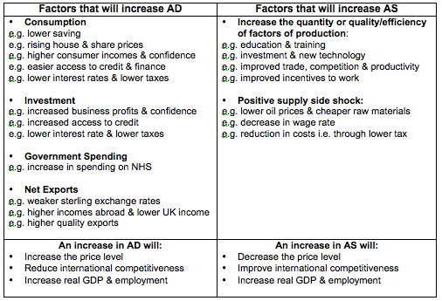
Fiscal (AD) and Supply Side (LRAS) Policies

Slide 11
THE BIG QUESTION FOR NEXT WEEK
RWS 8: Supply Side Policies
How do we solve the UK’s productivity puzzle?
In other words:
What is the ‘productivity puzzle’ and how is the Government trying to increase our productivity?
Evaluating the impact of supply side polices

Slide 12
WEEK 2

Slide 13
30

Slide 14
RWS8 (Macro): Supply Side Policies
TO DO (First 10 Minutes):
Homework OUT
Complete the white box of tasks to the right in pairs using your MICRO PREP sheets
THIS WEEK
HOMEWORK: RWS8 (4.5 to 6 hours)
Complete Micro and Macro RWS 8 for collection
MONDAY: MICRO/MACRO
Hand back RWS 7
MICRO: Recap Production Externality Diagrams
MACRO: Recap SS Policies and Look at Fiscal Rules
TUESDAY: MICRO
Debating Government Interventions to eradicate market failure
THURSDAY: MACRO
Productivity Puzzle in the UK – Causes and Solutions?
Evaluating Supply Side Policies?
STARTER ACTIVITY: USING YOUR PREP HOMEWORK (LAST TASK) INVESTIGATE THESE TASKS ON WHITEBOARDS/SCRAP PAPER (they get progressively harder as you go):
TASK 1: Draw the effect of a supply side policy on an AD and LRAS diagram (no SRAS) in macroeconomic equilibrium at ‘full employment’ What is the effect on the domestic macroeconomic indicators (growth, price levels and unemployment)?
TASK 2: Draw the effect of a supply side policy with now the SRAS included (as well as the LRAS and AD). Ensure the macroeconomic equilibrium is such that there are no output gaps. Remember that shifts in the LRAS also shift the SRAS. What is the effect on the domestic macroeconomic indicators (growth, price levels, and unemployment) if the AD curve does not move?
TASK 3: What would need to happen on the diagram from TASK 2: for their to be ‘stable prices’? Can you explain why this might happen?

Slide 15


Supply Side Policies and FISCAL Policy
FISCAL POLICY: Demand or Supply Side Policies?
Short-term fiscal policy: Demand Management (AD control) – Keynesian idea to combat a recession by intervening to boost AD and intervening in a boom to reduce AD
Medium-term fiscal policy: Supply Side Management – Hayek (Classical) idea of reforming the private sectors to improve productivity. Requires fiscal rules to ensure that Government’s do not get into too much debt (or at least give credibility to the financial markets that they will not get into too much debt)
FISCAL RULES
Rules that the Government set itself to provide financial markets (especially the ‘Bond Markets’_ with assurances that they will not get into too much debt. This is to ensure that the Government can borrow at reasonable rates in the future.
Day to Day Spending
Benefits, wages of public sector workers etc.
Investment Spending
Infrastructure!
The UK Fiscal Rules from various Chancellor of the Exchequer
  1997-2007: Gordon Brown’s ‘Golden Rule’
  2007-2010: Alastair Darling’s ‘Fiscal Stimulus’ through greater Government spending
  2010-2016: George Osborne’s ‘Balance the Books’ through Austerity
  2016-today: Philip Hammond: “Flexible Austerity”
The Eurozone’s Fiscal RulesGrowth and Stability Pact
  1992 to today: ‘The Growth and Stability Pact’ – The Budget Deficit can be no more than 3% of GDP per year

Slide 16
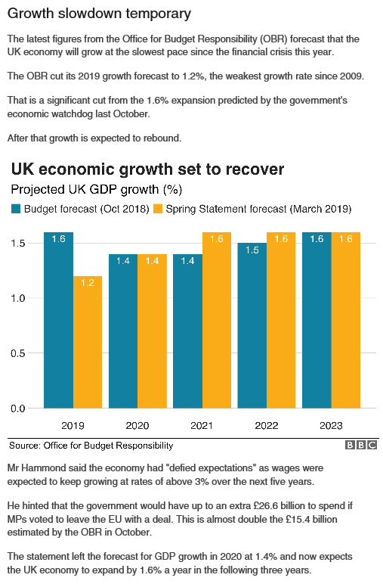
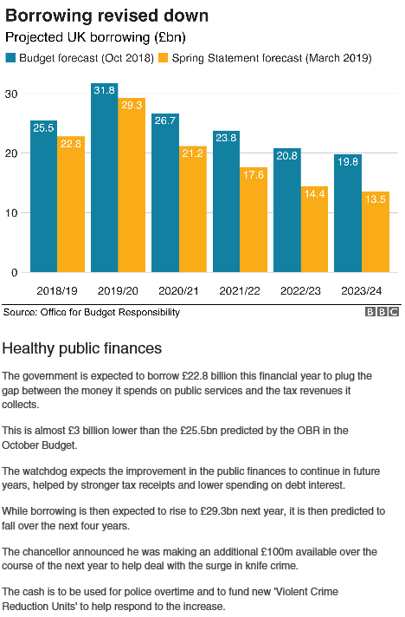
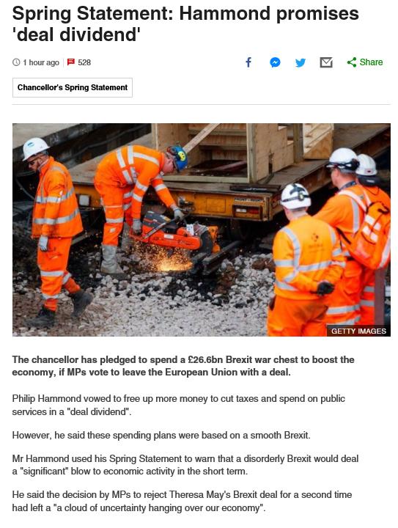
Supply Side Policies: Spring Statement March 2019
Free Market or Interventionist? Would they shift the AD or LRAS?

Slide 17
90

Slide 18
THE BIG QUESTION FOR THIS WEEK
RWS 8: Supply Side Policies
How do we solve the UK’s productivity puzzle?
In other words:
What is the ‘productivity puzzle’ and how is the Government trying to increase our productivity?
Evaluating the impact of supply side polices

Slide 19
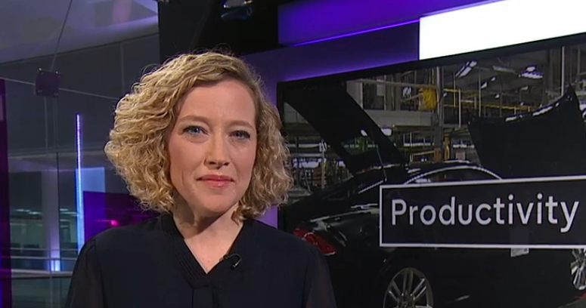

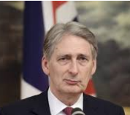
Productivity and Growth in the UK
Click on the Pictures to access the videos in full screen. Exception is PH article - this is in your booklets.
Channel 4 News Clip (4 Minutes)
Crash Course Economics (9 Minutes)
Philip Hammond Article

Slide 20
UK Productivity Puzzle
Brainstorm and Class Discussion
GROUPS OF 4-6: Comparing your PREP homework and taking notes down on the following areas -
What has caused the poor productivity the UK faces today?
  Create a list of possible causes
Effects of poor productivity?
  What will the impact be on the four macroeconomic indicators?
  What effects might there be on the National Debt of the UK?
  Using AD/AS Analysis, demonstrate the impact of improved productivity on macroeconomic indicators on a diagram.
Solutions?
  What has the Government (Coalition of Conservatives and Lib Dems 2010-2015 and Conservatives 2015-today) tried to do since 2010?
  To what extent has it been effective?
    POSITION
    SUPPORT YOUR POSITION
    DEFEND YOUR POSITION

Slide 21
UK Productivity Puzzle
Brainstorm and Class Discussion
Possible Causes?
Demographics: Growing elderly population and lower demographics over the past 30 years?
Austerity: Cuts in public investment - subsidies for renewables, FE funding cuts, cuts in growth of real NHS funding, lack of infrastructure spending?
Financial Crash: Problem since the financial crisis? Lack of corporate investment - Not yet recovered confidence?
Measurement Issues: Harder to measure now? Online business etc?
Corporate Investment Low: Lower wages due to trade union reform and immigration increase? Why waste money on labour saving technology when you can afford cheap labour?

Slide 22
Controversy with the supply side of the economy – Key Terms to take notes on
Neo-liberal agenda:
  Privatisation, Deregulation and Internal Markets
  Removing the role of the state in the economy to prevent ‘crowding out’ and ensure public finances are under control through ‘austerity’)
Laffer Curve Analysis: disincentive effects of taxation
Trickle Down Economics: the benefits of inequality benefit all eventually
Paradox of BREXIT: BREXIT will most probably cause increased barriers to trade and restraint on immigration (neo-liberals have gone all interventionist on us!?)

Slide 23
Advantages and Disadvantages of Supply Side Policies
TASK 1: GROUPS: Make a list for discussion
TASK 2: TRY TO CATEGORISE your list into 3 distinct points with evaluation points….
ADVANTAGES
Macroeconomic Indicators Improve
  Trend (sustainable) growth - economic growth with stable prices. No wage spirals (LRAS shifts to the right).
  Deflationary pressures Stablise price levels in the longer run, boosting confidence for investors in the economy. Lead to better balance of payments position as lower prices might mean boost in net exports cutting current account deficit?
  Unemployment - reduce the natural rate of unemployment (or increase employment in the economy by encouraging more into the workforce)
Trickle down effect (free market policies and a neo-liberal approach) Tax cuts for the rich and large corporations will lead to benefits ‘trickling down’ to those on lower incomes. Removing regulations and privatising improves efficiency in the economy and improves productivity. Also due to ‘laffer curve’ analysis, might improve tax receipts.
Intervention (Intervention policies only) to fill holes left by the private (or corporate sector) - solve market failure of merit goods (health and education) and public goods (infrastructure etc.)
DISADVANTAGES (Evaluation points to the Advantages)
Macroeconomic Indicators Improve?
  Deflationary pressures? Lead to a deflationary spiral like in Japan? Macroeconomic conflict?
  Time lags for unemployment?- Takes time; no short run effects? Not effective in a recession?
Inequality issues if more free market/neoliberal esque policies? Trickle down effect is not prominent necessarily. Will cutting taxes to the ‘rich’ just lead to greater inequality which could lead to social unrest and effect economic confidence? Removing regulations leads to worse standards of living and might lead to higher job insecurity?
Sustainability issues (crowding out and sustainable fiscal debt?) if more interventionist? Can we afford to have interventionist positions in the wake of the financial crash?

Slide 24
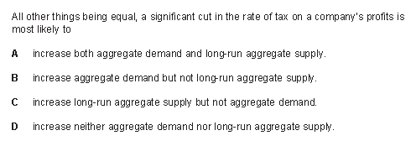
Further Assessment
EXTRA QUESTIONS:
What is this tax called in real life?
How have Governments from 2010 until now done with this tax?
What might happen to this tax in the future given BREXIT? Why?

Slide 25

Further Assessment
9 MARK QUESTION

Slide 26
ARCHIVE

Slide 27
AD
(Aggregate Demand)
Define the factors causing a movement along and a shift in the aggregate demand and aggregate supply curves
Alistair Darling in his recent budget decides to spend more money on the NHS. Government spending has increased and the AD curve shifts to the right.
MOVEMENTS ALONG THE CURVES
P/L – Price Level
(e.g. inflationary or deflationary pressures)
Price Level
LRAS
SHIFTS IN THE CURVES
SRAS
C – Consumption
(e.g. spending by households)
I – Investment
(e.g. spending by firms)
G – Government Spending
(e.g. spending by Governments)
(X-M) – Exports - Imports
(e.g. the trade balance)
P/L2
An increase in the price level results from the extra demand for goods and services needed to implement the Government’s new spending plans.
The higher price level has persuaded many firms to increase their production to meet the new demand (represented by a movement along the AD curve)
Output in the economy has increased from Y1 to Y2
P/L1
AD2
AD1
Y1
Y2
Real GDP

Slide 28
Define the factors causing a movement along and a shift in the aggregate demand and aggregate supply curves
SRAS
(Aggregate Supply)
Price Level
Shift in the SRAS curve due to a rise in the costs of production for all firms in the economy
(e.g. because of an increase in the price of raw materials)
LRAS
SRAS2
SRAS1
MOVEMENTS ALONG THE CURVES
P/L2
Changes in the price level have caused a movement along the AD curve. In other words, inflationary pressures caused by the rise in costs for firms, has led to a fall in total demand in the economy.
Output in the economy has fallen from Y1 to Y2
P/L – Price Level
(e.g. inflationary or deflationary pressures)
P/L1
AD
Y2
Ŷ
Real GDP
SHIFTS IN THE CURVES
SRAS – Costs of Production
(e.g. taxation, wages, raw materials)

Slide 29
Define the factors causing a movement along and a shift in the aggregate demand and aggregate supply curves
LRAS
(Aggregate Supply)
MOVEMENTS ALONG THE CURVES
P/L – Price Level
(e.g. inflationary or deflationary pressures)
LRAS1
LRAS2
Shift in the LRAS curve due to better trained workers
(e.g. because of an improvement in the Government’s education policy)
SHIFTS IN THE CURVES
A fall in the price level have caused a movement along the AD curve. In other words, deflationary pressures caused by more goods and services being produced as a result of a more productive workforce, has led to an increase in total demand in the economy – consumers and firms are now able to by more products.
Output in the economy has risen from Y1 to Y2
LRAS – Quality and Quantity of Labour and Capital
(e.g. An extra factory would add to the quantity of capital and better technology would add to the quality of capital)
(e.g. More workers willing to supply their labour would add to the quantity of labour and better trained/educated workers would add to the quality of labour)
P/L1
P/L2
AD
Y1
Y2
Real GDP

Slide 30
AGGREGATE DEMAND
PRICE LEVEL
Factors affecting demand:
C = Consumption
I = Investment
G = Government Spending
X-M = Exports-Imports
AD
(Aggregate Demand)
REAL NATIONAL INCOME /
OUTPUT

Slide 31
AGGREGATE SUPPLY – short run
PRICE LEVEL
Factors affecting supply in the short run (movement along the curve):
(1) Price Level
Factors affecting supply in the short run (shift the curve):
Costs of production:
(1) Raw material prices faced by firms
(2) Wage rates faced by firms
(3) Taxation on firms
SRAS
(Short Run Aggregate Supply)
REAL NATIONAL INCOME /
OUTPUT

Slide 32
MACROECONOMIC EQUILIBRIUM – short run
EXERCISE:
Explain what will happen to economic growth and inflation by drawing a short run macroeconomic AD/SRAS diagram (use bullet points with a very brief explanation) for the following situations:
(1) An increase in consumer confidence
(2) An increase in income tax
(3) Rise in oil prices

Slide 33
AGGREGATE SUPPLY – long run
PRICE LEVEL
LRAS
(Long Run Aggregate Supply)
Factors affecting supply in the long run:
Improving resources in the economy – e.g. labour AND capital.
By improving the quantity (amount) and quality (productivity) of labour and capital, the productive capacity of the economy increase.
REAL NATIONAL INCOME /
OUTPUT

Slide 34
MACROECONOMIC EQUILIBRIUM – long run
PRICE LEVEL
EXERCISE:
Explain what will happen to economic growth and inflation by drawing a LONG run macroeconomic AD/LRAS diagram (use bullet points with a very brief explanation) for the following situations:
(1) Extra education and training improves the productivity of workers
(2) A world war that destroys large parts of the UK
(3) Improvements in computer technology
LRAS
AD
REAL NATIONAL INCOME /
OUTPUT

