Slide 1
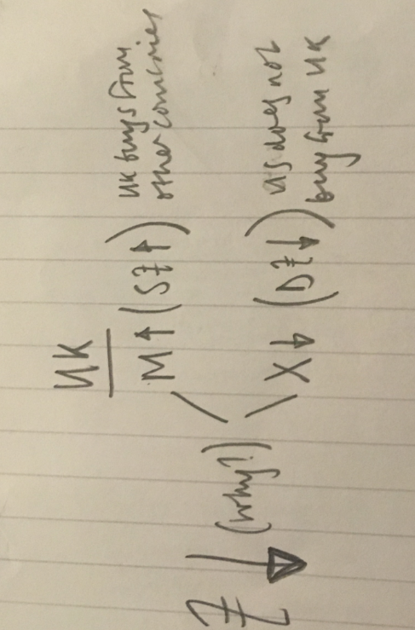
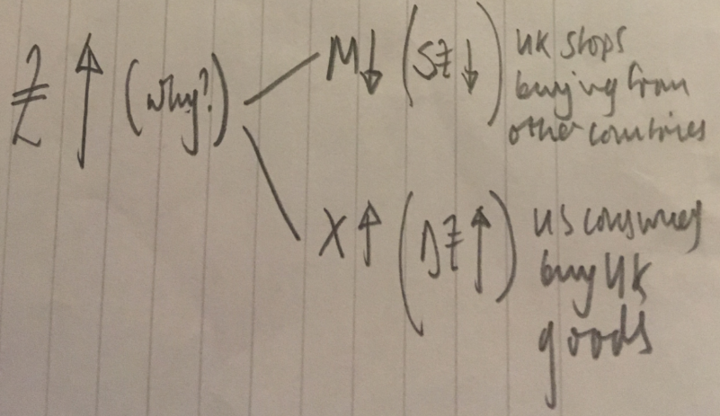
Early 2000’s peak Market Exchange Rate
Overvalued Pound will tend to come down all things remaining equal
£1 = $2.00
£1 = $1.44
£1 = $1.30
Long-term PPP estimate
Undervalued Pound will tend to come down all things remaining equal
2018 Market Exchange Rate

Slide 2
WEEK 1

Slide 3
45:

Slide 4
Exchange Rate Flow Chart
Determination
Effects on the Macroeconomy
Floating Exchange Rate System
Theoretically NO Government Intervention
Exchange rate determined by traders on the FOREX markets
Managed or ‘dirty’ float may occasionally occur (Government Intervention)
Economic Growth
(Levels of output in the economy, year on year)
Unemployment
(Number of people who want a job and do not have a job)
Purchasing Power Parity Theory (Long Run)
Real Exchange Rate (not nominal)
Determined by relative changes in price levels of a basket of goods in each country
EXCHANGE RATE
Price Levels
(Inflation and Deflation)
Balance of Payments
(Current Account)
Fixed Exchange Rate System
Fully-fixed (Gold Standard)
Semi-fixed or Managed (Adjustable Peg)
Bretton Woods
Exchange Rate Mechanism
Activity 1: Identify what the effects of a weak exchange rate might be on each macroeconomic indicator (similar to how the UK is at the moment post BREXIT referendum.
Activity 2: Read what the ‘J-curve effect’ is (on your phones?). How might you use this theory to evaluate your analysis in Activity 1?

Slide 5
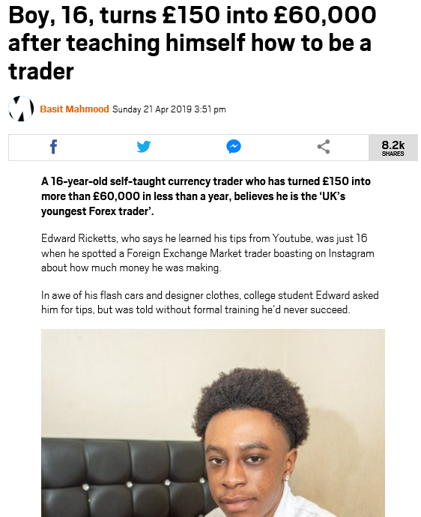
Floating Exchange Rate Systems Introduction to the FOREX Markets
The foreign exchange markets are open 24 hours a day, with 40% of activity taking place in London
Each day, £3.5tn changes hands in the foreign exchange markets.
Biggest most important currencies
US Dollar
Euro (Eurozone Countries)
Japanese Yen
Chinese Reminbi (Yuan)
Pound Sterling (UK)
What are the FOREX markets and where are they based?
Speculation
‘Shorting’
‘Going Long’
Notes:
GUARDIAN ARTICLE: What are the Forex Markets - https://www.theguardian.com/business/2015/may/20/what-is-forex-and-why-does-it-matter
GUARDIAN ARTICLE: How do you become a FOREX trader? https://www.theguardian.com/money/2010/dec/11/foreign-currency-dealer

Slide 6
Floating Exchange Rate Introduction

Slide 7
WEEK 2

Slide 8
90:

Slide 9
RWS9: Exchange Rate Systems Floating Exchange Rate System
STARTER: Using PREP2, compare your answers and ? any areas where you are not 100% confident when speaking in your 3’s

Slide 10
Exchange Rate Flow Chart
Determination
Effects on the Macroeconomy
Floating Exchange Rate System (Short Run)
Theoretically NO Government Intervention
Exchange rate determined by traders on the FOREX markets
Managed or ‘dirty’ float may occasionally occur (Government Intervention)
Economic Growth
(Levels of output in the economy, year on year)
Unemployment
(Number of people who want a job and do not have a job)
Purchasing Power Parity Theory (Long Run)
Real Exchange Rate (not nominal)
Determined by relative changes in price levels of a basket of goods in each country
EXCHANGE RATES
Price Levels
(Inflation and Deflation)
Balance of Payments
(Current Account)
Fixed Exchange Rate System
Fully-fixed (Gold Standard)
Semi-fixed or Managed (Adjustable Peg)
Bretton Woods
Exchange Rate Mechanism

Slide 11
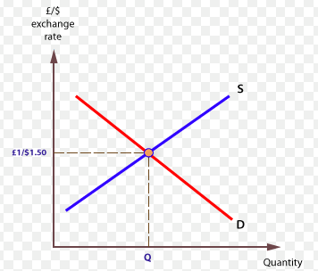
Floating Exchange Rate Systems Determinants: Demand and Supply Analysis
Nominal Exchange Rates
Short-Term = Speculation
Medium to Long-Term = Trade and Investment Flows
Real Exchange Rates
Longer Term = Relative Inflation Effects – Purchasing Power Parity
Factors Affecting Demand and Supply of Pounds
Inflation
Interest Rates
Speculation
Productivity
Current Account Surplus/Deficit
Government Debt
Government Intervention
Confidence in the Government/Economy

Slide 12
RWS9: Exchange Rate Systems Floating Exchange Rate System
CLASS: Go through PREP2 worksheet together

Slide 13
Floating Exchange Rate Systems Determinants: Demand and Supply Analysis
Scenarios (all for UK exchange rate - £/$):
What happens to the exchange rate when UK banks raise interest rates?
What happens to the exchange rate when UK inflation shoots up because of BREXIT?
What happens to the exchange rate when US raises interest rate?
What happens to the exchange rate when Donald Trump announces large tax cuts

Slide 14
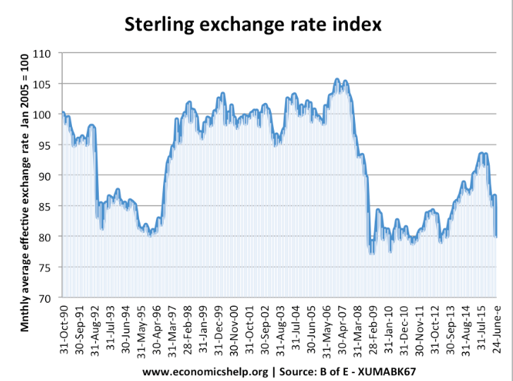

Slide 15
Floating Exchange Rate Systems Determinants: Demand and Supply Analysis
Nominal Exchange Rates
Short-Term = Speculation
Medium to Long-Term = Trade and Investment Flows
Real Exchange Rates
Longer Term = Relative Inflation Effects – Purchasing Power Parity
Factors Affecting Demand and Supply of Pounds
Inflation
Interest Rates
Speculation
Productivity
Current Account Surplus/Deficit
Government Debt
Government Intervention
Confidence in the Government/Economy

Slide 16
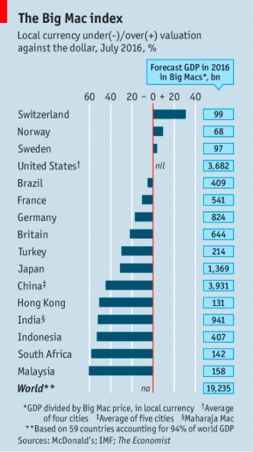
Determining Exchange Rates Real Exchange Rates: Purchasing Power Parity Theory
RECAP EXERCISE (Student Discussion):
What is the difference between the economic concepts of nominal and real
How are exchange rates determined so far have we established?
What is inflation?
What is the impact of inflation on exchange rates?
If you wanted to import something from the US, what would you have to do as a consumer?
EXAMPLE:
For example, using figures in July 2008:
the price of an Apple Mac was $3570 in the United States (varies by store)
the price of a Apple Mac was £2290 in the United Kingdom (varies by region)
the implied purchasing power parity was $1.56 to £1, that is $3570/£2290 = 1.56
this compares with an actual exchange rate of $2.00 to £1 at the time (2.00-1.56)/1.56 = 28%
The pound was thus overvalued against the dollar by 28% - this means the pound can buy 28% more than it should be able to!
If a UK citizen bought a Apple Mac from the US (import), they could demand $3570 from the FOREX markets (how much would this cost them in pounds?)
ANSWER: $3570/2 = £1785 (which is a saving of £505 on buying the goods domestically)
What would happen over time (if all other things remained equal = relative prices and exchange rate?)
ANSWER: Imports would continue until the price of Apple Mac in the UK fell and price of US Apple Mac rose (demand for AM in UK falling and demand for AM in US rising)
CONCLUSION: Purchasing power of a currency DRIVES the exchange rate ultimately
What problems can you see with this theory?
Notes:
Problems with the theory? What constitutes a ‘bundle of goods’? Might be different for different countries because of different ways of living.
Solution to this? BIG MAC INDEX by the Economist newspaper.

Slide 17
WEEK 3

Slide 18
90:

Slide 19
RWS9: Exchange Rate Systems First 10-15 Minutes of Lesson
STARTER ACTIVITY: You should be able to answer these questions now….discuss in threes to make sure you understand.
DISCUSSION: What are the two main exchange rate systems?
DISCUSSION: Under the ‘floating exchange rate system’, what determines ‘nominal exchange rates’ (think short-term…) and ‘real exchange rates’ (think long-term…)?
WRITE ROUGH ANSWER: The UK’s Central Bank decides to cut it’s base interest rate from 0.75% (May 2019) to 0.25% to boost the economy as a result of deflationary worries, following the uncertainty surrounding BREXIT? If all other things remained equal, what would happen to the UK’s pound compared to the Dollar? Draw a diagram to demonstrate the effect.
WRITE ROUGH ANSWER: The lower interest rate will boost AD (as consumers and firms now have cheaper access to credit/loans) but how will the change to the exchange rate you have established in “Q.3” change the UK economy as well?
WRITE ROUGH ANSWER: Why might the effect on the UK economy described in Q4 NOT happen or be mitigated?

Slide 20
Determining Exchange Rates Real Exchange Rates: Purchasing Power Parity Theory
EXAMPLE RECAP:
For example, using figures in July 2008:
the price of an Apple Mac was $3570 in the United States (varies by store)
the price of a Apple Mac was £2290 in the United Kingdom (varies by region)
the implied purchasing power parity was $1.56 to £1, that is $3570/£2290 = 1.56
this compares with an actual exchange rate of $2.00 to £1 at the time (2.00-1.56)/1.56 = 28%
The pound was thus overvalued against the dollar by 28% - this means the pound can buy 28% more than it should be able to!
If a UK citizen bought a Apple Mac from the US (import), they could demand $3570 from the FOREX markets (how much would this cost them in pounds?)
ANSWER: $3570/2 = £1785 (which is a saving of £505 on buying the goods domestically)
What would happen over time (if all other things remained equal = relative prices and exchange rate?)
ANSWER: Imports would continue until the price of Apple Mac in the UK fell and price of US Apple Mac rose (demand for AM in UK falling and demand for AM in US rising)
CONCLUSION: Purchasing power of a currency DRIVES the exchange rate ultimately
What problems can you see with this theory?
Notes:
Problems with the theory? What constitutes a ‘bundle of goods’? Might be different for different countries because of different ways of living.
Solution to this? BIG MAC INDEX by the Economist newspaper.

Slide 21
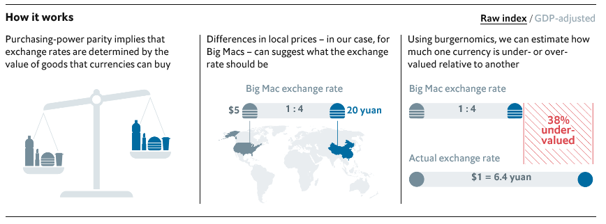
Determining Exchange Rates Real Exchange Rates: Purchasing Power Parity Theory
What is PPP Theory? SUMMARY
Long term theory which explains the main reason determining exchange rates is changes in prices levels. OR changes in the costs of living in different countries.
At any point in time the nominal rate probably does not equal the real rate. This is because short term nominal rates are based upon day to day speculation whereas PPP is based upon changes in price levels (inflation) between two countries.
In the long run, purchasing power parity theory argues that the long run exchange rates will change in line with the prices of a bundle of goods between countries.
Notes:
Problems with the theory? What constitutes a ‘bundle of goods’? Might be different for different countries because of different ways of living.
Solution to this? BIG MAC INDEX by the Economist newspaper.

Slide 22
Applications of PPP

Slide 23
Determining Exchange Rates Real Exchange Rates: Purchasing Power Parity Theory
WORKED EXAMPLE :
Pre Brexit vote June 2016 (nominal or market exchange rate £1 = $1.4)
Price of Big Mac UK £2.99 ($4.19)
Price of Big Mac $5.04
What is the PPP Rate?
How does it compare to the Nominal Rate?
What does it mean?
Undervalued = goods are cheaper in UK
Overvalued = goods are more expensive in UK
Criticisms of the Big Mac Index?
EXERCISE: Complete the 5 tasks on the worksheet in groups

Slide 24
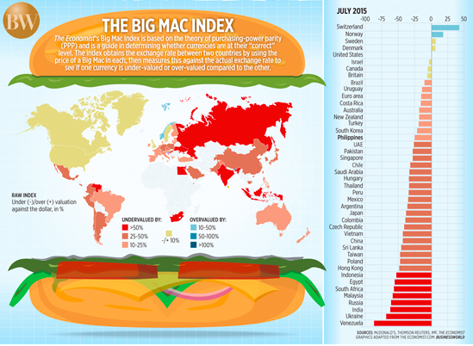

Slide 25
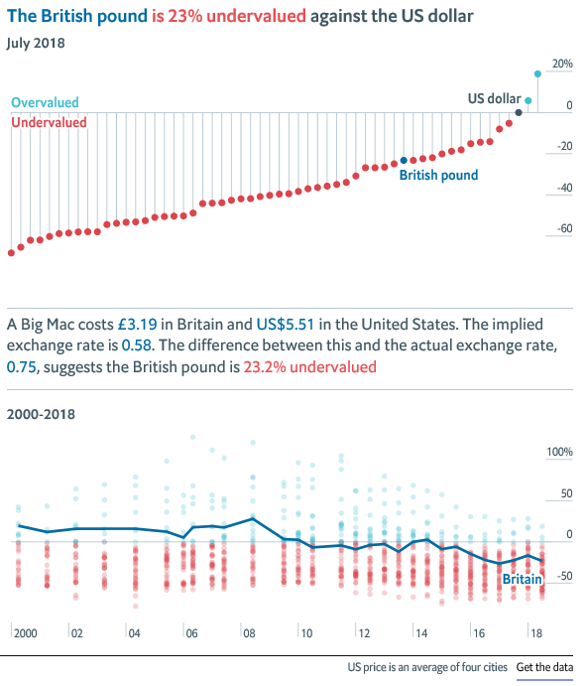
PPP – Big Mac Index
Notes:
https://www.economist.com/news/2018/07/11/the-big-mac-index

Slide 26
WEEK 2

Slide 27
60:

Slide 28
Chains of Analysis Depreciating exchange rate
Unemployment
Economic
Growth
Balance of
Payments
(Current Account)
AD
Move away from deficit towards surplus
X
ER
Price Levels
(Demand Pull Inflation)
M
SRAS
Price Levels
(Cost Push Inflation)

Slide 29
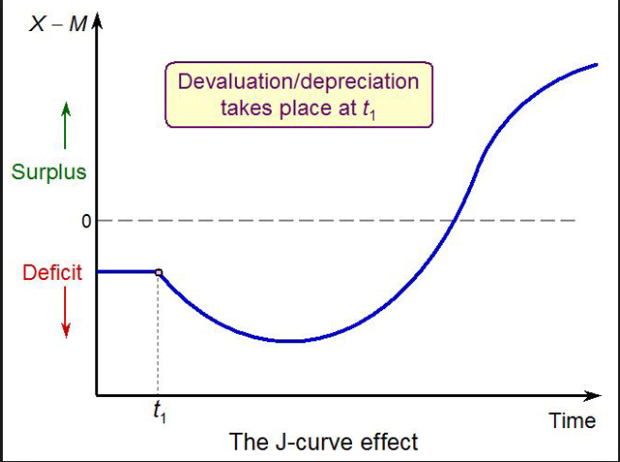
Evaluating the Effects of Exchange Rates on the Macroeconomy ‘J-Curve Effect’ and Marshall Lerner Condition

Slide 30
Determining Exchange Rates Fixed and Floating Systems
INSTRUCTIONS (10 MINUTES)
PAIRS: Swap notes on the two exchange rate systems of the Gold Standard and the Bretton Woods System. Make sure you have answers to both.
Draw a Venn diagram and identify as many similarities and differences between the two systems
EXTENSION: Comment on the timeline to the right – what could be significant about it? What does it tell us?
HISTORY OF THE UK
1816-1914: Gold Standard (fixed)
1914-1944: WWI and WWII
1914-1925: Floating Exchange Rates
1925-1931: Gold Standard (fixed)
1931-1944: Floating Exchange Rates
1944-1971: Bretton Woods (semi fixed)
1971-1990: Floating Exchange Rates
1990-1992: Joined the ERM (semi fixed)
1992-today: Floating Exchange Rates

Slide 31
Exchange Rate Flow Chart
Determination
Effects on the Macroeconomy
Floating Exchange Rate System
Theoretically NO Government Intervention
Exchange rate determined by traders on the FOREX markets
Managed or ‘dirty’ float may occasionally occur (Government Intervention)
Economic Growth
(Levels of output in the economy, year on year)
Unemployment
(Number of people who want a job and do not have a job)
Fixed Exchange Rate System
Fully-fixed (Gold Standard)
Semi-fixed or Managed (Adjustable Peg)
Bretton Woods
Exchange Rate Mechanism
EXCHANGE RATE
Price Levels
(Inflation and Deflation)
Balance of Payments
(Current Account)
HISTORY OF THE UK
1816-1914: Gold Standard (fixed)
1914-1944: WWI and WWII
1914-1925: Floating Exchange Rates
1925-1931: Gold Standard (fixed)
1931-1944: Floating Exchange Rates
1944-1971: Bretton Woods (semi fixed)
1971-1990: Floating Exchange Rates
1990-1992: Joined the ERM (semi fixed)
1992-today: Floating Exchange Rates
Purchasing Power Parity Theory (Long Run)
Real Exchange Rate (not nominal)
Determined by relative changes in price levels of a basket of goods in each country

Slide 32
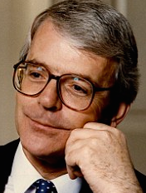
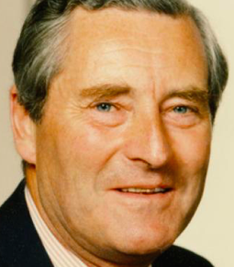
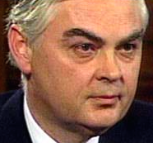
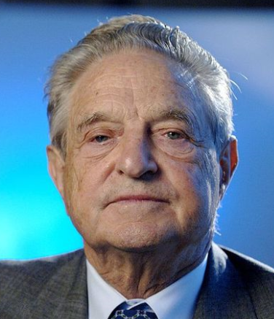
Semi-Fixed (Managed) Exchange Rate System The UK, the Exchange Rate Mechanism (ERM) and Black Wednesday 1990-1992 CASE STUDY
Background to the ERM
Black Wednesday and the UK’s expulsion from the ERM
Key Questions:
Why did the UK try and raise interest rates so much?
What were the short run implications for the UK economy?
What were the longer run implications for the UK economy?
What does this episode tell us about semi-fixed or managed exchange rate systems?

Slide 33
Exchange Rate Flow Chart
Determination
Effects on the Macroeconomy
Floating Exchange Rate System
Theoretically NO Government Intervention
Exchange rate determined by traders on the FOREX markets
Managed or ‘dirty’ float may occasionally occur (Government Intervention)
Economic Growth
(Levels of output in the economy, year on year)
Unemployment
(Number of people who want a job and do not have a job)
Fixed Exchange Rate System
Fully-fixed (Gold Standard)
Semi-fixed or Managed (Adjustable Peg)
Bretton Woods
Exchange Rate Mechanism
EXCHANGE RATE
Price Levels
(Inflation and Deflation)
Balance of Payments
(Current Account)
Purchasing Power Parity Theory (Long Run)
Real Exchange Rate (not nominal)
Determined by relative changes in price levels of a basket of goods in each country

Slide 34
45:

Slide 35
45:

Slide 36
Evaluating Fixed .v. Floating Exchange Rates
FLOATING |  |  | FIXED Including semi-fixed or managed
ADVANTAGES | DISADVANTAGES |  | ADVANTAGES | DISADVANTAGES
SMOOTH ADJUSTMENT | SPECULATION ISSUES |  | TRADING CERTAINTY | INFLEXIBILITY:
PURSUE DOMESTIC MACRO POLICY OBJECTIVES | INFLATIONARY TENDENCIES |  | ANTI INFLATIONARY | COST OF MAINTAINING CURRENCY

Slide 37
Evaluating Fixed .v. Floating Exchange Rates
FLOATING |  |  | FIXED Including semi-fixed or managed
ADVANTAGES | DISADVANTAGES |  | ADVANTAGES | DISADVANTAGES
SMOOTH ADJUSTMENT Balance of payments deficits on the current or financial account can be adjusted easily. Do not have to rely on deflationary policies to rebalance the balance of payments as currency can now devalue. | SPECULATION ISSUES Currency does not just adjust because of trade changes but also because of capital flows. In fact, 90% of currency transactions taking place are due to capital flows. Currencies in the short run can be vulnerable to ‘hot money’ flows as wealthy individuals move their money around the world. |  | TRADING CERTAINTY Currency is stable and traders know the relative value of currencies. | INFLEXIBILITY: Inability to adjust to a BoP surplus or deficit. As inflation changes in different countries, the current accounts around the world move into surplus or deficit. These deficits and surplus’s will stay permanent if ER’s are unable to adjust.
PURSUE DOMESTIC MACRO POLICY OBJECTIVES Balance of payments issues (prolonged deficits etc.) can now be ignored to pursue better economic growth, lower unemployment and stable prices | INFLATIONARY TENDENCIES Devaluation can lead to cost push inflation (SRAS to the left as imports more expensive for firms costs of production) and demand pull inflation (AD boosted due to export growth) |  | ANTI INFLATIONARY Incentive to control inflation to prevent balance of payment current account deficits. | COST OF MAINTAINING CURRENCY Should a deficit on the BoP become unsustainable then pressure for currency to devalue. If this cannot happen then there must be deflationary reductions (rising interest rates etc.) = hurts living standards. Speculators may also attack if they see a weakness in maintaining the fixed currency to force Government’s to spend lots oftheir foreign exchange reserves.

Slide 38
END

Slide 39
Speculators

Slide 40
Floating Exchange Rate Systems How FOREX brokers/traders can make money
A step-by-step scenario
3:45pm An international client calls the foreign exchange desk of a bank to convert some of its US dollars into £600m of sterling. It asks if the trade can be settled at the market benchmark price – established at 4pm each day and dubbed by the markets as "the fix" or "the fixing".
3.48pm The trader immediately buys £50m for the bank's own trading account at the market price of 1.6000 dollars to the pound. He does this as he knows he has a very large amount of pounds to buy over the next 12 minutes meaning there is a good chance that the price will rise.
3.50pm The trader has now made sure that his bank has been looked after. His £50m trade has caused the price of pounds to tick up to 1.6010 and the trader buys £100m at that price. He repeats this trade every two minutes, which drives the price higher each time. He stops when he has bought a total of £600m for his client by 4pm at an average price of 1.6035.
4pm The "fixing" states the price of the pound to the dollar is now 1.6060. The trader has filled his client's order and can also sell the £50m he bought for the bank. As the client has asked to pay the fixing price, he receives his £600m at a cost of $963.6m (£600m x 1.6060). But the bank has paid $962.1m (£600m x the average price of 1.6035), meaning it has made $1.5m out of the client's transaction. Add in the $300,000 won on the £50m side bet, and the trader has just made $1.8m for his bank in 15 minutes. Give the boy a bonus.

Slide 41
Floating Exchange Rate Systems How FOREX brokers/traders can make money
GOING LONG
You have a tip that a currency will rise in the future. Therefore you buy up as much as you can today. When the price rises tomorrow, you then sell it and make a profit as you will be able to sell the currency for more foreign exchange.
SHORTING
You expect a currency to fall. Therefore you borrow money in that currency (from a bank) and then immediately sell it for a stable currency or one that is on the up! Once the currency has fallen, you buy back up the first currency you just sold at a lower price, pay off your lender and pocket the profits. Obviously if the price of the currency rises instead, then you will have to pay back your lender more than you borrowed and you will lose money.
HOW DO I BECOME A TRADER (for under £1000)
Register with the FSA
Set up a limited company
Start a bank account
Get a laptop and access to the internet
Start Trading!
Notes:
Let’s walk through Soros’s trade to understand why it was so elegant. As we stated earlier, the trade was for the Quantum Fund to “short” the British pound, meaning they would make money if the currency’s value went down.
Now, what exactly does it mean to “short” a currency, or anything for that matter? Let’s say it’s January 2009 and you think Apple’s iPhone is over the hill and that the company’s stock price (of $90) will decline. How do you benefit from this insight?
Well, you or your broker can go to someone that owns some Apple stock and ask to borrow a single Apple stock from them. You’ll give them back the share later and of course pay them interest for the loan. But for now, you sell that stock for $90 in cash. Two days later, the stock price is $88, so you buy one share with your $90 in cash. That leaves you with $2 in profit! (Well almost two dollars—you have to pay the person who loaned you the stock two days of interest.)
But what if you didn’t sell your Apple stock when it hit $88 and instead decided to hold onto it until the stock plummeted further? Well, you’d be screwed because the stock went up from $90 to around $600; you would lose $510 on a the trade, plus interest!
If you buy a stock, the worst you can do is lose all your money. If you short a stock, your downside is limitless because the stock can always keep going up. You can possibly lose more than all your money, and that's a very bad thing. So if you take a short position, you want to make sure your downside risk is hedged.
And what if you want to short a currency like the British pound? In this case, you’d go to a British person or company and ask to borrow money from them. They say, “Sure, here’s 100 British pounds. Just give me back the pounds in a few days with some interest, and we’ll have some tea and crumpets.” Now, you take those 100 British pounds, and you convert them into 295 Deutschemarks at the agreed upon exchange rate.
At this point, you would really like the British pound to lose value relative to the Deutschmark. Why? Because if the British pound depreciates 10%, when you convert the 295 DM back to pounds to repay the loan, you’ll have 110 pounds. You can pay back the 100 pounds and a little bit of interest, and you’ll still clear about 10 pounds in profit.
So you make money if the pound devalues. But what if the pound appreciates? You’ll lose your shirt. Therein lies the brilliance of Soros’s bet: if the pound tanked, they would make billions on their short. And if the pound increased in value? Well, that scenario was impossible because everyone knew the sterling was over priced. It already traded at the bottom of its trading band, and the only thing that kept it propped up was government intervention. There was no scenario in which the pound would appreciate.
So, either the pound would stay about the same in value (in which case Soros’s fund wouldn’t make any money, but wouldn’t lose that much money), or the pound would be devalued and the firm would make an obscene amount of money. There was no massive downside—only a massive upside.
As The Handbook of Hedge Funds puts it:
“If speculators were to break the ERM, being short the pound could turn out to be a very profitable position. Even if the devaluation did not occur, the chances of seeing the pound strengthen were small -- it was more likely to stay at the bottom of its fluctuation band. The only downside for speculators was transaction costs."
And so that morning, Soros and his fund increased their short position against the British pound from $1.5 to $10 billion. It was the perfect bet with a mitigated downside and a limitless upside. It was like betting on a coin flip, were if the coin lands on heads (the pound devalues), they make a lot of money. If the coin lands on tails (the exchange rates remained fixed), they only lose a small amount of money on loan interest. That’s the kind of bet Soros would pour money into all the day, even if he had to borrow billions.
Fighting off the Speculators
"Our total position by Black Wednesday had to be worth almost $10 billion. We planned to sell more than that. In fact, when Norman Lamont [the British finance minister] said just before the devaluation that he would borrow nearly $15 billion to defend sterling, we were amused because that was about how much we wanted to sell."
- George Soros, 1992
As Europe slept, Soros borrowed and sold pounds from anyone that he could. The Quantum Fund’s position exceeded $10 billion shorting the pound. Other hedge funds got wind of the trade (and the report from the Bundesbank) and started following suit, also borrowing and selling pounds.
By the time London markets opened for business and British treasury officials started their day, tens of billions of pounds had been sold. The pound was dangerously close to trading below the levels mandated by the ERM.
The Bank of England was about to have a very shitty day.
British officials first responded by buying one billion pounds at 8:40 AM. The purchase had no effect on the price of the pound. The whole world was selling, and the British government didn’t have the buying power to fight it all off. It’s estimated that the British government spent £27 billion of its reserves buying up pounds to no avail.
By 9AM, finance minister Norman Lamont contacted Prime Minister John Major and told him they couldn’t possibly buy up enough pounds to keep the currency propped up. The only option left for the British government to keep their currency trading at the right level would be to increase interest rates dramatically and attract people to buy pounds. Major refused. Britain was in the midst of a recession, and increasing rates would further shrink the economy. It would be political suicide.
Blood was in the water. Global capital continued to bet against the pound. An hour and a half later, Lamont called the Prime Minister to re-plead his case. The Prime Minister relented. At 11AM, the British government announced they would increase interest rates 200 basis points, from 10% to 12%.
How did the value of the pound react to this enormous increase in interest rates? Nothing happened. The pound continued to plummet. Lamont headed to the Prime Minister's residence to figure out how to salvage the situation, which led them to announce an interest rate increase of another 300 basis points, from 12% to 15%.
What was the effect of this rate increase on the sterling? Again, nothing. As Mallaby later documents in his book, Soros and the gang of speculators knew victory was near:
"At their desks on the other side of the Atlantic, Druckenmiller and Soros saw the rate hikes as an act of desperation by a dying man. They were a signal that the end was nigh--and that it was time for one last push to sell the life out of the British currency."
The market expected that Britain would have to devalue its currency and that no amount of interest rate hikes or currency purchasing would change that. At this point, the sentiment that Britain would exit the ERM and devalue its currency was a self-fulfilling prophecy; if the speculators believed it enough to put their money behind it, it would eventually come true.
At 7:30 PM that night, Lamont held a news conference to announce that Britain would be exiting the ERM and floating its currency on the market. Soros and the speculators won.

Slide 42
The Case of the ERM
Notes:
GUARDIAN ARTICLE: The way the day unfolded - https://www.theguardian.com/business/2012/sep/13/black-wednesday-20-years-pound-erm

Slide 43
Floating Exchange Rate Systems Equilibrium and Disequilibrium
NOTES
Just Current Account: Just Trade
Demand and Supply Downward Sloping?
Shifts in demand and supply?
Current and Capital/Financial Account: Trade and Financial Flows
Disequilibrium!
£1/$1.10
A
B
£1/$1.24
£1/$1.10
A
D2
D1
Qd
Qs

