Slide 1
WEEK 1

Slide 2
RWS 10: PREP
(5 hrs 50 minutes total including Thursday cover work)
Due Monday 10th June at 0845
MICRO
Worksheet to Complete:
  Introduction to Labour Markets and Market Failure
  Defining and Measuring Poverty
  Defining and Measuring Inequality
MACRO
Balance of Payments Crisis’
  Reading 1 article (on GOL) followed by 4 newspaper articles (accessed by links on document)
  Answering questions on whether UK is at risk and reaching a conclusion for a debate next week

Slide 3
45:

Slide 4
RWS10 - Summary
MICRO:
Inequality and Poverty
Defining, Measuring and Causes of Inequality and Poverty – why is it a market failure?
Why might inequality be a market success?
How can the Government intervene to combat inequality and poverty issues
Why might Governments have failed in the past?
MACRO:
Balance of Payments
Balance of Payments RECAP
Balance of Payments Disequilibrium and Global Imbalances
Balance of Payments Crisis – is the UK headed for one?
Government policy to prevent a balance of payments crisis

Slide 5
WEEK 2

Slide 6
RWS 10: PREP
(6 hours in total including class time)
Due w/b 17th May
MICRO
Causes of Poverty and Inequality WORKSHEET
MACRO
Balance of Payments Solutions
  How can Government’s solve a balance of payments deficit?
  Research the 3 D’s:
    Devaluation…
    Deflation…
    Direct Controls…

Slide 7
45:

Slide 8
RWS10: Market Failure 5
Inequality and Poverty
RWS10: Balance of Payments
Crisis’ and Solutions
STARTER (First 15 Minutes)
Homework out for collection
Answer the Questions for both micro and macro below
Get out a fresh page of note paper and write the heading at the top and then give written answers (note form only) to the following questions:
  Why does Cristiano Ronaldo get paid more than a Nurse?
  Is it right that Wayne Rooney gets paid more than a Nurse?
  Why might inequality and poverty be considered a failure of what Market?
Get out another fresh page of note paper and write the heading at the top and then give written answers (note form only) to the following questions:
  What is the balance of payments?
  What is the difference between the ‘current account’ and the ‘financial account’?
  What does ‘Balance of Payment’ disequilibrium mean?
  Why might ‘developing countries’ be particularly vulnerable to a ‘Balance of Payments’ deficit? What would the effect be on the countries economy?
  What role should the exchange rate play in correcting a balance of payments deficit?
Occupations by wage (annual)
Cristiano Ronaldo (Footballer) = £20 million
CEO = £1 million
Teacher = £35,000
Nurse = £25,000
Factory worker = £15000

Slide 9
60:
Benchmarks Back

Slide 10
30+90:
1-2-1s

Slide 11
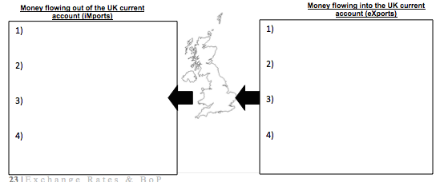
Balance of Payments
Measures of Flows in and out of the Economy
Current Account (Trade, Investment Income, Transfers)
Financial Account (FDI, Hot Money Flows, Portfolio Investments)
Capital Account (Government transfers and Re-nationalization of funds abroad)
Foreign Reserves
Balancing Item
FLOWS OUT OF THE ECONOMY
FLOWS INTO THE ECONOMY
5)
5)

Slide 12
(1) Current Account
Examples of IN’s and OUT’s

Slide 13
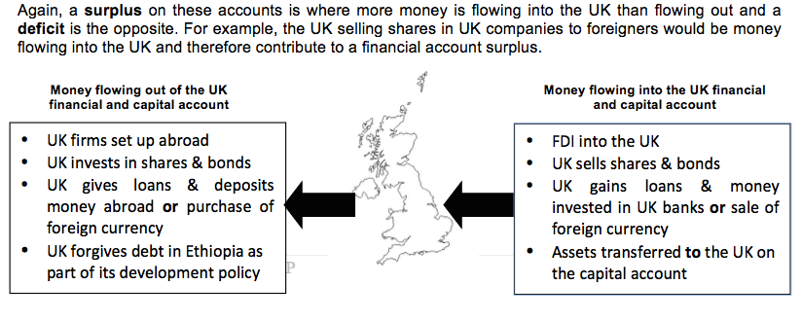
(2&3) Financial and Capital Account
Examples of IN’s and OUT’s

Slide 14
(4) Gold and Foreign Exchange Reserves The role of the central bank

Slide 15
(5) The Balancing Item
Why it is called the ‘Balance of Payments’

Slide 16
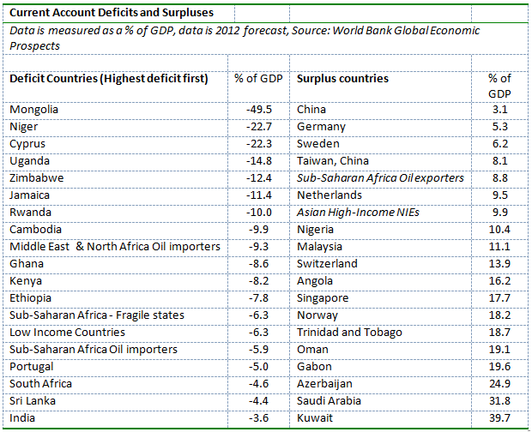
Global Imbalances
Surplus and Deficits

Slide 17
Balance of Payments Exercise
BOP Worksheet
A BoP must always equal zero (or balance) as the money flows in must equal money flows out. Thererfore what does BoP Deficit or Disequilibrium mean?
How might a BoP deficit or disequilibrium be financed and therefore persist for a long time?
How might exchange rates prevent a long run BoP deficit from occurring?
Why might certain Eurozone countries running current account deficits face painful adjustments?
In these Eurozone countries, how would their economy adjust to restore their BoP equilibrium?
Why might developing countries be particularly vulnerable to a persistent BoP deficit? What is the worst that could happen?
Read the article on the back – is the UK at risk from its BoP deficit/ disequilibrium?
INSTRUCTIONS
Olly Introduction
Individual Reading of first page of worksheet
Answering questions in pairs
Class feedback on those questions

Slide 18
Balance of Payments RECAP Activity
A country has the following international transactions on current account: exports of manufactured goods £20bn; imports of food £10bn, earning from foreign tourists £5bn; interests, profits and dividends paid to foreigners £4bn; purchase of oil from abroad £8bn; earnings of nationals working overseas which are repatriated £7bn, sale of coal to foreign countries £2bn, payments by foreigners to domestic financial services firms £1bn.
Which of the items are (i) visible exports; (ii) exports of services; (iii) income and current transfer credits; (iv) visible imports; (v) imports of services; (vi) income and current transfer debits
Calculate (i) the balance of trade; (ii) the balance on all invisibles; (iii) the current balance

Slide 20
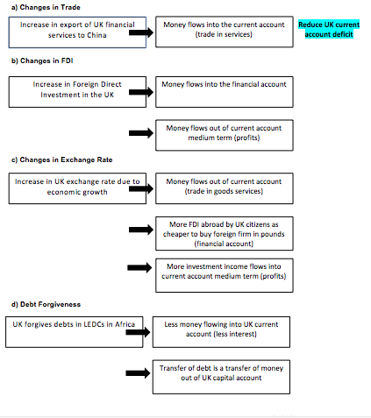
EFFECTS OF BALANCE OF PAYMENTS CHANGES
Activity: Identify the correct impact on the UKs current/financial/capital account of the BoP. The first one has been done for you

Slide 21
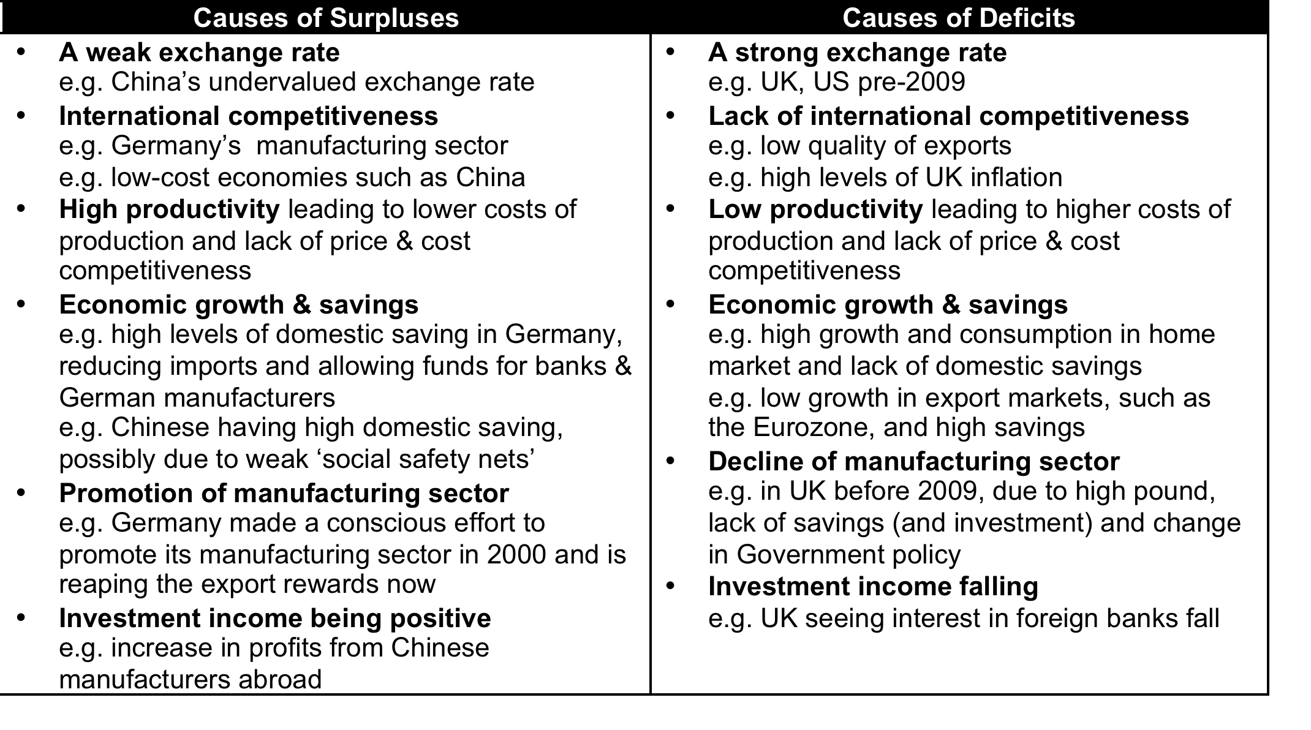
Current Account
Causes of Surplus/Deficits
EXERCISE: Which of these apply to the UK, China, Germany and USA

Slide 23
Role of Exchange Rates in Correcting Balance of Payments Deficits

Slide 24
CORRECTING DEFICITS
TASK: In theory, why will a current account deficit not last and correct itself if there is a floating exchange rate?
Stage 1:
Current account in deficit
Stage 2:
Why will the exchange rate devalue if the current account is in deficit
Stage 3:
Devalued exchange rate’s effect on current account
UK exports are not good quality
M
Current Account in Deficit
X M
£
S1
X
UK productivity is poor
S2
Goods are cheaper to buy in foreign countries
£
Current account increases (so deficit reduces)
£1
A
£2
B
£3
M
C
D2
D1
Foreign countries are in a recession
Q
Q
X
UK is in a boom
QUESTION 1: Explain what would be happening to exports and imports if there was a rising current account deficit
QUESTION 3: Explain why a falling pound would affect the exports and imports in this way?
QUESTION 2: Explain what is happening in the graph of Stage 2
QUESTION 4: Why has the exchange rate solved the current account deficit and restored the equilibrium?

Slide 25
Will exchange rates always correct deficits and surpluses?
3 KEY EVALUATION POINTS
Exports are price inelastic
Goods are still cheaper (or better quality) in foreign countries and so exports from this economy are still not demanded.
‘Marshall-Lerner Condition’ (Elasticity Considerations)
Elasticities of exports and imports need to be greater than one for exchange rates to have an effect
No floating exchange rate (fixed) - e.g. EU countries
J-Curve Theory
Imports are price inelastic
Firms are tied into contracts which means they cannot change the amount they import instantly
Goods are better quality (or cheaper) in the domestic country so no need to import still.
QUESTION2 : Explain how a fixed exchange rate would mean that the exchange rate would be useless in trying to correct a balance of payments deficit?
Current Account Surplus
MEDC
J-Curve
LEDC
J-Curve
QUESTION2 : Using the graph and the internet, explain how the J-curve works referring to the concepts of elasticity above.
0
Time
1
3
2
Current Account Deficit
  Developed Countries (MEDC’s)
  Developing Countries (LEDC’s)

Slide 26
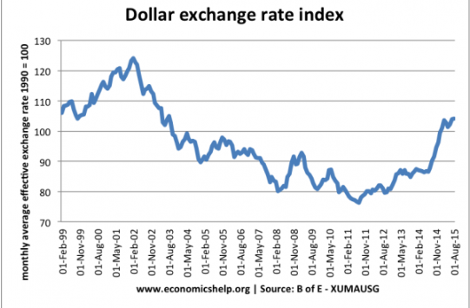
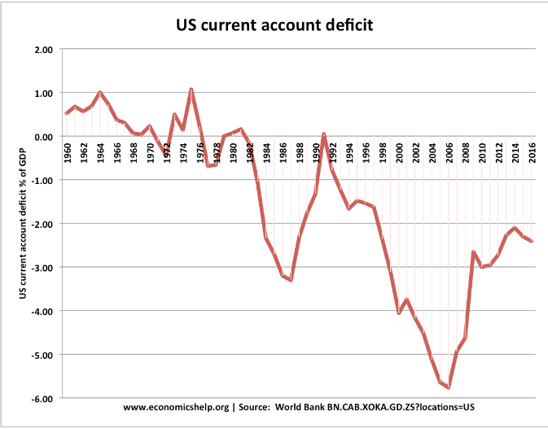
Does the J-Curve Exist?
Fig. 1
Study the graphs and see if you can see whether the data shows the J-Curve?
Fig. 2

Slide 27
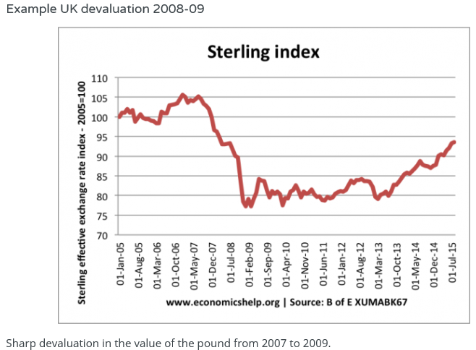
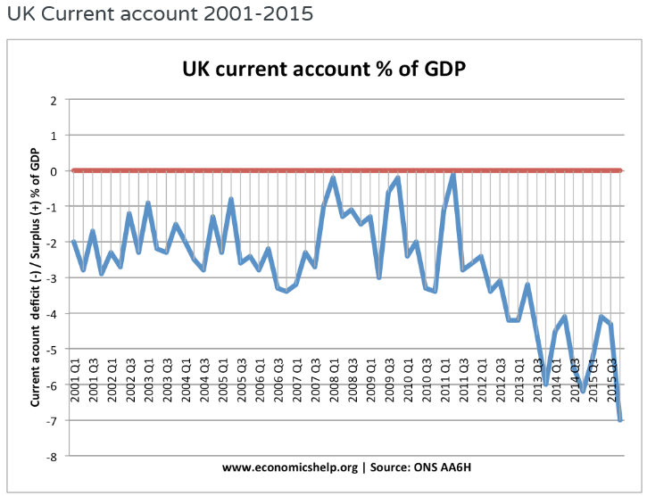
Does the J-Curve Exist?
Fig. 1
Study the graphs and see if you can see whether the data shows it?
Fig. 2

Slide 28
Does the J-Curve Exist?
Fig. 1
From 2002 to 2006, there is a deterioration in the current account (also caused by strong domestic consumption)
After 2006, there is a sharp improvement in the current account. Suggesting that the J-Curve may be coming into play – the current account is finally responding to the depreciation in the dollar.
However, the sharp improvement in the current account from 2006 was also due to the slowdown in the US economy and a decline in consumer spending on imports.
Fig. 2

Slide 29
Does the J-Curve Exist?
Fig. 1
During the depreciation of 2007-09, there is no discernable improvement in the UK current account – it is volatile, but remains in deficit.
In the longer-term, after the depreciation, we might expect an improvement in the current account, but actually, it worsens.
This is not helpful for trying to prove the J-Curve effect. But, it shows many factors can influence the current account balance of payments other than the exchange rate. And therefore is a good example of why exchange rates do not always leap to the rescue! Other factors other than exchange rates include:
  State of the economy (in a recession demand for import spending falls)
  Consumer demand in other countries (e.g. Eurozone recession hit demand for UK exports)
  Productivity and competitiveness of manufacturing industries – relative to main competitors.
Fig. 2

Slide 30
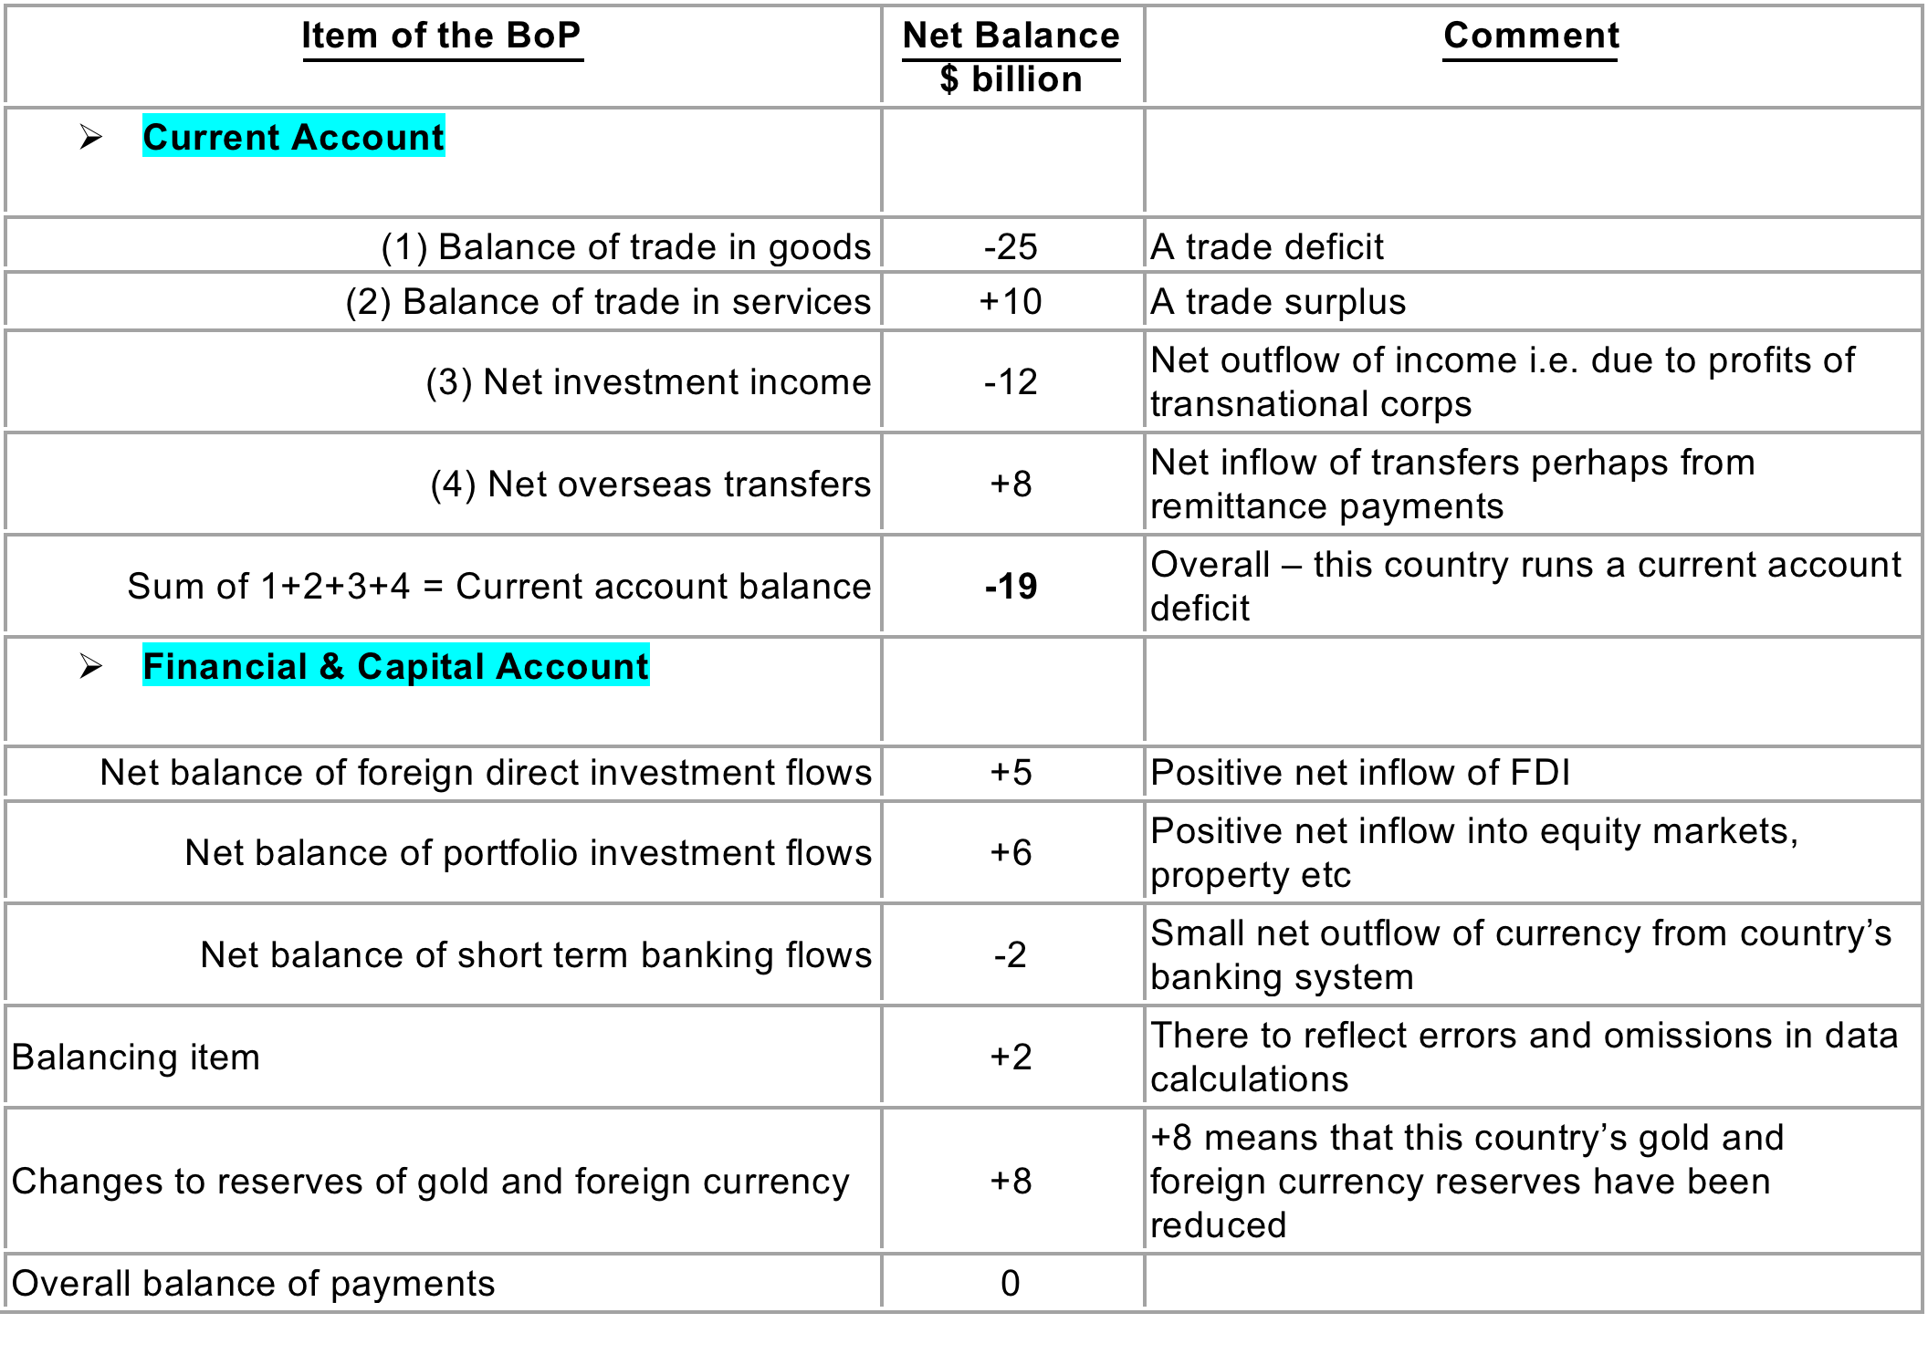

Slide 31
Balance of Payments Accounts
Why might this countries BoP deficit correct itself?
What might happen to the economy if this adjustment does not correct the BoP deficit?
What does the positive change to currency reserves reveal about possible Government action?
Overall, what do you think the prospects are for this economy given the info you have? (no right or wrong answer here!)
UK Current Account Deficit is: £12 billion
Currency UK to US $ exchange rate is: £1 to $1.29

Slide 32
WEEK 3

Slide 33
45:

Slide 34
45:
OLLY AWAY

Slide 35
45:

Slide 36
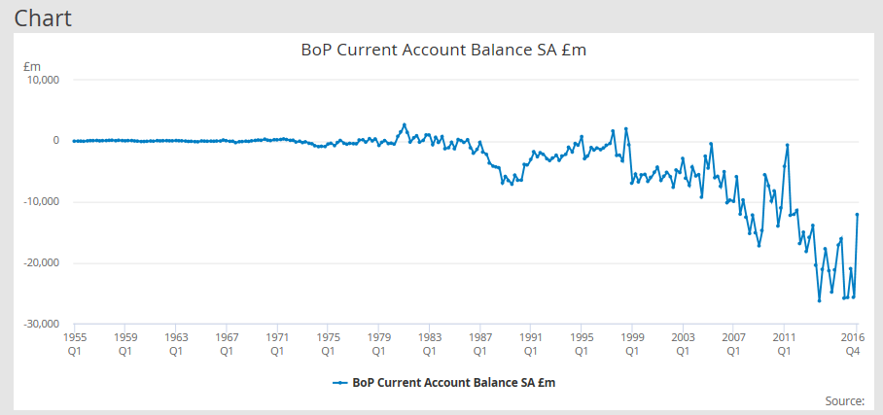
Balance of Payments Problems
Is the UK vulnerable to a BoP Crisis?
TASK: Draw a two columned table and on the left hand side, state THREE key points as to why we should be worried. Evaluate each point in the right hand column.

Slide 37
Balance of Payments Problems
Is the UK vulnerable to a BoP Crisis?
Yes, we should worry | No, we shouldn’t be concerned
RELIANCE ON FOREIGN CAPITAL FLOWS: UK has the largest in the advanced world (2014) as a % of GDP! It is a sign of un-competitiveness, which will lead to lower economic growth and poorer prospects in the long run. We are too reliant on financial inflows from foreigners - ‘the kindness of strangers’ SHARP DEVALUATION? The UK has had a persistent deficit since the mid 1980’s; perhaps it is crunch time? If capital / financial flows dry up, it could lead to a sharp depreciation in the exchange rate and a fall in living standards (less imports available) and imported inflation which could cause a recession. UK inflation recently crept up to 2.7% (May 2017) when we were facing deflation in January 2016. UNBALANCED TRADE POSITION: It is a sign of an unbalanced economy as we are importing much more than we are exporting | In era of globalisation, financial flows are easier to attract and therefore the deficit is financed by these capital inflows. In fact, 81% of financing is from FDI not ‘hot money flows’ which means these capital flows are more stable and cannot be retracted very easily in the short term. The UK has had a persistent deficit since the mid 1980s. Countries with large current account surplus have not necessarily done better, e.g. Japan had a long period of stagnation. If the current account was too large, there would be a gradual depreciation in the exchange rate to restore the balance and so solve the issue. Arguably this has not happened because the deficit is not an issue. The recent depreciation (16/17) only because of BREXIT referendum and uncertainty. A current account deficit is a bigger concern in a fixed exchange rate (like Euro) because there is no option of depreciation. about the future NOT because of the current account. The actual trade deficit has not changed hugely; the receipts of investment income have declined because of the Financial Crash of 2008, falls in oil and commodity prices and increasing foreign ownership of our domestic industries.

Slide 38
“In 2014, the UK balance of payments had the worst deficit of any advanced country”. Evaluate the measures which may be taken to deal with a balance of payments deficit on current account (25 marks)

Slide 39
“In 2014, the UK balance of payments had the worst deficit of any advanced country”. Evaluate the measures which may be taken to deal with a balance of payments deficit on current account (25 marks)

Slide 40
END

Slide 41
Balance of Payments: Government’s to the Rescue?
How can Government’s control the Balance of Payments Deficit in the UK?
The THREE D’s!
CATEGORISING POLICIES: The Three D Policies
Deflationary Policies (of the economy) - Expenditure Reduction
Direct Controls Implementation (Protectionism) - Expenditure Switching
Devaluation (of the currency) - Expenditure Switching
OR CATEGORISE THEM AS…..
Expenditure Reduction (Deflationary Policies)
Expenditure Switching (Devaluation and Protectionism)
TASK:
Provide examples of possible options for the UK Government in achieving each of these 3 D’s?
Why would each of these policies above reduce the balance of payments deficit?
What problems might each of these policies have for the UK economy?
Which do you think is the best policy?
Any other policy you can think of that the Government should be pursuing that does not come under the three D’s?

Slide 42
RWS 9 and 10:
Exchange Rates and Balance of Payments
Writing Macro Essays - 2 to 3 Points
“In 2014, the UK balance of payments had the worst deficit of any advanced country”. Evaluate the measures which may be taken to deal with a balance of payments deficit on current account (25 marks)
Assess the importance of a floating exchange rate to a country trying to achieve a period of macroeconomic stability (25 marks)
To what extent would the UK benefit from joining the EURO? (25 marks)
“The UK’s Trade Deficit seems to be worsening”. Evaluate the implications for the macroeconomic performance of the UK (25 marks)

Slide 43
Government Policies to combat a current account deficit |  |  | Positive Evaluation Point (remember to use economic analysis and real life examples to back up and analyse your points) | Negative Evaluation Point (remember to use economic analysis and real life examples to back up and analyse your points)
Short Run Policies (affecting AD) | Expenditure Reducing (i.e. reducing imports by cutting UK income) | Deflationary Policies Tight monetary and fiscal policy (raising interest rates, increasing taxes and lowering Government spending)
 | Expenditure Switching (i.e. getting UK citizens to switch from buying foreign products to buying UK products. Also to encourage foreigners to buy UK products) | Devaluing Currency Lowering interest rates, selling reserves of currency on the FOREX
 |  | Direct Controls Protectionism (tariffs etc)
Long Run Policies (affecting LRAS) | Improve Competitiveness and Productivity | Supply Side Policies Free Market – Privatisation (explain) Interventionist – Subsidies for R+D; Better education and training

Slide 44
ESSAY 2: Assess the importance of a floating exchange rate to a country trying to achieve a period of macroeconomic stability (25 marks)
INTRO
Floating exchange rate - UK has had one since 1992 when it got thrown out of ERM
Alternatives - Fixed Exchange Rates
Macroeconomic Stability?
MAIN
P1: Floating exchange rates are important to a country trying to achieve a period of macroeconomic stability because of automatic adjustment and more freedom to the domestic Government to control the economy.
As: Automatic adjustment arguments provides greater stability. Also more freedom to set interest rates to control inflation - Goldilocks economy managed to control inflation well. After ERM, interest rates could be cut to stimulate economy. During ERM, currency reserves needed and interest rates pushed up, plunging UK into recession in 1992.
(Ae): Automatic adjustment? Had persistent trade deficit since 1992. Other factors might determine whether exports rise such as the productivity of labour within an economy which might keep exports uncompetitive and therefore a fall in the exchange rate will only have a minimal impact. Also how automatic? In response to the Financial Crisis, QE of £375 billion and interest rates cut to 0.5%. This had the potential to increase supply of pounds onto the FOREX markets and depreciate the currency to boost exports. Therefore do we really have a floating exchange rate?
P2: Floating exchange rates are not important to a country trying to achieve a period of macroeconomic stability due to the threat from speculation
As: Speculation can lead to greater instability due to exchange rate volatility as speculators bet on the direction of the currency to benefit from ‘Arbitrage’ by holding long and short positions on currency. This exchange rate instability can lead to uncertainty and a lack of confidence (AD shifting to the left). This could happen to the UK as we approach a more ‘coalition’ type of Government system. Also, a real problem for emerging or developing countries
Ae: Speculation has not affected the UK significantly since 1992; therefore how much of a threat is it?
P2: Floating exchange rates are not necessarily important as fixed exchange rates might be a viable alternative to maintain macroeconomic stability
As: Can prevent speculation which helps with stability by giving confidence to investors etc. Also provides discipline to a country especially if they have high inflation as the UK did in 1992
Ae: Did not prevent speculation with the ERM in 1992? Can prove very costly to Governments if currency comes under attack and ultimately leads to loss of reserves and possible recession.
CONCLUSION - Some possible general questions/justifications to help you come to your point….
How automatic
Depends on the development of the country economically, socially and politically?
How important is speculation do you feel to the instability of a country?
Are fixed exchange rates just too costly to maintain?

Slide 45
ESSAY 3: To what extent would the UK benefit from joining the EURO? (25 marks)
INTRO
MAIN
  Point 1:Euro Beneficial
    As:
    Ae:
  Point 2: Euro Detrimental
    As:
    Ae:
CONCLUSION

Slide 46
Euro is beneficial |  | Euro is detrimental
As | Ae | As | Ae
EXCHANGE RATE STABILITY AND LOWER TRANSACTION COSTS Removes barrier to trade due to volatility of FOREX markets. Especially true for smaller/less influencial members of the Eurozone Encourages greater FDI as a result | EXCHANGE RATE STABILITY AND LOWER TRANSACTION COSTS Governments can help to control exchange rate volatility; do not need to join another currency to do this Studies show that no major difference between non-Euro and Euro countries. E.g. UK benefitted from huge amounts of FDI since launch of Euro | LOSS OF INDEPENDENT MONETARY POLICY The argument of ‘one size fitting all’ means common monetary policy is not possible House price sensitivity in the UK might make this worse. Geographical mobility is not there due to language and cultural differences. Problems in Greece with large trade deficits External shocks affecting one country might not affect another | LOSS OF INDEPENDENT MONETARY POLICY Weaker countries before 2008 benefitted from the security the Euro gave them. More opportunities for UK to trade to these countries?
LOW INFLATION Provides a discipline for volatile economies. | LOW INFLATION Deflationary pressures heading towards deflationary spiral Countries outside of the Euro have maintained lower inflation –e.g. UK and the ‘Death of Inflation’ | FISCAL INDEPENDENCE HAS CREATED HUGE ISSUES A lack of monetary policy has meant undue pressure put on fiscal policy to manage AD in economies. Greek debt for example | FISCAL INDEPENDENCE HAS CREATED ISSUES Fiscal rules were created – Growth and Stability Pact
SHORT RUN COSTS in LEAVING Reverting back to original currencies affects confidence for consumers, firms and investors given uncertainty | SHORT RUN COSTS in LEAVING The last time countries changed currency was the adoption of the Euro and this went smoothly? Hard to predict what would happen. | BURDEN OF WEAKER COUNTRIES Fiscal issues and bailouts – Greece for example. Weaker countries are more vulnerable to external shockx | BURDEN OF WEAKER COUNTRIES Strong conditions to join the Euro; ERM and other tests mean economies have to be ready. Greece is more of a problem once it was in

Slide 47
GROUP EXERCISE:
ESSAY 4: “The UK’s Trade Deficit seems to be worsening. Evaluate the implications for the macroeconomic performance of the UK” (25 marks)

Slide 48
Suggested Basic Plan of an Answer
POINT 1: Trade deficit will lead to decreased economic growth and unemployment are bad macroeconomic implications for the UK economy of a worsening current account deficit
(As) AD falling, leading to lower growth and higher unemployment. Talk about multiplier and reliance on particular regions of the UK – e.g. ship building on Tyneside (exports falling in this industry led to mass unemployment) – Explain using diagram of AD curve shifting to the left
(As) Structural Problem? Makes the situation even worse. Sign of an unbalanced economy (weakened industrial base with a high level of consumer spending – maybe a sign of too much personal debt?). Countries cannot always rely on a surplus on the financial account to fund their current account. - Explain
(Ae) Having a floating exchange rate (adjustable exchange rate) means the effect might be less because as the deficit worsens, the exchange rate will depreciate and this will mean more exports and less imports
(Ae) Effect might only be cyclical (i.e. period of a boom might be sucking more imports in – leads to longer run economic growth? OR a global recession means countries aren’t buying our imports?) – explain.
(Ae) Foreign capital inflows help to pay for this - globalisation means these are easy to come by. 81% of UK capital inflows is from stable FDI not unpredictable ‘hot money flows’
POINT 2: Deflationary pressures are good macroeconomic implications for the UK economy of a worsening current account deficit
(As) AD falling – price fall = especially in an overheating economy – consequences of this to the overall economy? Greater platform for longer term growth etc. – Explain why (referring to initial AD graph). Can reverse the trade deficit if prices domestically are falling.
(Ae) Danger of deflationary spiral with recession? Especially at the moment in a time of low growth! We don’t want to be the next Japan (over a decade of stagnant growth and high unemployment – ouch) Explain.

Slide 49
CORRECTING DEFICITS
In theory, why will a current account deficit not last and correct itself if there is a floating exchange rate?
Stage 1:
Current account in deficit
Stage 2:
Why will the exchange rate devalue if the current account is in deficit
Stage 3:
Devalued exchange rate’s effect on current account
UK exports are not good quality
M
Current Account in Deficit
X M
£
S1
X
UK productivity is poor
S2
Goods are cheaper to buy in foreign countries
£
Current account increases (so deficit reduces)
£1
A
£2
B
£3
M
C
D2
D1
Foreign countries are in a recession
Q
Q
X
UK is in a boom
Current Account Surplus
HOWEVER!
0
3
Time
Current Account Deficit
1
2

Slide 50
Balance of Payments
Questions you should be able to answer at this stage….
Define the balance of payments
What are the three ‘accounts’ which the Balance of Payments is split up into?
What is the name of the account that contains trade, primary and secondary income?
What is the name of the account that contains FDI, portfolio investment, hot money flows and Foreign exchange reserves
Does the balance of payments record just the actions of the Government?
What does a Balance of Payments deficit refer to if the balance of payments is always supposed to balance?!
What is causing the current trade deficit in the UK?

Slide 51
Capital and Financial Account
Growth of Global Finance
FDI and Portfolio Investment
  CLICK LINK
‘Hot Money Flows’
  1986: Deregulation of Financial Markets and Loosening of ‘Capital Controls’ around the World
  Good? Easy access to money and credit / economies develop faster
  Bad? Volatility for exchange rates and economies
Foreign Exchange Reserves
  Owned by the Central Bank
  Consists of notes, gold etc.
  Outflows and inflows often used to control exchange rates
Funding the current account deficit with the capital account
  Selling off foreign assets (credit)
  Reliance on FDI and ‘hot money flows’ from abroad (credit)
  Loans from abroad (credit)

Slide 52
FDI and Portfolio Investment into the UK
Why invest in Britain?
  GOVT VID
Why is FDI good for the UK?
  Investment for economic growth and jobs?
  Technology and management expertise?
  Greater tax revenues?
Why is FDI bad for the UK?
  Inflationary pressures?
  Sustainable? Will it last?
  Loss of political sovereignty: ‘A race to the bottom’?
  Tax avoidance?
Selling off Britain is not a sign of strength, but profound weakness
http://gu.com/p/46dz9 Useful article about ever ending FDI to pay for our current account!

Slide 53
Evaluate the importance of International Capital Flows to the UK Economy (25 marks)
ADVANTAGE: Improved standard of living and economic welfare
Helping finance the growth in World Trade by providing capital to firms who might not be able to secure finance in their own countries – provides jobs in the economy – leading to better Economic welfare and a higher standard of living. Countries are able to exploit their comparative advantage
FDI is leading to transfer of skills and technology – some developing countries rely on this heavily
Spreading risk – potential savers are less vulnerable if they can save in different ways (e.g. internationally). This results in an increase of loanable funds and allows for more investments (higher jobs etc.)
DISADVANTAGE: Vulnerability
The financial system is vulnerable. When one area is affected badly, the rest follows – e.g. 2008/09 financial crisis
FDI leads to national firms becoming owned by national firms – an issue of national security?
Overborrowing? Government’s ending up in more debt and becoming increasingly vulnerable – e.g. debt crisis in poorest countries in 70’s, 80’s and 90’s

Slide 54
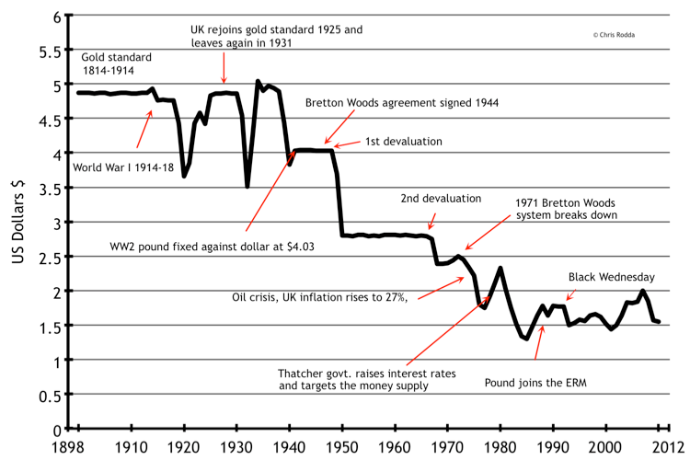
Exchange Rates
UK Sterling .v. Dollar

Slide 55
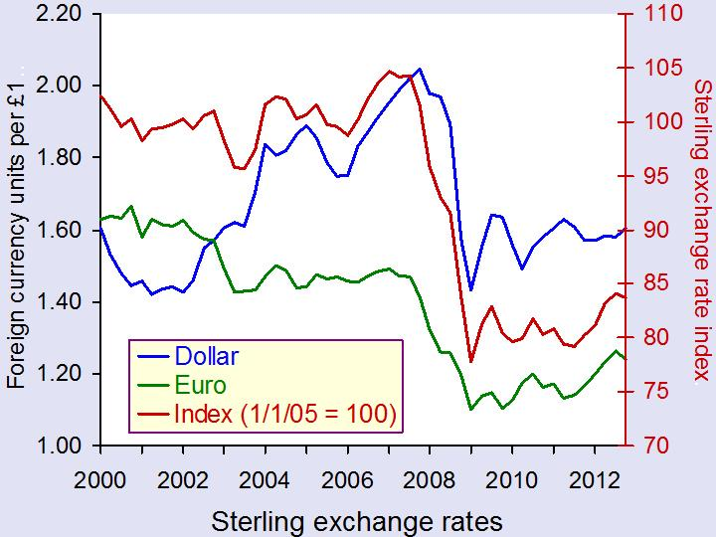
Exchange Rates
UK Sterling .v. Rest….

Slide 56
Current Account
Role of Exchange Rates
CAUSES
Interest Rates
Inflation Rates
Economic Growth
Current account
Political factors
CHANGES IN EXCHANGE RATES
EFFECTS
Current account
Inflation
Economic Growth
Unemployment

Slide 57
Role of Exchange Rates Exercise
JANUARY 2015
An appreciating Exchange Rate
FEBRUARY 2015
A depreciating Exchange Rate
The Swiss Central Bank stops trying to control it’s exchange rate (managed or ‘dirty’ float) to follow the euro’s progress and leaves it FULLY to the free market (floating exchange rate).
The exchange rate appreciates immediately by 30%
Explain what the possible consequences will be for:
  The current account
  The overall economy (so growth, inflation and unemployment)
  The capital account
EXTENSION: What can the Government do?
The Greek elections take place on the 25th January (this Sunday) and the left wing part ‘Syriza’ are elected on a platform of ‘anti-austerity’. This is basically against Germany’s plan for Greece that is should be bailed out as long as it has a plan for ‘Austerity’.
By 1st February, this reaches a fever pitch and the Greek’s pull out of the Eurozone and reintroduce the ‘Drachma’ as their currency which immediately depreciates at the level the Greek central bank set it.
Explain what the possible consequences will be for :
  The current account
  The overall economy (so growth, inflation and unemployment)
  The capital account
EXTENSION: What can the Government do?

Slide 58
Further Terminology and Issues with Global Economics
Productivity
Export led Multiplier
Globalisation
BRIC countries – “Emerging Economies”
Free Trade .v. Protectionism (Global Economics)
Role of WTO (World Trade Organisation)
Role of Exchange Rates (Monetary Policy)
Trading BLOC: EU, NAFTA etc.

Slide 59

The WTO
Free Trade .v. Protectionism

Slide 60
Current Account
Trading BLOCs
EU – European Union
NAFTA – North American Free Trade Agreement
EFTA – European Free Trade Agreement

Slide 61
RECAP: Balance of Payments
Factors affecting the Balance of Payments
Define and explain how each of these factors could affect the Balance of Payments
GDP growth and lower unemployment
Productivity
Inflation
Interest Rates (Base Rate set by Bank of England)
FDI Levels
High propensity to save
Health of the Global Economy

Slide 62
90: Controlling Deficits and Surpluses

Slide 64
Balance of Payments
Questions you should be able to answer at this stage….
TASK 1: Read the article and summarise why Larry Elliot thinks the current account deficit is worrying and why it is like this.
TASK 2: Be able to answer these questions
Define the balance of payments
Does the balance of payments record just the actions of the Government?
What is causing the current trade deficit in the UK?
What is causing the capital account surplus in the UK?
What might happen to the current account of Greece if it adopted the Drachma as its currency?
If the current account is in deficit, what should the capital account be? Surplus or deficit?

Slide 65
Balance of Payments ‘Deficit/Surplus’
Case Study: The UK and Chinese Economies
A capital account surplus pays for (finances) a current account deficit. If the deficit reflects the import of machinery and equipment that will raise future growth, this is good and sustainable. If it merely funds the import of consumption goods, it may not be.
Long run, could there be a balance of payments crisis if all these foreign firms pulled their money out of the UK?
The Chinese Economy
Imbalances with the USA?
  China sells USA plastic toys
  USA borrows money from China to pay for the toys
  Chinas Foreign Reserves increase as they stockpile US treasury bonds

Slide 66
UK CASE STUDY
Balance of Payment Deficit
CHINA CASE STUDY
Balance of Payment Surplus
Advantages | Disadvantage
Boost to living standards – consumers buying more imports (UK’s standard of living has risen since 1980’s especially through the ‘Goldilocks years’) | Does rampant consumerism arguably as a result of lower imports lead to less of a propensity to save (which might affect the levels of domestic loan funds available?). Causes agents in the economy to borrow money from abroad.
Fall in AD prevents an overheating economy – deflationary effects | Fall in AD could lead to greater unemployment and slower economic growth or even a recession. Consumers rely on foreign goods rather than domestic; not sustainable in the long run
Short run a trade deficit can just be financed through foreign borrowing, selling off foreign assets or encouraging FDI (UK economy from 1980’s until today) Also, the deficit will not get too out of control if the exchange rate is floating. The Global FOREX markets will ensure that equilibrium is eventually restored | Long run, a trade deficit can be unsustainable and eventually might trigger a ‘balance of payments crisis’ as the country is unable to attract more capital from abroad. The currency might devalue causing an immediate stop to imports and ‘Capital Flight’. This will result in a fall in living standards(East Asian Financial Crisis 1997) What if the deficit is caused by long term lack of competitiveness?
 | In the short run, if investment income is falling, this suggest that the country is either too reliant on FDI inflows or/and it has sold off a lot of foreign assets
Advantages | Disadvantages
Increase in AD leads to jobs and stronger economic growth especially with the ‘export-led’ multiplier | Imports are more expensive which can lead to inflationary cost-push pressures Demand pull inflationary pressures from the ‘export multiplier’ from large flows of money from export revenue
 | Can cause global issues – one countries surplus is another countries deficit (China and the US 2011)

