Slide 1
Introduction to Benchmark 1
Introduction to the EXAM
Paper 1 (Microeconomics)
Choice of 2 Data Response Questions
2 Mark: Calculation
4 Mark: Definition and Data
9 Mark: Explanation (Application of Theory)
25 Mark: Essay (Evaluation)
Choice of 3 Questions
15 Mark: Explanation
25 Mark: Essay (Evaluation)
Paper 2 (Macroeconomics)
Choice of 2 Data Response Questions
2 Mark: Calculation
4 Mark: Definition and Data
9 Mark: Explanation
25 Mark: Essay (Evaluation)
Choice of 3 Questions
15 Mark: Explanation
25 Mark: Essay (Evaluation)
Paper 3 (Synoptic)
Choice of 1 Unseen Case Study
25 Marks: Multiple Choice
10 Mark: Data Evaluative
15 Mark: Explanation
25 Mark: Essay (Evaluative)
TODAY
Introduction to the final assessment
Introduction to Benchmark 1 (and homework)
Review of Mind Map
Price determination questions
Taxation and Subsidies
Introduction to 2, 4 and 9 Mark Questions
THURSDAY (Olly Away) – work on GOL
Price determination questions
PPF and Circular Flow questions
Revision
MONDAY
Price determination
PPF Questions
TUESDAY
Benchmark!
THURSDAY
Introduction to RWS 3 and Half-term Homework
STARTER: Task A and B to be completed in 1st 10 Minutes
TASK A: Please get out the following for inspection:
Mind Map
Price determination sheet answers
TASK B: In three’s, look through the exam papers on display and work out how the final exam in two years is structured

Slide 2
Benchmark 1 = 1Hour Long
MICRO – 30 Minutes
Multiple Choice
10 MC Q’s
Unseen Case Study (no choice)
2 Mark
4 Mark
9 Mark
MACRO – 30 Minutes
Multiple Choice
10 MC Q’s
Unseen Case Study (no choice)
2 Mark
4 Mark
9 Mark

Slide 3
Benchmark 1 = Revision Methods
Best way to revise?
CONTENT: Mind map overview – connections, remind yourself of key words etc.
SKILLS: Practice past questions (available on GOL)

Slide 4
MIND MAP OVERVIEW
RWS 1
RWS 1
Benchmark 1
Micro
Macro
RWS 2
RWS 2

Slide 5
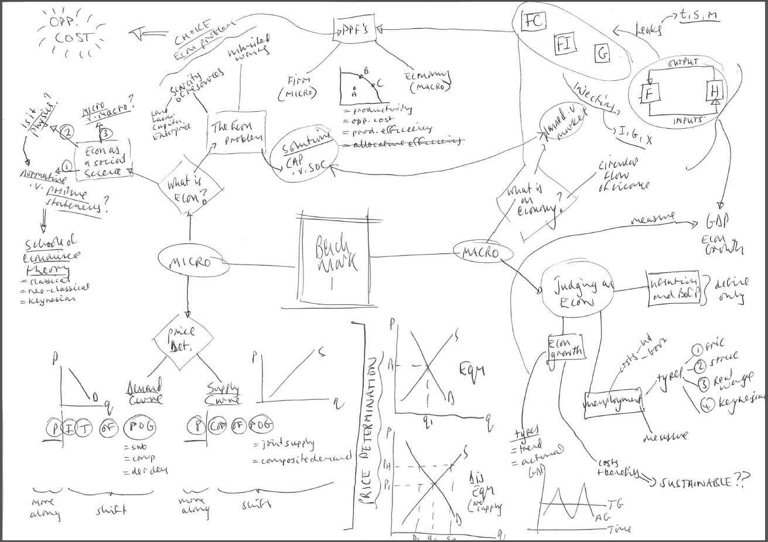
Or……

Slide 6
Price Determination Questions
Compare in 3’s the first 10 questions
Answer the following questions as well. Each question will need a diagram:
  The Government imposes an indirect tax (VAT) onto cabbages…explain what would happen to the price and quantity of cabbages
  The Government provide subsidies to firms who pursue clean technologies. What would happen to the price and quantity of car manufacturers who develop electric cars rather than fossil fuelled cars?
  The agricultural market in the UK will suffer because of BREXIT as the market will lose the EU subsidies it currently enjoys. What will happen to the price of food stuffs in the UK as a result?
  Government decides to cut income tax received by workers. What might happen to the price and quantity of cabbages as a result?

Slide 7
90

Slide 8
Introduction to Benchmark 1
Introduction to the EXAM
Paper 1 (Microeconomics)
Choice of 2 Data Response Questions
2 Mark: Calculation
4 Mark: Definition and Data
9 Mark: Explanation (Application of Theory)
25 Mark: Essay (Evaluation)
Choice of 3 Questions
15 Mark: Explanation
25 Mark: Essay (Evaluation)
Paper 2 (Macroeconomics)
Choice of 2 Data Response Questions
2 Mark: Calculation
4 Mark: Definition and Data
9 Mark: Explanation
25 Mark: Essay (Evaluation)
Choice of 3 Questions
15 Mark: Explanation
25 Mark: Essay (Evaluation)
Paper 3 (Synoptic)
Choice of 1 Unseen Case Study
25 Marks: Multiple Choice
10 Mark: Data Evaluative
15 Mark: Explanation
25 Mark: Essay (Evaluative)
STARTER: Task A and B to be completed in 1st 10 Minutes
TASK A: Please get out the following for inspection Thursdays tasks:
Price Determination Questions
PPF and CFI Questions
TASK B: Compare the answers to your questions above…have you got them correct…if there are any differences, why? Perhaps make a note of disagreements to share with the class
MONDAY
Price determination
PPF Questions
Exam Technique
Final bits of info:
  Economic Growth: Concept of ‘spare capacity’
  Economic Growth: PPF work
  Unemployment: Work .v. Leisure
TUESDAY
Benchmark!
THURSDAY
Introduction to RWS 3 and Half-term Homework

Slide 9
EXAM TECHNIQUE PRACTICE
2 Mark: Calculation
  Display any working out
  Display units correctly
4 Mark: Definition and Data
  Define
  Evidence
  Explanation
9 Mark: Explanation (Application of Theory)
  Definition of key terms
  Explanation Paragraph
  Explanation Paragraph 2 if appropriate
WRITING PARAGRAPHS for 9, 15 and 25 marks
Point (sentence)
Analysis (theory, diagrams and chains of logical explanation)
Application (real life examples and reference to extracts if appropriate)
Link back to Question using the wording in the question (sentence)
N.B. Some paragraphs will contain more Analysis or more Application depending on the point; do not assume it is 50:50

