Slide 1
MACRO PRACTICE QUESTIONS

Slide 2
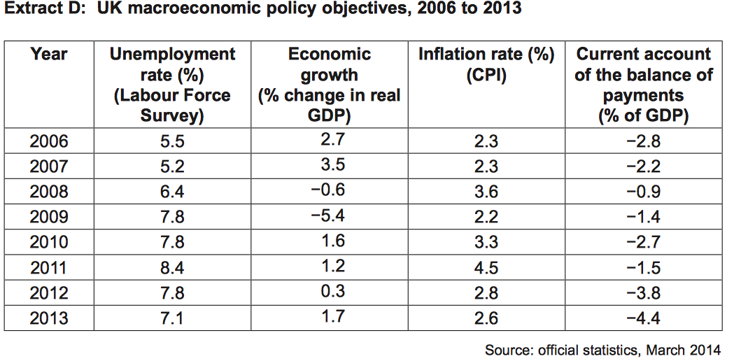
QUESTION 1
(1) Calculate the mean average inflation rate from 2010 to 2013 (2 marks)
(2) Explain how the data in Extract D shows that the UK economy was in recession at some point between 2006 and 2013 (4 marks)
(3) Using a relevant diagram, explain how actual growth might lead to a reduction in unemployment (9 marks)

Slide 3
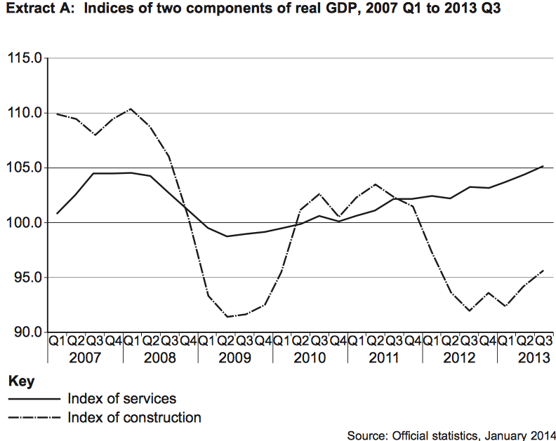
QUESTION 2
(1) Calculate the percentage change in ‘index of construction from 2007 Q1 (110) to Q3 2013 (96) to 2 decimal places (2 marks)
(2) Explain how the data in Extract A, shows how growth in different sectors of the economy are more volatile than others (4 marks)
(3) Explain how an increase in the construction industry will increase economic growth in an economy (9 marks)

Slide 4
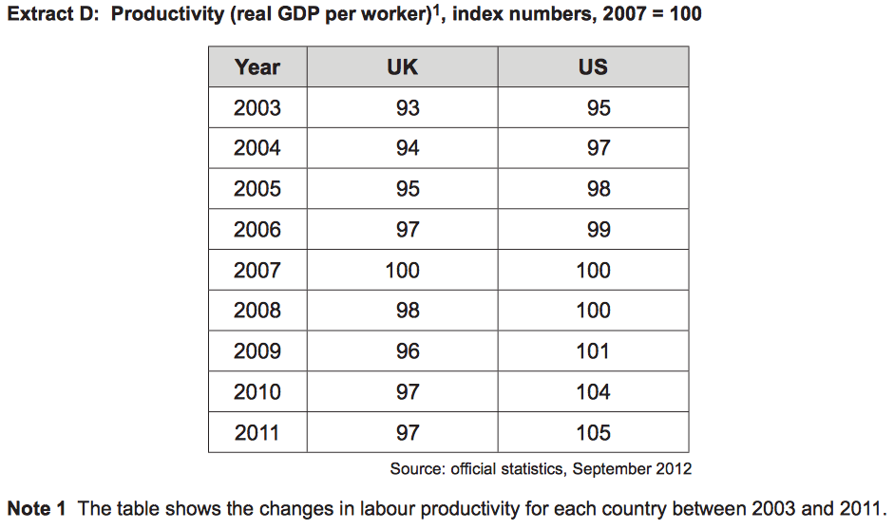
QUESTION 3
(1) Calculate the percentage decrease for the UK productivity from 2005 to 2006 to 2 decimal places (2 marks)
(2) Explain how the data in Extract D, shows that the productivity in the UK differs from the USA (4 marks)
(3) Using a diagram, explain how trend and actual growth might increase in an economy (9 marks)

Slide 5
QUESTION 4
(1) Calculate to 2 decimal places the percentage decrease in unemployment from 2008 to 2009 (2 marks)
(2) Explain how the data in Extract A might show a relationship between economic growth and unemployment (4 marks)
(3) Explain why structural unemployment might be considered to be both voluntary and involuntary unemployment (9 marks)

