Slide 1
MACRO PRACTICE QUESTIONS

Slide 2
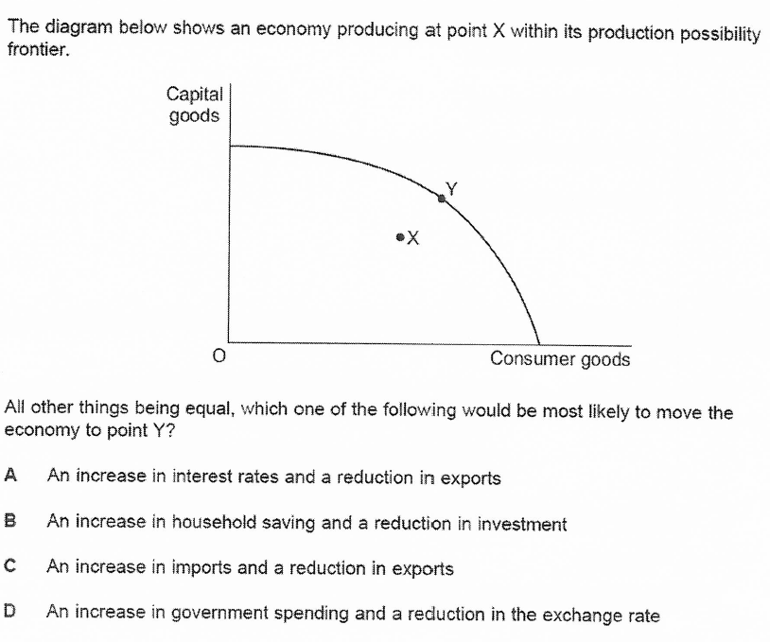
Q1

Slide 3
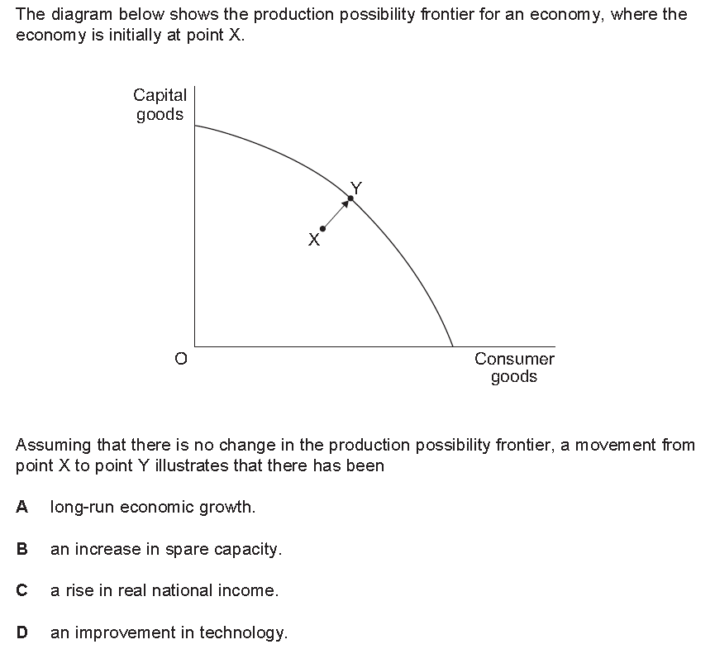
Q2
an increase in the trend growth rate

Slide 4
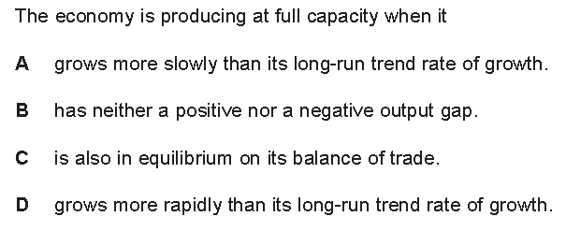
Q3

Slide 5
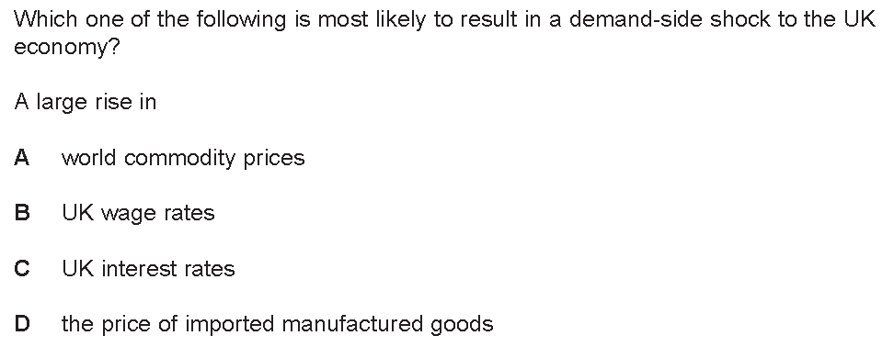
Q4

Slide 6
Q5
A supply side shock to cause a downturn in the economic cycle might be:
Cheaper imports as a result of increased Globalisation
OPEC cutting production
A fall in consumer confidence
A fall in incomes

Slide 7
Q6
A negative output gap in an economic cycle is most likely to be where:
There is a downturn in the economy
Unemployment starts to fall
Growth is above the trend growth rate
Growth is below the productive capacity of the economy

Slide 8
Q7
Inflation is best described as:
The amount of people who are starting to lose their jobs
A rise in prices of goods in the economy
An average price increase in a common basket of goods and services in the economy
A rise in economic growth

Slide 9
Q8
The period from 1992 to 2007 characterised with stable inflation, sustainable high growth and low unemployment is called:
The Great Moderation
The Red Riding Hood Economy
The Lawson Boom
The Barber Boom

Slide 10
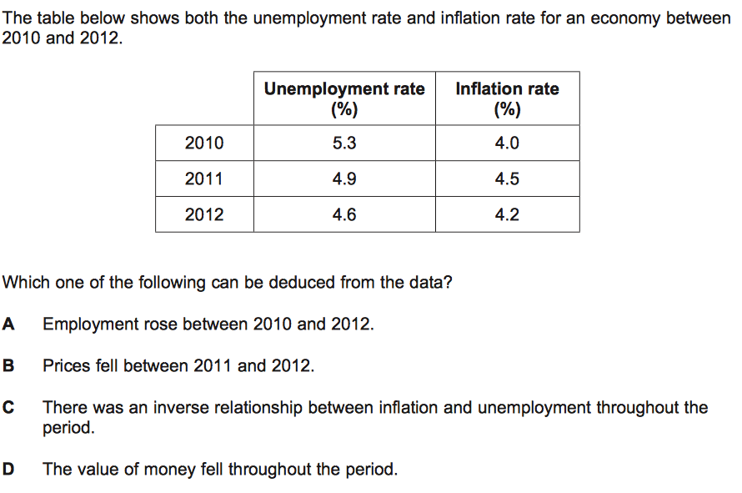
Q9

Slide 11
Q10
The PPF will shift outwards because of:
A reduction in unemployment
BREXIT causing European nationals to leave the UK
An increase in the productivity of ‘capital goods’
An increase in consumer spending

Slide 12
Q11

Slide 13
Q12

Slide 14
Q13
The balance of payments is best described as:
All the money flows into and out of the economy
Measuring trade flows into and out of the economy
Measuring investment flows into and out of the economy
None of the above

Slide 15
Q14
The PPF line can be best described as representing the following in the economy:
Levels of unemployment
The productive capacity of the economy
The inflation capacity of the economy
Total resources of the Government

Slide 16
Q15
Classical unemployment is where
Workers are refusing to lower their wages and therefore are sacked
Workers lose their jobs because of downturns in the economy
Workers lose their jobs because of the threat of globalisation
Workers lose their jobs because they only work in the summer

Slide 17
ANSWERS macro
1D
2C
3B
4C
5B
6D
7C
8A
9D
10C
11B
12B
13A
14B
15A

