Slide 1
MICRO PRACTICE QUESTIONS

Slide 2
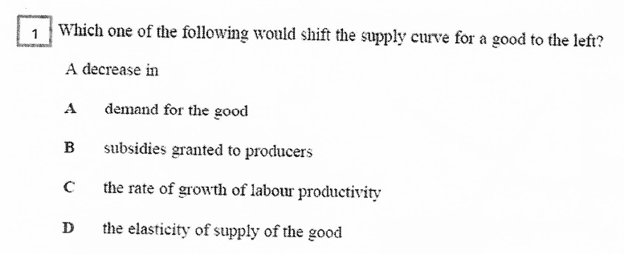
Q1
Income in the United Kingdom falls

Slide 3
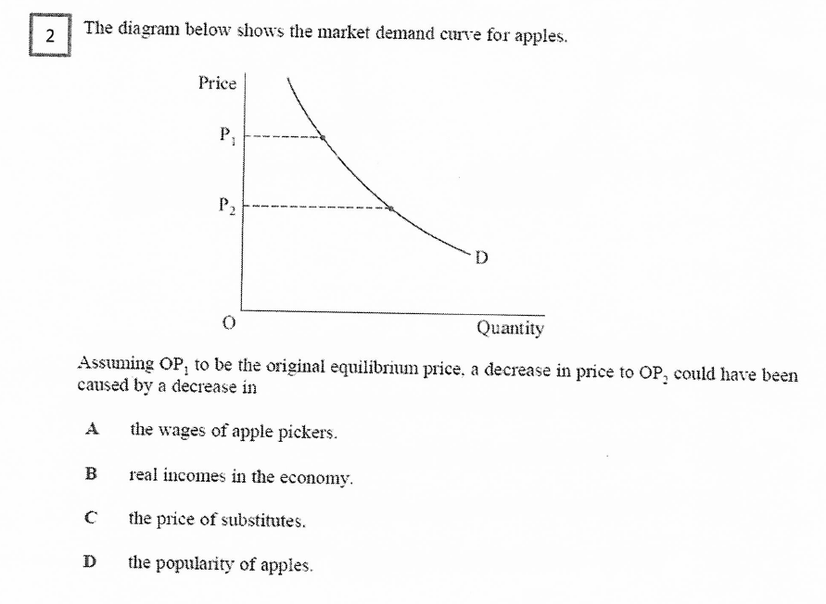
Q2

Slide 4
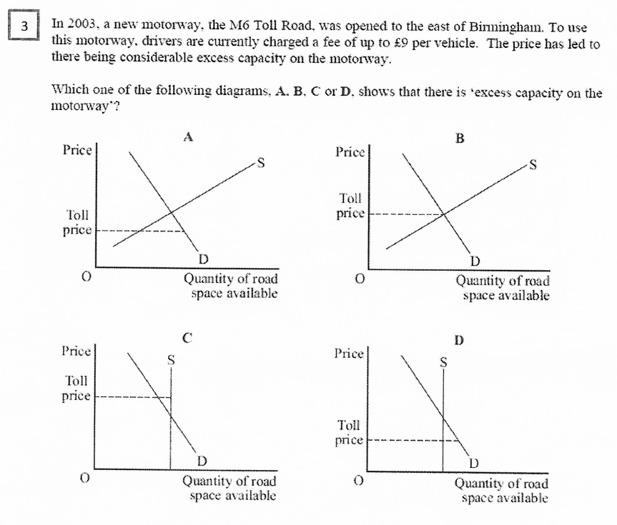
Q3

Slide 5
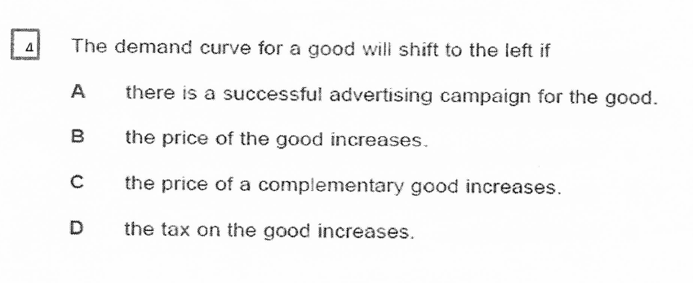
Q4

Slide 6
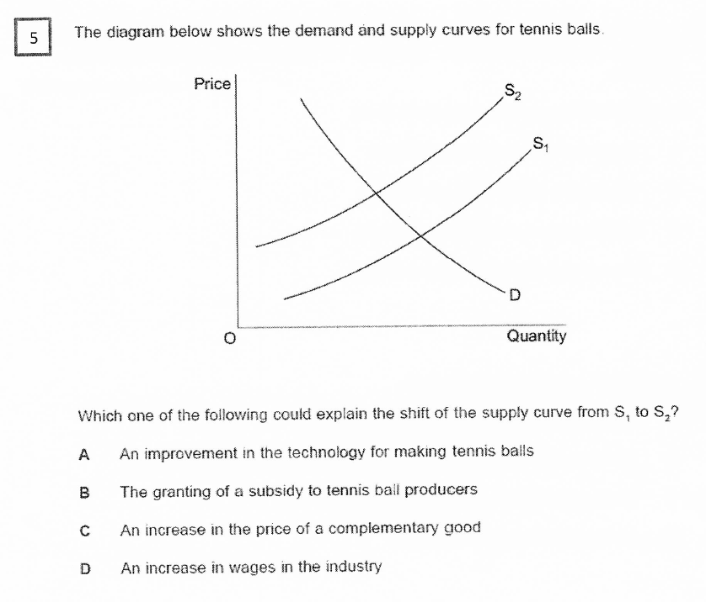
Q5

Slide 7
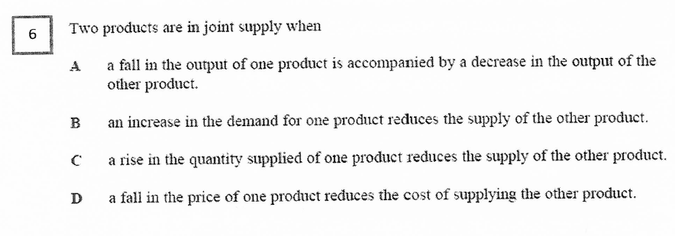
Q6

Slide 8
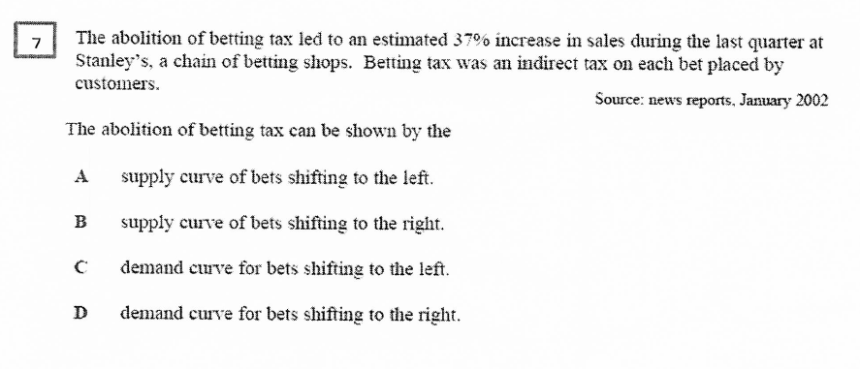
Q7

Slide 9
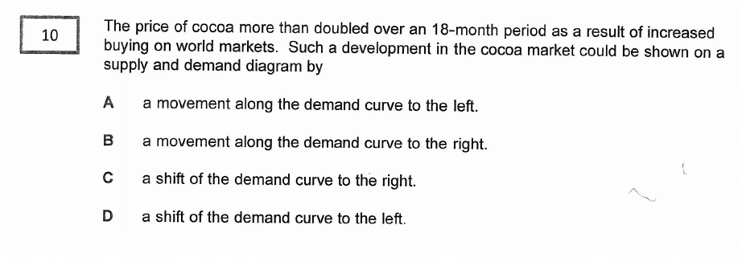
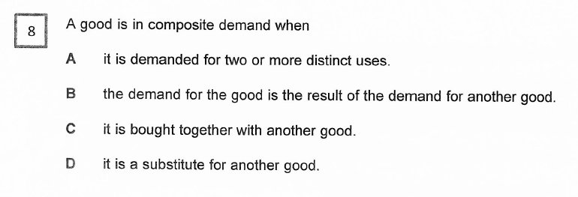
Q8

Slide 10
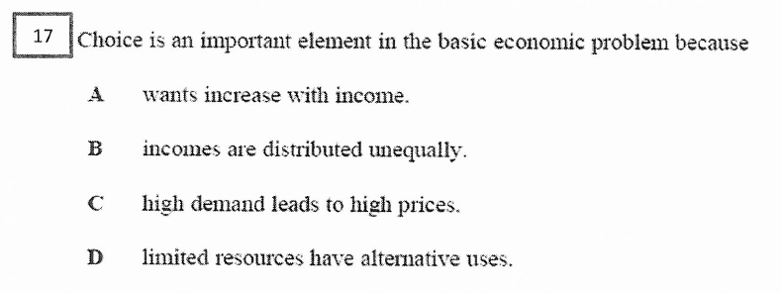
Q9

Slide 11
Q10
Which one of the following may lead to a rightward shift of the demand curve for coffee?
New research suggests that coffee is seen as a dangerous toxin to the body
Incomes of citizens of the UK increase
The price of a coffee substitute falls
The price of coffee plummets

Slide 12
Q11
Which one of the following will result in a movement along the demand curve for a good?
An advertising campaign
An increase in the price of a substitute for another good
An increase in incomes
A change in the price of the good

Slide 13
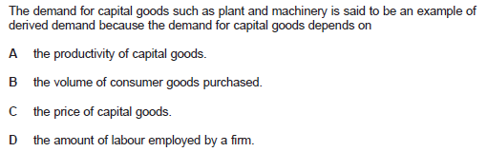
Q12

Slide 14
Q13
The diagram below shows the market for beef
If the initial equilibrium is indicated by point Y, what will be the new equilibrium position if the cost of producing beef rises and the price of chicken falls? A E B F C G D H

Slide 15
Q14
On a supply and demand diagram, other things remaining the same, an increase in consumers income will normally shift
A The demand curve to the right.
B The supply curve to the right.
C The demand curve to the left.
D The supply curve to the left.

Slide 16
Q15
A PPF DIAGRAM CAN BE USED TO DEMONSTRATE:
A: Scarcity
B: Choice
C: Opportunity Cost
D: All of the above

Slide 17
ANSWERS
1 B
2 A
3 C
4 C
5 D
6 A
7 B
8 C
9 D
10 B
11 D
12 B
13 D
14 A
15 D

