Slide 1
MICROECONOMICS
DATA RESPONSE QUESTIONS

Slide 2
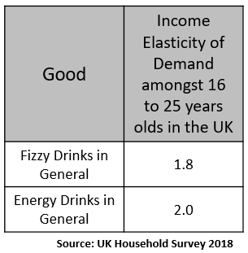
Question 1
Extract B
It is estimated that today’s obesity epidemic costs the global economy about $2tn (£1.6tn) or some 3% of GDP. For individuals, deciding what to eat is a jealously guarded privilege, but for economists obesity is not really about people exercising free-market choice. Instead it is a market failure.
The political spotlight is now on sugar, with “environmental” changes proposed to reduce the appeal of sugary foods, such as warning labels and nutritional information panels. There’s serious talk of taxing them, in the way that tobacco has been. None of this is supported by any real evidence, but certainly new taxes are always popular with governments. (It’s pretty obvious, after all, that there are plenty of thin children who enjoy sugary foods, and plenty of overweight people whose tastes lie elsewhere.)
Obesity affects poor households far more than their richer neighbours – and the cost of eating healthily is a very practical reason why.
And, as the US economist Richard McKenzie has pointed out, much of the rise of obesity is precisely a consequence of free-market economics. For example, fast food has become cheaper, in part because of mechanisation and in part because the workers producing it are paid less and less. At the same time, the economic forces that propelled 1960s women away from the kitchen and into jobs also propelled families towards processed foodstuffs and eating out … or just snacking.
Adapted from Guardian article 24th November 2016
Extract A
If the Price elasticity of demand for fast food is -0.3, what would the percentage increase in price be if the quantity demanded fell from 100 fast food meals to 90 fast food meals (2 marks)
Explain using Extract A how the household survey data on income elasticity of demand demonstrates why obesity levels maybe rising (4 marks)
Explain the effect of a tax on both consumers and producers and explain using some of the information in extract B why a tax on sugar might be effective in reducing the problems of obesity in children (9 marks)

Slide 3
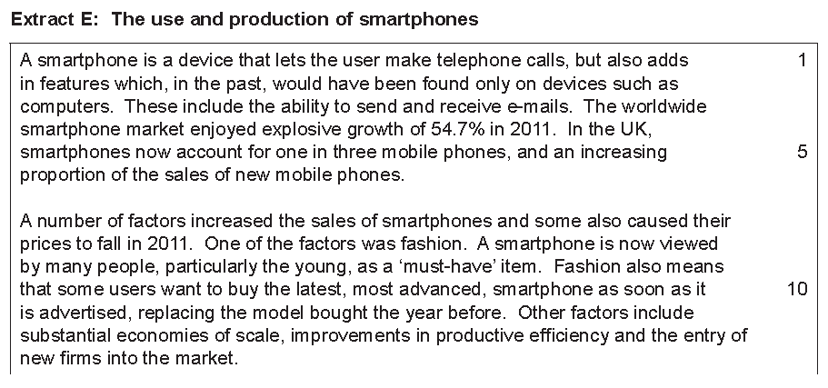
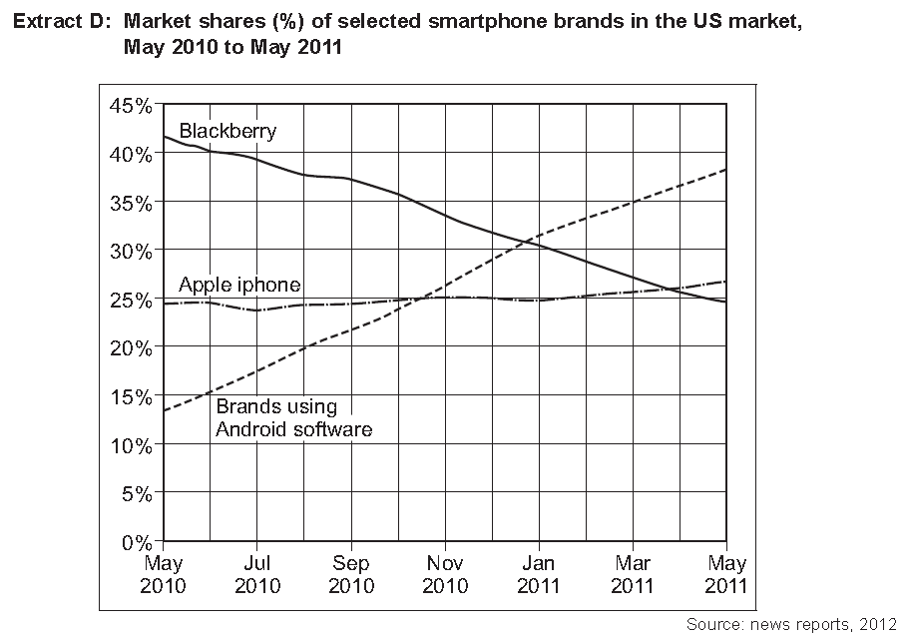
Question 2
If the price of apple iphones increases by 10% and the quantity of iphones sold falls by 1%, calculate the PED to 1 decimal place (2 marks)
Explain how the data in extract D shows that the market for smartphones remained allocatively efficiency when some consumers decided they did not like Blackberry phones anymore (4 marks)
With the help of the information in Extract E and taking elasticity into account, explain using a diagram two possible reasons for the change in the sales of smartphones in 2011 (9 marks)

Slide 4
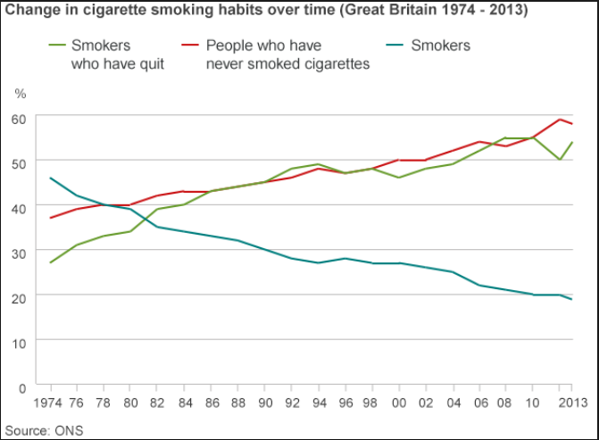
Question 3
Extract A
Extract B
Philip Morris has launched a new, less harmful cigarette in the UK which it says could mean halting sales of its conventional tobacco products. The so called IQOS product heats tobacco rather than burning it.
The tobacco giant claims this means smokers get the same nicotine hit, but 90% less of the nasty toxins that come with cigarette smoke. The new product is likely to cause less harm than compared to a conventional cigarette.
The IQOS is a £45 battery pack that looks like a small, dumpy mobile phone. The IQOS creates much less smoke than a conventional cigarette.
It charges a slim cigarette holder. You buy packets of tobacco sticks - a packet of 20 will cost £8 - that look like someone has taken a pair of scissors to normal cigarettes and chopped them in half.
The stick goes in the holder, and you puff away. There is much less smoke than a conventional cigarette, and, users say, the smell does not stick to your clothes. Other cigarette companies are not far off producing rival versions.
Adapted from BBC News article 30th November 2016
Calculate how much income would have to rise by as a percentage if the quantity demanded of cigarettes increased by 2% and the income elasticity of demand for cigarettes is +0.4 (2 marks)
Explain how the data in Extract D shows that taxes on cigarettes have been successful in reducing cigarette consumption (4 marks)
Explain what the basic economic problem is and analyse why the scenario in Extract B is a good example of why markets work in efficiently allocating scarce resources (9 marks)

Slide 5
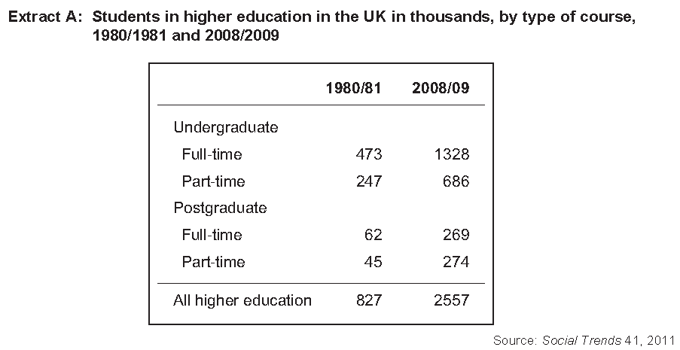
Question 4
Calculate the percentage increase in full and part-time undergraduate students from 1980/81 to 2008/09 (2 marks)
Explain why the data in extract A shows there might have been an effect on labour productivity for UK firms? (4 marks)
Higher education refers to students going to University. Explain why subsidising Universities might lead to benefits for prospective students? (9 marks)

Slide 6
MACROECONOMICS
DATA RESPONSE QUESTIONS

Slide 7
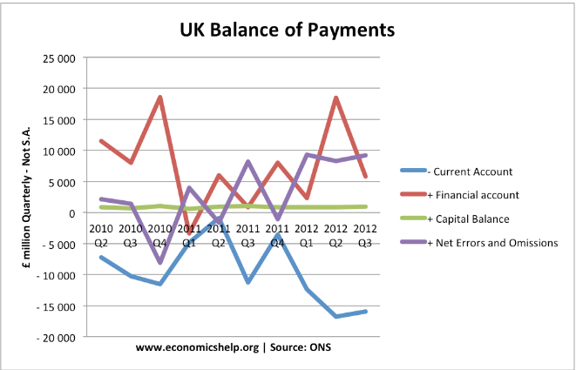
Question 1
Extract B: Current Account Deficits in the US, Developing Countries and the Eurozone
One of the most important features of the current account is that it can be a sign of relative competitiveness.
This is particularly noticeable for countries in the Eurozone with a fixed exchange rate. Southern European economies such as Italy which became uncompetitive saw record current account deficits. Because prices and costs increased in southern Europe, it was more attractive for countries to import from northern Europe. In the Euro, there is no scope for uncompetitive countries to devalue the exchange rate, therefore the imbalances can be large.
In the case of the US, they experienced a current account deficit of nearly 6% of GDP at the end of the 2000s economic boom. However, the downturn of 2008-09 helped to gradually restore equilibrium. The dollar has slightly fallen against the Chinese currency to slowly erode the disequilibrium that exists.
For developing counties who may run a current account deficit, there maybe advantages in the short term to increase local productivity and exports in the future. In the short-term, a current account deficit is mostly advantageous. Foreigners are willing to invest capital into a country to drive economic growth beyond what it could manage on its own. However, in the long term, a current account deficit can drain economic vitality and maybe unsustainable.
Adapted from various news sources
Extract A
Calculate the percentage decrease from 2010 Q2 to 2012 Q3 on the current account for the UK (2 marks)
Explain how the diagram shows a current account deficit on the balance of payments account for the UK in this period (4 marks)
Using information from extract B as well as your own economic knowledge, explain why a current account deficit might be considered to be both beneficial and detrimental to the UK economy’s macroeconomic indicators? (9 marks)

Slide 8
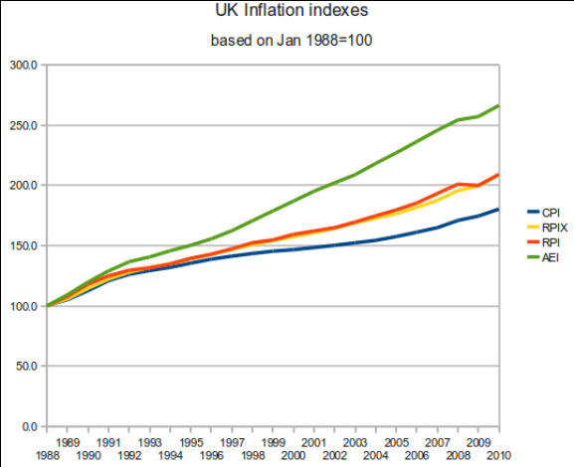
Question 2
Extract B: UK inflation in October 2016
The UK inflation rate registered a surprise fall in October 2016. Consumer Prices Index (CPI) inflation fell to 0.9%, from 1% in September, the Office for National Statistics said.
That was below the 1.1% predicted by economists, who said sterling's fall would push October's CPI higher. However, the ONS said the costs of raw materials rose much faster in October. The price of goods leaving factories rose by 2.1%, faster than expected and the biggest increase since April 2012. And costs faced by producers for raw materials and oil showed a record monthly jump in October, up by 4.6%.
"After initially pushing up the prices of raw materials, the recent fall in the value of the pound is now starting to boost the price of goods leaving factories as well," ONS statistician Mike Prestwood said.
"However, aside from fuel, there is no clear evidence that these pressures have so far fed through to the prices in shops," he said.
The cost of clothing and university tuition fees rose more slowly than in 2015, however, helping to keep inflation in check. The ONS said certain games and toys, overnight hotel stays and non-alcoholic beverages fell in price. The pound has fallen about 16% against the dollar and about 11% against the euro since June. Nick Dixon, investment director at Aegon, said the trajectory for interest rates was also upwards.
"While slowing price growth may have come as a surprise to the markets, the days of low interest rates are numbered," he said.
The Retail Prices Index (RPI) - a separate measure of inflation, which includes housing costs - was 2% in October, unchanged from September, the ONS said.
Adapted from various news sources
Extract A
Calculate the percentage increase of the UK’s official inflation rate today from 1988 to 2010 (2 marks)
Explain how the graph shows that for this data, there has been no deflation in the UK in this period (4 marks)
Explain what inflation is and why should the UK not be worried about inflation in 2017? (9 marks)

Slide 9
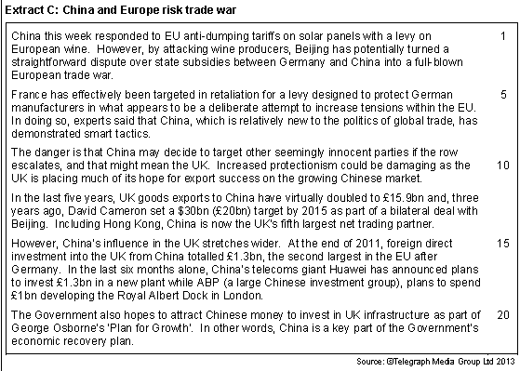
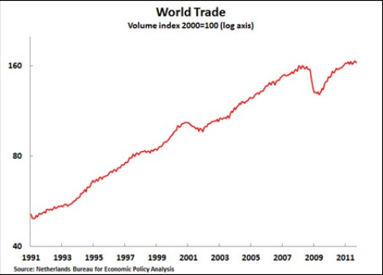
Question 3
Extract A
Calculate the percentage increase in World Trade from 1991 (55) to 2011 (160) (2 marks)
Explain how the graph shows that Globalisation has become more prevalent in the world from 1991 to 2011 (4 marks)
Using elements of extract C and your own economic knowledge, explain why Globalisation has arguably had a detrimental effect on the world economy? (9 marks)

Slide 10
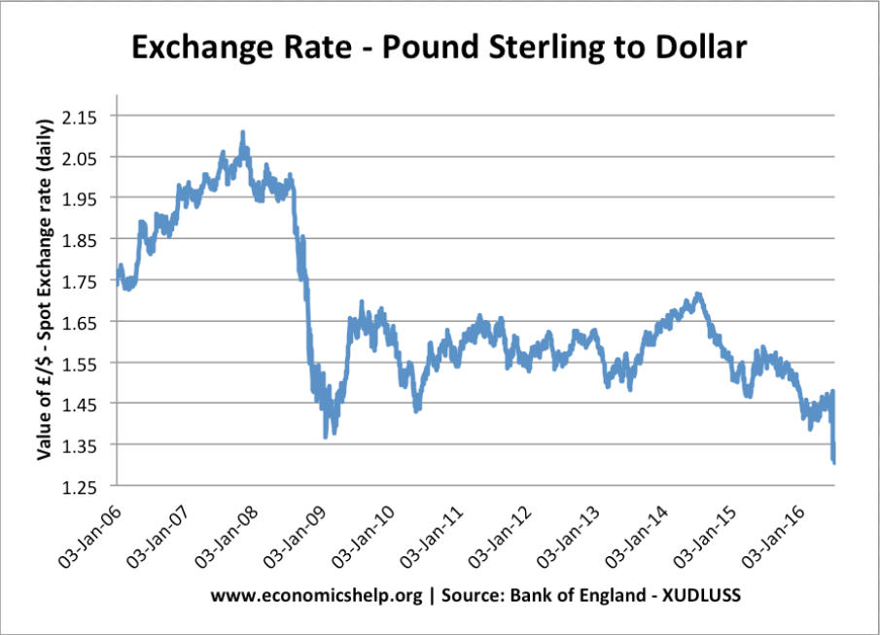
Question 4
EXTRACT B: Weak Pound and UK Farmers
You might think the most important thing happening in the UK farming industry is the summer harvest. But as the fields of wheat and barley are brought in for the winter, farmers will have their eye on something other than the weather.
"The exchange rate between the pound and the euro is absolutely vital. It is the single biggest determinant of the profitability of British farming," says Anand Dossa, economist at the National Farmers Union.
The average exchange rate between the euro and the pound in September will determine how much money UK farmers get from the European Union's Common Agricultural Policy (CAP) - the source of more than half of UK farming's income last year.
CAP payments are set in euros, so what British farmers get depends on the exchange rate; last year they got the worst rate in eight years.
Since the EU referendum the pound has fallen to 30-year lows against the dollar and has weakened significantly against the euro.
This means there could be a 15% increase in farmers' EU subsidies once they're converted into sterling - about an extra £500m.
However, the weaker pound can make fuel, fertiliser and food for animals more expensive, but there is some evidence that in some areas it has already given a boost to UK produce, both at home and abroad.
Adapted from BBC News Sources August 2016
Extract A
Calculate the index number of the 03rd January 2009 ($1.35 to £1) if the base year is 03rd January 2008 ($2.10 to £1) (2 marks)
Explain why the graph demonstrates a possible reasons for why the current account deficit is improving (4 marks)
Using the extracts and your own economic knowledge explain how the weakening pound can benefit the UK economy’s macroeconomic indicators? (9 marks)

