Slide 1
MICROECONOMICS
MULTIPLE CHOICE QUESTIONS

Slide 2
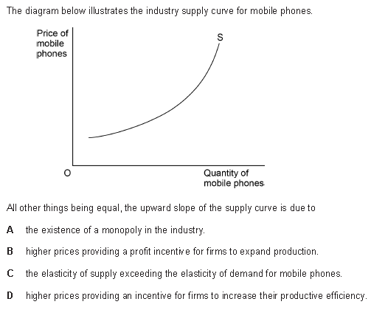
QUESTION 1

Slide 3
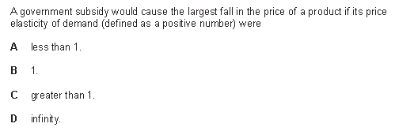
QUESTION 2

Slide 4
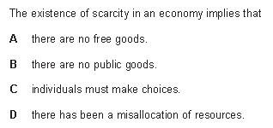
QUESTION 3

Slide 5
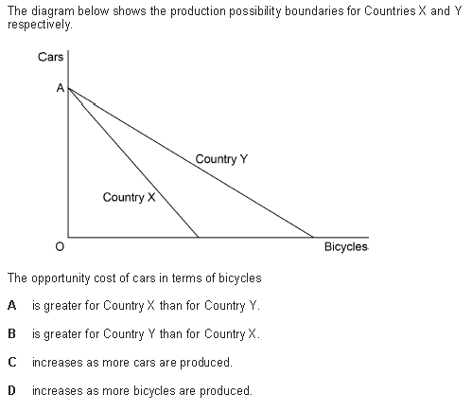
QUESTION 4

Slide 6
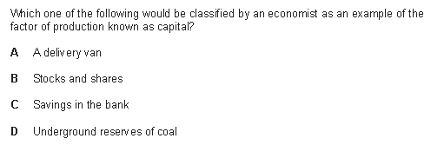
QUESTION 5

Slide 7
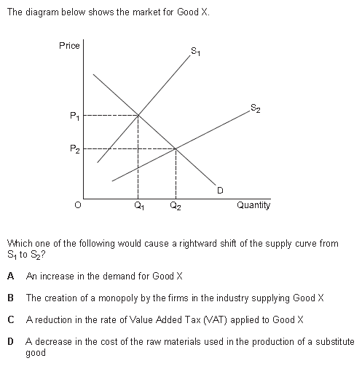
QUESTION 6

Slide 8
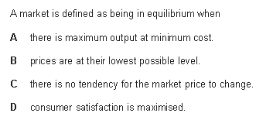
QUESTION 7

Slide 9
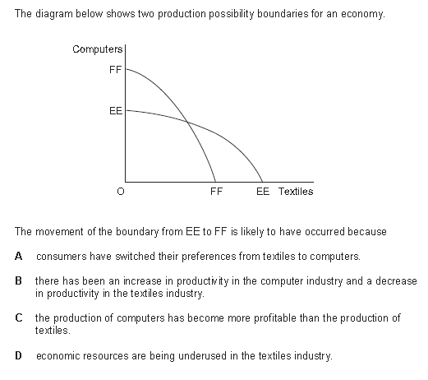
QUESTION 8

Slide 10
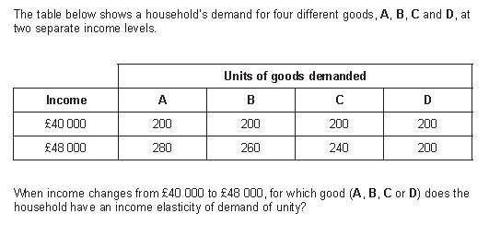
QUESTION 9

Slide 11
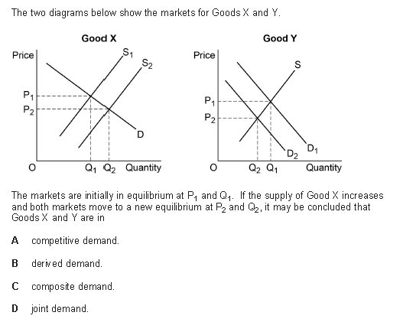
QUESTION 10

Slide 12
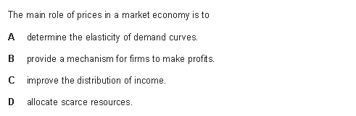
QUESTION 11

Slide 13
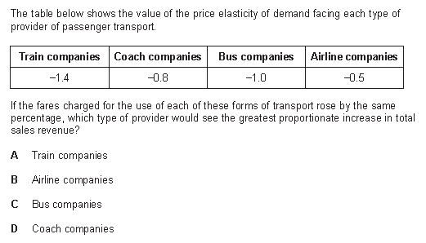
QUESTION 12

Slide 14
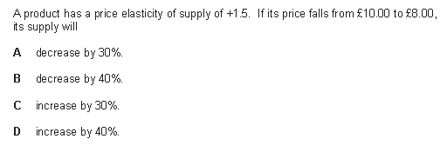
QUESTION 13

Slide 15
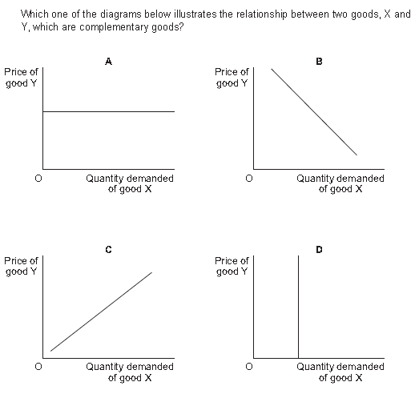
QUESTION 14

Slide 16
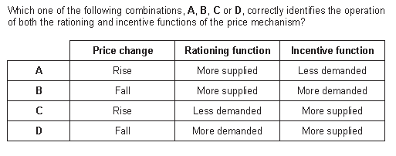
QUESTION 15

Slide 17
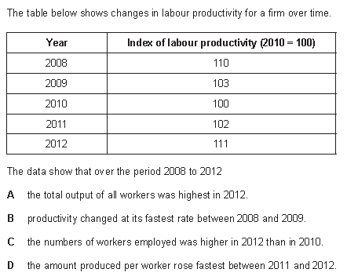
QUESTION 16

Slide 18
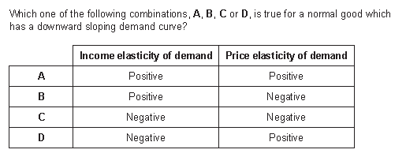
QUESTION 17

Slide 19
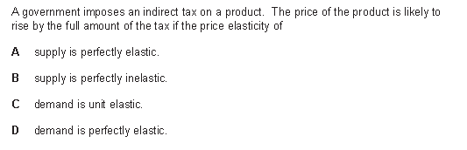
QUESTION 18

Slide 20
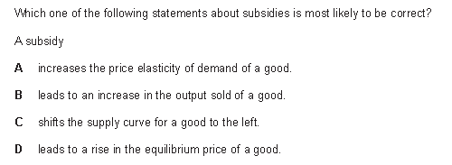
QUESTION 19

Slide 21
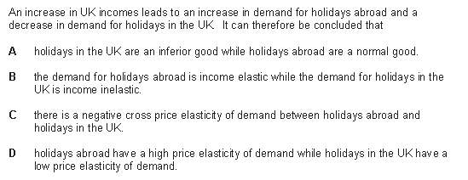
QUESTION 20

Slide 22
MICRO ANSWERS
1B
2A
3C
4A
5A
6C
7C
8B
9C
10A
11D
12B
13A
14B
15C
16D
17B
18A
19B
20A

Slide 23
MACROECONOMICS
Multiple Choice Questions

Slide 24
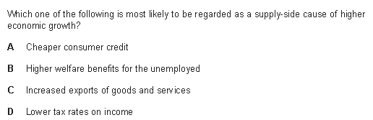
QUESTION 1

Slide 25
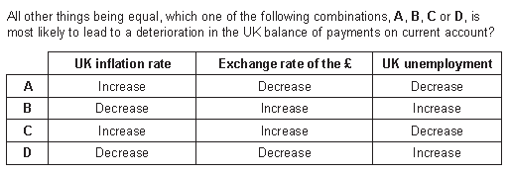
QUESTION 2

Slide 26
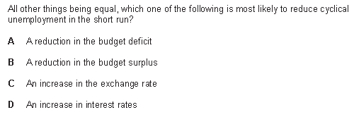
QUESTION 3
Increased Taxation
Increased Government Spending
Increased in the Cost of Borrowing for Firms

Slide 27
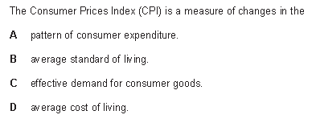
QUESTION 4

Slide 28
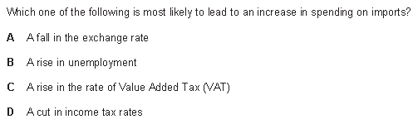
QUESTION 5

Slide 29
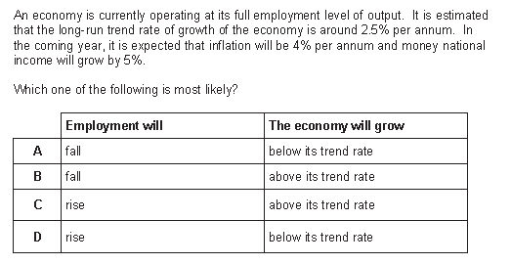
QUESTION 6

Slide 30
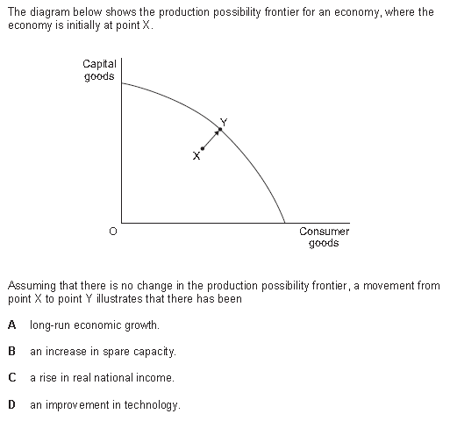
QUESTION 7

Slide 31
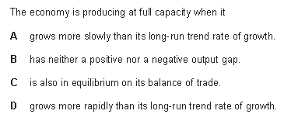
QUESTION 8

Slide 32
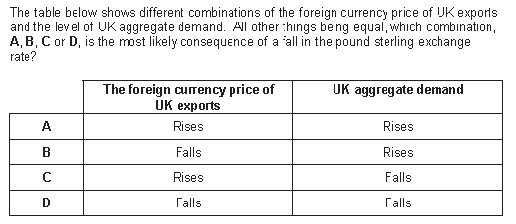
QUESTION 9

Slide 33
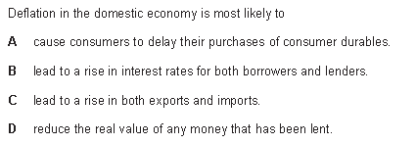
QUESTION 10

Slide 34
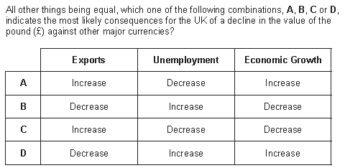
QUESTION 11

Slide 35
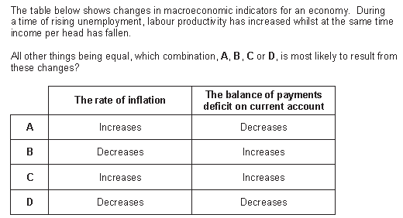
QUESTION 12

Slide 36
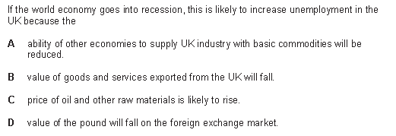
QUESTION 13

Slide 37
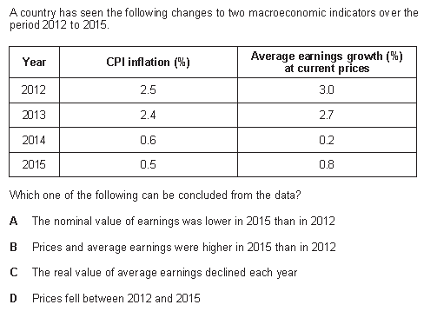
QUESTION 14

Slide 38
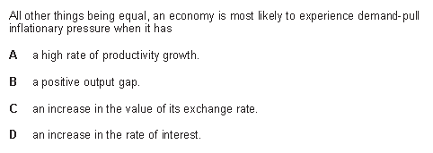
QUESTION 15

Slide 39
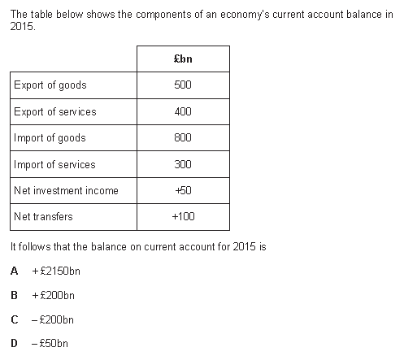
QUESTION 16

Slide 40
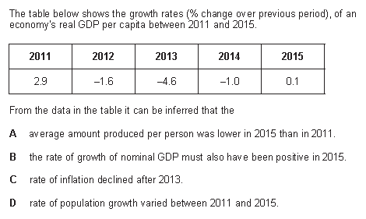
QUESTION 17

Slide 41
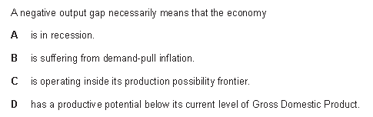
QUESTION 18

Slide 42
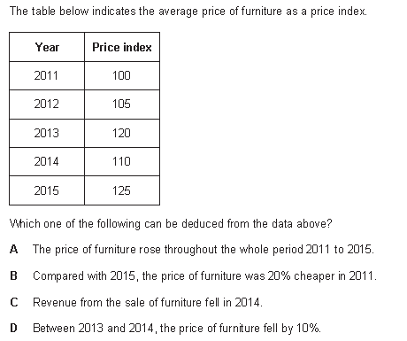
QUESTION 19

Slide 43
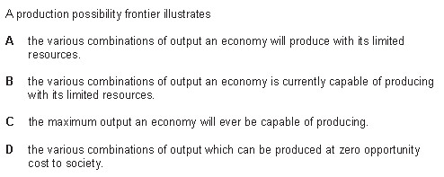
QUESTION 20

Slide 44
MACRO ANSWERS
1D
2C
3B
4D
5D
6A
7C
8B
9B
10A
11A
12D
13B
14B
15B
16D
17A
18C
19A
20B

