Slide 1
MICRO QUESTIONS
RWS5: Role of Government
RWS6: Market Failure #1 – Monopoly (including Theory of the Firm Basics)

Slide 2
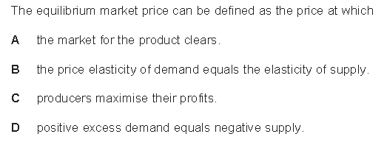
1

Slide 3
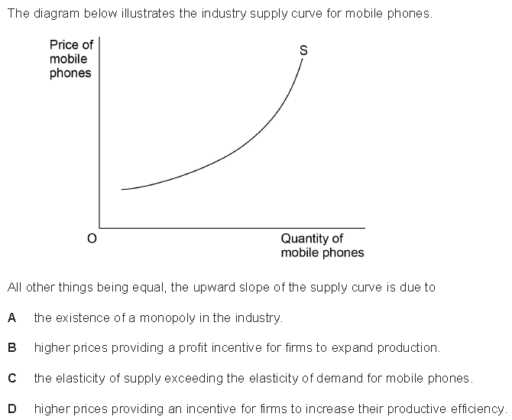
2

Slide 4
3

Slide 5
4

Slide 6
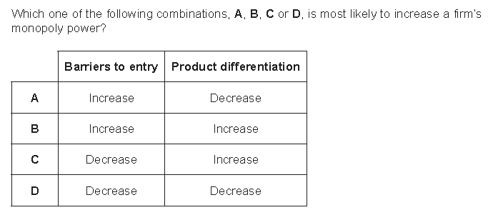
5

Slide 7
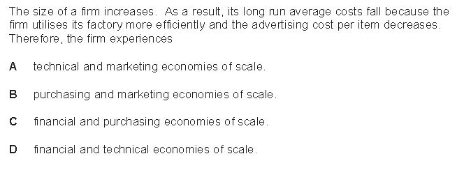
6

Slide 8
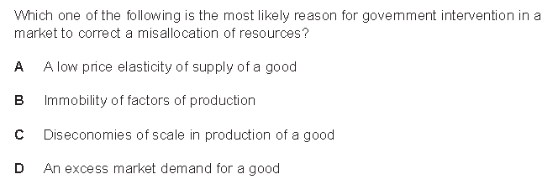
7

Slide 9
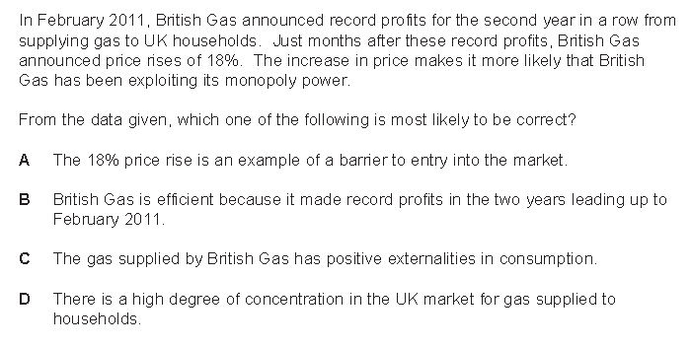
8

Slide 10
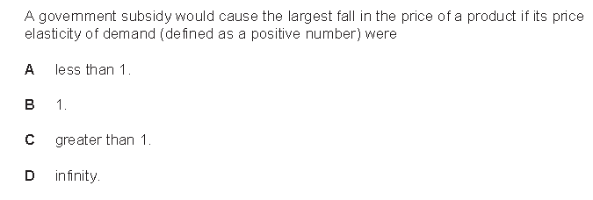
9

Slide 11
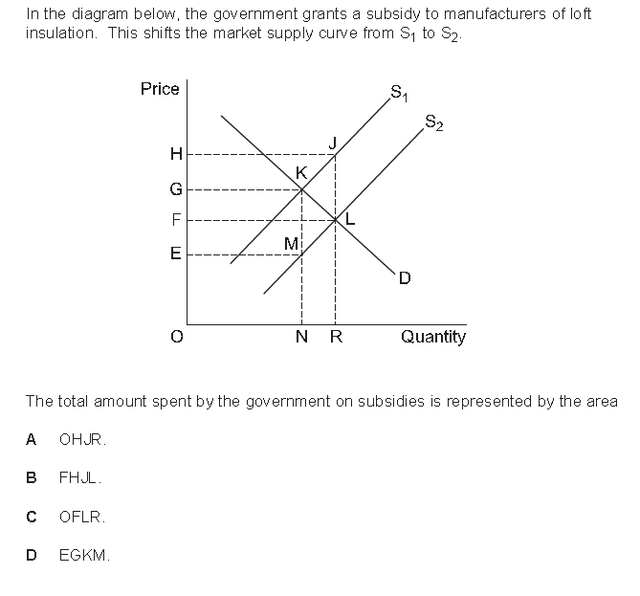
10

Slide 12
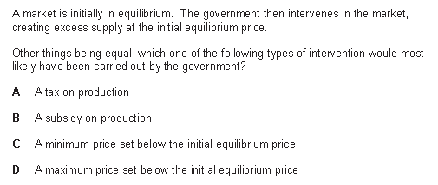
11

Slide 13
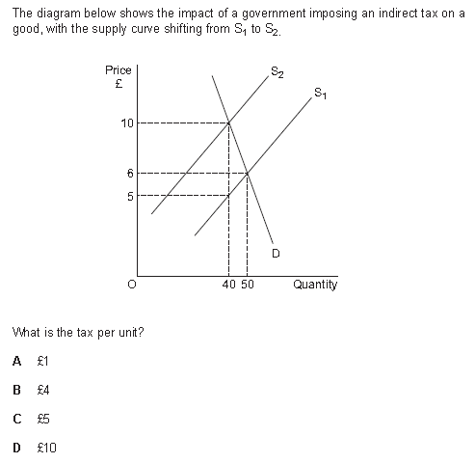
12

Slide 14
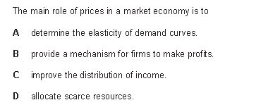
13

Slide 15
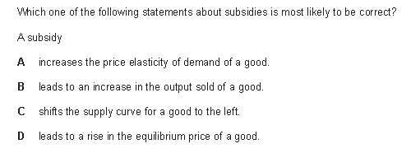
14

Slide 16
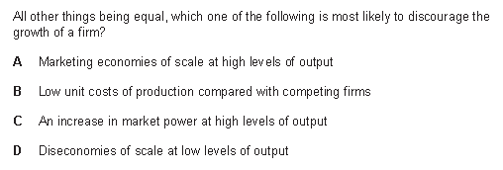
15

Slide 17
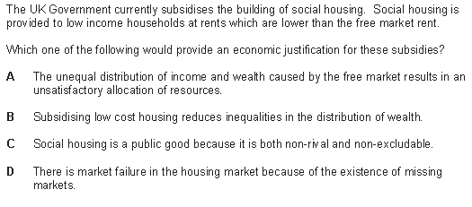
16

Slide 18
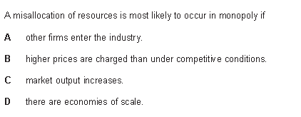
17

Slide 19
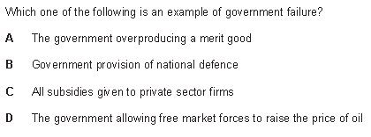
18

Slide 20
19

Slide 21
20

Slide 22
21

Slide 23
22

Slide 24
23

Slide 25
24

Slide 26
25

Slide 27
26

Slide 28
27

Slide 29
28

Slide 30
29

Slide 31
30

Slide 32
ANSWERS - MICRO
15D
16A
17B
18A
19C
20D
21A
22A
23A
24A
25A
26D
27C
28D
29 NULL
30C
1A
2B
3D
4A
5B
6A
7B
8D
9A
10B
11B
12C
13D
14B

Slide 33
MACRO QUESTIONS
RWS5: Introduction to Aggregate Demand (AD) and Aggregate Supply (AS)
RWS6: Macroeconomic Equilibrium

Slide 34
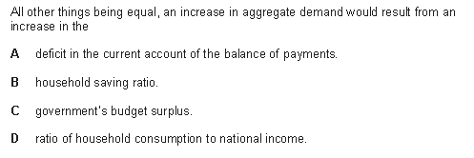
1

Slide 35
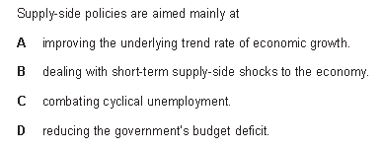
2 (this is hard!)

Slide 36
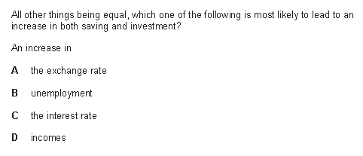
3

Slide 37
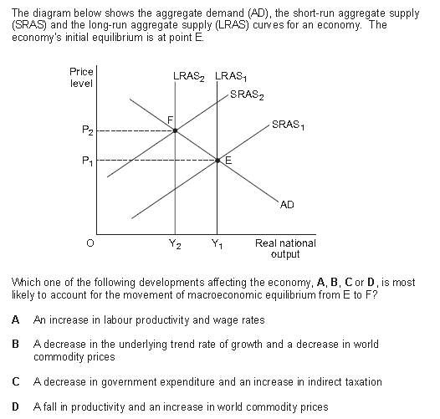
4

Slide 38
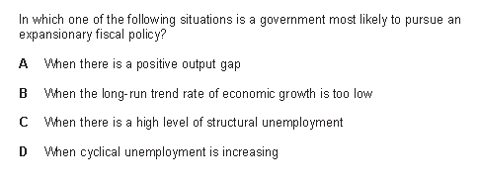
5

Slide 39
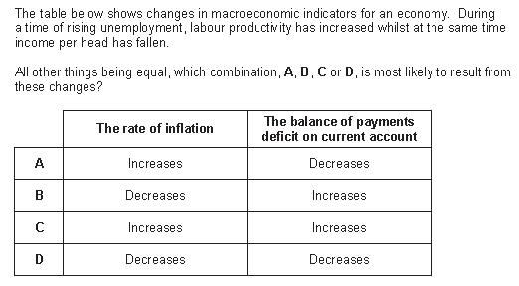
6

Slide 40
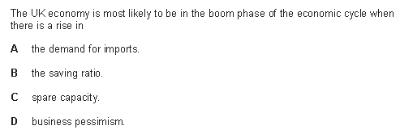
7

Slide 41
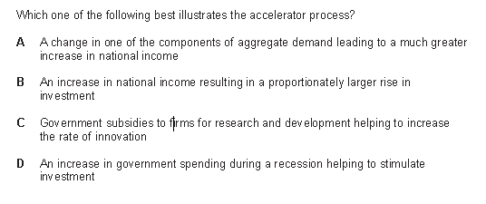
8

Slide 42
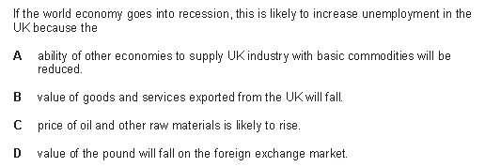
9

Slide 43
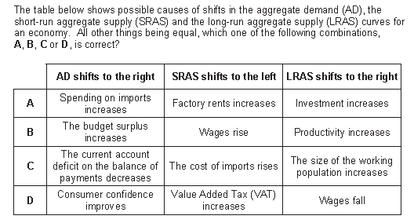
10

Slide 44
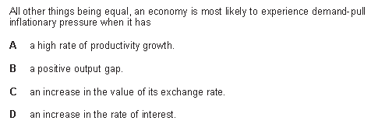
11

Slide 45
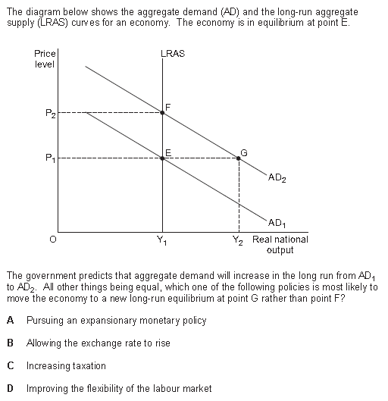
12 (THIS IS HARD!)

Slide 46
13

Slide 47
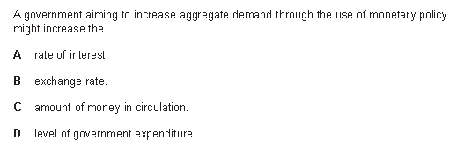
14 (this is hard!)

Slide 48
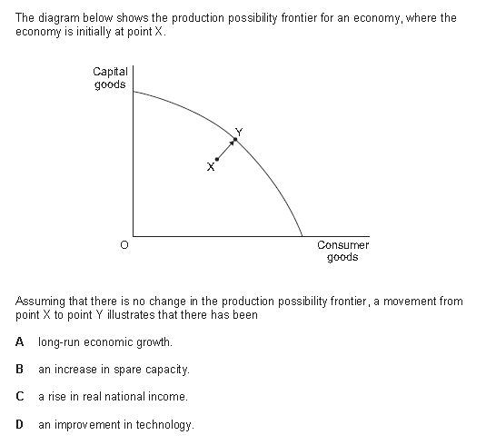
15

Slide 49
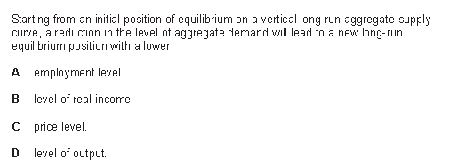
16

Slide 50
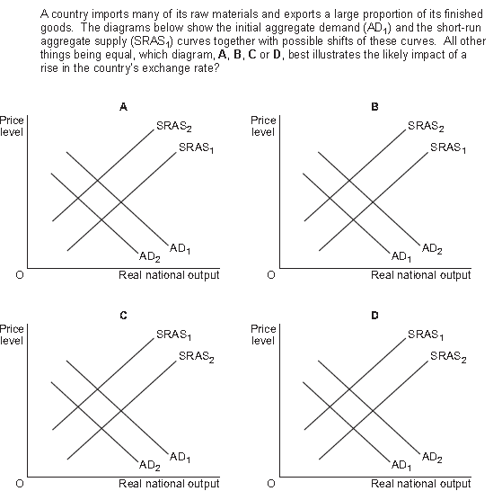
17

Slide 51
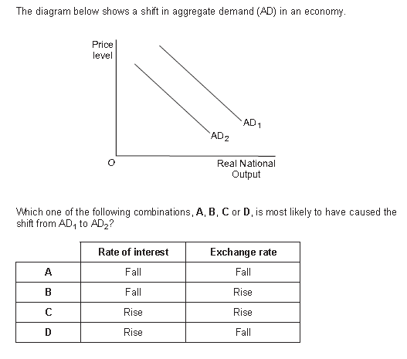
18

Slide 52
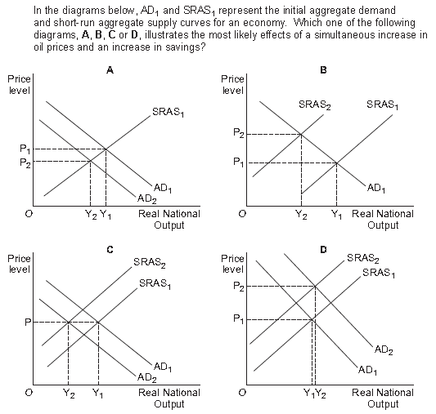
19

Slide 53
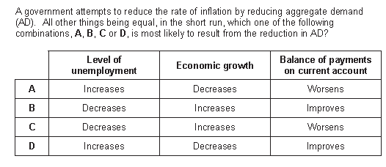
20

Slide 54
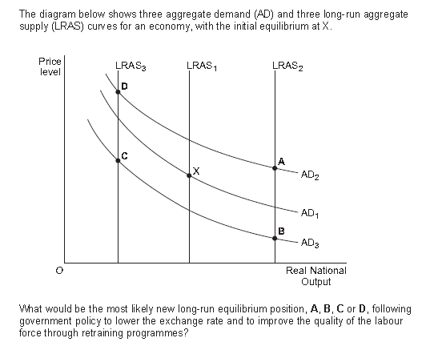
21

Slide 55
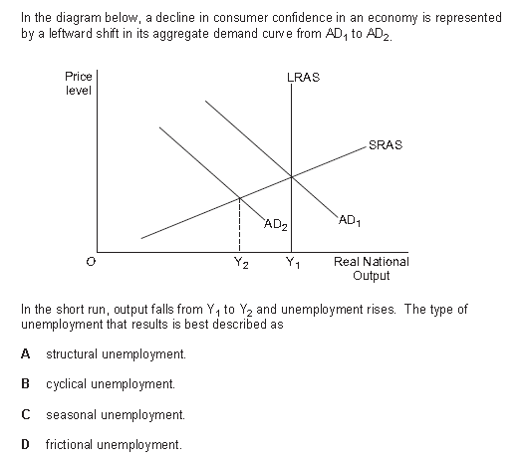
22

Slide 56
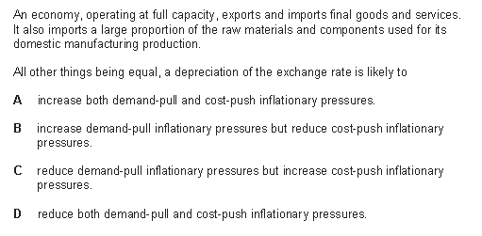
23

Slide 57
24

Slide 58
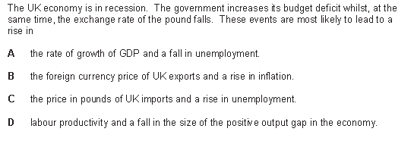
25

Slide 59
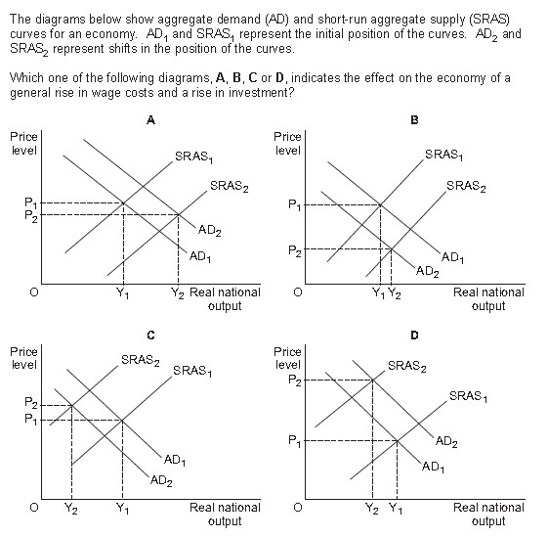
26

Slide 60
27

Slide 61
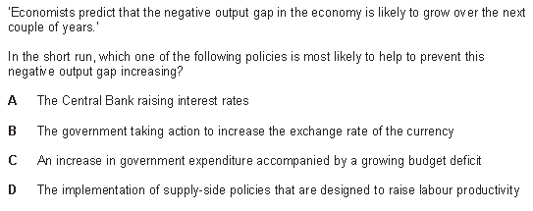
28 (THIS IS HARD!)

Slide 62
29

Slide 63
30

Slide 64
ANSWERS - MACRO
15C
16C
17C
18C
19C
20D
21A
22B
23A
24A
25A
26D
27A
28C
29B
30B
1D
2A
3D
4D
5D
6D
7A
8B
9B
10C
11B
12D
13C
14C

