Slide 1
BENCHMARK 4

Slide 2
LESSON 1

Slide 3
RWS 5
Intro to Aggregate Demand and Supply
RWS 7
Consumption Externalities (and the obesity issue)
10 Multiple Choice Questions
25 Mark Essay
RWS 6
Macroeconomic Equilibrium
10 Multiple Choice Questions
MICRO
B4
MACRO
RWS 7
Demand Side Policies
RWS 8
Production Externalities (and the climate change issue)
RWS 8
Supply Side Policies
EXERCISE: DRAW MIND MAP AND USE EACH OTHER TO START YOUR FIRST VERSION

Slide 4
EXTENSION ANALYSIS:
Why is the market failing - an explanation of the diagrams
Establish the allocative inefficiency
  Underproduction or overproduction: can you identify on your diagram?
Who is to blame?
  Consumers? (Benefit curves split)
  Firms? (Cost curves split)
Why are they to blame?
  Consumers
    Over or under valuing the good and therefore demanding too much or too little because of imperfect information.
    This leads to price being too high or low
    This leads to supply (along the line) being too high or low (think profit motive incentives for firms)
  Firms
    Over or under estimate the costs of production and therefore supply too much or too little because of imperfect information
    This leads to price being too high or low
    This leads to demand (along the line) being too high or low (think price incentives for consumers

Slide 5
Why is the market failing?
EXTENSION ANALYSIS
NEGATIVE EXTERNALITIES IN CONSUMPTION
(Over Consumption by consumers leading to over production by firms)
D
High
P
High
S
High
Go through 1st side of A3 SUMMARY sheet
HOW MUCH DO YOU UNDERSTAND? Explain (using a production externality diagram) why there is a market failure in the sugary drinks market?
Go through 2nd side of A3 SUMMARY sheet
NEGATIVE EXTERNALITIES IN PRODUCTION
(Over Production by Firms leading to over consumption by consumers)
S
High
P
Low
D
High
POSITVE EXTERNALITIES IN CONSUMPTION
(Under Consumption by consumers lead to under production by firms)
D
Low
P
Low
S
Low
POSITIVE EXTERNALITIES IN PRODUCTION
(Under Production by Firms leading to under consumption by consumers)
S
Low
P
High
D
Low

Slide 6
LESSON 2

Slide 7
Why is the market failing?
EXTENSION ANALYSIS
NEGATIVE EXTERNALITIES IN CONSUMPTION
(Over Consumption by consumers leading to over production by firms)
D
High
P
High
S
High
Go through 1st side of A3 SUMMARY sheet
HOW MUCH DO YOU UNDERSTAND? Explain (using a production externality diagram) why there is a market failure in the sugary drinks market?
Go through 2nd side of A3 SUMMARY sheet
NEGATIVE EXTERNALITIES IN PRODUCTION
(Over Production by Firms leading to over consumption by consumers)
S
High
P
Low
D
High
POSITVE EXTERNALITIES IN CONSUMPTION
(Under Consumption by consumers lead to under production by firms)
D
Low
P
Low
S
Low
POSITIVE EXTERNALITIES IN PRODUCTION
(Under Production by Firms leading to under consumption by consumers)
S
Low
P
High
D
Low

Slide 8
Importance of Planning
Assess whether the UK Government should encourage greater use of market forces in the provision of health care (25 marks)
Evaluate whether Government Intervention through a ‘5p tax’ to reduce plastic bag use is the best course of action to reduce climate change? (25 marks)
Assess the view that a minimum price law provides the best way of tackling the problem of over-consumption of alcohol. (25 marks)
Evaluate the view that attempts by governments to eliminate market failure by intervening in markets for merit goods will inevitably lead to government failure. (25 marks)
Evaluate the role of Government in correcting the externalities caused by waste disposal and landfill sites (25 marks)
To what extent should Government’s be subsidising museum entry (25 marks)
Evaluate the case for and the case against the NHS charging for its services (25 marks)
Assess which is the best policy that the UK government could adopt to reduce congestion on the roads?
To what extent should Universities be mainly funded through the charging of fees to their students? (25 marks)
Evaluate whether the Government should intervene in the UK energy markets (25 marks)
40 minutes for essays = 5 minutes should be planning
Best way to revise and prepare for unseen essays is to….
Every essay needs an I, M and C?
Every essay needs 2-3 points
Micro essays follow a similar format: your points need to be backed up by MS, MF, GI and GF arguments
Use shorthand in your essay under timed conditions AND use the whole of the A4 page

Slide 9
EXAMPLE: Discuss whether the Government should intervene to reduce alcohol consumption in the UK
(25 marks)
INTRO
  Define Government Intervention (perhaps with reference to current intervention)
  Context of alcohol industry and effect on consumers in the UK?
  Route through the essay? Hint that market forces might also solve the issue (efficiency?), hint at market failure (???) and misallocation of resources.
MAIN
  Point 1: Shouldn’t intervene because market forces work
    As: Market Success Arguments?
    Ae: Market Failure Arguments?
  Point 2: Government should intervene because there is market failure
    As: Government Intervention Arguments?
    Ae: Government Failure Arguments?
CONCLUSION
  Position
  Justify your position
  Defend your position
BASIC ECONOMIC
PROBLEM
SOCIALISM
CAPITALISM
GOVERNMENT INTERVENTION
FREE
MARKETS
(or MARKET SUCCESS)
GOVERNMENT FAILURE
MARKET
FAILURE

Slide 10
IMPORTANCE OF ESSAY PLANS
TASK:
Use a scrap of A4 paper and you have 7 minutes to plan an essay in pairs or threes.
We will then feedback as a class and comment on your attempts
Assess whether the UK Government should encourage greater use of market forces in the provision of health care (25 marks)
Evaluate whether Government Intervention through a ‘5p tax’ to reduce plastic bag use is the best course of action to reduce climate change? (25 marks)
Assess the view that a minimum price law provides the best way of tackling the problem of over-consumption of alcohol. (25 marks)
Evaluate the view that attempts by governments to eliminate market failure by intervening in markets for merit goods will inevitably lead to government failure. (25 marks)
Evaluate the role of Government in correcting the externalities caused by waste disposal and landfill sites (25 marks)
To what extent should Government’s be subsidising museum entry (25 marks)
Evaluate the case for and the case against the NHS charging for its services (25 marks)
Assess which is the best policy that the UK government could adopt to reduce congestion on the roads?
To what extent should Universities be mainly funded through the charging of fees to their students? (25 marks)
Evaluate whether the Government should intervene in the UK energy markets (25 marks)

Slide 11
How to write a Paragraph to explain market failure
Establish the allocative inefficiency
  Underproduction or overproduction: can you identify on your diagram?
Who is to blame?
  Consumers? (Benefit curves split)
  Firms? (Cost curves split)
Why are they to blame?
  Consumers
    Over or under valuing the good and therefore demanding too much or too little because of imperfect information.
    This leads to price being too high or low
    This leads to supply (along the line) being too high or low (think profit motive incentives for firms)
  Firms
    Over or under estimate the costs of production and therefore supply too much or too little because of imperfect information
    This leads to price being too high or low
    This leads to demand (along the line) being too high or low (think price incentives for consumers

Slide 12
Assess whether the UK Government should encourage greater use of market forces in the provision of health care (25 marks)
INTRO
Define - market forces? UK Government and healthcare (NHS)
Context - background to the NHS
Route through essay - is the government failing or the market failing? Which should we trust to deliver better healthcare?
MAIN
P1: Should not encourage as market forces fail
  As = MF
  Ae = MS
P2: Should encourage as government is failing
  As = GF (reasons as to why Government is failing)
  Ae = GI (reasons why Government interventions is working
CONCLUSION
Position
Support and defend position

Slide 13
LESSON 3

Slide 14
EXAMPLE: Discuss whether the Government should intervene to reduce alcohol consumption in the UK
(25 marks)
INTRO
  Define Government Intervention (perhaps with reference to current intervention)
  Context of alcohol industry and effect on consumers in the UK?
  Route through the essay? Hint that market forces might also solve the issue (efficiency?), hint at market failure (???) and misallocation of resources.
MAIN
  Point 1: Shouldn’t intervene because market forces work
    As: Market Success Arguments?
    Ae: Market Failure Arguments?
  Point 2: Government should intervene because there is market failure
    As: Government Intervention Arguments?
    Ae: Government Failure Arguments?
CONCLUSION
  Position
  Justify your position
  Defend your position
BASIC ECONOMIC
PROBLEM
SOCIALISM
CAPITALISM
GOVERNMENT INTERVENTION
FREE
MARKETS
(or MARKET SUCCESS)
GOVERNMENT FAILURE
MARKET
FAILURE

Slide 15
POINT 1: Writing a Paragraph
TASK 1: Write two paragraphs for the point below using diagrams on the A3 sheet for reference.
TASK 2: Email me with your answer
Point 1: Shouldn’t intervene because market forces work
  As: Market Success Arguments?
  Ae: Market Failure Arguments?

Slide 16
MACROECONOMICS (Don’t Forget!!)

Slide 17
ARCHIVE

Slide 18
Identifying the ‘hook’ in the essay - practice
Market success is where the price mechanism leads to the correct allocation of resources. Everything that is needed is provided for by the market because consumers place a value on the consumption of goods and firms produce the good to make profit.
Market failure is the misallocation of these resources. This can happen because:
  The full price of consuming or producing a good is not taken into account by the consumer (household) or the firm and therefore there is ‘overproduction or underproduction’ or ‘overconsumption or underconsumption’
  Lack of competition means firms in the market are able to determine the prices (price makers rather than price takers). This often leads to an increase in price and underproduction
  The good/service has certain characteristics which mean firms are unable to charge consumers because they will simply consumer the good and not pay. Also it is very hard to price the good because one persons consumption does not affect the others. This can lead to no production or underproduction
What is the market failure - under or over production? (try to strip out any current Government intervention
Healthcare
Sewage treatment
Keeping fit
Driving a fast car
Coal fired electricity generation

Slide 19
Identifying the ‘hook’ in the essay - practice
Assess the view that a minimum price law provides the best way of tackling the problem of over-consumption of alcohol. (25 marks)
To what extent should Government’s be subsidising museum entry (25 marks)
Discuss whether flood defences should be provided solely by the Government (25 marks)
Evaluate the case for and the case against the NHS charging for its services (25 marks)
To what extent should Universities be mainly funded through the charging of fees to their students? (25 marks)
Evaluate whether the Government should intervene in the UK energy markets (25 marks)
Assess which is the best policy that the UK government could adopt to reduce congestion on the roads?

Slide 20
BENCHMARK CONTENT: Market Failures and Government Interventions?
Market Failure | Example | Why a Market Failure? | Possible Government Interventions and Solutions (why do they work?) | Possible Government Failures (why might they not work?)
POSITIVE EXTERNALITIES IN PRODUCTION | Tree farms | UNDERPRODUCTION
NEGATIVE EXTERNALITIES IN PRODUCTION | Coal fired power station | OVERPRODUCTION
MERIT GOODS (Consumption Externalities - Positive) | Keeping fit | UNDERCONSUMPTION
DEMERIT GOODS (Consumption Externalities - Negative) | Smoking Cigarettes | OVERCONSUMPTION

Slide 21
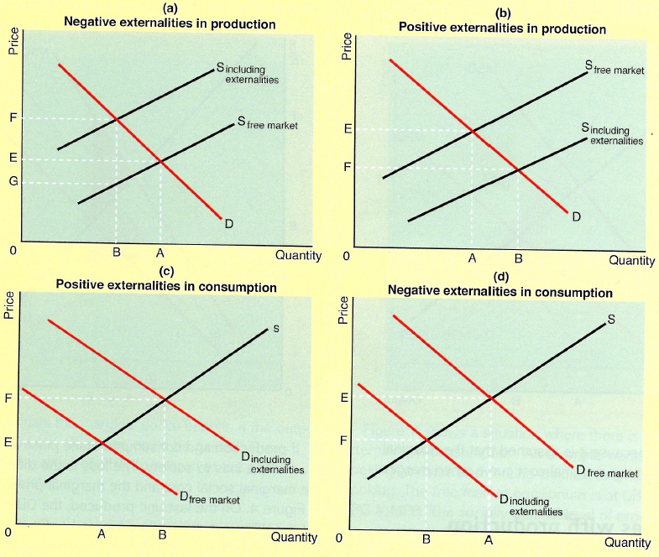
Market Failure
Externalities in production and consumption
TASK:
In fours, each member draw an externality diagram to show either:
Negative externalities in production
Negative externalities in consumption
Positive externalities in production
Positive externalities in consumption

