Slide 1
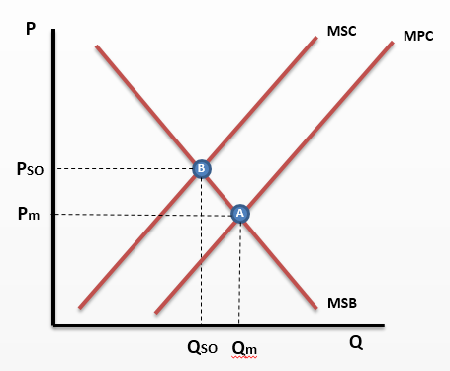
1 - Please enter explanation here as to why the market for burning of fossil fuels (coal) to generate electricity is failing
The producer overproduces coal fired electricity in the market (Qm > Qso), causing allocative inefficiency. This is because the producer is selfish and/or has imperfect information and will only take into account their private costs (MPC) and private benefits (MPB) and so the free market equilibrium is at A and not at the socially optimal (SO) of B. The costs to society (MSC) are greater than the cost to the firm (MPB) which means the producer is not taking into account the negative external costs (negative externalities) of their actions and underestimating their costs. These external costs can include the harmful effects of pollution and the impact on future generations of increased CO2 emissions with climate change problems (greater risks of flooding and drought in certain areas) are not taken into account. Therefore, we can say that the firm is underestimating the cost of their production. The resulting lower price charged to consumers (Pm<Pso), then provides consumers with an incentive to overconsume this type of energy at Qm as they wish to maximise their utility. Therefore the Government needs to intervene in the market to correct this market failure.
On the other hand, the market is arguably succeeding. Because of the low price energy accessible to those on lower incomes preventing fuel poverty today. Is it not better to allocate resources for those today rather than overly worry about the costs to society in the future especially if it is hard to measure those costs? Estimating future external costs on society is notoriously hard as there is imperfect information and this calls into question whether we can estimate accurately where Qso and Qm are and therefore whether there is allocative inefficiency. Also, the market may correct any problems itself because as supply of fossil fuels falls, the price will rise and reduce demand and consumption of these polluting fuels whilst producers and consumers switch to cleaner renewables. Therefore the market will sort out any potential problems caused by overproduction and too much pollution. Finally, burning fossil fuels like coal can be a quick and easy method of generating electricity and for a developing country like China 20 years ago (and the UK/USA in the 19th and 20th century), this was the fastest way to develop and improve living standards for all. Therefore the Government does not need to intervene.

Slide 2
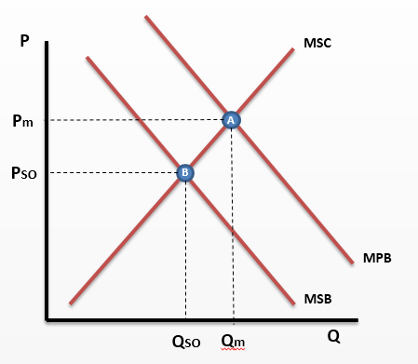
2 - Please enter explanation here why the market for sugary drinks is failing here
The consumer overconsumes sugary drinks in the market (Qm > Qso), causing allocative inefficiency. This is because the consumer is selfish and/or has imperfect information and will only take into account their private costs (MPC) and private benefits (MPB) and so the free market equilibrium is at A and not at the socially optimal (SO) of B. The MPC are greater than the full cost to society (MSB) which means the consumer is not taking into account the negative external benefits (effectively external costs or negative externalities) of their actions and over valuing the consumption. Costs to those around them such as looking after them when they suffer from Obesity and diabetes does not enter their mind. The impact on co-workers of time off sick from work due to obesity is also not taken into account. Therefore, we can say that the consumer is overvaluing the consumption activity of drinking a sugary drink. The resulting higher price consumers are prepared to pay is above the socially optimal (Pm>Pso). This provides firms with the incentive to increase their supply and overproduce to maximise their profits. Therefore the Government needs to intervene in the market to correct this market failure.
On the other hand the sugary drinks market isn’t failing because markets are self regulating with the production of sugar free drinks and healthier alternatives. Coca Cola have created products such as Coke Zero, to meet the new demand set by consumers for healthier alternatives. In this case the price equilibrium shifts, as demand for normal Coca Cola decreases and the demand for Coke Zero increases. Thus the price mechanism has solved the misallocation of resources. Therefore the government do not need to intervene because it is a personal choice, intervention would interfere in the free market. Secondly it is hard to put a monetary value upon the external costs of this activity - it is very hard to value the impact on co-workers etc. of absences. There the position of Qm ad Qso aren’t definite and could be closer.

Slide 3
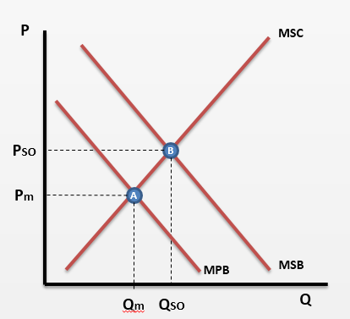
3 - Please enter explanation here for why the healthcare market is failing
The consumer under consumes healthcare in the market (Qm<Qso), causing allocative inefficiency. This is because the consumer is selfish and/or has imperfect information and will only take into account their private costs (MPC) and private benefits (MPB) and so the free market equilibrium is at A and not at the socially optimal (SO) of B. The MPB is less than the full cost to society (MSB) which means the consumer is not taking into account the external benefits (positive externalities) of their actions and under valuing the consumption. The positive externalities or external benefits such as preventing the spread of contagious diseases or minimising the impact on others of absences from work due to sickness are not taken into account. Therefore, we can say that the consumer is prepared to pay too low a price for healthcare. The resulting lower price is below the socially optimal (Pm<Pso). This does not provide firms with the incentive to supply as much as Qso as the price is too low to maximise their profits at this production level. Therefore the Government needs to intervene in the market to correct this market failure.
In contrast this in not a market failure because the free market will respond and other markets will be developed to correct this failure. For example markets such as health fitness programmes like weight watchers which allow consumers who want to combat problems such as obesity which is a result of under consumption of healthcare. Also sport centres will also benefit with the increasing demand as obese people realise they have to make a change and adjust their preferences and therefore effect the price in the market to reduce the gap to make the consumption closer to Qso. Additionally, perhaps consumers are consuming what they need and it is hard to value the external benefits of underconsumption. Maybe the gap between Qm and Qso is less than is thought?

Slide 4
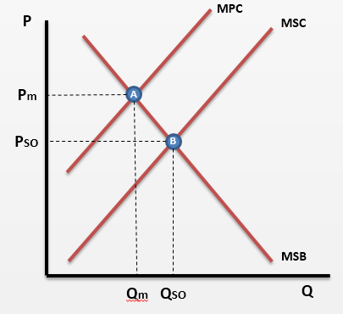
4 - Please enter explanation here for why the solar panel market is failing here
The firm under produces solar panels in the market (Qm<Qso), causing allocative inefficiency. This is because the firm is selfish and/or has imperfect information and will only take into account their private costs (MPC) and private benefits (MPB) and so the free market equilibrium is at A and not at the socially optimal (SO) of B. The MPC is less than the full cost to society (MSC) which means the producer is not taking into account the negative external costs (external benefits or positive externalities) of their actions and over estimating the costs of production. These positive externalities such as providing future generations with less CO2 emissions in the future and mitigating the problems of climate change are very hard for the firm to charge for. Therefore their costs of production are higher than society things. The resulting higher price is above the socially optimal (Pm>Pso). This does not provide consumers with the incentive to consume (and purchase) more solar panels as the price is higher and they wish to maximise their utility. Therefore the Government needs to intervene in the market to correct this market failure.
It may be argued that there is not a market failure in the market for solar panels. This is because the point Qso and Pso are hypothetical points and hard to quantify; a monetary value can not be easily placed on the costs and benefits of production as economic agents have imperfect information. How can we value the perceived benefits to future generation with any accuracy? Therefore who knows whether there is actually a market failure or not? Furthermore, solar panels are being used more frequently throughout the UK as an increasing number of buildings are getting them fitted, so the diagram may be inaccurate for todays production. Finally, as alternative energy such as fossil fuels become rarer and are given a negative image, more and more frequently, the market for fossil fuels will decrease in production, leading to a higher price and therefore an increase in consumer demand for alternative power such as solar power.
MSC @ Qm
C

