Slide 1
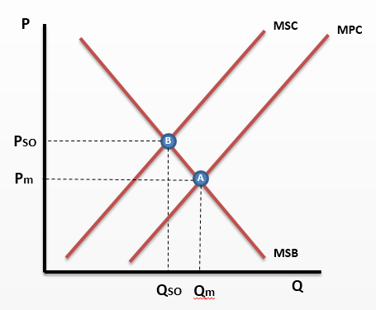
1 - Please enter explanation here as to why the market for burning of fossil fuels (coal) to generate electricity is failing

Slide 2
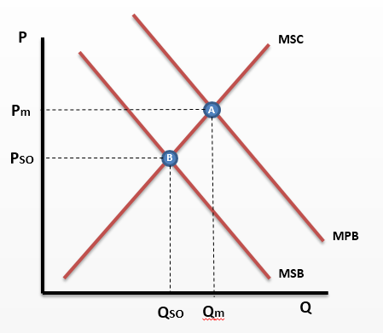
2 - Please enter explanation here why the market for sugary drinks is failing here

Slide 3
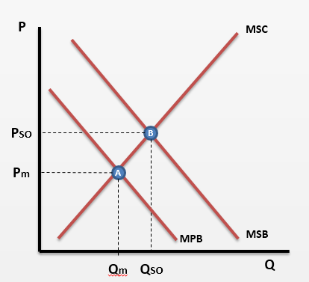
3 - Please enter explanation here for why the healthcare market is failing

Slide 4
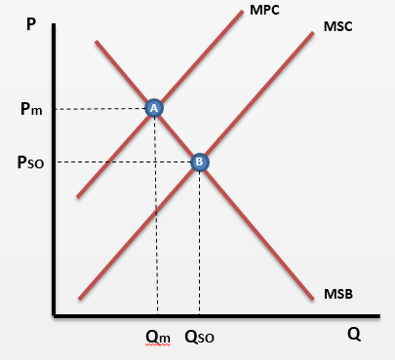
4 - Please enter explanation here for why the solar panel market is failing here

