Slide 1
Never Let Me Go
Chapter 3 and 4, setting and genre

Slide 2
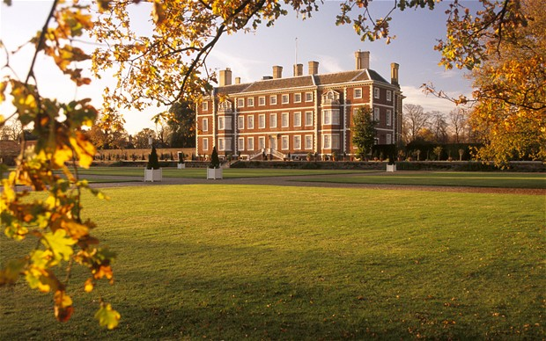

Slide 3
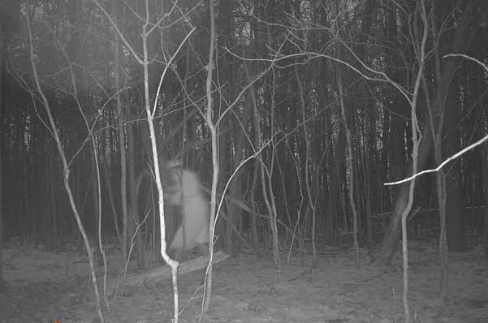

Slide 4
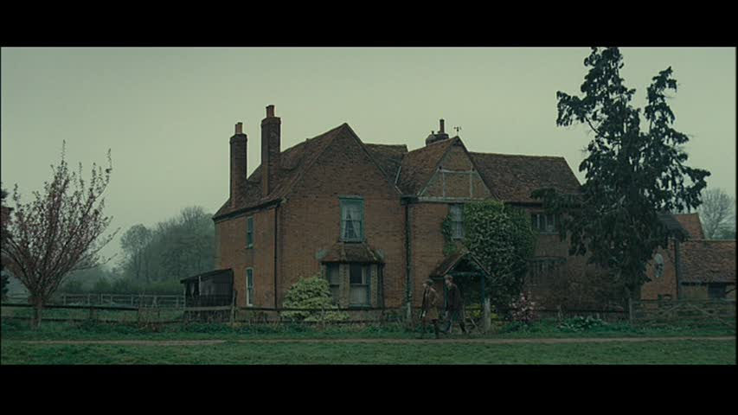

Slide 5
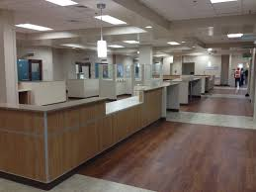

Slide 6
The Function of Setting – a few ideas:
To create the illusion of reality within the novel (referential function)
In other words: this is a fictional place where the fictional characters could actually exist.

Slide 7
To imitate the “real” world outside the novel (by using place names, names of cars etc) (verisimilitudinal function)
I O W: this novel is not disconnected from our world completely.

Slide 8
To build up atmosphere or to suggest a message (in the use of repetitions or contrasts, for example) (symbolic function)
I O W: these two settings contrast dramatically because of the type of people who live there/because different settings allow different actions to happen/the contrasts heighten our perception of each setting etc.

Slide 9
To suggest or reveal a character’s state of mind as a parallel becomes obvious between the setting and the character (analogical function)
I O W: this is the same setting, but the adjectives used/the focus is very different – it is the character whose perception has altered.

Slide 10
Quick Fire Quiz on Chapter 3
To which side of the house does the pond lie?
What was Kathy wearing the day she met Tommy by the pond?
What time of the year was it?
What colour hair does Miss Lucy have?
Who was watching Tommy and Kathy talking by the pond?
What word does Tommy use to describe the physical manifestation of Miss Lucy’s anger?
How many times a year does Madame turn up to collect works for the Gallery?
What does Madame always wear?
Where does the work get stored before it is taken away?
In analysing Madame’s reaction to being surrounded by the girls, to what creature does Kathy compare the students?

Slide 11
Settings – what function do each of these have?
The pond lay to the south of the house. To get there you went to the back entrance, and down the narrow twisting path, pushing past the overgrown bracken that, in the early autumn, would still be blocking your way. p25
The way the sound travelled across the water was hard to predict; if people wanted to eavesdrop, it was the easiest thing to walk down the outer path and crouch in the bushes on the other side of the pond. p25
It was well into October by then, but the sun was out that day… p25
We were in Room 7 on a sunny winter’s morning. p32
Hailsham stood in a smooth hollow with fields rising on all sides. That meant that from almost any of the classroom windows in the main house – and even from the pavilion – you had a good view of the long narrow road that ame down across the fields and arrived at the main gate. p34
The afternoon Madame’s car was spotted coming across the fields, it was windy and sunny, with a few storm clouds starting to gather. p34
We were in the library, sitting around the big oak table. I remember there was a log burning in the fire-place… p40
Hailsham was full of hiding places, indoors and out: cupboards, nooks, bushes, hedges. p43
The little footpath that went all round the back of the main house was a real favourite of mine. It followed all the nooks, all the extensions; you had to squeeze past shrubs, you went under two ivy-covered arches and through a rusted gate. All the time you could peer in through the windows, one after the other. I suppose part of the reason I like the path so much was because I was never sure if it was out of bounds. p44
Because more and more these days, I’ll be driving past fields on a long afternoon, or maybe drinking my coffee in front of a huge window in motorway service station… p45
We’re in the open, under a warm sun, so it’s probably the sandpit in the Infants’ play area… p45
The woods were at the top of the hill that rose behind Hailsham House. All we could see really was a dark fringe of trees, but I certainly wasn’t the only one of my age to feel their presence day and night. p49
Even now, if I’m driving on a long grey road… p55

Slide 12
Genre
E19. [Fr. = kind] Kind, type; esp. a style or category of painting, novel, film, etc., characterised by a particular form or purpose.

Slide 13
Possible themes
Deception
Memory and the past
Freedom and restriction
Art and creativity
Science
Identity
Passivity
The future and aspirations

Slide 14
But in the end I managed it, and the instant I saw her again, at that recovery centre in Dover, all our differences—while they didn't exactly vanish—seemed not nearly as important as all the other things: like the fact that we'd grown up together at Hailsham, the fact that we knew and remembered things no one else did. (1)
I can see now, too, how the Exchanges had a more subtle effect on us all. If you think about it, being dependent on each other to produce the stuff that might become your private treasures—that's bound to do things to your relationships. (2)
"The problem, as I see it, is that you've been told and not told. You've been told, but none of you really understand, and I dare say, some people are quite happy to leave it that way. But I'm not. If you're to have decent lives, you have to know who you are and what lies ahead of you, every one of you." (7)
"But we have been taught about all that," I said. "I wonder what she meant. Does she think there are things we haven't been told yet?" (3)
Everything—the walls, the floor—has been done in gleaming white tiles, which the centre keeps so clean when you first go in it's almost like entering a hall of mirrors. Of course, you don't exactly see yourself reflected back loads of times, but you almost think you do. (2)
So you're waiting, even if you don't quite know it, waiting for the moment when you realize that you really are different to them; that there are people out there, like Madame, who don't hate you or wish you any harm, but who nevertheless shudder at the very thought of you—of how you were brought into this world and why—and who dread the idea of your hand brushing against theirs. The first time you glimpse yourself through the eyes of a person like that, it's a cold moment. It's like walking past a mirror you've walked past every day of your life, and suddenly it shows you something else, something troubling and strange. (3)
"None of you will go to America, none of you will be film stars. And none of you will be working in supermarkets as I heard some of you planning the other day. Your lives are set out for you." (7)
When I think about my essay today, what I do is go over it in some detail: I may think of a completely new approach I could have taken, or about different writers and books I could have focused on. […] It's at that sort of level—daydream stuff. (10)
One big idea behind finding your model was that when you did, you'd glimpse your future. Now I don't mean anyone really thought that if your model turned out to be, say, a guy working at a railway station, that's what you'd end up doing too. We all realised it wasn't that simple. (12)
The woods were at the top of the hill that rose behind Hailsham House. All we could see really was a dark fringe of trees, but I certainly wasn't the only one of my age to feel their presence day and night. (5)
"It's just as well the fences at Hailsham aren't electrified. You get terrible accidents sometimes." (7)
If we were honest, though, particularly near the beginning, most of us would have admitted missing the guardians. […] But this was one thing we'd been told over and over: that after Hailsham there'd be no more guardians, so we'd have to look after each other. (10)
I won't be a carer any more come the end of the year, and though I've got a lot out of it, I have to admit I'll welcome the chance to rest—to stop and think and remember. I'm sure it's at least partly to do with that, to do with preparing for the change of pace, that I've been getting this urge to order all these old memories. (4)
Or maybe I'm remembering it wrong. (1)
Driving around the country now, I still see things that will remind me of Hailsham. I might pass the corner of a misty field, or see part of a large house in the distance as I come down the side of a valley, even a particular arrangement of popular trees up on a hillside, and I'll think: "Maybe that's it! I've found it! This actually is Hailsham!" (1)
If Tommy had genuinely tried, she was saying, but he just couldn't be very creative, then that was quite all right, he wasn't to worry about it. (3)
The gallery Tommy and I were discussing was something we'd all of us grown up with. Everyone talked about it as though it existed, though in truth none of us knew for sure that it did. I'm sure I was pretty typical in not being able to remember how or when I'd first heard about it. Certainly, it hadn't been from the guardians: they never mentioned the Gallery, and there was an unspoken rule that we should never even raise the subject in their presence. (3)
"I was like you, Tommy. I was pretty much ready when I became a donor. It felt right. After all, it's what we're supposed to be doing, isn't it?" (19)
But I didn't say or do anything. […] I remember a huge tiredness coming over me, a kind of lethargy in the face of the tangled mess before me. It was like being given a math problem when your brain's exhausted, and you know there's some far-off solution, but you can't work up the energy even to give it a go. Something in me just gave up. (16)
I won't be a carer any more come the end of the year, and though I've got a lot out of it, I have to admit I'll welcome the chance to rest—to stop and think and remember. (4)

Slide 15
Dystopian Fiction
Science-Fiction
A coming-of-age novel
Experimental post-modern novel – playing with time, perspective etc
A metanarrative (story about the process of telling stories)
A romance
A satirical novel – questioning the values of society
A memoir
Social realism – charting scientific advances

