Slide 1
ILLUMINATING ‘Frankenstein’

Slide 2
Learning objectives
Demonstrate understanding of the significance and influence of the contexts in which ‘Frankenstein’ was written and received
Articulate creative, informed and relevant responses to ‘Frankenstein’
Demonstrate critical understanding in analysing the ways in which language, structure and form shape meaning in ‘Frankenstein’

Slide 3
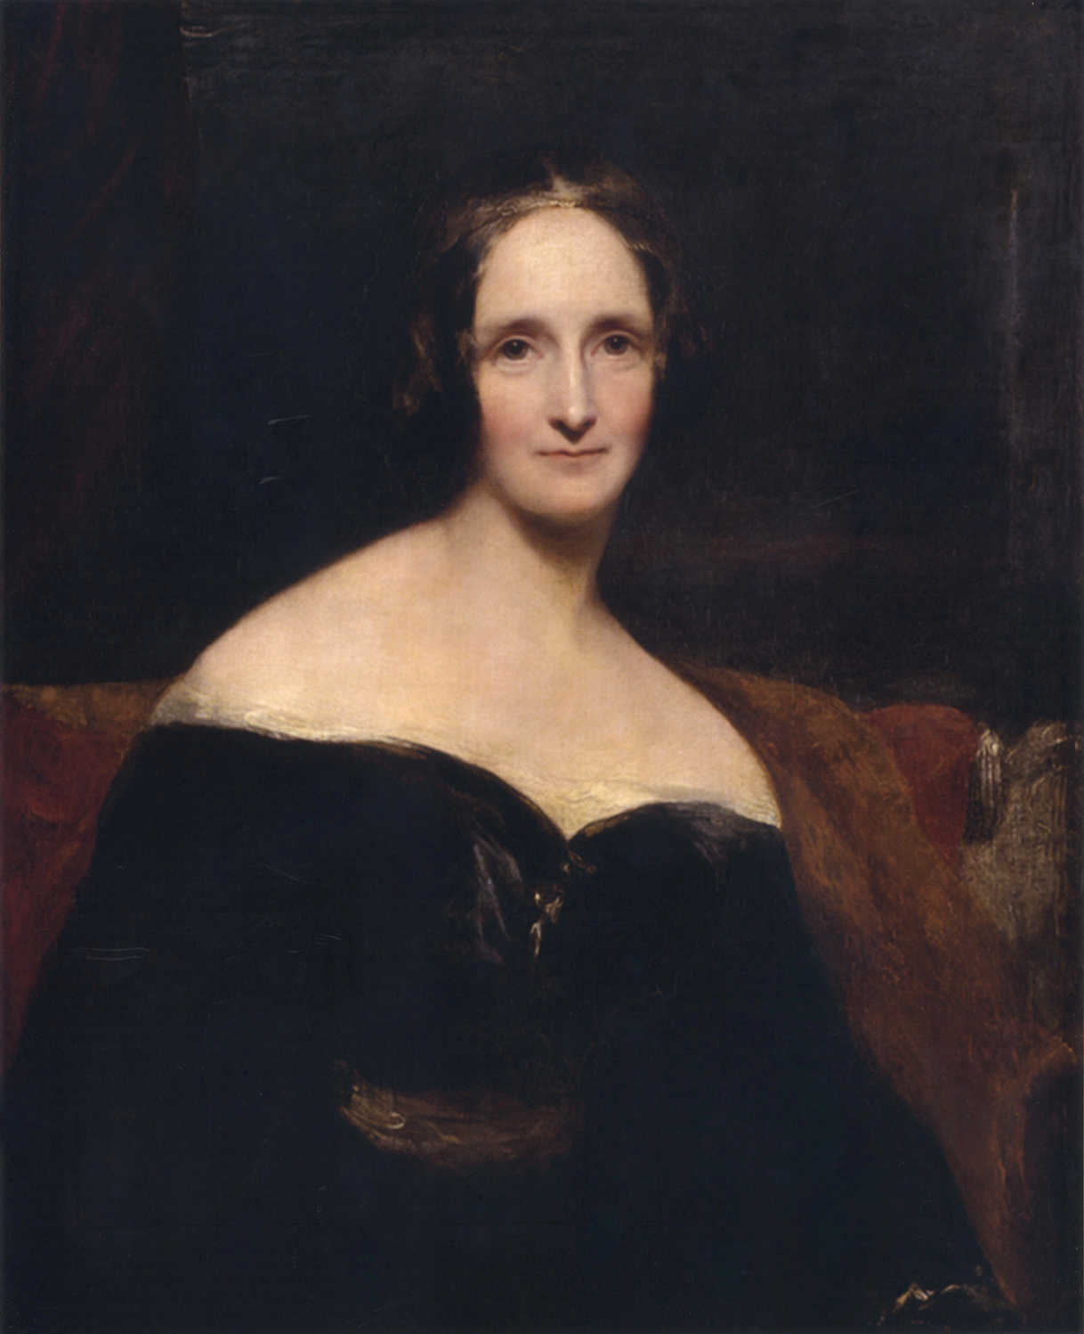
Context
Shelley wrote ‘Frankenstein’ in 1817 and it was published in 1818 when she was just 20.
The idea for the novel came during a summer stay on the shores of Lake Geneva in Switzerland, very near to Victor Frankenstein’s hometown of Geneva.
In the course of the visit, at Lord Byron’s suggestion, a ghost-story telling competition was begun and as a result, Shelley was inspired to begin her tale.
However, ‘Frankenstein’ is more than just a ghost story; it concerns social issues – individual and social morality and the question of humanity, as the well as the imprint of Shelley’s parents, the Romantic movement, the Gothic, Milton and indeed, her husband, Percy Shelley.

Slide 4
Family background and personal life
Parents radical political thinkers
Unrestricted and intellectually stimulating childhood
Lack of affection from stepmother
Non-traditional family structure
Married young to Percy Shelley
All children died
Travelled Europe

Slide 5
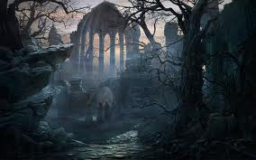
The Gothic Movement – origins
Emerged in 18th century through literary works like Anne Radcliffe’s ‘the Mysteries of Udolpho and Matthew Lewis’ ‘The Monk’ and developed through to Victorian era with novels like ‘Dracula’ and ‘Jekyll and Hyde’
Originated from Elizabethan/ Jacobean tragedy, graveyard poetry, William Blake, the Romantics, novel of sensibility, Milton and the medieval Gothic with its focus on the Grotesque.

Slide 6
The Gothic Movement – typical features
Wild landscapes and ruined or grotesque buildings
Religious settings
Sensibility (the cult of emotion) and sudden shifts in emotion
Excess and extremity
Supernatural and ghostly
Imagery of darkness, shadows and decay
Isolation and loneliness
Horror and terror
Sex and sexuality
Blurring of distinctions between sanity and insanity
Multiple narrators
Crime and lawlessness
Absolute power
Stock characters – absent mother, helpless heroine, the villain, the lover
The outsider
The devilish

Slide 7
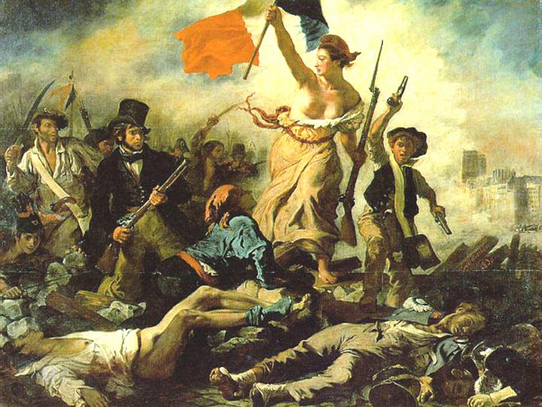
The Romantic movement: political
Originated 1789, year of French Revolution, optimistically seen as the beginnings of a new age of justice and equality for all
Politically inspired by American/ French revolutions
Background of social unrest and political activism
Optimism and idealism for future and a belief in the perfectibility of human race
Human institutions/ restrictions seen as source of evil
However, experience often caused disillusion about possibilities of reform through political movement.

Slide 8
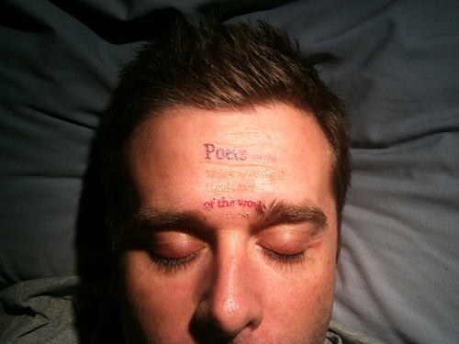
The Romantic movement: literary
Through their championing of social progressive causes and rejection of social morals, many Romantics felt isolated and alienated from society as a whole.
Attempts to transform the world through poetry – Shelley wrote ‘poets were the unacknowledged legislators of the world’ – furthered this inward turn
For the Romantics, imagination is seen as powerful; it can be used to escape the world and such creativity is seen as powerful/ Godlike
Emphasis is on assertion of self and individual experience.

Slide 9
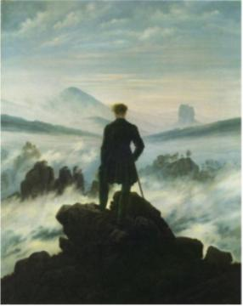
The Romantic movement: geographical
Romantics not only looked to their inner natures, but the natural world around them.
They reacted against 18th century admiration for ordered/cultivated and were more interested in the wild and untamed
Influenced by Edmund Burke and his concept of the sublime, with its association of terror, darkness, infinity and the incomprehensible
Mountains, ice, expansive and sterile regions like the Antarctic appealed.
Walking was also seen as an imaginative pursuit, particularly in these kind of untamed landscapes.

Slide 10
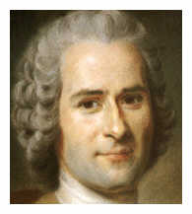
Changing philosophies
Jean Jacques Rousseau, Genevan philosopher – 18th century writer who inspired Romanticism
His political writings, ‘Discourse on Inequality’ and ‘On the Social Contract’ are cornerstones in modern political and social thought, asserting a belief in democratic government and social empowerment
Concept of ‘the noble savage’ and the damaging influences of institutions
Rousseau’s novel ‘Emile’ asserts in belief in the importance of the education of the whole person
‘Man is born free; and everywhere he is chains.’

Slide 11
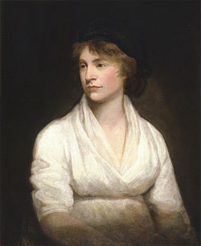
Feminism
Shelley’s mother, Mary Wollstonecraft, was one of the earliest feminist writers and her book, ‘A Vindication of the Rights of Women’, is one of the most important documents in the history of women’s rights.
She believed in the education of women and the importance of individual rights
‘I do not wish women to have power over men, but over themselves.’
‘Make women rational creatures and free citizens’
‘If women be educated for dependence, that is to act according to the will of another fallible being, and submit, right or wrong, to power, where are we to stop?’

Slide 12
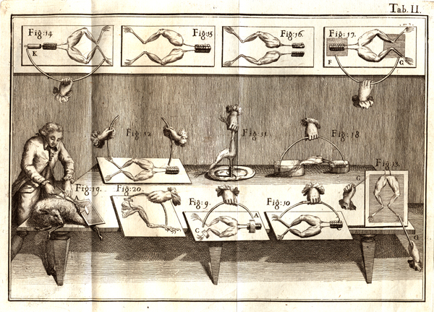
Science and invention
Shelley had a lifelong interest in science; at her father’s house, she would’ve met the physicist, Erasmus Darwin, and chemists Humphrey Davy and William Nicholson.
Shelley read Davy’s book ‘Elements of Chemical Philosophy’ as part of her research for ‘Frankenstein’
Davy worked with galvanism – the science of healing and rekindling life by electrical current.
By 1816, Shelley speculated about the Darwin’s search for the origins of cellular life and ‘the nature of the principle of life, and whether there was any probability of it ever being discovered and communicated.’

Slide 13
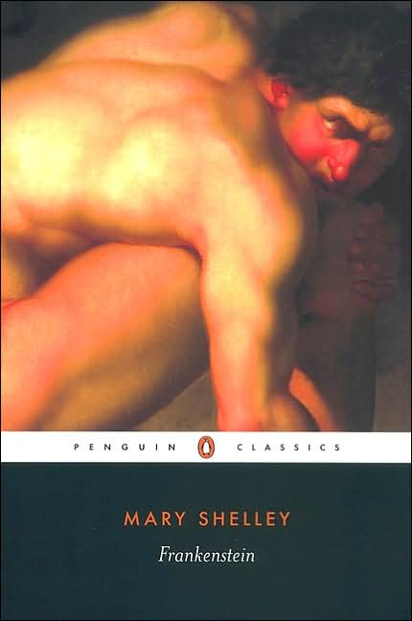
Creating a reading agenda
The AO4 objective relies upon the successful evaluation of contextual factors, using them pertinently and creatively to interpret and illuminate your reading of the text.

Slide 14
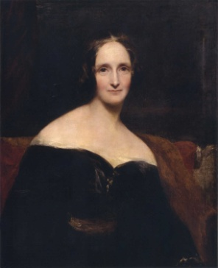
Cloning/ genetic modification
Mary Shelley’s own childhood
Narrative technique
Films/ television/ theatre interpretations
Gothic literature and art
Allusions in the news/ media e.g. Power-crazy dictators
Plot devices
Mary Shelley’s dream; the unconscious mind
Analogy
Challenging the mysteries/ existence of God
Modern literary theory e.g. the author is dead?
Allusions
Romantic literature
Linked narratives e.g. Almodovar’s ‘The Skin I Live In’
Geography/ landscape
Metaphor
Structure
Rise of science – Galvanism, pursuit of invention and creation
Science fiction
Doubling
Freud, Marx and Feminism
Demonstrate understanding of the significance and influence of the contexts in which ‘Frankenstein’ was written and received
Horror
Political and social revolution

Slide 15
Creating a thematic agenda
One way to group contextual factors is thematically – this is how questions in the examination will be phrased, so will help you to make far better use of contextual information...

Slide 16
Sample thematic concerns
SCIENCE – Galvanism, pursuit of invention and creation in science, challenge to God, Atheism
CHILDHOOD – Shelley’s own upbringing and education, birth v death, nature v nurture, Rousseau ‘The Noble Savage’
THE JOURNEY – Travel writing, The Romantics, the metaphorical journey
DREAMS – imagination, supernatural, the subconscious
GOTHIC – horror, macabre, fantasy, sexuality

Slide 17
TASK
Today’s task requires you to make links between context and central themes/issues raised by the text.
Each pair will be allocated a passage from the text which links to a particular theme/ idea and will need to read it closely, evaluating the significance of the contexts in which texts are written and received, as well as analysing the text itself.
You will be required to feedback to the group as whole on your findings

Slide 18
For example... From chapter 2, focus on science
Pivotal moment in education
When I was about fifteen years old we had retired to our house near Belrive, when we witnessed a most violent and terrible thunderstorm. It advanced from behind the mountains of Jura; and the thunder burst at once with frightful loudness from various quarters of the heavens. I remained, while the storm lasted, watching its progress with curiosity and delight. As I stood at the door, on a sudden I beheld a stream of fire issue from an old and beautiful oak which stood about twenty yards from our house; and so soon as the dazzling light vanished the oak had disappeared, and nothing remained but a blasted stump. When we visited it the next morning, we found the tree shattered in a singular manner. It was not splintered by the shock, but entirely reduced to thin ribands of wood. I never beheld anything so utterly destroyed.
Before this I was not unacquainted with the more obvious laws of electricity. On this occasion a man of great research in natural philosophy was with us, and, excited by this catastrophe, he entered on the explanation of a theory which he had formed on the subject of electricity and galvanism, which was at once new and astonishing to me. All that he said threw greatly into the shade Cornelius Agrippa, Albertus Magnus, and Paracelsus, the lords of my imagination;
Adjectives suggest intrigue behind discovery – desire to know/understand – typical of 18th century investigations
Short statement stressed imp. of moment; destruction is stressed. Conflict between creation and destruction. Links to debate about God’s power and nature of scientist
Galavanism – Shelley’s own reading

Slide 19
Final task
Return to Shelley’s introduction to the novel and re-read in context of what has been explored today: how does our knowledge impact our interpretation of the introduction and of the novel?

Slide 20
Ken Russell’s ‘Gothic’ trailer
http://www.youtube.com/watch?v=c2hl5Ee5_1E
HOW MIGHT THIS BE SEEN AS AN INTERPRETATION/ READING OF SHELLEY’S INTRODUCTION?
WHAT KIND OF IDEAS ABOUT CREATION AND AUTHORSHIP ARE PORTRAYED?

Slide 21
Homework
Read ‘The Author is Dead’ from Robert Eaglestone’s book and consider how this might impact your reading of the novel – for brief discussion at beginning of Thursday’s lesson.

