Slide 1
Theory of Evolution

Slide 2
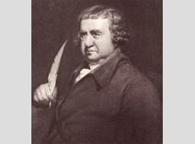
Erasmus Darwin
He was an English physician and natural Philosopher, working in the late 1700’s
He was Charles Darwin's Grandfather
His theory of Biological evolution via natural selection was greatly criticised by the Church.

Slide 3
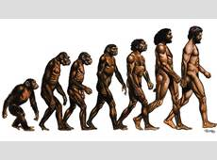
The theory of evolution
All of life on earth shares a common ancestor known as the last universal ancestor, which lived approximately 3.5–3.8 billion years ago.
Over time everything evolved to fit it s habitat,
Survival of the fittest – only those best suited to their habitat would go on to reproduce.
Angered religious people because this contradicted their religion, for example the concept that God created humankind in his own image.

Slide 4
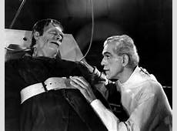
Frankenstein
This is relevant in Frankenstein, as it was clear that people were losing faith as science was advancing ahead of religion and ‘divine power’. This might have been the reason why Frankenstein felt that he could be a creator himself and act as God.
“I began the creation of the human being”.
“I succeeded in discovering the cause of generation and life”.

