Slide 1
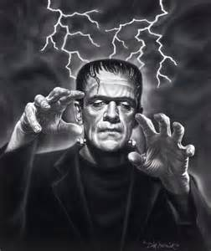
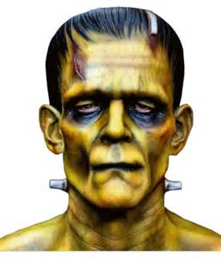
Frankenstein - Context
Isabella, Lotte, Cherry, Jammy

Slide 2
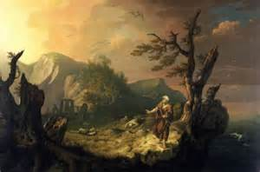
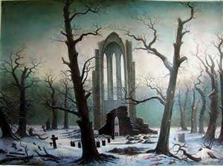
The Romantic Movement – poetry & the Arts
Romanticism was an artistic, literary, and intellectual movement that originated in Europe toward the end of the 18th century.
It was partly a reaction to the Industrial Revolution, the aristocratic social and political norms of the Age of Enlightenment - it challenged the authority of institutions that were deeply rooted in society, especially the Roman Catholic Church.
Romantics favoured the appreciation of Nature & creation – the feeling of awe, linking in with the ‘Sublime’.
Percy Shelley (Mary’s husband) and his close friend Byron were avid members of the Romantic Movement – along with other famous poets like Coleridge and Wordsworth.
Romanticism followed specific themes such as the powers of imagination, the beauty and forces of nature and finding a spiritual connection with Earth and the surrounding landscapes.

Slide 3
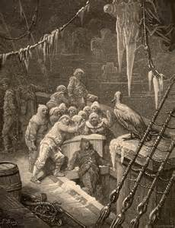
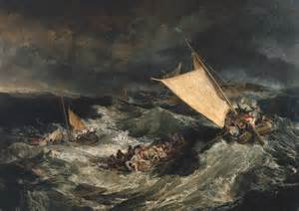
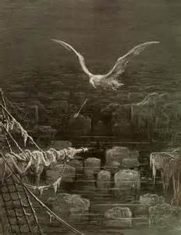
Mary Shelley through her characterisation of Victor references S.T Coleridge’s Ancient Mariner – the famous Romantic poet. “Like one, on a lonesome road, who doth walk in fear and dread, and, having once turned round, walks on, and turns no more his head; because he knows a frightful fiend doth close behind him dread”. – Coleridge’s poetry was radical – it was enhanced by the imagination and nature – Shelley was captivated by this and felt these common and recurring themes (the supernatural, the sublime etc) were clearly reflected and inspired in her novel Frankenstein.

Slide 4
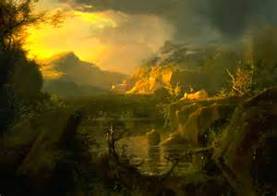
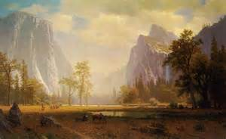
Role of Nature & Sublime
The Sublime is the quality of greatness, physically, morally, intellectually, metaphysically, aesthetically, spiritually, or artistically. The term especially refers to a greatness beyond all possibility of calculation, measurement, or imitation – the feeling of awe and terror.
It is the awareness of something greater than yourself.
State of ecstasy
This theme was inextricably linked with the Romantic Period – the appreciation of nature beyond God and religion.

Slide 5
Frankenstein expresses his delight at seeing the mountains: “Dear mountains! My own beautiful lake!” – Frankenstein’s negative emotions at this particular time don’t link in with his vast, surrounding landscape – it clearly portrays the greatness of the setting beyond all possibility of calculation, measurement and imitation.
“The immense mountains and precipices that overhung me on every side– the sound of the rive raging among the rocks and the dashing of the waterfalls around, spoke a power might of omnipotence” – expresses and reflects the presence of God. The landscape is expansive and tremendous and Victor even quotes himself that it is filled with “sublime ecstasy”.

