Slide 1
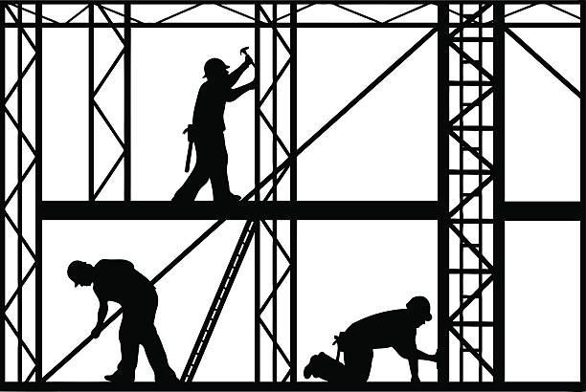
From the Journal of a Disappointed Man – Andrew Motion
Language
Form
Considers the role of men in society. The male narrator observes a group of workmen failing to complete a task
The key to the poem lies in the contrast between the workmen and the narrator – there is no interaction between the observer and the observed, and the poem dramatizes this physical and symbolic distance
The physical strength and activity of the workmen, in comparison to the passivity of the narrator, is compounded by the use of language
“Journal” appears personal and authentic (reinforced by use of first-person pronouns throughout), yet the anonymity indicated by “man” indicates the poem represents the thoughts of many
Contrast between the speaker and the men he observes is made immediately evident, as the poem opens with “I discovered these men”. Connotations of a scientific discovery, which implies the speaker’s focus on the intellectual
The learned tone is reminiscent of 18th-19th century fiction – the narrator is a man who understands literary heritage. The complicated nouns (“paraphernalia”) and references (“crack of Doom”) juxtapose the silent workmen who speak with functional simplicity. Contrasts with the polysyllabic low-frequency lexis of the narrator
Sense of telling a story with discourse markers that draw attention to the spoken voice (“I said…”)
Lexical repetitions of silence, emphasised by sibilance (“still saying nothing”)
Persistent use of imagery throughout the poem – the workers are performing a practical action, in contrast to the more intellectual thoughts of the onlooker. Thus, hyper-masculine imagery is criticised by highlighting individuality
Plosives emphasise masculine tone (“pulleys”, “powerful”, “baffled”). On closer inspection however, these plosives can symbolise the narrator’s lack of voice, as the vocal cords do not vibrate when making these sounds
There is a very limited use of figurative language in the poem. Therefore, “gaze down like a mystic” is inevitably more noticeable (along with the description of the workmen as “monsters”. Represents a shift in tone where the intellectual speaker assigns these personifications of traditional physical masculinity the ability to attain insight
The final image of the “pile still in mid-air” is symbolic of the whole enterprise
The structural development in the poem is minimal – the speaker observes an event, but never becomes physically involved. The speaker is left looking at failure
Repetitive structure with a consistent layout of quatrains of even line length - a visual impression of solid blocks (links to the traditional association between masculinity and strength). Also implies conformity to societal expectations, rather than showing elements of individuality
The event is retrospectively and calmly recorded
No rhyme scheme. Emphasises hopeless, joyless tone
However, enjambment brings diversity to the pace of the poem
End-stopped lines ensure the tone of the poem remains blunt, particularly for this recount of manual labour
Enumeration in the first stanza sets a precedent for a multitude of punctuation in the poem (hyphens, speech, semi-colons). Juxtaposes simple stanza structure; perhaps Motion is considering the ways in which the external presentation of masculinity may differ to internal thoughts and experiences. An external appearance of conformity does not always reflect the internal truth
Enjambment over stanzas forces reader to emulate process by which the speaker attempts to make sense of what he sees
Increasing use of end-stopped lines demonstrates increasing conformity

Slide 2

Out of the Bag – Seamus Heaney
Language
Form
Explores idea of revealing a secret (in this case, how children are born), through transitions in time and perspective as the narrator matures
Blends deep knowledge of the classical world of Ancient Greece with personal memory to interrogate myths of origin
The poem demonstrates both how far the narrator has come from when he was an impressionable child, and how important that start remains in their psyche and poetic practice
The title plays on common colloquialism and idiom
The use of Latin phrases and repetitious references to Ancient Greece makes the reader feel overwhelmed in their lack of knowledge, much like a child. Mirrors the physical and mental distance between the narrator and their appreciation of what is going on. Emphasises theme of secrecy and the unknown
“Those nosy, rose, big, soft hands of his” – internal rhyme indicates admiration, while the creation of a compound word (“ soft, sud-luscious”), coupled with sibilance, evokes a sensuous atmosphere
“Milk and ice, swabbed porcelain, the white/And chill of tiles…” – adjectives in conjunction with enumeration and enjambment over tercets create an overwhelming sense of setting
A multitude of classical referencing, including an allusion to “Asclepius” (A Greek physician elevated to the status of a god). The speaker gives the doctor, whom he greatly admires, a god-like status
The overwhelming amount of classical referencing and intellectual language (“miraculum”) is the speaker attempting to prove himself, asserting that he is the equal to his idol (Dr Kevin)
Semantic field of hands (demonstrates physical nature of work as the secret becomes increasingly tangible)
Internal rhyme is repeated once more towards the end of the poem (“It was midday, mid-May”), demonstrating the speaker’s relapse as he realises his academic capabilities are limited
As the poem progresses, a sematic field of light emerges (“sunlight”, “light”, “day”, “haven”) – light touches everything, much like Dr Kevin influence washes over everything the speaker sees
Lexis shifts as the poem progresses into high-frequency (“under seeded grass”)
Wondrous tone shifts to a feeling of helplessness as the speaker fails to restore his childlike curiosity
Awkwardness and discomfort around the female body (“peering”)
As the poem concludes, an anonymous “she” is referred to. The reader later discovers that “she” is the speaker’s mother. The speaker learns that it is the mother who gives life, not a goddess – revealing female power and creating a poignant moment
The mother has the last word: “And what do you think/Of the new wee baby the doctor brought for us all/When I was asleep?”. Reinforces cyclical structure as the myth is continued. The strength and love of the mother surpasses all that has preceded. The narrator’s voice at the end, with it’s sweet colloquial tone, contrasts completely with Heany’s erudition and acts like a final dramatization of the tensions which run throughout the poem
The numbered sections mark the transitions in place and time (from childhood to adulthood), while the separation demonstrates how fundamentally different the narrator’s understanding of the world is
Complementary effect created through free verse, which places further emphasis on the free-flowing nature of the memories and thoughts being shared
Unbound by line length
Lack of notable rhyme scheme encourages the reader instead to focus on imagery
The poem is tightly controlled in tercets, but this is undermined by the enjambment across stanzas – suggesting that the speaker’s broken thoughts need to be pieced together. Could also created fluidity (eg. the flow of life)
There is only one line which breaks the ordered tercet structure: “A bit like the rosebud in his buttonhole”. Last sense of childlike wonder before adulthood, a turning point
The tone becomes increasingly negative as the narrator grows and the secret is revealed (“chemotherapy”)

