Slide 1
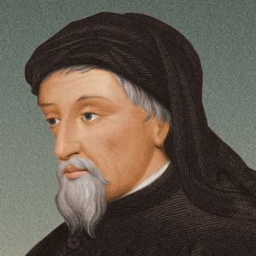
CHAUCER BACKGROUND
By Sophie x2

Slide 2
Chaucer was an MP
In 1386, Chaucer was a Member of Parliament for Kent. In those days, Parliament sat for just two months a year, in October and November, and Chaucer was only returned as MP for one year. So his political career was hardly long-lasting. But it was eventful. Chaucer’s Parliament of 1386 would go down in history as the ‘Wonderful Parliament’, which responded to King Richard II’s extravagant expenditure (and lavishing of gifts upon his favourites) by appointing fourteen Commissioners to keep tabs on Richard’s money. Chaucer’s son Thomas would later be speaker of the House of Commons.

Slide 3
Chaucer was accused of rape
He was charged with ‘rape’. . Chaucer the great poet, also a possible rapist???? But the incident is something of a mystery: ‘rape’ in the fourteenth century was a term also applied to abduction (the word has its origins in the Latin rapere, ‘seize’), so it’s not clear whether Chaucer’s crime was kidnapping or something even worse, In 1380 one Cecily Chaumpaigne released Chaucer from ‘all manner of actions such as they relate to my rape or any other thing or cause’ (this is the English translation of the court rolls, which were written in Latin). But what was the ‘rape’ Chaumpaigne referred to here? We’ll probably never know…

