Slide 1
Canterbury Tales

Slide 2
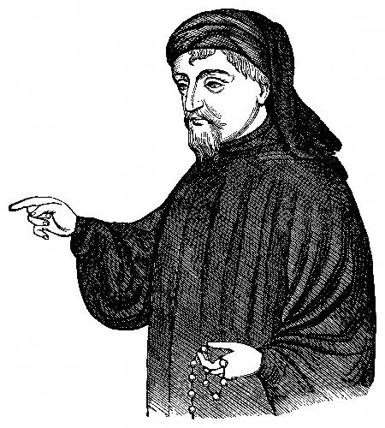
Written in middle English between 1387-1400 and encounters the pilgrimage to the shrine of Thomas Becket in Canterbury, Kent. The main reason for this is that people thought if they touched a piece of cloth soaked in his blood it would cure them of blindness, epilepsy and leprosy.
The tales attempt to engage different social types of people for example a monk, a knight and a man of law.
Wealthy people sometimes preferred to pay others to go on the pilgrimage for them.

