Slide 1
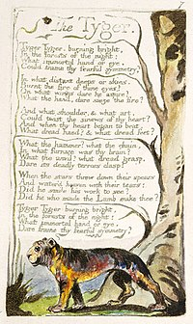
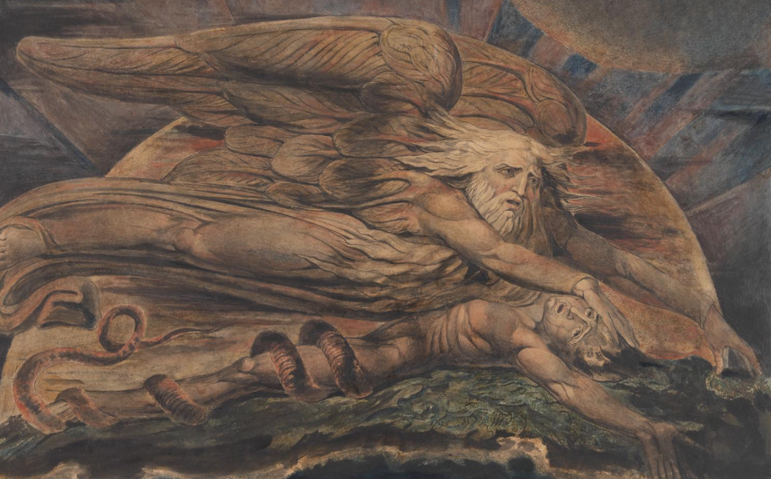
Contexts
Blake’s work – Songs of Experience (1794)
Poem featured in Songs of Experience and is often paired with ‘The Lamb’ from Songs of Innocence (published earlier)– where the lamb is often allied to the figure of Christ, this creature, the tiger, is full of ‘deadly terrors’ and belongs to experience.
Experience is not always seen as negative for Blake but has the dual role of representing a world where knowledge is acquired which can be both exhilarating and destructive.
Blake’s beliefs
Blake had unorthodox Christian belief and the authoritarian Old Testament God is often represented quite negatively in his work reacted against the Old Testament God figure. He also distrusted the organised Church of England religion of his day.
Meaning
Writer’s craft
Religious belief and the nature of the divine, sublime beauty of nature, mortality and immortality. The poem asks: who could create something so powerful, sublime, mystical and destructive and why?
A seemingly simple, childish poem which actually asks profound questions about the nature of the divine.
The speaker appears to be a Blake persona, addressing the tiger in a form of poetic apostrophe (the tiger can’t reply) in a series of 14 questions, none of which are answered…
Begins with great excitement, with the exclamations. Note the opening is trochaic (‘Tyger! Tyger!) which is opposite to the traditional iambic rhythm of a lot of famous lyrical English poetry, and more like the rhythm of children’s rhymes.
Simple alliteration belongs to child’s verse – ‘burning bright’ .
This innocence and excitement is at odds with the huge questions the poem asks about the nature of creation, the place of violence within it (part of Songs of Experience)
Partially symmetrical, with first two stanzas mirroring each other, with the subtle change of ‘could’ to ‘dare’ – could this be Blake wondering if he, as the poet, can ‘dare’ to capture the tiger in a poem?
‘Immortal hand or eye’ features in both opening and final stanza and seems to be a God-figure
In stanza two the internal fire of the tiger seems first to burn in a sublime, disembodied state, like the fire of inspiration etc and the creator, who seems to be metaphorically or literally winged, then makes that fire into something physical.
Stanza three sees the tiger’s sinews twisted together and the heart beating, but the speaker is most keen to know who did the twisting – does this creator have hands and feet?! Clearly there is a sense of ‘dread’ for this figure
Stanza 4 has some clear industrial imagery, perhaps mocking the idea of physically ‘making’ a tiger as you might a steam engine etc
By Stanza 5 the work is done and the speaker asks whether there is a ‘smile’ from the creator – but is a smile gruesome or kindly?
Final stanza, which mirrors the first, seems full of wonder at what divine force would dare to create this beast.
The Tyger
Tyger! Tyger! burning bright, In the forests of the night, What immortal hand or eye Could frame thy fearful symmetry? In what distant deeps or skies, Burnt the fire of thine eyes? On what wings dare he aspire? What the hand dare seize the fire? And what shoulder, & what art, Could twist the sinews of thy heart? And when thy heart began to beat, What dread hand? & what dread feet? What the hammer? what the chain, In what furnace was thy brain? What the anvil? what dread grasp, Dare its deadly terrors clasp? When the stars threw down their spears And water'd heaven with their tears, Did he smile his work to see? Did he who made the Lamb make thee? Tyger! Tyger! burning bright, In the forests of the night, What immortal hand or eye, Dare frame thy fearful symmetry?
Elohim (Hebrew name for God) creating Adam
Imagery of fire - ‘fire of thine eyes’, ‘seize the fire’, furnace’, ‘burning bright’ again highlights the destructive force of the creature and religious associations
Social and cultural context
He would not have responded positively to the social and cultural shifts of his day, with movement from rural employment to city employment and the rise of industry.
Some critics see this as an anti-industrial poem with its mechanical, industrial language, but we could see this as more of a passing comment – human ingenuity (which was on display in the growing industries of Blake’s time) could surely not ‘make’ a tiger.
(Peter Ackroyd and others suggest that the tiger is akin to the terrors of the later stages of the French revolution, but there is not much that is concrete that can link to that in the poem.
He also raises the idea of particular cosmic displays (meteors etc) that were seen in Blake’s time, which would no doubt have confounded anyone watching…)
Verbs – physical, material, dynamic (‘seize’, ‘grasp’, ‘clasp’) suggest the power of this divine force
Mythology
Prometheus stole fire from the Gods. Fire can be synonymous with knowledge – like that in the Garden of Eden, it is both powerful and potentially destructive
Questioning how the same being could make something so typically associated with purity and something so great and sublime, but also deadly as the Tiger
An interesting reading can be constructed where the speaker/poet/artist is himself trying to contemplate the creation of the tiger in the poem itself (‘dare’)
Repetition of ‘immortal hand or eye’ – key to poem’s meaning, reflecting on this divine being. ‘Eye’ of this creator can be linked to the ‘fire’ of the ‘eyes’ of the creature itself.
‘fearful symmetry’ oxymoron, repeated: its beauty and terror
Links to other Romantic Poems
Imagination - Lines inscribed upon a cup formed from a skull/Rhime of the Ancient Mariner
Religion,belief,mythology - Rime of the Ancient Mariner/Tintern Abbey/Ode on a West Wind/Holy Thursday/Ode to a Nightingale.
Mortality and immortality – Ode to a Nightingale, Ode on a Grecian Urn
Nature – all sorts!

