Slide 1
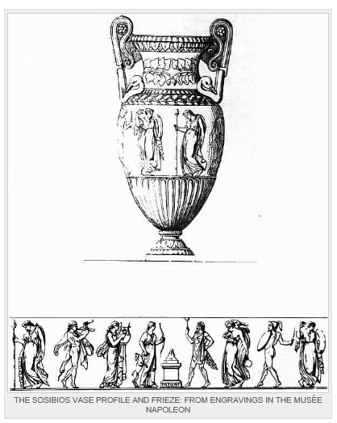

Slide 2
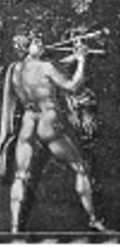

Slide 3
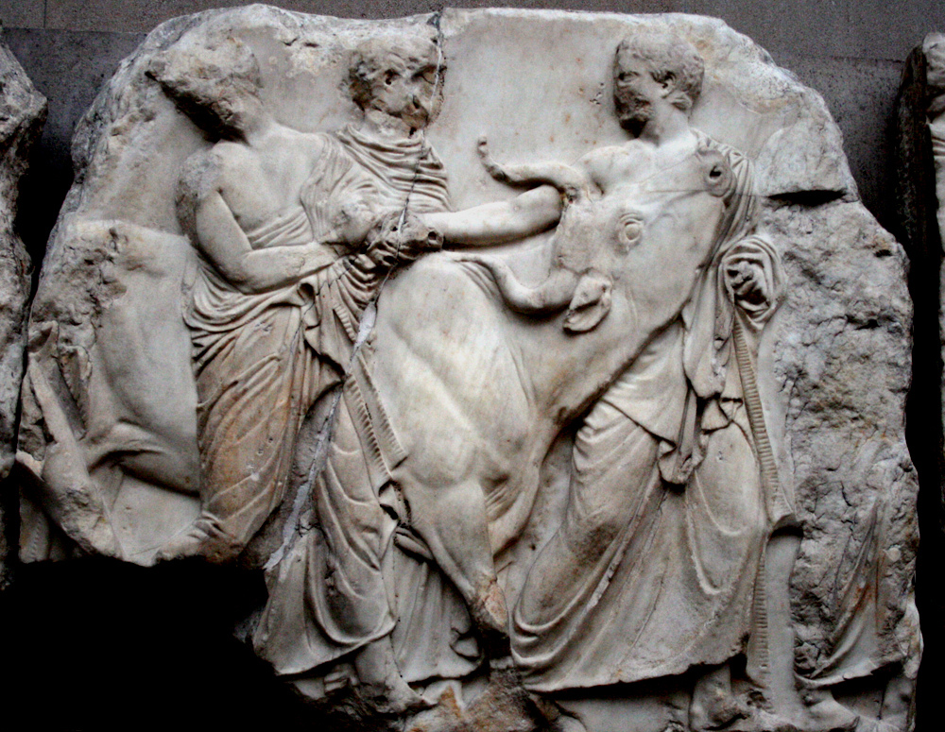

Slide 4
Frieze on the Townley Vase – British Museum

Slide 5
Frieze on the Townley Vase – British Museum

Slide 6
Frieze on the Townley Vase – British Museum

Slide 7
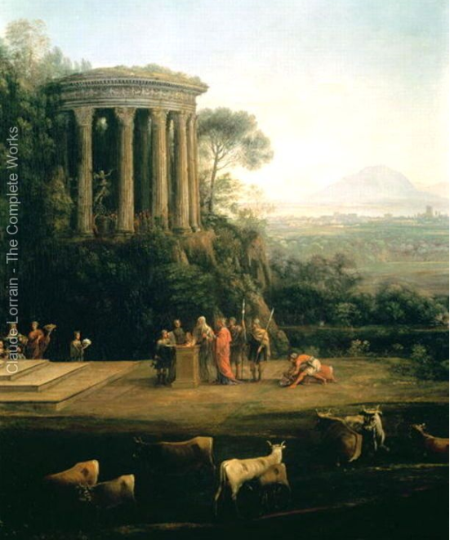
Frieze - Parthenon
Claude – Sacrifice to Apollo

Slide 8
"attic" refers to Attica, a region of ancient Greece of which Athens was the chief (primate) city.
The Vale of Tempe (Greek: Τέμπη) is a gorge in the Tempi municipality of northern Thessaly, Greece
Arcady (Arcadia)- an ideal rustic paradise.

Slide 9
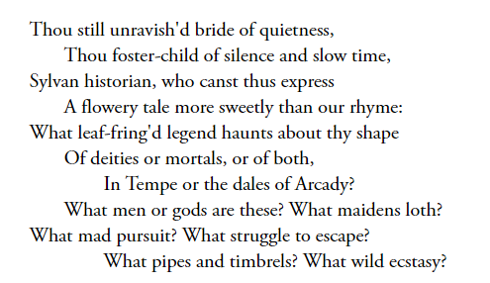
Interpret the first two lines and compare them with the second part of the first stanza

Slide 10
Ode form is always written in praise of something
Interpret the first two lines and compare them with the second part of the first stanza
‘Still’ – time now, preserved and perfect, despite the way the urn is threatened
Addressed directly to the urn – ‘thou’ (called poetic apostrophe)
the urn is fostered by time – looked after by it for an age
‘poetry should be great and unobtrusive’ says Keats
‘unravished bride’ –the urn is a female form that is still sexually pure (what should a modern reader make of this?!)
Contrast – perfect and unchanging first two lines, vs tumultuous questions
Stormy, intense, showing a kind of frustration. Note the anaphora which allows a frantic pace of repetition. Short questions, ending mid-line
The ‘maidens’ have men in ‘mad pursuit’ and are ‘loth’ (they are running from them, perhaps)

Slide 11
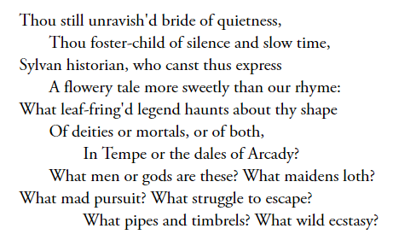
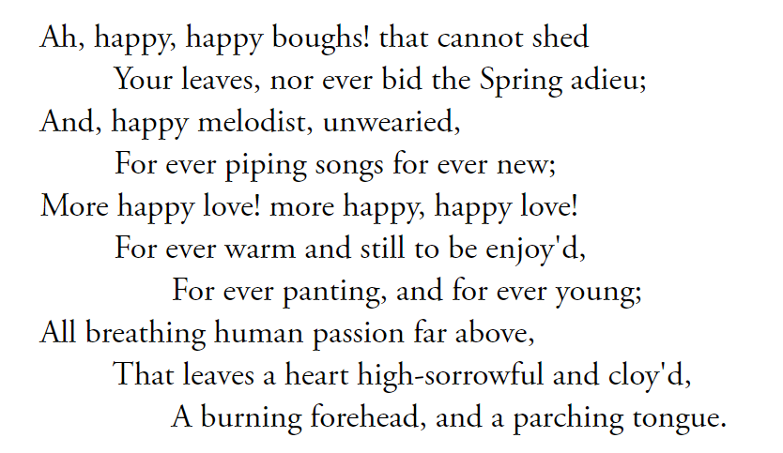
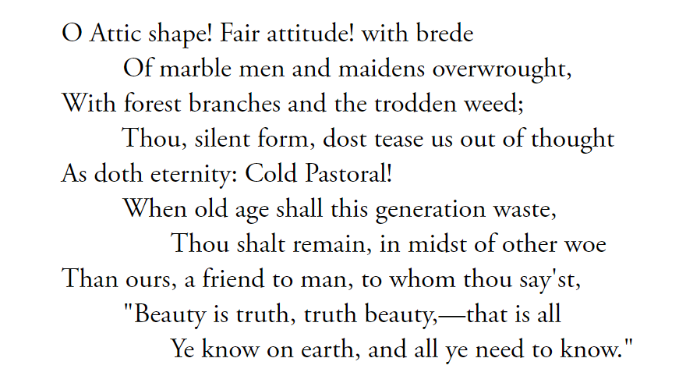
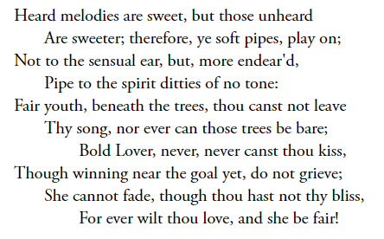
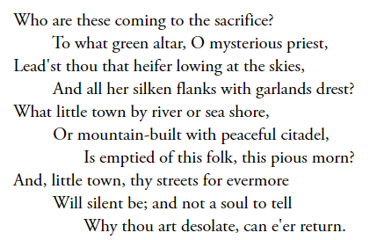
Look at the images of silence in the poem and suggest what Keats might be doing with them. In particular, can you relate this to the power of the imagination?

Slide 12
Consider the idea of ‘Cold Pastoral’, comparing it to stanza 4. Why the exclamation mark?

Slide 13
A poem about:-
art (a human creation), including music and poetry itself can surpass life
idealised natural scenes (Pastoral, Arcady etc), like any ideal state, cannot exist
how the imagination can transform etc
mortality: this ‘silent form’ is ‘eternity’; we are transient – the human condition
the changeability of emotion; the transience of human happiness vs permanent happy state on the urn
what the urn provides is precious, timeless, and offers brief respite from realities of life

Slide 14
What contrasts can you see between the tone and subject matter of stanza 3 and the phrase ‘Cold Pastoral’ in the last stanza?

