Slide 1
The Romantics: William Wordsworth
Lines Written in Early Spring
Tintern Abbey
Ode: Intimations on Immortality

Slide 2
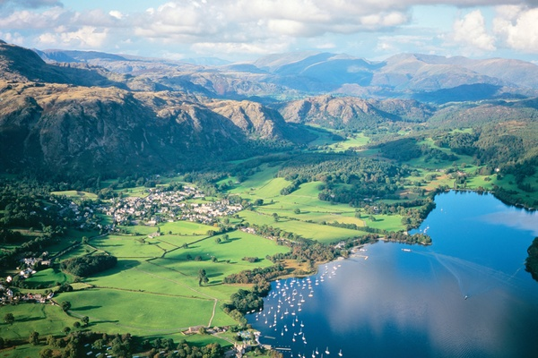
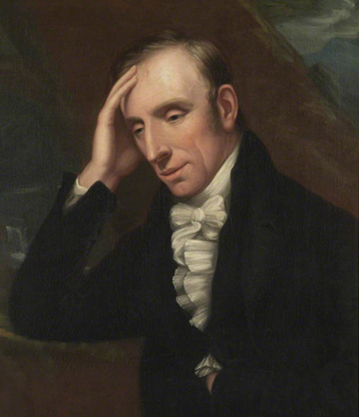
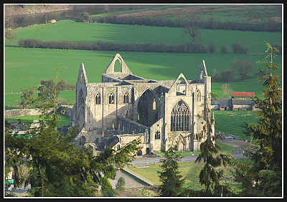
Introduction to Wordsworth
What do you already know about Wordsworth?

Slide 3
Introduction to Wordsworth
Born in Cumberland in 1770
Much of his poetry was inspired by the dramatic
landscape of the Lake District
His sister and lifelong companion, Dorothy, was born in
1771
Between 1787 and 1790, Wordsworth studied at
Cambridge, spending holidays walking in the lakes and
trekking across revolutionary France to the Alps
In 1795, William and Dorothy set up home together in the
West Country - there they met Samuel Taylor Coleridge, with whom Wordsworth published Lyrical Ballads in 1798 (this included ‘Lines Written in Early Spring’ and ‘Tintern Abbey’)
Wordsworth and Dorothy returned to the Lake District in 1799, settling at Dove Cottage in Grasmere; Robert Southey and Coleridge lived nearby
Life at Grasmere inspired some of his greatest poetry, including ‘I wandered Lonely as a Cloud’ and ‘Ode: Intimations of Mortality’

Slide 4
Introduction to Wordsworth
In 1802 Wordsworth married Mary Hutchinson
The next few years were personally difficult for Wordsworth: two of his children died, his brother was drowned at sea and Dorothy suffered a mental breakdown
His political views underwent a transformation around the turn of the century, and he became increasingly conservative, disillusioned by events in France culminating in Napoleon Bonaparte taking power
In 1813, the Wordsworths moved from Grasmere to nearby Ambelside
Wordsworth continued to write poetry, but it was never as great as his early works
In 1842, he was given a government pension and the following year became poet laureate
He died on 23 April 1850 and was buried in Grasmere churchyard. His great autobiographical poem, 'The Prelude', which he had worked on since 1798, was published after his death.

Slide 5
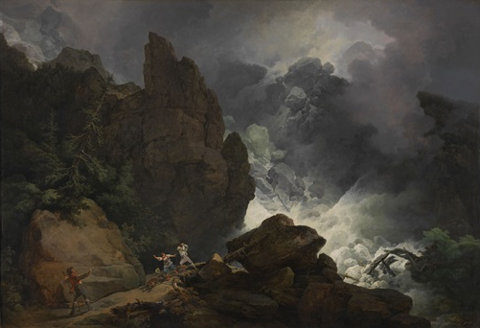
The Sublime
We can’t study Wordsworth without considering the notion of the ‘sublime’ – a concept that was important for all of the Romantics, but especially for Wordsworth.
Read through the information on
your sheet and jot down a few
notes to explain what is meant
by this term.
‘Poetry is the spontaneous overflow of powerful feelings: it takes its origin from emotion recollected in tranquility.’
Wordsworth, Lyrical Ballads
Avalanche in the Alps (1803), a sublime landscape painting by Philip James de Loutherbourg

Slide 6
Lines Written in Early Spring
What happens in this poem?
The speaker reclines in a beautiful grove surrounded by nature, and yet it inspires a melancholy mood and the speaker begins to have dark thoughts about humanity
However, he takes in the beautiful scene that surrounds him, looking more closely at the seemingly jubilant birds, plants, and other creatures of nature
He tries to decide whether or not they are really full of pleasure; he decides that they are
In the final stanza, he asks whether, if it is true that nature is full of pleasure, he then has a good reason to be sad about "what man has made of man”

Slide 7
Lines Written in Early Spring
What is the message of this poem? And the tone?
What is it that ‘grieves’ the speaker?
How are nature and mankind contrasted?
What would you say is the most important word within the line ‘what man has made of man’? Why?
What is the effect of the personification of Nature?
How is the speaker’s connection to nature demonstrated? Why does he appear to think it his duty to ponder the mistakes of humanity (and how can we tell this)?
Does the poem come to a conclusion or resolution?

Slide 8
Comparing Poems
If you were to use ‘Lines Written in Early Spring’ as your comparison, how could you approach this task?
AO1
AO2
AO3

Slide 9
Exemplar Essay
What has been done well here?
How have the criteria of the mark scheme been met?
What ‘top tips’ could you take away from this exemplar?

Slide 10
Comparing Poems
Plan your response and then write up the introduction and opening paragraph, using the exemplar essay as a model for structure.

Slide 11
‘Lines Composed a Few Miles above Tintern Abbey, on Revisiting the Banks of the Wye during a Tour, July 13, 1798’
This poem has an incredibly long title!
It is usually shortened to ‘Lines Composed a Few Miles above Tintern Abbey’, or even simply ‘Tintern Abbey’.
But why is the full title significant?
‘above’ → the poem’s perspective on the abbey is elevated and distant, and perhaps even detached
‘revisiting’ → the poet has visited the Wye Valley before – a place of significance to him? Or somewhere he loves?
‘during a tour’ → written during the course of a pleasure trip in which several different places of interest are visited
’July 13, 1798’ → the poem’s exact moment of composition

Slide 12
‘What should we make of the title’s eagerness to establish an exact time and precise place? In the poem’s opening lines we learn that the speaker is revisiting the Wye after a period of five years. The man who visited the region during a walking tour from London to North Wales in the summer of 1793 has changed significantly; at that time Wordsworth was an anxious, aimless and disillusioned young man: the father of an illegitimate child to a woman in revolutionary France, the recent author of two unnoticed poems, and a political radical beset with concerns about Britain’s entry into the war against France. Looking back on this turbulent period, the opening lines insist that then as now the poet receives a healing influence from nature: just as the ‘lofty cliffs … connect / The landscape with the quiet of the sky’, so the disunited perceiver of this scene is rejuvenated and made whole. To some degree, therefore, ‘Tintern Abbey’ presents absorption in natural beauty as the solution to mental, political and social disconnection.’
(Philip Shaw, The British Library)

Slide 13
The narrative of the poem
To track the course of this poem, give each of the stanzas a ‘heading’ or brief description, e.g.
Stanza 1: returning
Stanza 2:
Stanza 3:
Stanza 4:
Stanza 5:
How would you describe the form and structure of the poem? Why is this significant?

Slide 14
Memory
What is the significance of memory in the poem?
How is the idea of memories/revisiting established in the opening stanza?
Is memory more or less effective than immediate experience? (Look in stanza 2)
What makes the ‘unremembered pleasures’ (p.110) so important? Where do they come from?
What is Wordsworth’s message to Dorothy?

Slide 15
The younger and the older Wordsworth
How does Wordsworth present his younger self (stanza 4)?
In what ways has he changed in the past five years?

Slide 16
Nature
In ‘Tintern Abbey’, Wordsworth discovers that, in his maturity, his appreciation of natural beauty has allowed him to recognise a divine power in nature.
Pick out quotations that reveal this sense of the ‘divine’ in nature.
Which quotations or sections might suggest that Wordsworth experiences the ‘sublime’?
Key stanzas:
2, 4 and 5
Remember that Wordsworth, for a time, considered himself a pantheist (believing that all reality is identical with divinity)

Slide 17
How far do you agree?
‘The younger Wordsworth’s enjoyment of nature is purely physical and unreflective; he is unable to access the transcendental joy felt by his older counterpart because he has not allowed his ‘eye’ to be ‘made quiet’.’
Give evidence to back up your argument.

Slide 18
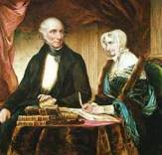
Stanza Five: Dorothy
How does Wordsworth present Dorothy in this stanza?
In what ways does she remind him of his past self?
What does he want for his
sister?

Slide 19
‘Ode: Intimations of Immortality’
This poem begins with an epigraph
taken from another of Wordsworth’s
poems, ‘My Heart Leaps Up’. He wrote
this poem in 1802, the day before he
began writing the ‘Ode’. Some scholars
have noted that ‘My Heart Leaps Up’
indicates Wordsworth's state of mind
while writing the longer poem and
provides clues to its interpretation.
What is the subject and tone of ‘My Heart Leaps Up’?
How does it link to the ideas in ‘Ode: Intimations of Immortality’?
My heart leaps up when I behold
A rainbow in the sky:
So was it when my life began;
So is it now I am a man;
So be it when I shall grow old,
Or let me die!
The Child is father of the Man;
And I could wish my days to be
Bound each to each by natural piety.

Slide 20
‘Ode: Intimations of Immortality’
What’s this poem all about?
What is its key message?
What is the significance of…
…childhood?
…memory?
…nature?

Slide 21
‘Ode: Intimations of Immortality’
This is a complex poem, in which the speaker jumps from one thought to another in each stanza, using a range of metaphors and images to explore philosophical/metaphysical ideas.
Sort the stanza summaries into the correct order, then look at how the tone/mood develops from the beginning to the end of the poem.
What does all of this have to do with immortality?

Slide 22
The speaker thinks back to a time (in childhood) when nature seemed mystical to him, and reflects that this is no longer the case.
Although the world is beautiful, the speaker feels that something has been lost.
All around him nature seems joyful, but the speaker feels melancholy. He resolves not to feel this way, declaring that the earth is full of joy.
The speaker wants to be part of the joy of nature, and yet seeing a tree, a field and then a pansy, he again has the sense that something is amiss.
The speaker asserts that, as children, we have some memory of heaven, but once we are grown into maturity, this memory and connection fades away.
The speaker reflects on the idea that, as soon as we reach earth, everything around us conspires to help us forget heaven.
The speaker sees (or imagines) a six-year-old child and foresees the rest of his life. He will learn from experience and spend most of his effort on imitation.
He speaks directly to the child; he cannot understand why the child would rush to grow up.
With a sudden rush of joy, the speaker realises that, through memory, he will always be able to connect to his childhood, and through his childhood to nature/heaven.
The speaker asks the creatures that earlier made him sad to sing out. He admits he has lost some of the glory of nature in growing out of childhood, but is comforted by the knowledge that he can rely on his memory.
The speaker reflects that nature is still the stem of everything in his life. It brings him insight, fuelling his memories and his belief that his soul is immortal.

Slide 23
Ode: a lyric poem, typically one in the form of an address to a particular subject, written in varied or irregular meter.
‘Ode: Intimations of Immortality’
How would you describe the form and structure of this poem? In what way does it differ from ‘Tintern Abbey’?
Work through each stanza and pick out the key images and ideas used by Wordsworth:
What is the effect of his use of imagery/metaphor/personification?
What are the philosophical ideas/message behind these images?

Slide 24
Explore the ways in which memory is presented in Ode: Intimations of Immortality by William Wordsworth and one other poem.
You must discuss relevant contextual factors.
Plan a response to the above task.
AO1: Key points/arguments
AO2: Evidence/brief analysis
AO3: Significance of context (this could be biographical, social/historical, literary…)
Remember this includes features of Romanticism. Nature is a biggie for all of the Romantic poets!

