Slide 1
The Romantics: Percy Bysshe Shelley
‘The cold earth slept below’
Stanzas Written in Dejection, near Naples
Ode to the West Wind
The Question

Slide 2
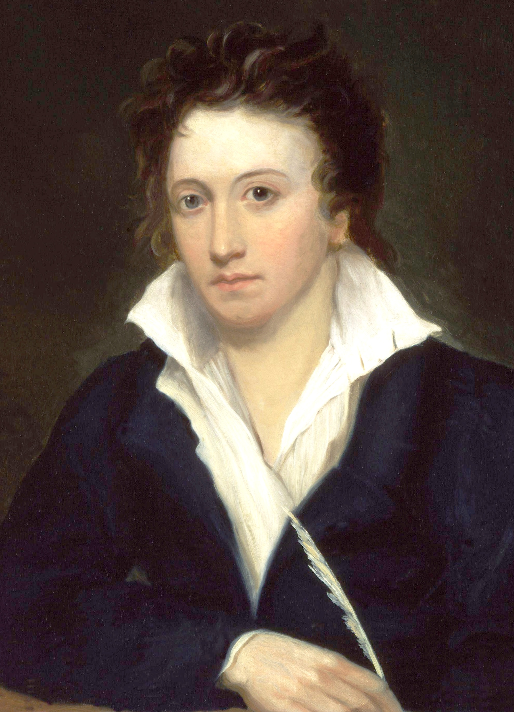
Percy Bysshe Shelley (1792-1822)
What do you know about this poet?
Came from a wealthy family and was in line to inherit his grandfather’s role as an MP
Went to Eton College and then Oxford, but was expelled from university for writing a pamphlet about atheism – this led to a fallout with his father, who disinherited him
He eloped in 1811 at the age of 19, with Harriet Westbrook (aged 16) – they moved to the Lake District where he continued to write
Three years later he left for Europe with another woman, Mary Godwin (who became Mary Shelley – author of Frankenstein)
In 1816 Harriet Westbrook’s body was found in a lake – it is thought she drowned herself
Three weeks later Shelley married Mary
He died just before his 30th birthday when he was caught in a storm on a sailing trip
Shelley was the most politically active of the Romantic poets. He detested the waste of living in luxury and felt that the royal family were liars and hypocrites
He believed in humanity and equality rather than Christianity
He was an idealist who took an extreme position on things – this partly damaged his reputation as some people felt they couldn’t take him seriously

Slide 3
‘The cold earth slept below’
Who could be the subject of this poem?
Composed in December 1816 in response to the death of Shelley’s first wife
The poem was first published posthumously in 1823 in Hunt’s Literary Handbook. Interestingly, in this edition it is dated November 1815. However, the editor’s note in Hutchinson’s Shelley: Poetical Works reads as so:
“These [lines] appear to be antedated by a year, as they evidently allude to the death of Harriet Shelley in November, 1816.”
Since the original manuscript shows a date of December 1816, the date must have been deliberately changed, presumably by Mary Shelley, to give the false impression that the poem was written before, rather than after and in response to, the death of Harriet Shelley.

Slide 4
‘The cold earth slept below’
What is the overall tone/mood of this poem?
How is the subject’s death presented?
There are a variety of contrasting images and symbols used in this poem, meaning that its message and tone is more complicated than it might seem at first glance.
Some of the key images used to convey death are sleep, winter and night. Find examples of these and explore how they are used. What sort of tone do they create?
Are there any other images that contrast with those above? How do these affect the tone/meaning?

Slide 5
‘The cold earth slept below’
Explore the form and structure of this poem:
What is the rhyme scheme?
What is the meter?
How does this affect/reflect the tone?

Slide 6
Stanzas Written in Dejection, near Naples
Context
Written in December 1818, when Shelley was living in Naples
Shelley was extremely depressed whilst in Naples
He was in poor health and his young daughter Clara had died in September of that year – this loss left Mary in a deep depression which isolated her from her husband
Shelley had also lost custody of his two children with Harriet, had a range of financial problems, friends had turned against him and his poetry was not being received well by the public or critics

Slide 7
Stanzas Written in Dejection, near Naples
Write a short ‘headline’ or summary for each stanza in this poem
What do you think was Shelley’s intention in structuring the stanzas in this way?

Slide 8
Stanzas Written in Dejection, near Naples
Explore the first two stanzas, in which Shelley describes the beauty of Naples
Pick out several examples of imagery and comment on their effects – what tone is created in these opening stanzas?
Are there any hints in Stanza 2 at the change in tone that is to come?

Slide 9
Stanzas Written in Dejection, near Naples
How is Shelley’s state of dejection conveyed in Stanza 3? Explore the use of language and structure.
What do you think he means by these lines?
‘Others I see whom these surround – Smiling they live, and call life pleasure; – To me that cup has been dealt in another measure.’

Slide 10
Stanzas Written in Dejection, near Naples
How does the tone develop in Stanza 4? What desire does Shelley express here?
Explore the use of language and imagery to convey these ideas.

Slide 11
Stanzas Written in Dejection, near Naples
Stanza 5: ‘Some might lament that I were cold’ – what does this suggest?
How does Shelley suggest in this stanza that he is aware of the fact that he is unappreciative of the beauty of the natural world around him?
How does the use of structure in this stanza affect the tone? Think about caesurae in particular.
The final few lines have a fairly awkward syntax: what does Shelley mean when he says the following?
…and yet regret,
Unlike this day, which when the sun
Shall on its stainless glory set,
Will linger, though enjoyed, like joy in memory yet.

Slide 12
Ode to the West Wind
What is this poem about?
Is the West Wind literal or metaphorical?
What are the key ideas expressed?

Slide 13
Context of the poem
Written in Italy in 1819
Some have interpreted the poem as Shelley lamenting his inability to help those back in England
The poem also expresses the hope that it will inspire and influence those who read it (a typically Romantic aim)
Some also believe that it was written in response to the loss of his son William (who died the year after Clara, in early 1919)
Shelley certainly would have had the Peterloo Massacre (August 1819) in mind at the time of writing
A long period of famine and unemployed following the Napoleonic Wars led the Manchester Patriotic Union to organise a demonstration to demand the reform of parliamentary representation
Local magistrates called on military authorities to arrest the organisers and disperse the crowds
Cavalry charged the crowds, leading to 15 deaths and 400-700 injuries
Other poems written at the same time include the same themes of political change and revolution (e.g. ‘Prometheus Unbound’ and ‘England in 1819’)

Slide 14
Form and structure
What is the form of this poem?
It is an ode, written in iambic pentameter
It consists of five sections known as ‘cantos’ written in terza rima (using the interlocking rhyme scheme ABA BCB CDC DED), each ending with a rhyming couplet
What could be the significance of this form?

Slide 15
Canto 1
Comment on the poetic voice in this canto (and in cantos 2 and 3). Key word: apostrophe
Which of the elements is referred to in this stanza? Explore one or two examples of this.
Explore the use of autumnal imagery: what mood or tone is created?
How does this imagery develop/change in the penultimate stanza?
What is the significance of the phrase ‘destroyer and preserver’?

Slide 16
Canto 2
Which of the elements is referred to here? How does this differ from Canto 1?
What is the significance of the imagery in stanzas 2 and 3?
How does Shelley make use of funereal imagery in this canto?
Explore the use of colour in this canto.

Slide 17
Canto 3
Which of the elements is now referred to? Explore the imagery and use of colour in relation to this.
What could be the significance of the imagery in stanza 2? Explore more than one interpretation.
How is the influence of the West Wind demonstrated in the final stanza here?

Slide 18
Canto 4
The tone changes in this canto: in what way?
What is the significance of the imagery in the first stanza here?
What impression do we get of the speaker/Shelley in this canto?
What is the significance of the words in the final couplet?

Slide 19
Canto 5
How does the tone continue to change/develop here?
How has the metaphor of the wind changed here? Explore Shelley’s final message.
Which of the elements in introduced in this canto and with what effect?
What is the significance of the final line: ‘If Winter comes, can Spring be far behind?’

Slide 20
Key themes
Comment on the significance of these key themes and motifs in ‘Ode to the West Wind’:
The poet as a visionary figure
Power of nature / the sublime
Autumn

Slide 21
The Question
What is the significance of the title ‘The Question’?
What are the key images, themes and ideas in this poem?
Comment on the form and structure:
Rhythm/meter?
Rhyme?
Significance of this?

Slide 22
The Question
This poem is a loose adaptation of a section of Dante’s ‘Purgatorio’ (Canto 28).
Have a read through the extract from Purgatorio on your handout
What similarities do you notice between the two poems?
There are also some stark contrasts: what are they and what is the significance of these?

Slide 23
The Question
Key images to explore:
The idea of dreams and visions
Significance of the stream
In Dante’s poem, the river he visits is Lethe, a river in Hades whose water caused forgetfulness
Wide range of references to spring flowers (why spring in particular? why so many different flowers? why such specific names of flowers?)
Comparisons of flowers to children (stanza 2 and stanza 5) – think about the importance of children in Romantic poetry
References to the heavens/stars
Significance of the final stanza: what could the ‘visionary flowers’ represent? why does Shelley have no one to present them to?

Slide 24
Exam style task
Explore the ways in which nature is presented in ‘Ode to the West Wind’ by Percy Bysshe Shelley and one other poem.
You must discuss relevant contextual factors.
(30 marks)

