Slide 1
John Donne
The Relic/Relique

Slide 2
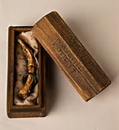
A Relic

Slide 3
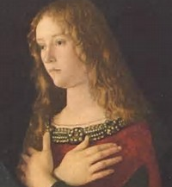
Mary Magdalene

Slide 4
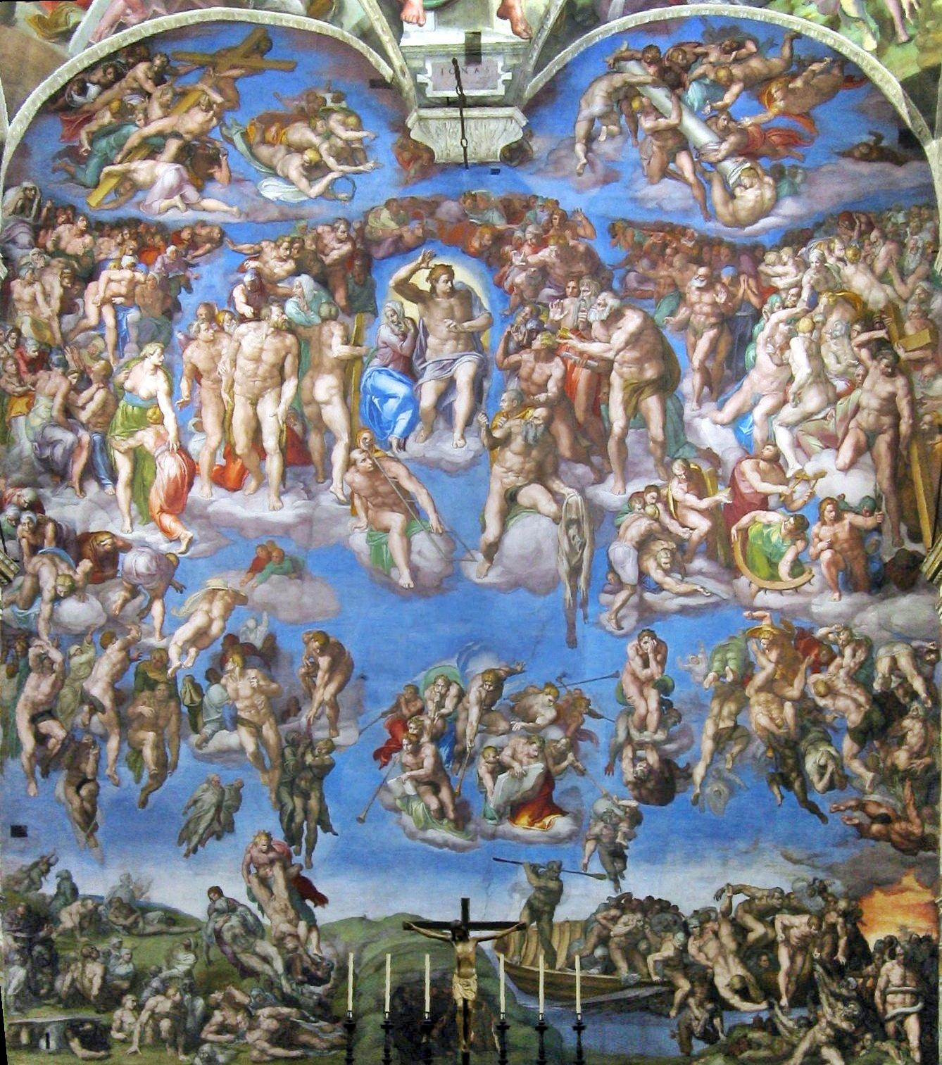
‘The Last Busy Day’ (Judgement day)

