Slide 1
Twicknam Garden
John Donne

Slide 2
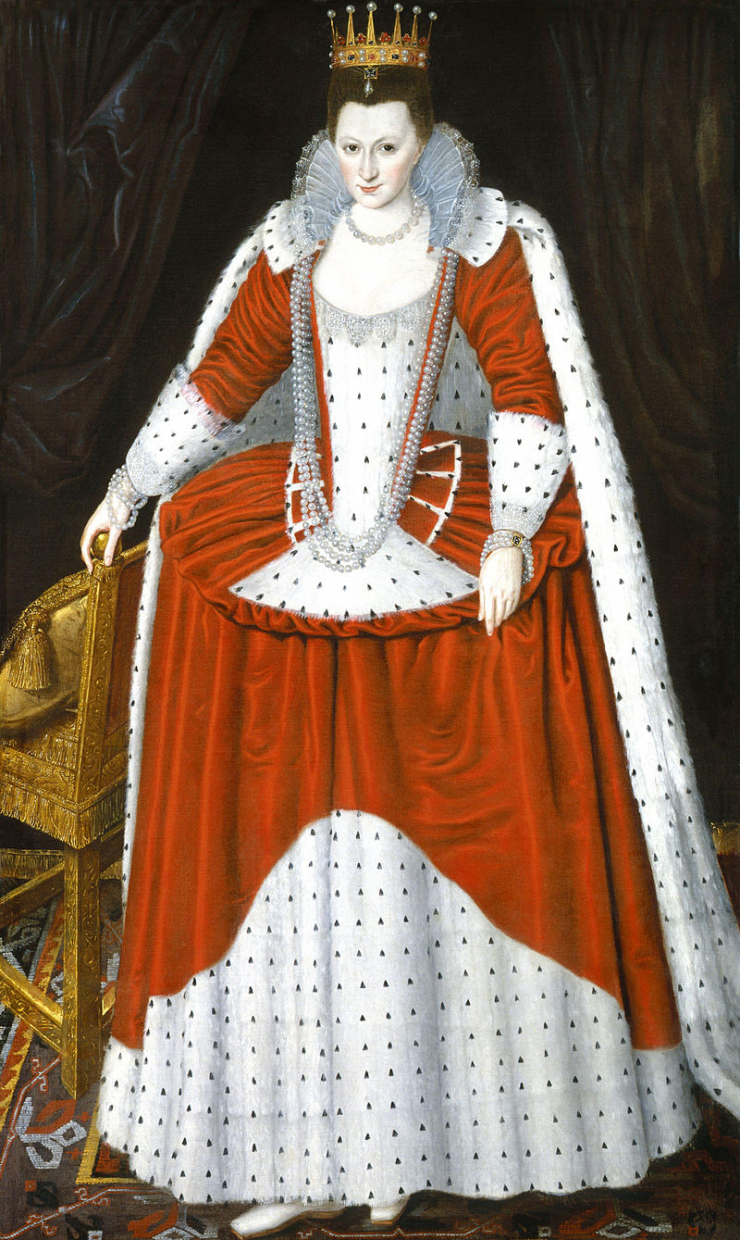
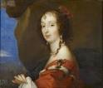
Lucy Countess of Bedford
Donne introduced to her by his friend, Henry Goodyer.
One of ‘bright young things’ of James’ court.
Preened herself on highbrow tastes. Encouraged authors to visit her house.
Wrote verses herself.
Seems to have enjoyed having this daring young poet (Donne) as her pet laureate.
Donne not in love with her
(faithful to Anne) but enjoyed
her friendship and patronage.

Slide 3
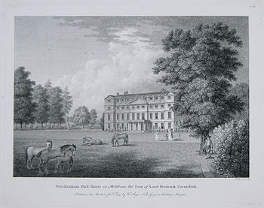
Twickenham Park (Twickenham =SW of London.)
•Lucy, Countess of Bedford, a wealthy woman in her own right, bought the Twickenham Park estate from Francis Bacon in 1608 and made it her principal residence.
Donne’s poem, Twicknam Garden must therefore have been written after this date, which makes him in his late thirties.
Not much in
poem relates
to Lucy apart
from the title.

Slide 4
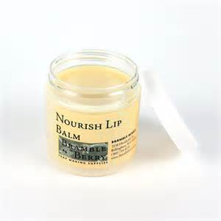
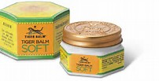
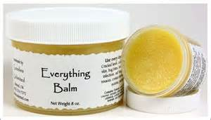
Balmes: Healing influences

Slide 5
Transubstantiation
Transubstantiation is, according to the teaching of the Catholic Church, the change of substance by which the bread and the wine offered in the sacrifice of the sacrament of the Eucharist during the Mass, become, in reality, the body and blood of Jesus the Christ.
Transubstantiation = transformation.

Slide 6
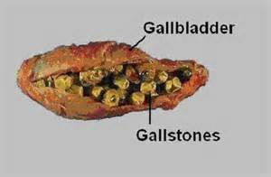
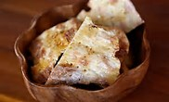
Manna Gall

Slide 7
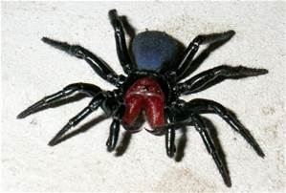
Spider Love
Spiders were originally thought to be full of poison

Slide 8
Paradise…I have the serpent brought

Slide 9
Mandrake

Slide 10
Stone fountain

Slide 11
Chain of Being

Slide 12
Crystal vial

