Slide 1
Good Friday 1613 Riding Westward
John Donne

Slide 2
Context: religious
Good Friday.
Good Friday is a Christian holiday commemorating the crucifixion of Jesus Christ and his death at Calvary. It is observed during Holy Week as part of the Paschal Triduum on the Friday preceding Easter Sunday, and may coincide with the Jewish observance of Passover. It is also known as Holy Friday, Great Friday, Black Friday,^{[1][2][3]} or Easter Friday,^{[4][5]} though the last term properly refers to the Friday in Easter week.

Slide 3
Context: Personal
The context of Good Friday, 1613. Riding Westward is explained in the poem itself, unusually for Donne. He has been forced to ride out on some business matter on a Good Friday. Normally, he would have preferred to spend the day in quiet meditation on Christ's death, since in the Christian calendar, that is the day on which Christ was crucified.
it it certainly suggestive that this 42-line poem, conceived as Donne entered his 42nd year, was written at exactly the time Donne made his decision to take orders, in spring 1613. (After overcoming many “distractions or diversions” cast in his path, he was eventually ordained in 1615.) The poem was probably composed on a journey which saw Donne visit Sir Edward Herbert at Montgomery Castle in Wales, and Sir Henry Goodere in Polesworth, Warwickshire. Following his return he announced his “resolution of a new course of life and new profession” – divinity.

Slide 4
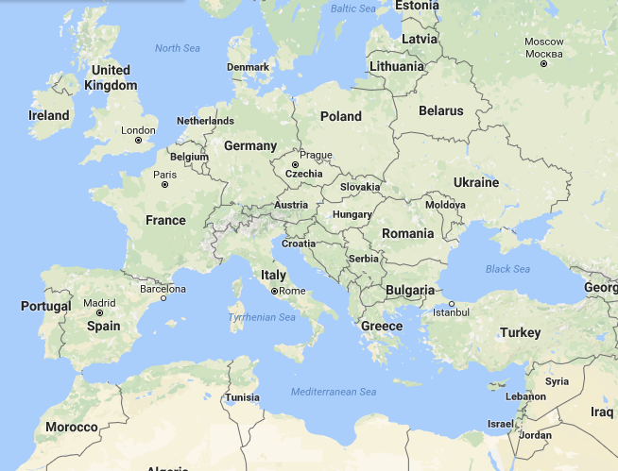

Slide 6
