Slide 1
John Donne
Pyrford

Slide 2
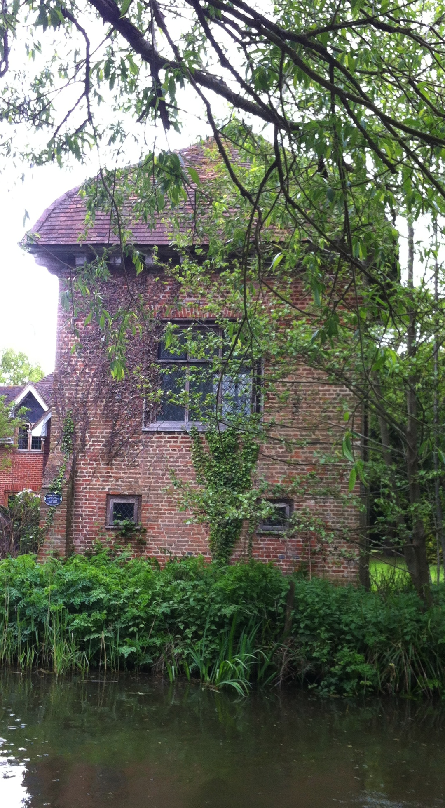

Slide 3
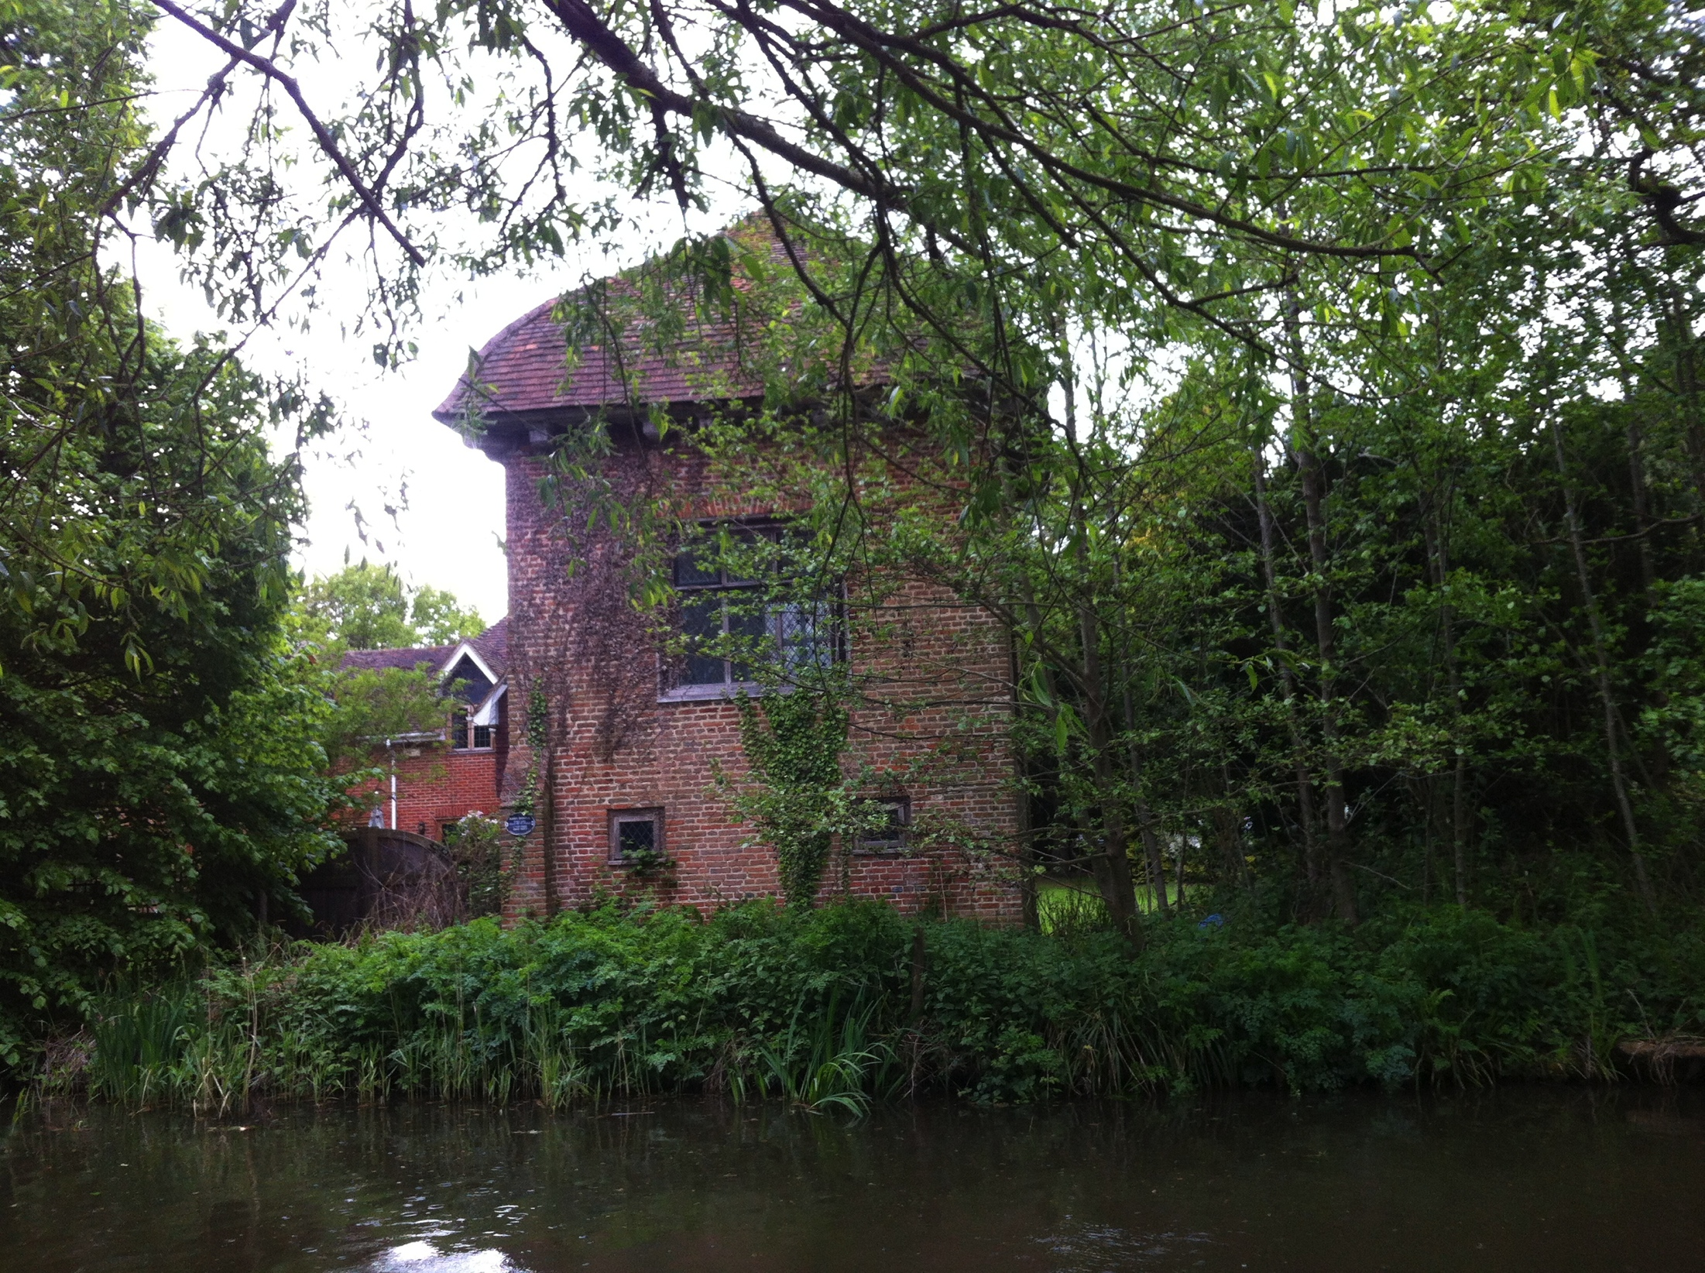

Slide 4
