Slide 1
Othello: 1:.3.219-386
Maddy (&RIAN)

Slide 2
Section Summary
The section starts in the court with Brabantio having just risen the issue of Othello marrying Desdemona
The court is more preoccupied with discussing military plans (the military being something Othello excels in)
Desdemona is shown to be well-spoken and prepared to appeal to both sides of the argument
It is decided that Desdemona will go to Cyprus too – Othello promises to not be distracted by her
Roderigo threatens suicide to Iago – Iago promises him the Othello will change his mind about Desdemona so Roderigo will be able to seduce her
Iago’s “monstrous birth” begins to take shape in his soliloquy

Slide 3
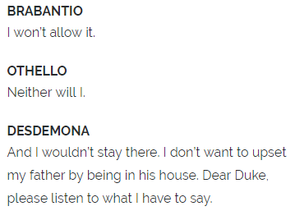
Summary: Here Desdemona manages to agree with both her father and her husband, despite their contrasting personalities and opinions.
Analysis: Brabantio’s anger at both Othello and Desdemona is shown through his refusal to allow his daughter back into his house. Othello wants Desdemona for himself, hence why he too doesn’t want her to go and stay with her father. However, the most cunning and intelligent person in this moment is Desdemona – while her father and husband are strongly opposed to one another, she manages to appeal to both of them, therefore keeping the conflict at bay. The subtle use of her complimentary line portrays Desdemona as a passive but intelligent woman.
“BRABANTIO: I’ll not have it so.
OTHELLO: Nor I.
DESDEMONA: Nor I.”
Spark notes translation
Context: - In Shakespeare’s time, women were generally seen as of a lower level of intelligence than men. - However, in this scene filled with men of a high status, Desdemona manages to come across as the most cunning and well spoken. - Despite being eager to please both parties, she still manages to come across as witty and well-spoken, while still retaining the image of a submissive and obedient lady.

Slide 4
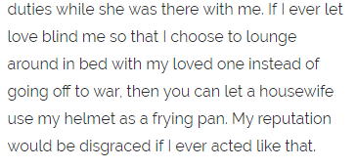
Summary: Here, Othello is promising to the Duke that his new marriage to Desdemona won’t mean he’ll be distracted from his responsibilities as a soldier.
Analysis: - Othello’s line here is ironic, and inevitably he does forget his duties as a soldier, as he becomes racked with jealousy. - Iago’s “poison” forces Othello to abandon his strong and admirable mental state, and his line here foreshadows his inevitable downfall and eventual broken promise to the Duke. - Also shows that his love of Desdemona is purely directed at her mind – he isn’t motivated by sex and therefore feels that he can always prioritise his duties.
“OTHELLO: […] I therefore beg it not / To please the palate of my appetite, […] Let housewives make a skillet of my helm,”
Spark notes translation
Context: - Othello mentions that he should be punished if he neglects his duties (“Let housewives make a skillet of my helm.”) Although subtle, this line shows that Othello, like many others, stereotypes gender roles (here assuming that women’s role is to cook). - However, this mild sexism contrasts greatly to the more blatantly sexist remarks that Iago comes up with, showing that Othello has (at this point in the play) a much stronger moral code.

Slide 5
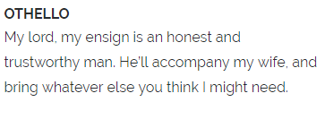
Summary: Othello here passes responsibility for his wife over to Iago, a trusted friend.
Analysis: - Ironically, Iago is the least trustworthy character in the play. Othello unknowingly hands over full responsibility of Desdemona to the villain who will use this trust to cause his downfall. - “My ancient” shows true respect towards the Duke. At this point, Othello’s moral code and respectful nature is still intact.
“OTHELLO: So please your grace, my ancient: / A man he is of honesty and trust. / To his conveyance I assign my wife,”
Spark notes translation
Context: - The irony here links to the tragedy of the play. Othello’s line reflects his absolute trust in Iago; something which is completely misplaced.
Gender: Othello is assuming that Desdemona needs a man to keep watch over her at all times, demonstrating the stereotyping of the time.

Slide 6
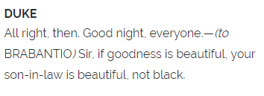
“DUKE: […] If virtue no delighted beauty lack, / Your son-in-law is far more fair than black. […]
BRABANTIO: Look to her, Moor, if thou hast eyes to see: / She has deceived her father and may thee.”
Summary: The Duke expresses his love for Othello, trying to convince Brabantio that perhaps he is a good choice for his daughter after all. Brabantio gives his final line in a rhyming couplet.
Analysis: - The Duke is aware of the negative connotations that a black man represents in Venetian society, but clearly holds Othello in high regard. This is an example of Othello as an outsider – in a military sense, he is very respectable, but when it comes to the domestic life, people are more hesitant to let him in. - Brabantio’s last line reflects a curse – this is ironic, as after linking Othello with witchcraft, he himself sounds as though he is speaking a chant. Although Desdemona never actually does deceive Othello, this could foreshadow how Othello too will eventually begin to question her loyalty. - “thou” is disrespectful, demonstrating Brabantio’s hatred for Othello.
Spark notes translation
Context: - Othello will never be able to get past his race as a boundary preventing him from becoming fully integrated into Venetian society. Even the Duke, who respects him greatly, associates his blackness with evil, and claims that he is white (or pure) at heart.

Slide 7
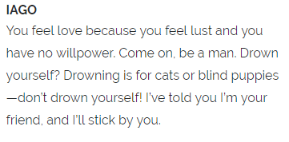
Summary: Iago mocks Roderigo, while pretending to treat him as a close friend
Analysis: - Iago compares Roderigo to a helpless animal – he is able to manipulate and bully him without Roderigo being aware of it - Iago acts like a trusted friend, when in reality, he is using Roderigo as a pawn for his villainous plan - He again relates the discussion back to the idea of cables and strings, suggesting strong friendship, but also entrapment
“IAGO: […] Drown thyself? Drown cats and blind puppies. I / have professed me thy friend and I confess me knit to thy / deserving with cables of perdurable toughness.”
Spark notes translation
Context: - Iago is the villain in this tragedy – his manipulative nature in this scene foreshadows how he will be able to create the same effect later when talking to Othello, the tragic hero

Slide 8
Summary: Iago admits that he is creating his plan purely on suspicion, and his ideas begin to unfold
Analysis: - Shows Iago’s lack of morality as he has no proof of his accusations against Othello - Comparing his plan to a conception is a grotesque way of demonstrating his evil - The rhyme of “night” and “light” makes his last line reflect a spell, showing Iago’s strong associations with magic and evil
“IAGO: […] Yet I, for mere suspicion in that kind, / Will do as if for surety. […] It is engendered. Hell and night / Must bring this monstrous birth to the world’s light.”
Spark notes translation
Context: - Hell relates to the focus on religion at the time, showing Iago’s confliction with religious morality and his desire to entertain evil - This is also shown through “monstrous birth”

