Slide 1
Similarities between Soviet Russia, Nazi Germany and 1984 in controlling information

Slide 2
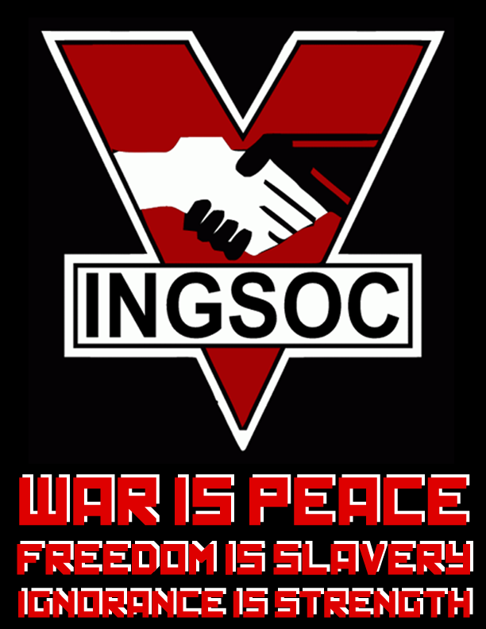
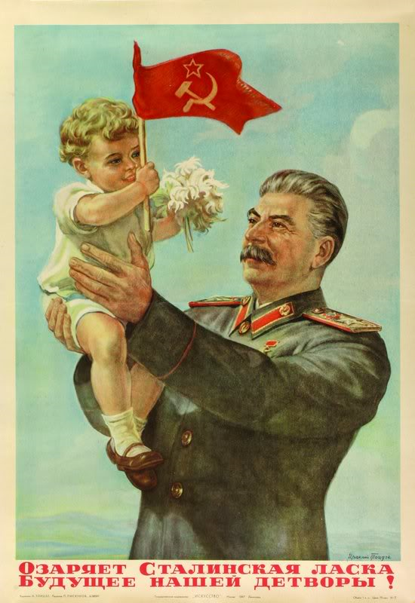
Propaganda

Slide 3
Opposition

Slide 4
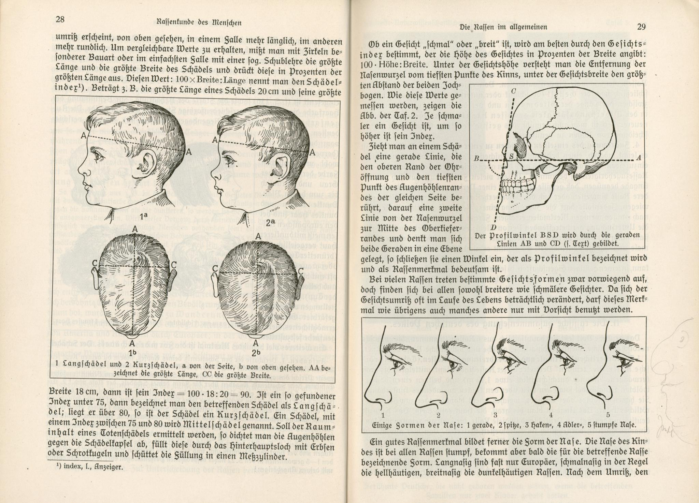
Changing history

Slide 5
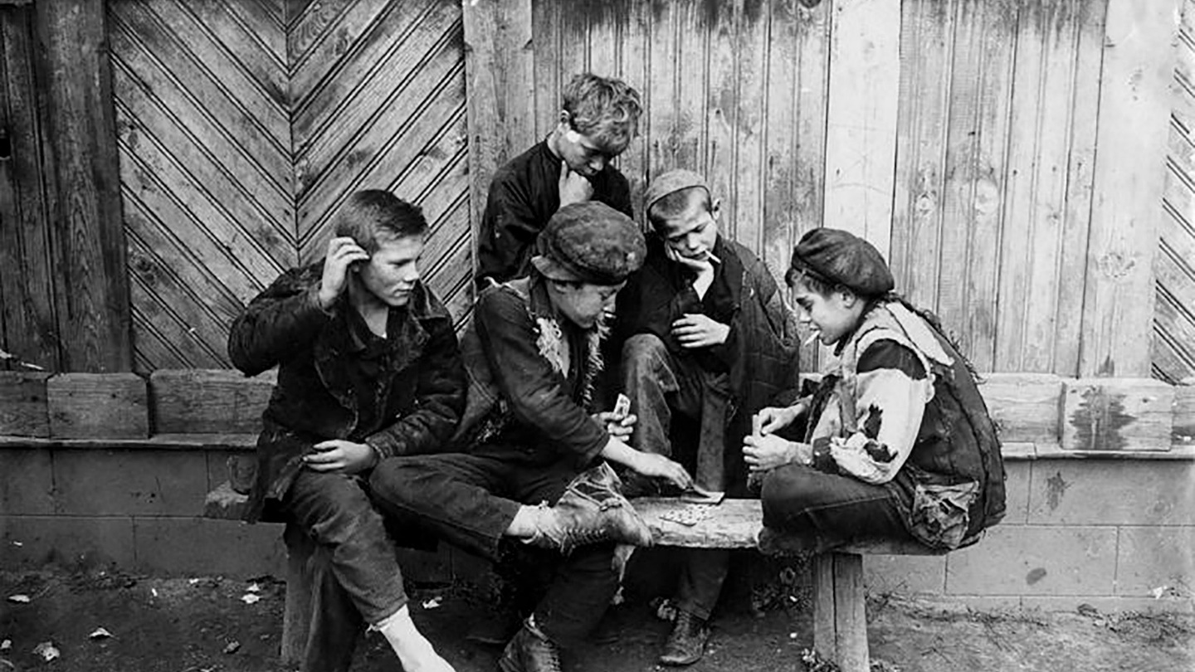
Production

