Slide 1
How does 1984 fit into general political context?

Slide 2
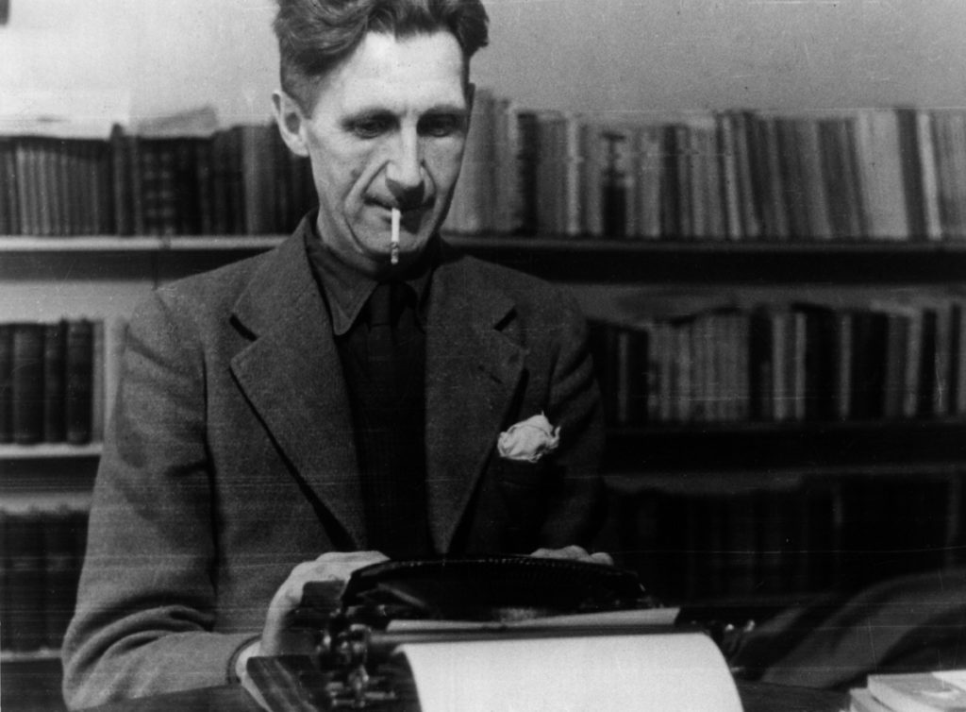
Why does Orwell criticise communism?
Party of Marxist Unification
Dislike of totalitarian regime
Anti-Stalinist
Democratic Socialist

Slide 3
Exploration of Communism
Effects of totalitarian regime
vs

