Slide 1
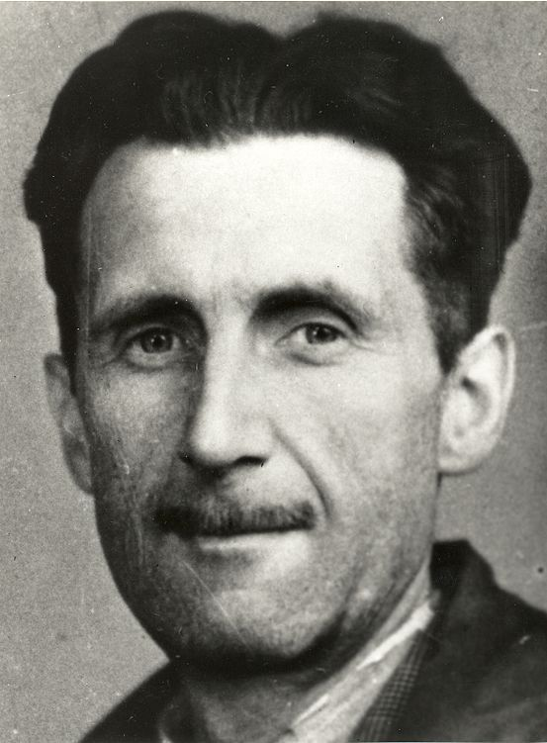
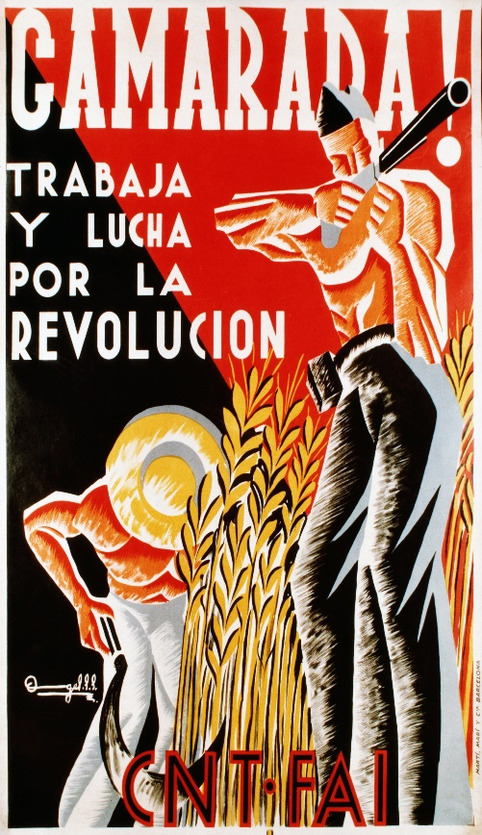
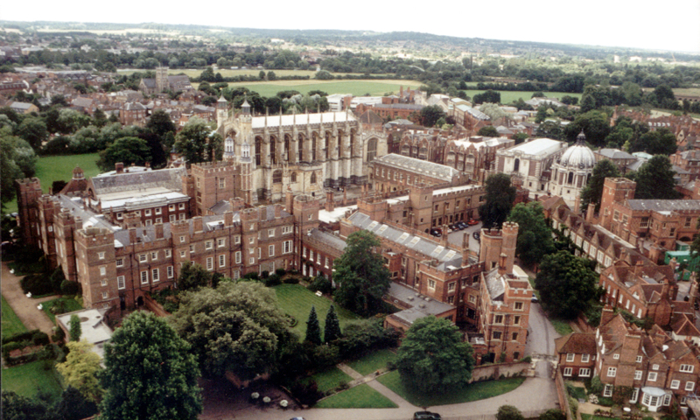
How does 1984 fit into Orwell’s life and work?
25 June 1903 – 21 January 1950
Brought awareness of social injustice, opposition to totalitarianism and outspoken support of democratic socialism
Spanish civil war- 1936
‘ Eric Arthur Blair’

