Slide 1
Othello Characters
By Abby Dowsett and Izzy Hill

Slide 2
Introduction
In Othello, the main majority of important characters are introduced to the audience within the first two acts. These main characters are;
Roderigo
Iago
Othello
Cassio
Desdemona
There are some side, less important characters introduced as well, these are;
Brabantio – Desdemona’s Father
Duke
Seneta
Montano – Commander in Cyprus
Emilia – Iago’s Wife
‘Gentleman.

Slide 3
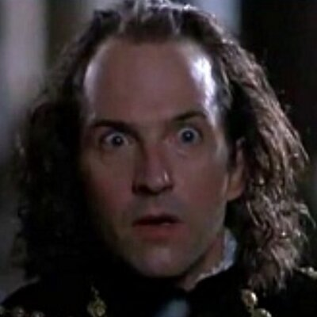
Roderigo
First Scene – Act 1 Scene 1
Rich
Stupid, until he speaks with Brabantio
Easily manipulated
‘Friends’ with Iago and lends him money
In love with Desdemona but got rejected by her father
Triggered at Othello for stealing the ‘love of his love’
KEY QUOTE: “Who hast my purse as if the strings were thine”

Slide 4
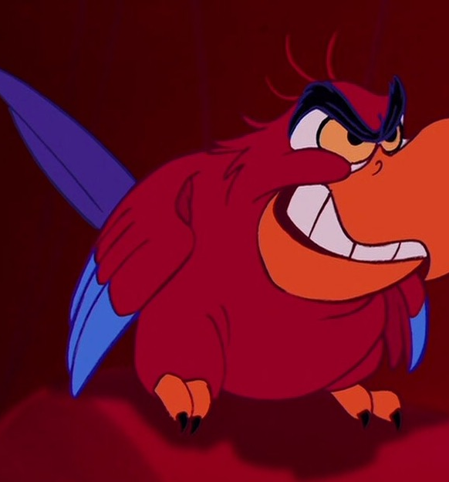
Iago
First Scene – Act 1 Scene 1
Manipulative
Selfish
Rude
Cunning
Masodonistic
Racist
Super smart
Cynical
Just a general psychopath really
Salty at Othello for giving what he thought was his promotion to somebody else and thinking that he slept with his wife
Hell bent on destroying Othello for what he did
Wants to make everyone suffer
Has low level interest in Desdemona and suspects Othello has slept with his wife
KEY QUOTE: “I follow him to serve my turn upon him.”

Slide 5
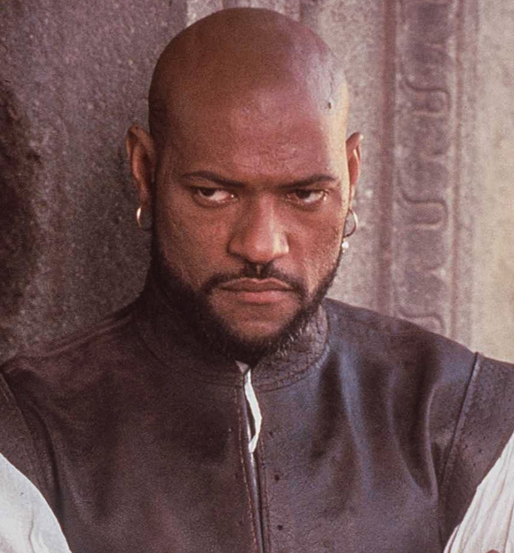
Othello
First Scene – Act 1 Scene 2
The pain ‘protagonist’
Smart
High society
Has an exciting past with lots of drama
Royal blood
General in the navy
Very good at his job- Venice relies on him
Moor- he gets a lot of prejudice for this – constantly repeated as title for him
In love with Desdemona
Brave
Polite
KEY QUOTE: “She loved me for the dangers I had passed, And I loved her that she did pity them”

Slide 6
How Othello’s Seen By Others
Mocked and seen as lesser, “his Moorship”
Seen as animalistic – “old black ram”
Has evil, unnatural powers – “thou hast enchanted her,”
A fool – Iago thinks it of everyone
Honourable
Brave

Slide 7
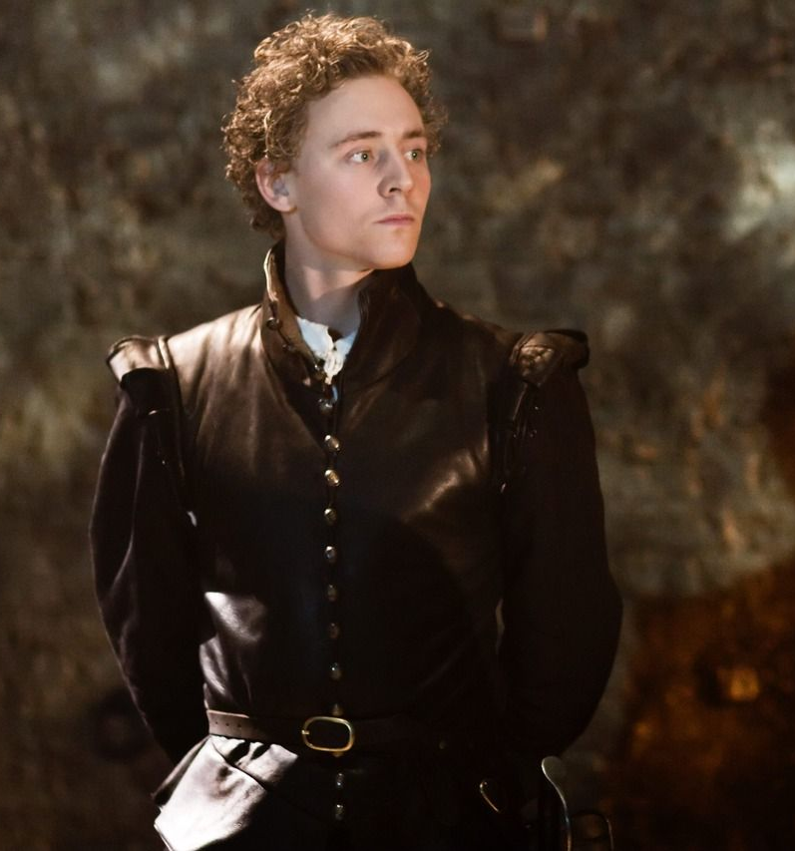
Cassio
First Scene – Act 1 Scene 2
Lieutenant to Othello (at first)
Respects and is friendly with Desdemona
From Florence- not Venice
Described by David as ‘slimy’
Is made drunk by Iago, and ends up having a big scrap with Roderigo, and his rank is stripped off him
KEY QUOTE: “The Divine Desdemona”

Slide 8
How Cassio’s Seen By Others
“a great arithmetician” – A sneer from Iago at Cassio’s position
Lesser due to his heritage as “a Florentine”
Useless as an officer as he’d “never set a squadron in the field,”
A ladies man
Thanks to Iago he’s considered to be a drunk

Slide 9
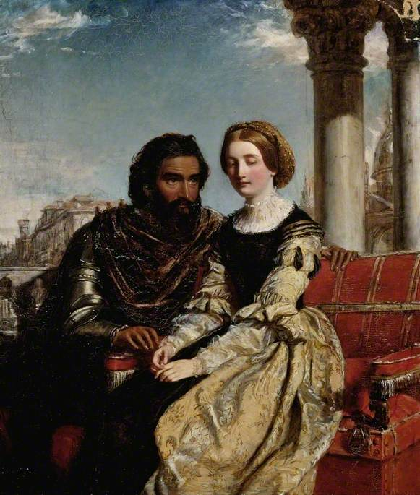
Desdemona
First Scene – Act 1 Scene 3
Beautiful
Strong and independent
She married who she wanted to, not who her father wanted her to (not that her Father wanted her to marry)
Is infatuated with Othello
Became interested in Othello while listening to his stories
Can fish for compliments
But generally a nice girl who sticks up for herself
KEY QUOTE: “The heavens forbid
But that our loves and comforts should increase,”

Slide 10
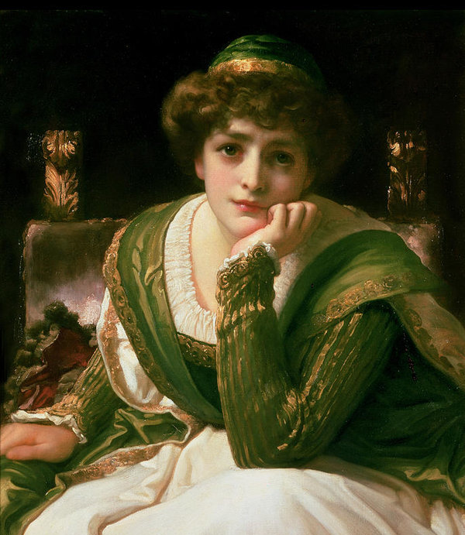
How Desdemona Is Seen By Others
Belonging to her father – “Thieves, thieves! Look to your house, your daughter, and your bags” – Little more than an object
Only useful for “her duty, beauty, wit, and fortunes”
Innocent – “your white ewe” – again a possession
Bewitched by Othello “in chains of magic”
Immature – “O unhappy girl!”

Slide 11
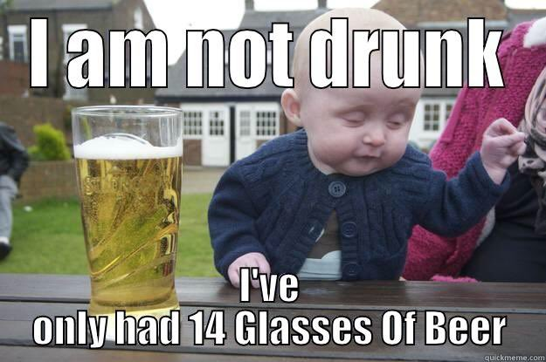
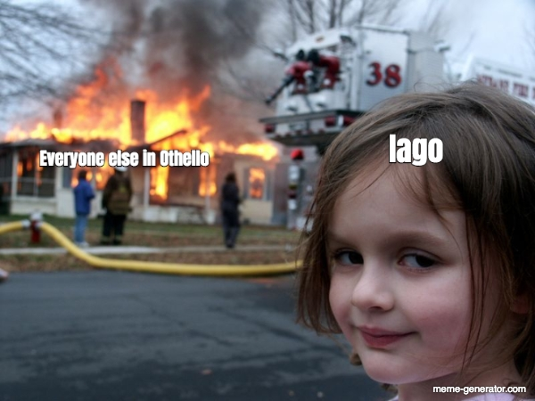
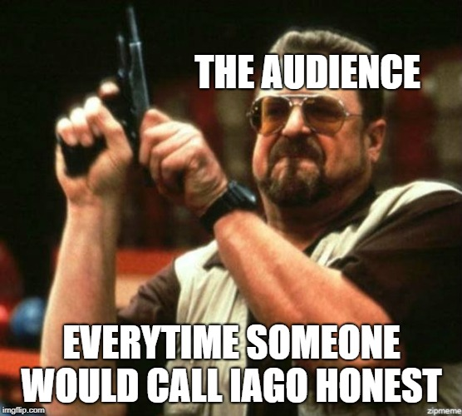
Thank You, We Hope You Enjoyed

