Slide 1
The Two Chimney Sweepers
A Revision Guide
Notes:
Aims and objectives: introduction. This week is all about offering an overview of each of the poems – explaining how they could be interpreted according to the criteria of the specification. Requested to revise the two chimney sweepers: 5 mins

Slide 2
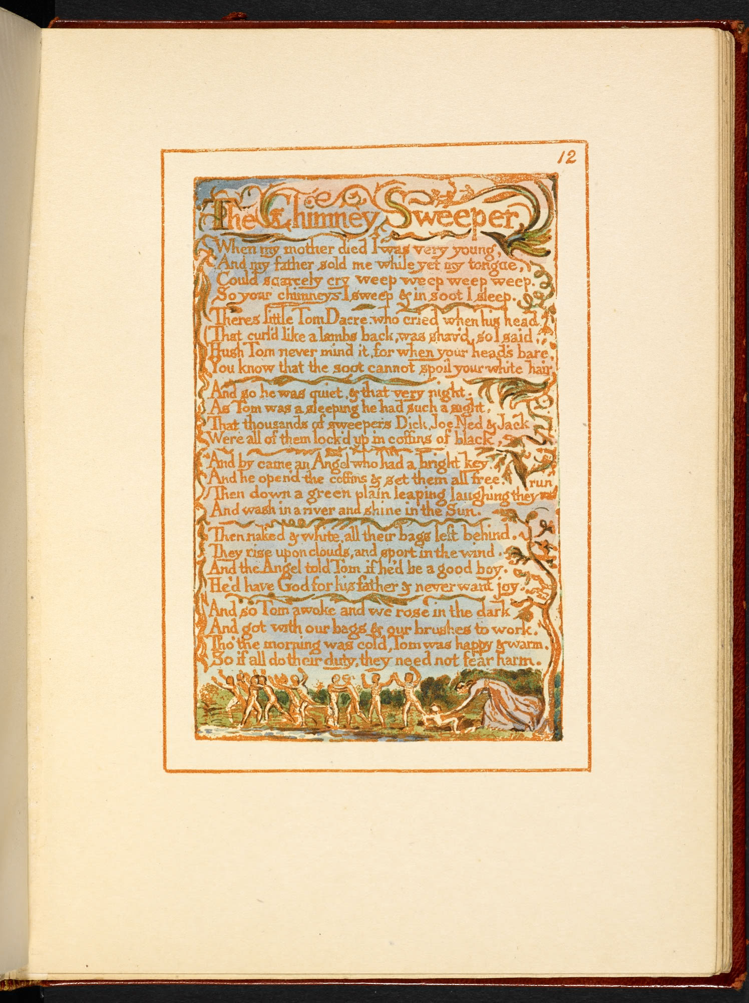
Notes:
I started by looking at the engravings: contrasting colours and depiction of children. 5 mins

Slide 3
Innocence
The figures of the dancing children, seem to become part of nature: extensions of the vines and leaves and curling calligraphy.
The green in the foreground suggests a pastoral paradise and the adult figure in the bottom right-hand corner is reminiscent of Blake’s depictions of Jesus.
Light and unearthly quality of the children - far removed from the life of the chimney sweep.
This is the image of salvation, not a depiction of the real conditions of suffering
Notes:
What I found…. 5 mins

Slide 4
Experience
In contrast: child is stooped, against the onslaught of winter weather and hard work. His face is turned accusingly towards the viewer and turned upwards. This puts us in an uncomfortably similar position to the parents, who are ‘gone up to the church to pray’.
The snow drives down and the sky is dark. The colouring of the plate is black, white and a kind of muddy brown, suggesting an industrialised winter scene where nothing can grow or thrive.
Unlike the plate from Innocence, where the figures are slender and free of earthly restraint, this boy is heavyset.
This is a depiction of the real conditions of suffering
Notes:
And in contrast 5 mins

Slide 5
Innocence and Experience Context (AO3)
Of the poems: e.g. characteristic preoccupation of Blake: two poems in which the children are controlled, repressed by adults and the power of the established church and state. Reference to the plates. Reference to the fact that one poem is from Experience and one from Innocence
Possible connections to other Blake poems: “Holy Thursday”, “London”
Of the wider literary/cultural or other relevant contexts: Social reality of both poems (industrialisation, child chimney sweepers, repressive authority figures).
Notes:
Idea of the context that I might include.

Slide 6
My thesis: the poems convey a sense of Blake’s feelings about innocence and experience as ‘contrary states’.
The sweep in Innocence doesn’t understand the life in which he finds himself. He is sold ‘while yet [his] tongue, / Could scarcely cry weep weep, weep weep.’.
In contrast, Blake suggests that experience is a state of knowledge and control: the child of Experience directs his anger at the organised religion of the church. In the last line of the poem, he implies that the church profits from the miserable life that he leads and therefore ‘make[s] up a heaven of our misery’. This suggests that organised religion is built upon innocent pain.
Notes:
Idea that I would start with a thesis. 5 mins The sin of organised religion, as Blake sees it, is to prevent people from seeing things as they are by training them in the fallacy of received wisdom. Just as the child’s parents fail to perceive his misery, so they fail to perceive the lack of spiritual truth in the doctrines and practices of the church.

Slide 7
Voice:
Innocence: first person speaker, framing the narrative of Tom Dacre’s dream: the malicious fiction that suffering in this world is relieved by salvation in the next. Both voices are ventriloquial voices for institutional control. Final line: doctrine of oppression: ‘So if all do their duty, they need not fear harm’ - the language of oppression is unchallenged.
‘The Chimney Sweeper’ (Experience): frame narrative of third person omniscient narrator; the direct speech of the child takes over in verse two and three in order to challenge the oppression.

Slide 8
Form and structural development:
e.g. Innocence: six quatrains. Moving from bleakness of first three lines of trochaic metre, and enjambment to suggest an emotional outburst. Framing narrative structure: moving from the dark urban reality, to the bright, pastoral idyll of the dream, and back to the dark at the close of the poem.
‘Experience: quatrains of regular line length – development from introduction to the child and his situation, to the child’s explanation for his parents’ actions – and critique of the situation

Slide 9
Imagery
Innocence: contrast between light and dark throughout (bright, shine, white in the dream – dark, soot, black, night in reality) Simile of lamb: characteristic of Blake’s poetry – associated with innocence and Jesus. Child, angel, white hair, washing in river: associated with purity and innocence - contrast to the coffins of black: sense of restrictive, sooty, dangerous chimneys.
In ‘The Chimney Sweeper’ of Experience, the child is initially dehumanised (little black thing etc.). Imagery of snow and external setting (heath, snow (x2)): the child outside the institution of the church: social critique. “clothes of death” “notes of woe”: adjectival phrases undercutting of accepted connotations of nouns

Slide 10
Rhyme and Rhythm
AABB rhyming scheme, but as the poem progresses, the rhymes become less regular; for example, "dark" and "work" (21-22) and "warm" and "harm" (23-24) - slant rhyme/half-rhyme/imperfect rhyme – unsettling. Shifts from anapaestic to iambic throughout – broken obviously in line 1, and final spondaic “fear harm” – negativity of death and control. The metre alternates between anapestic and iambic, which is usually found in comic or light-hearted verse – contrast of positive tone adopted by the speaker, with much of the content.
Regularity of common metre of ‘The Chimney Sweeper’ (Experience), broken in the spondee (weep weep) in second line. Phonology: e.g. (weep weep) – echo of pun on (sweep) (ref. to ‘The Chimney Sweeper’ (Innocence)).
Notes:
Underlining the idea of the innocent speaker who does not appreciate the full implications of what he is saying, or of one who uses words and happy visions to blot out the painful reality of his life.

Slide 11
Lexis
In both: "The Chimney Sweeper,“ does not refer to one individual, but rather they are homogenised in the title: they are not individuals, but are a work force. In Innocence: “weep” (x4): the sweep's professional advertisement of his labour (‘[S]weep! [S]weep!'); the portrayal of the misery of his position (‘[I] weep! [I] weep!); the imperative for the reader to be appalled at the situation (‘[You ought to] weep!')
Lexis of nature (snow, heath) – echoes of innocence; of sound in ‘The Chimney Sweeper’ (Experience) (crying, notes, etc.) – hearing the voice of the marginalised, oppressed child. Contrast of children (verbs associated with them: smiled, sing (X2) and dance) and adults (gone (x2) pray, to praise, clothed, taught etc) - characteristic separation of authoritative older generation. Contrast of (happy (x2), and woe (x2)) – the innocence v experience.

Slide 12
Syntax
Innocence: use of enjambment in lines 2 and 3 to suggest an emotional outburst, foregrounded in the repetition, exclamation marks and emphatic monosyllables of ‘weep!‘ Use of dietic language (“There’s”) to create sense of spoken voice, and the present tense creates an immediacy. Seen also in final line: implication that this is the enduring truth of the Church’s teachings.
Similarly (crying) in ‘The Chimney Sweeper’ (Experience)– an unresolved, continuing condition. Shift from past to present tense in the final verse (syntactical repetition of “Because I was happy…” and “because I am happy”): foregrounding the immediacy and relevance of present problem.

Slide 13
Your turn
Complete your revision sheets.
Remember to include reference to the comparison poems, saying how you would compare them
Be prepared to give a presentation on your poems, using the “Presenter”.
You may choose to use images.
You should aim to present for 10 minutes.

