Slide 1
The Ecchoing Green stylistic analysis
By Lewis smith

Slide 2
Lexis
The adjectives used in the first 10 lines are positive and refer to nature and new life. They present ideas of village life and delight of children playing sports on the green surrounded by nature.
‘Happy’, ‘merry’, ’louder’, ‘chearful’ ‘Echhoing’. These words present a light-hearted tone at the beginning of the poem.
Words such as ‘louder’ and ‘chearful’ could reflect the liveliness and joy of the wildlife and the children playing on the green.
However after the first ten lines, the adjectives used contrast this idea of upbeat activity. Words such as white, weary, old and darkening are used to describe the elderly as they are recalling the time they once played on the green too.
The poem inevitably shifts to a more solemn tone as a result as the adjectives used indicate old age and stress.

Slide 3
Rhythm
Line 3 to 7 within the first stanza contain usage of the Iamb to try and create the rhythm of conversation as much as possible.
These four lines are heavily descriptive and the usage of the Iamb by Blake could be a way in which he is trying to place a clearer image within our minds of the atmosphere on the Green. The rhythm is laid back and casual.
Line 1 to 4 of the second stanza contain usage of Spondee to try and further reinforce how the mood becomes much more solemn.
These four lines are heavily descriptive of ‘Old John’s’ appearance, thoughts and feelings and the usage of the spondee by Blake could arguably be to represent the disquieting and uneasiness of the elderly seen within the poem. The rhythm is stressed, which further highlights the contrast in tone between the first part of the poem and the second.

Slide 4
Symbolism
The ‘Ecchoing Green’ suggests that this scene, just like the season of spring itself has played out before and will play out again and again in the future.
In the second stanza the introduction of ’Old John’ is meant to represent how time has and is passing. The tone of the 2nd stanza is not meant to be sorrowful, but in some ways inspiring. The oak tree could represent this feeling as it could symbolize strength and security of these elderly folk as they are still around and are enjoying the sheer innocence of youth as they were once there themselves.
The ’Ecchoing’ Green shifts to the ‘darkening’ Green in the final stanza hinting how time is beginning to run out. This contrast in adjectives is meant to represent how spring will always come and be filled with joy but it will eventually end. This links to how there will always be innocent youth to enjoy life to the full, however time is inevitable and they will eventually mature into ‘Old John’ and have to become reminiscent of this joy they experienced while others take their place.

Slide 5
Phonology
Blake uses many soft sounding and fricative language within the first stanza.
Words such as ‘Sun’, ’Sound’, ‘Spring’, ‘Thrush’ ‘Sing’. This further reinforces the light hearted tone as the innocent children are described playing on the green. It gives us a sense of calmness and tranquility.
However as the poem progresses, we notice Blake uses more harsh sounding, glottal and plosive language which produces a negative feel from the text.
Words such as ‘Does’ ’Oak’ ‘Folk’ ‘Darkening’ gives the second part of the poem a sense of negativity and melancholy which is another determining factor that highlights this shift in atmospheric mood and tone from happiness to sorrow.

Slide 6
The Garden of Love
Maddie Stuart-Smith

Slide 7
Context & Comparison poems
Largely focused on the corruption of the Church – this is a common theme of Experience, as well as the overarching power of the institution/government.
‘A chapel was built in the midst’ – demonstrates industrialized religion and how this has destroyed the ‘Garden of Love’.
This poem also looks at the relationship between man and nature, in the past (or innocence) this relationship was harmonious, but in the present (or experience) this harmony no longer exists.
In the past, ‘The Garden of love’ seemed a place of idyllic beauty, but now is in a state of doom and gloom – ‘That so many sweet flowers bore’/’and tomb-stones where flowers should be’.
Comparison: ‘The Ecchoing Green’, Innocence, could be regarded as partner poem. The Garden of Love looks at what happens to the ‘Green’.
I went to the Garden of Love.
And saw what I never had seen:
A chapel was built in the midst,
Where I used to play on the green.
And the gates of this Chapel were shut
And Thou shalt not, writ over the door;
So I turn’d to the Garden of Love,
That so many sweet flowers bore,
And I saw it was filled with graves,
And tomb-stones where flowers should be:
And Priests in black gowns, were walking their rounds;
And binding with briars, my joys & desires.

Slide 8
Form & Structure
Simple structure/ rhyme scheme ABCB in the first two stanzas – could be to lull us into a sense of security. Also reflective of the relationship between man and nature, which is broken by the corruption/institution. The rhyme breaks in the final stanza to become ABCD, highlighting the power of the Church.
I went to the Garden of Love.
And saw what I never had seen:
A chapel was built in the midst,
Where I used to play on the green.
And the gates of this Chapel were shut
And Thou shalt not, writ over the door;
So I turn’d to the Garden of Love,
That so many sweet flowers bore,
And I saw it was filled with graves,
And tomb-stones where flowers should be:
And Priests in black gowns, were walking their rounds;
And binding with briars, my joys & desires.

Slide 9
Lexis & Syntax
‘Thou’, ‘shalt’ & ‘writ’ – old fashioned lexis, relating to religious language or language in the Bible.
‘Thou shalt not, writ over the door’ – non-standard syntax (for today), highlights the ‘Thou shalt not’, quite aggressive. Reflects Blake’s views of Orthodox religion, he resisted it as he saw it as very restrictive.
‘Where I used to play on the green’ – each word is monosyllabic, reflective upon a child’s language, reinforcing the past of this green. – Blake considered childhood to be very important, but this was not a common view of the time.
‘Briars’ – archaic (meaning a shrub, like a wild rose, with long stems and sharp thorns’).
‘bore’ the archiac form of to give birth, the main verb of this sentence. Relates to new life, and innocence, which contrasts to this poem that implies religious corruption.
I went to the Garden of Love.
And saw what I never had seen:
A chapel was built in the midst,
Where I used to play on the green.
And the gates of this Chapel were shut
And Thou shalt not, writ over the door;
So I turn’d to the Garden of Love,
That so many sweet flowers bore,
And I saw it was filled with graves,
And tomb-stones where flowers should be:
And Priests in black gowns, were walking their rounds;
And binding with briars, my joys & desires.

Slide 10
Imagery /Symbolism/Figurative Language
‘Garden of Love’ – imagery of love and life, however this is ironic as this is a graveyard, a place of the dead/doom and gloom. Could relate to heaven.
‘And I saw it was filled with graves (…) where flowers should be’ – graves of flowers - oxymoron of life and death. More death than life, relates to mortality of the time.
‘Priests in black gowns, were walking their rounds’ – 10 syllables, imagery of prison guards, relating to the power of the Church. That they have superiority, but this is used for bad/evil.
‘binding with briars, my joys & desires’ – violent imagery, that Blake’s ‘joys’ and ‘desires’ are being bounded by the Priest or institution of the church with nature. This again references the relationship of man and nature, and how industrialization has destroyed this. As ‘desires’ has sexual overtones, this could refer to sex before marriage, which is wrong in the Bible. As well, Blake finds marriage restricting and wrong.
I went to the Garden of Love.
And saw what I never had seen:
A chapel was built in the midst,
Where I used to play on the green.
And the gates of this Chapel were shut
And Thou shalt not, writ over the door;
So I turn’d to the Garden of Love,
That so many sweet flowers bore,
And I saw it was filled with graves,
And tomb-stones where flowers should be:
And Priests in black gowns, were walking their rounds;
And binding with briars, my joys & desires.

Slide 11
Rhythm & Rhyme
‘gowns’ and ‘rounds’ / ‘briars’ and ‘desires’ – internal rhyme, all plural nouns, this intensifies the scale/power of the Church.
‘seen’ and ‘green’ (stanza one) / ‘door’ and ‘bore’ (stanza two) – the rhyme scheme is broken in the final stanza, where Blake uses internal rhyme in the final two lines of the poem.
ABAB rhyme scheme for first two stanzas, ABCD for final stanza. Broken by the Church, draws focus on the power on the institution.
First stanza – each line is 8 syllables / Second stanza – first three lines 9 syllables, last is 8 / Final stanza – 10, 9, 10, 12
Anapestic trimeter, breaks at ‘And Thou shalt not, writ over the door’ which is 4 beats. The Anapestic trimeter resumes until the final two lines which are four beats again.
The anapestic trimeter rhythm is songlike, reminds us of childhood. Broken by experience and corruption.
Beats are on ‘binding’/’briars’/’joys’/desires’ emphasizes the plosive sounds, leaving the resonating image of corruption in our minds. Plosives show the aggression or power of the Church.
I went to the Garden of Love.
And saw what I never had seen:
A chapel was built in the midst,
Where I used to play on the green.
And the gates of this Chapel were shut
And Thou shalt not, writ over the door;
So I turn’d to the Garden of Love,
That so many sweet flowers bore,
And I saw it was filled with graves,
And tomb-stones where flowers should be:
And Priests in black gowns, were walking their rounds;
And binding with briars, my joys & desires.

Slide 12
Tone & Voice
First person narrator addressing the reader – this makes the poem from Blake’s perspective and more personal/emotive.
In relation to person, the pronouns in the poem are ‘I’ used 5 times, and ‘my’ used once. These are first person personal pronouns; he does not use any collective or plural first person pronouns.
‘A chapel was built in the midst’ – multiple plosive sounds, aggressive.
Lexical clusters of nature; ‘garden’ ‘green’ ‘flowers’ juxtaposing lexical clusters of death & corruption; ‘graves’ ‘tomb-stones’ ‘binding’ ‘black’. The nature is most apparent in the first stanza, the second stanza the corruption of the church begins to take control, and then the death and corruption seizes power over nature in the final stanza.
I went to the Garden of Love.
And saw what I never had seen:
A chapel was built in the midst,
Where I used to play on the green.
And the gates of this Chapel were shut
And Thou shalt not, writ over the door;
So I turn’d to the Garden of Love,
That so many sweet flowers bore,
And I saw it was filled with graves,
And tomb-stones where flowers should be:
And Priests in black gowns, were walking their rounds;
And binding with briars, my joys & desires.

Slide 13
The Chimney Sweeper
Innocence

Slide 14
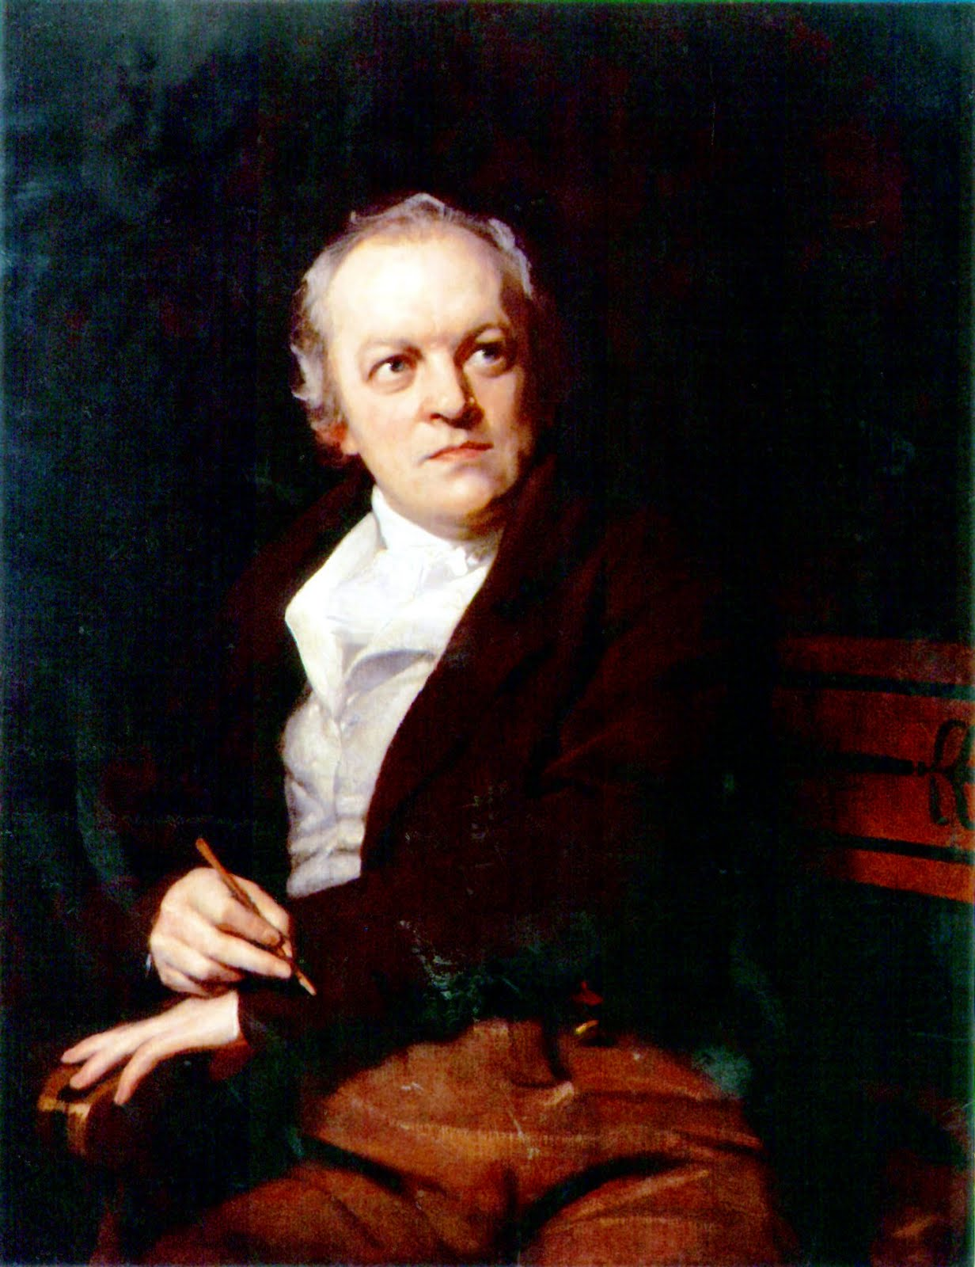

Slide 15
Context
The life of a chimney sweep was very dangerous. The children were generally sold into the business by their parents between the age of four and seven.
Children were forced up the 7 inch vents; encouraged by poles, pricked with pins or scorched with fire.
The poem is written from the perspective of a young chimney sweep who begins by talking about himself and then moves on to talk about another sweep…Tom Dacre.
The children seem to be controlled by adults, the power of the established church and state.
Poem may represent the effect of industrialisation and repressive authority figures.

Slide 16
Voice
First person speaker, framing the narrative of Tom Dacres dream.
The child has become objectified/used before even having the ability to speak.
Lexical clusters of pain, sadness. (weep, cry)
Phonological repetition of ‘Weep! Weep! Weep! Weep!’ creates the sound of a child crying.
When my mother died I was very young, And my father sold me while yet my tongue Could scarcely cry 'weep! 'weep! 'weep! 'weep!
So your chimneys I sweep, and in soot I sleep

Slide 17
Form and Structure
Six quatrains with rhyming couplets.
Moving from the bleakness of the first three lines of trochaic metre and enjambment to suggest an emotional outburst.
The structure of the poem changes as it moves away from the dark urban reality and into the dream with the ‘Angel’ the hope for happiness.
‘And by came an Angel who had a bright key,
And he’d open the coffins and set them all free,
Then down a green plain leaping, laughing they run’

Slide 18
Imagery and Figurative Language
Contrast between light and dark throughout.
(bright, shine, white, light- dream) (dark, soot, black, night- reality)
‘coffins of black’- strong link to death/how many children died in the chimneys
‘naked and white’- although the white imagery represents the dream there is a sense of vulnerability and violation/ they cannot escape reality
Restriction v Freedom

Slide 19
Rhyme and Rhythm
AABB rhyming scheme, but as the poem progresses, the rhymes become less regular; for example, "dark" and "work" (line 21-22) and "warm" and "harm" (23-24)
slant rhyme/half-rhyme/imperfect rhyme – makes the poem seem more unsettling.
Shifts from anapaestic to iambic throughout – broken in line 1, and final spondaic “fear harm” – represents negativity of death and control.

Slide 20
Lexis
Lexical repetition of ‘weep’- emphasises the pain and sadness of the life of a chimney sweeper (repeated 4 times)
Repetition of ‘weep’ may also be a phonological device to show his labour- (s)weep!, (s)weep!
Or… the portrayal of the misery of his position/childhood- (I)weep!, (I)weep!
Or… the imperative for the reader to be appalled by the situation- (you)weep!, (you)weep!
Lexis of pain contrasting lexis of happiness- (pain)‘coffins of black’ ‘could scarcely cry’ ‘in soot I sleep’ ‘that curled like a lambs back’
(happiness) ‘leaping, laughing they run’ ‘shine in the sun’ ‘need not fear harm’

Slide 21
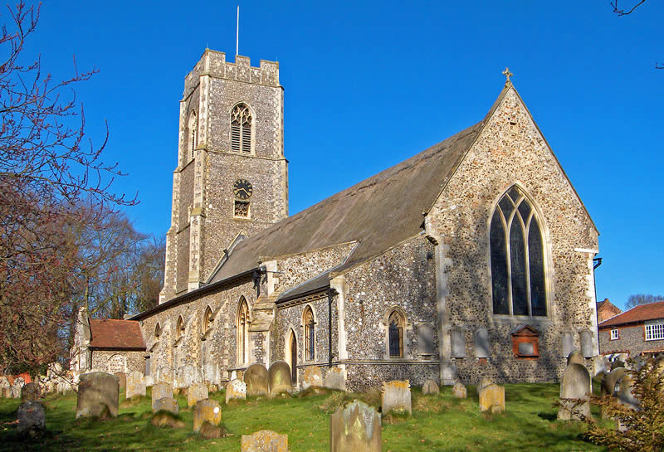
Syntax
Use of enjambment in lines 2 and 3 to suggest an emotional outburst- ‘And my father sold me while yet my tongue, Could scarcely cry “Weep!...’
Repetition, exclamation marks and emphatic monosyllables of ‘weep!‘ Use of dietic language ‘There’s’ to create sense of spoken voice, and the present tense creates an immediacy. Seen also in the final line: implication that this is the enduring truth of the Church’s teachings.

Slide 22
The divine image
Analysis

Slide 23
Form and Structure
To Mercy Pity Peace and Love,
All Pray in their distress:
And to these virtues of delight
Return their thankfulness
For Mercy Pity Peace and Love
Is God our father dear:
And Mercy Pity Peace and Love,
Is Man his child and care.
For Mercy has a human heart
Pity, a human face:
And Love, the human form divine,
And Peace, the human dress.
Then every man of every clime,
That prays in his distress,
Prays to the human form divine
Love Mercy Pity Peace.
And all must love the human form,
In heathen, turk or jew.
Where Mercy, Love & Pity dwell,
There God is dwelling too.
Grammar - Blake uses a variety of grammar throughout this poem such as colon, commas and full stops. This breaks the lines up and gives the poem characteristics of spoken discourse which emphasises the importance of phonology and tone in this particular poem.
5 x quatrains- sounds song-like which gives the poem a degree of innocence which could refer to the hymns taught to young children by the Church.

Slide 24
Lexis
The abstract noun ‘Love’ is placed at the end of the first three lists of virtues in the poem and then appears at the beginning of the fourth list in the fourth stanza. The word is also included more than all other virtues. He also describes love as ‘the human form divine’ in the middle of the poem. This could suggest that Blake believes that love is the most important virtue and outweighs the others in with regards to importance.
Capitalisation - Blake makes a point to capitalise some words over others in this poem. He capitalises words such as ‘Mercy’, ‘Pity’, ‘Peace’, ‘Love’ (all Christian virtues) ‘Pray’ and ‘Man’ but has not capitalised ‘heathen’, ‘turk’, or ‘jew’ which are all titles referring to a belief other than Christianity. This, therefore, strips these other beliefs of their importance and validity against Christianity which is the main theme of this poem.
To Mercy Pity Peace and Love,
All Pray in their distress:
And to these virtues of delight
Return their thankfulness
For Mercy Pity Peace and Love
Is God our father dear:
And Mercy Pity Peace and Love,
Is Man his child and care.
For Mercy has a human heart
Pity, a human face:
And Love, the human form divine,
And Peace, the human dress.
Then every man of every clime,
That prays in his distress,
Prays to the human form divine
Love Mercy Pity Peace.
And all must love the human form,
In heathen, turk or jew.
Where Mercy, Love & Pity dwell,
There God is dwelling too.
Anaphora – Blake repeats the word ‘every’ in the first line of the fourth stanza bring emphasis to the message he is spreading with regards to his belief that people of all beliefs should be treated fairly and embrace these virtues. This demonstrates the controversial views Blake had that were ahead of his time.
Repetition – ‘Mercy Pity Peace and Love’ are repeated three times throughout the poem and these virtues are repeated individually multiple times; Mercy-6, Pity-6, Peace-5, Love-7. It is interesting that Peace is referred to one time less than the other virtues which occurs when it is stated that ‘Mercy, Love & Pity dwell, There God is dwelling too.’ This suggests that peace does not come with the belief in a God and could reflect Blake’s view on the evil and conflict that accompanies Christianity.

Slide 25
imagery
Blake defines the four virtues by tying them to humanity and God- ‘Is God our father dear:’, ‘Is Man his child and care.’ This explains that these virtues become evident through people and he could be implying that we have the power to display these virtues and it is our choice to do so. He could be persuading his audience that they need to find these characteristics in themselves and show them because he could not see them in the society he knew as he addresses the corruption of religion and industrialisation in many of his poems.
To Mercy Pity Peace and Love,
All Pray in their distress:
And to these virtues of delight
Return their thankfulness
For Mercy Pity Peace and Love
Is God our father dear:
And Mercy Pity Peace and Love,
Is Man his child and care.
For Mercy has a human heart
Pity, a human face:
And Love, the human form divine,
And Peace, the human dress.
Then every man of every clime,
That prays in his distress,
Prays to the human form divine
Love Mercy Pity Peace.
And all must love the human form,
In heathen, turk or jew.
Where Mercy, Love & Pity dwell,
There God is dwelling too.
Personification – Blake personifies the virtues by using the third person possessive verb ‘has’ as he describes their attributes. This ties these virtues to the people that possess them and banishes the idea that these virtues are separate from us.
Blake explains that God exists beside ‘Mercy, Love & Pity’ which suggests that he does not believe that God dwells in the Church. This reinforces his negative feelings towards the Church and eats beliefs and rituals. He believes that it is not Gods house and the events that occur within it are not justified.

Slide 26
Rhyme and Rhythm
The rhythm consists of one line of iambic tetrameter followed by another of iambic trimeter and then iambic tetrameter etc. This pattern is repeated consistently throughout the poem and also gives the poem a song-like tone to it, making the poem sound innocent and childish.
To Mercy Pity Peace and Love,
All Pray in their distress:
And to these virtues of delight
Return their thankfulness
For Mercy Pity Peace and Love
Is God our father dear:
And Mercy Pity Peace and Love,
Is Man his child and care.
For Mercy has a human heart
Pity, a human face:
And Love, the human form divine,
And Peace, the human dress.
Then every man of every clime,
That prays in his distress,
Prays to the human form divine
Love Mercy Pity Peace.
And all must love the human form,
In heathen, turk or jew.
Where Mercy, Love & Pity dwell,
There God is dwelling too.
Near rhymes- The words at the second and fourth lines of the first four stanzas are near rhymes e.g. dear and care. This gives the poem an underlying sense that something is slightly off. This could represent the immoral acts of the church that are ignored by the public. The poem is imperfect much like the Christian religion in Blake’s opinion.
The rhyming between the second and fourth lines in the final stanza is works well which brings the poem to a satisfying resolution as the rhyming in the rest of the stanzas have been incomplete. In this stanza Blake also declares that people of all beliefs should be treated with these virtues. The successful rhyming suggests that this attitude will bring a peaceful solution to the corruption he sees in society.
In the second stanza there is a perfect rhyme between the first and third lines as ‘Mercy Pity Peace and Love’ is repeated and the fourth stanza contains a rhyme between the first and third lines. This creates a pattern because the first, third and fifth stanzas don’t contain successful rhymes between the first and third lines. This adds to the song-like, childish sound this poem has and Blake could be employing this sound to disguise the serious and controversial message in this poem to make it easier to digest.

Slide 27
Tone
Blake also wrote this poem in an omniscient tone as he explains these virtues and their importance as if his view is unbiased and factual e.g. ‘For Mercy Pity Peace and Love Is God our father dear:’ This makes the poem appear more trustworthy and reliable.
To Mercy Pity Peace and Love,
All Pray in their distress:
And to these virtues of delight
Return their thankfulness
For Mercy Pity Peace and Love
Is God our father dear:
And Mercy Pity Peace and Love,
Is Man his child and care.
For Mercy has a human heart
Pity, a human face:
And Love, the human form divine,
And Peace, the human dress.
Then every man of every clime,
That prays in his distress,
Prays to the human form divine
Love Mercy Pity Peace.
And all must love the human form,
In heathen, turk or jew.
Where Mercy, Love & Pity dwell,
There God is dwelling too.
Imperative- In the final stanza Blake adopts a prophet-like persona when he states that ‘all must love the human form,’ This creates a sense of urgency and reveals the purpose of this poem; to inform the reader of the characteristics of the four virtues and persuade them to use them correctly by enforcing peace between different beliefs.

Slide 28
Context
Blake’s reference to a ‘heathen, turk or jew’ is also an archaic reference to someone that doesn’t believe in God. This portrays the strict, discriminatory beliefs od the Christians at the time this poem was written which would have made his suggestion to treat these people with these virtues even more shocking for the people that read this poem closer to the time it was published.
To Mercy Pity Peace and Love,
All Pray in their distress:
And to these virtues of delight
Return their thankfulness
For Mercy Pity Peace and Love
Is God our father dear:
And Mercy Pity Peace and Love,
Is Man his child and care.
For Mercy has a human heart
Pity, a human face:
And Love, the human form divine,
And Peace, the human dress.
Then every man of every clime,
That prays in his distress,
Prays to the human form divine
Love Mercy Pity Peace.
And all must love the human form,
In heathen, turk or jew.
Where Mercy, Love & Pity dwell,
There God is dwelling too.
The use of archaic lexis when he refers to an individuals ‘clime’ (the climate/environment they grew up in) reflects the discrimination of the time as the concept of treating people with different backgrounds, beliefs and ethnicities fairly is a new and controversial one.

Slide 29
Analysis of poems art
The growth of the golden plant that encompasses the poem could represent the happiness that the virtues bring if they are shared or the virtues themselves.
The people interacting above and below the poem could represent Blake's message to share these virtues with people of different ‘climes’ and beliefs.

Slide 30
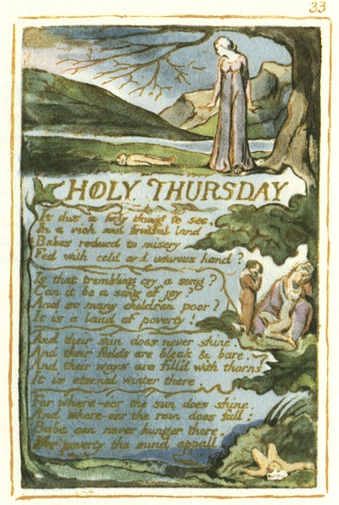
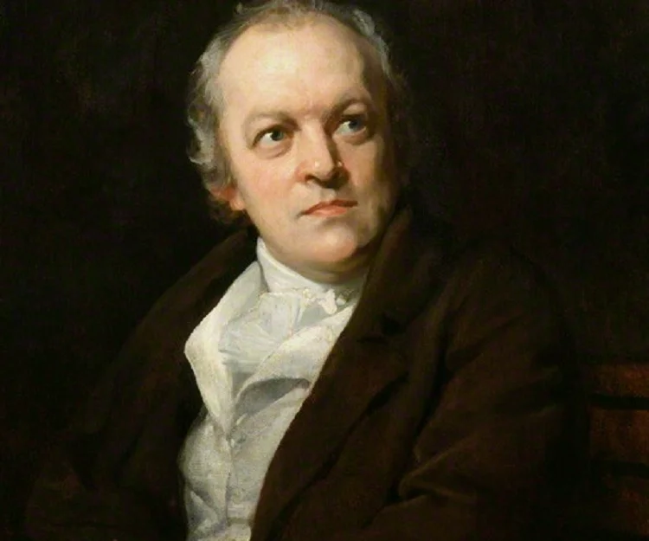
Holy Thursday (experience)
Bariah Tahir

Slide 31
Context
Describing an annual event in St. Paul’s Cathedral, this consisted of beadles marching a number of children from charity schools of London into St Paul’s. Reference to Holy Thursday innocence.
Blake expresses his feelings towards this as event as social injustice of poverty and charity. Directly attaching the presence of poverty ‘in a rich and fruitful land’.
Attacking the churches authority. ‘is this a holy thing to see’.

Slide 32
Voice
Demonstrative pronouns ‘this’ & ‘that’
Second person, omniscient narrator
Juxtaposing lexical clusters of pain/misery & joy/comfort. Pain (adjectives) represents the reality and joy (verbs) used to mock/ attack the authority of church.
Repetition of the sound ‘d’ (x18) & ‘b’ (x4). Plosives = attacking the authority. E.g. conjunction ‘And’ (x6), sense of continuity.
Use of ‘&’ instead of ‘And’ in line 10
Use of question marks (x2), interrogative tone to mock (not present in the last stanza)= questioning the authority of church.

Slide 33
Rhyme and rhythm
Rhyme scheme in stanza 1,3 & 4 (ABCB)
Anaphoric repetition of ‘And there’ (x3) = continuity in things that Blake thought was wrong with the power of church over the people.
Repetition of ‘where-e’er the’ & ‘does’ (x2) = portraying the scale of land under the rule of church, therefore representing the scale of corruption.
Repetition of the abstract noun ‘poverty’ (x2) = emphasising on the concept.
Repetition of the noun ‘song’ (x2) = referring to the songs sung by these children, innocence taken advantage of.

Slide 34
Lexis
Refers back to all the problems highlighted throughout the poem in the last stanza = highlighting the main problems with the society + presents an image of an ideal society.
Use of the conjunction ‘where-e’re’ instead of ‘where ever’ = to maintain the
‘children poor’ = poor education and health care + poverty
Lexical cluster of words related to nature i.e. ‘land’, ‘sun’, ‘fields’ = talks about the corruption of nature and urbanization
‘usurous’ = charging illegal or exorbitant rates of interest for the use of money.

Slide 35
Syntax
A combination of interrogative and declarative terms = stating the situation rather then portraying sense of confusion.
Repetition of words making the stanza seem longer then they are.

Slide 36
Form and structure
Four quatrains with a broken rhyme scheme = how the society seems structured and well maintained society in the forefront but everything within in chaotic.

Slide 37
Imagery and figurative language
A mother standing beneath a leafless tree. She gases at the lifeless body of her infant. In the right hand margin are other scenes of poverty and death.
Juxtaposing imagery created within the stanza’s = ‘in a rich and fruitful land’ with ‘their field are bleak and bare’ suggesting that the people, specifically children are being restricted from their rights.
Use of cold and dark colours; icy blue for the sky and dark green for leaves.

Slide 39
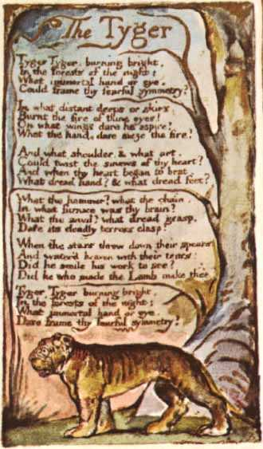
The Tyger
William Blake

Slide 40
Form and Structure
x6 quatrain stanzas - organisation and planning, visually neat and structured.
Framing by the repetition of the first stanza as the last stanza, suggesting a cyclical nature of events.
Deviates with the change from the modal verb “Could” at the start to the more aggressive “Dare” at the end, becomes darker throughout the poem.

Slide 41
Lexis and Syntax
“Tyger” non-standard orthography, polysemic meanings, religious reading, symbol of God’s creation Context of religious time period
Lexical cluster of industrialisation “furnace” “anvil” “hammer” “chain” link to the industrial revolution context, shows symbol of the human creation of industrialisation vs God’s creation of nature and animals.
“Did he who made the Lamb make thee?” LINK to the Lamb, with polysemic meaning, both representing states of the human soul, power vs weakness, experience vs innocence.
Tiger is an exotic animal, even more so in the context of Blake’s era because it isn’t native to Europe. Paired with ideas of industrialisation could show that it isn’t natural, both industry and tigers don’t belong in traditional English society that Blake supports.
There are 14 interrogatives used, sense of urgency and uncertainty. Shortening of “dread” from dreadful in the 3rd stanza increases the pace and furthers the sense of urgency.

Slide 42
Imagery and Figurative language
Industrial imagery through “Fire” “burning” and “burnt” create images of hell fire with religious connotations, showing Blake’s view of the corruption of industrialisation on society by juxtaposing industry with hell.
“the stars threw down their spears” – metaphor, reference to god and heaven, context 1783 meteor, ‘The great meteor’ said to resemble ‘a spear from the sky’ and would’ve been a significant event in Blake’s lifetime.
The continued metaphor and personification of the stars, “water’d heaven with their tears” link to biblical stories of Noah’s arch, or the religious belief of a ‘Judgement day’.

Slide 43
Rhyme and Rhythm
Regular AA, BB rhyme scheme, deviates in first and last stanzas with “eye” and “symmetry”
Ironic because the regular pattern is broken and it is no longer symmetrical, it reinforces the sense of imbalance and uncertainty created through the polysemic meanings in the poem.
Creates an uncomfortable, incomplete ending, suggesting that there is a darker undertone that disrupted the “symmetry” of the poem.

Slide 44
Tone and Voice
Omniscient, 3rd person narrator ties into the religious reading of the poem because it creates a god like voice watching over.
Or, Interrogatives, a questioning voice, potentially doesn’t know all the answers so isn’t omniscient like God.

Slide 46
Nurse’s song (E)
By Nicole Taylor

Slide 47
FORM AND STRUCTURE
2 symmetrical quatrain stanzas
When the voices of children are heard on the green And whisp'rings are in the dale, The days of my youth rise fresh in my mind, My face turns green and pale. Then come home, my children, the sun is gone down, And the dews of night arise; Your spring & your day are wasted in play And your winter and night in disguise.

Slide 48
LEXIS AND SYMBOLS
Denotes the freshness and fertility of the land and the children - represents freedom and growth
Sounds are secretive and covert
When the voices of children are heard on the green And whisp'rings are in the dale, The days of my youth rise fresh in my mind, My face turns green and pale. Then come home, my children, the sun is gone down, And the dews of night arise; Your spring & your day are wasted in play And your winter and night in disguise.
Evocative term:
Children- full of fun- create the Nurse's jealousy because they have a life apart from hers
Older children engaged in illicit activities- loss of innocence
The literal and moral ‘high ground' of Nurse's Song (I) (where ‘laughing is heard on the hill') is exchanged for shady goings on in the dale/valley
Ambiguous and ironic. The memories come ‘fresh' in so far as they come repeatedly -not fresh and full of life. They are often-visited and devoid of life.
Refers to jealousy, which leads to stagnation and constraint.... Also refers to sickness

Slide 49
IMAGRY AND SYMBOLISM
The nurse- Used to represent the caring and nurturing capacity within human beings. Can be used to protect the freedom of what is carefree, innocent and vulnerable. Ideally the nurse delights in their charge and has no desire to repress or rule but this capacity can also be distorted into a desire to control and devour what is carefree and vulnerable.
-Quasi-parental figure, deliberately inhibits and represses the children. She uses the authority of a society based on external authority figures and laws to mask jealousy and cruelty as ‘love'.
When the voices of children are heard on the green And whisp'rings are in the dale, The days of my youth rise fresh in my mind, My face turns green and pale. Then come home, my children, the sun is gone down, And the dews of night arise; Your spring & your day are wasted in play And your winter and night in disguise.
Disguise, idea of concealment has already been hinted at in ‘whisperings' and is the product of experience rather than innocence. From the Nurse's bitter perspective, even the ‘purity' of childhood is a pretence. Alternatively, she might be reflecting on her adult self (in the ‘winter' of her life) and the necessity of concealment of the true self in order to function socially.

Slide 50
RHYME AND RHYTHM
Anapaestic metre lines 1, 5, and 8 creates a jauntiness that is undercut by the content and tone of the poem, particularly by the heavy iambs of line 4.
When the voices of children are heard on the green And whisp'rings are in the dale, The days of my youth rise fresh in my mind, My face turns green and pale. Then come home, my children, the sun is gone down, And the dews of night arise; Your spring & your day are wasted in play And your winter and night in disguise.
nurse's denial of life is underlined by the internal rhyme in the third line of stanza two, which contrasts the two sentiments. The overall effect is to give the statement the weight of an undeniable maxim, which the repeated ‘and's reinforce.

Slide 51
TONE
Sounds song like however the words embedded in the poem have darker meanings which could represent the corruption that is oppressing childrens freedom to play and express their inate joy
When the voices of children are heard on the green And whisp'rings are in the dale, The days of my youth rise fresh in my mind, My face turns green and pale. Then come home, my children, the sun is gone down, And the dews of night arise; Your spring & your day are wasted in play And your winter and night in disguise.
Dark lexis hidden within the song like structure connotes concealment

