Slide 1
Revising Narrative
The Great Gatsby

Slide 2
The Prose question
What: Section A Component 03
Length: one hour
Worth: 32 marks
Details: open text
Details: one generic question, from a choice of two, on an aspect of narrative (e.g. narrative voice, the handling of time, moments of crisis), in The Great Gatsby
Assessment Objectives tested: AO1, AO2, AO3

Slide 3
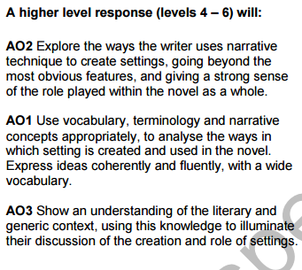
Weightings: AO2: 6% AO1: 5% Ao3: 5%
Notes:
Reminder of Aos.

Slide 4
Feedback on your mocks
Generally, good knowledge of the text, with good references being made across the text.
Remember: with the "Tensions" question, you are not just pointing out which bits in the text are tense. You are explaining HOW tension is created.
Similarly: do not be tempted to outline the places in The Great Gatsby – you need to explain their FUNCTIONS. You need to explain HOW place is being created.
You need to give a linguistic analysis (word classes, lexical clusters, lexical oppositions, sentence types, sentence moods etc.)
You need to integrate context throughout
Keep the question in sight at all times

Slide 5
Advice Given to Me By a Wise Old Man
In order to do well in any exam, you need only do three things.
Read the question
Answer the question
Repeat as many times as necessary or appropriate

Slide 6
Your Task
If you did the "Place" question. Prepare a ten point plan for the tension question.
If you did the "Tension" question. Prepare a ten point plan for the place question.
Hand on your plan to another student who has done the other question.
Use the guidance provided to add to the plan.
Discuss: what else could you have included? Ideas on the board.

Slide 7
Your task
In your group, you have a set of cards, face down on the table in front of you. They each have a narrative term written on them.
You should take it in turns to select one.
You then have a minute to talk about your particular term in relation to The Great Gatsby

Slide 8
Same idea, different terminology
In your pair, take your card…
Write down other words that the examiners might choose to use instead
For example, the question might ask you to analyse the "representation of speech" rather than "dialogue", or "the use of place" rather than "settings".
Please focus on: genre, style, structure, time, point of view, narrative voice, dialogue, setting, suspense

Slide 9
Same ideas, different terminology: What Other Words might the Examiners use?
Genre:
Style:
Structure:
Time:
Point of view:
Narrative voice:
Dialogue:
Setting:
Suspense:

Slide 10
Same ideas, different terminology
Genre:
conventions, expectations, rules, journey or quest
Style:
description, narration v dialogue, lexical choices, tone and register
Structure:
development, retrospection, denouement, conflict, patterns, contrasts and oppositions, non-linearity, disruption, turning point, climax, revelation, resolution, exposition, crisis, key events
Time:
gaps in the narrative, retrospection, proleptic and analeptic references, tense usage, compression, shifts
Point of view:
judgement, comment, direct address, participation, detachment, multiplicity, perspectives
Narrative voice:
unreliability, naïvity, retrospection, alternative voices, dialect/idiolect, reported speech, free indirect discourse
Dialogue:
dialect/idiolect, speech tags, introduction of other voices, direct speech
Setting:
backdrop, place, symbol, pathetic fallacy, atmosphere, locations
Suspense:
manipulation, delay of resolution, pace, tension

Slide 11
Your Task
In your pair, you have a PowerPoint slide.
Your task is to teach what is on the slide. You may use whatever method you think is appropriate.
You will not have the slide on display as you teach.

Slide 12
Past Questions
Sample Question 2016
How does the writer of your text use settings? You should range across the text to allow you to explore how they are presented and what role they play in the novel.
How does the writer of your text use suspense? You should range across the text to allow you to explore how suspense is presented and what role it plays in the novel.
Practice Paper 2016 Set 1
How does the writer of your text use symbols and motifs? You should range across the text to explore how symbols and motifs are used, the function they play in the novel as a whole, and the broader generic context.
In what ways does the writer of your text use dialogue? You should range across the text to explore how dialogue is used, the function it plays in the novel as a whole, and the broader generic context.

Slide 13
Gatsby Past Questions
Practice Paper 2016 Set 2
In what ways does the writer of your text use prose style? You should range across the text to explore how prose style is used, the function it plays in the novel as a whole, and the broader generic context.
How does the writer of your text use beginnings and endings? You should range across the text to explore beginnings and endings of the whole and / or sections of the text, the function these play in the novel as a whole, and the broader generic context.
June 2017
How does the writer of your text use moments of crisis? You should range across the text to explore how moments of crisis are used, the function they play in the novel as a whole, and the broader generic context.
How does the writer of your text use minor characters? You should range across the text to explore how minor characters are used, the role they play in the novel as a whole, and the broader generic context.
June 2018
In what ways does the writer of your text use narrative voice? You should range across the text to explore how narrative voice is used, the function it plays in the novel as a whole, and the broader generic context.
How does the writer of your text use form and structure? You should range across the text to explore how form and structure shape the narrative, the function this plays in the novel as a whole, and the broader generic context.

Slide 14
What could come up?
Narrative voice:
intrusive narrator
self-conscious narrator
free indirect style
inadequate or naïve narrator
unreliable narrator
multiple voices
first person narrator
focaliser/focalisation
stream of consciousness
second person address
interior monologue
narrative distance

Slide 15
what could come up?
genre
adhering to the rules of a genre: setting up reader’s expectations
breaking the rules of a genre to undermine and challenge expectations
use of the rules of genre to tell a different story
to draw attention to the events of a particular passage or chapter
introducing another text type into a novel
drawing on more than one genre, perhaps to unsettle the reader
Notes:
Each group has

Slide 16
what could come up?
structure
focus on openings (to introduce themes, voice, tone, to introduce a problem)
ab initio/in medias res/frame narrative
proleptic references/analeptic references
focus on endings (to bring together motifs, themes etc)
building tension, expository chapters, climax and resolution in the novel
adherence to the structure of a particular genre
Non-linear narrative (disjointed narrative or disrupted narrative is a technique where events are portrayed, for example, out of chronological order. Each narrative is unfinished.)
Gaps in the narrative (used to represent the narrator’s need to repress, or inability to see an event; indicating passing time; forcing the reader to piece together the narrative; indicating unreliability; indicating exclusivity – worlds to which the reader/narrator are not invited.)
Repetitions and patterns (repetition or opposition of themes/ settings/ repetition of names, events, words and phrases, motifs)

Slide 17
what could come up?
Use of dialogue
use of speech tags to establish character traits (invisible, or “minimal phrases” , interpretive verbs, use of adverbial tag , mental process phrase, tags can be placed in 1) initial, 2) medial or 3) final positions)
use of dialogue to move forward the plot,
to create character through idioms/repeated phrases etc
discourse features: longer utterances/louder tone/ack of politeness features/interruptions/agenda setting

Slide 18
what could come up?
setting
the role of the setting: verisimilitudinal/referential/symbolic
to evoke place or mood
to signal genre
to add structure
to act symbolically
to establish themes
to create expectations
to convey contrasts in character

Slide 19
what could come up?
characters
roles of characters as antagonist/protagonist/ foil?
where they appear in the novel and why
whether we see the scene through their eyes/focaliser
whether they are dynamic or static
choice and function of name
imagery associated with them
terms of address associated with them
verbs associated with them
speech attribution etc.

Slide 20
what could come up?
use of symbol and motif
used to establish thematic patterns across the novel
guiding readers through the plot
creating contrasts between characters
setting up echoes in the novel
linking key moments

Slide 21
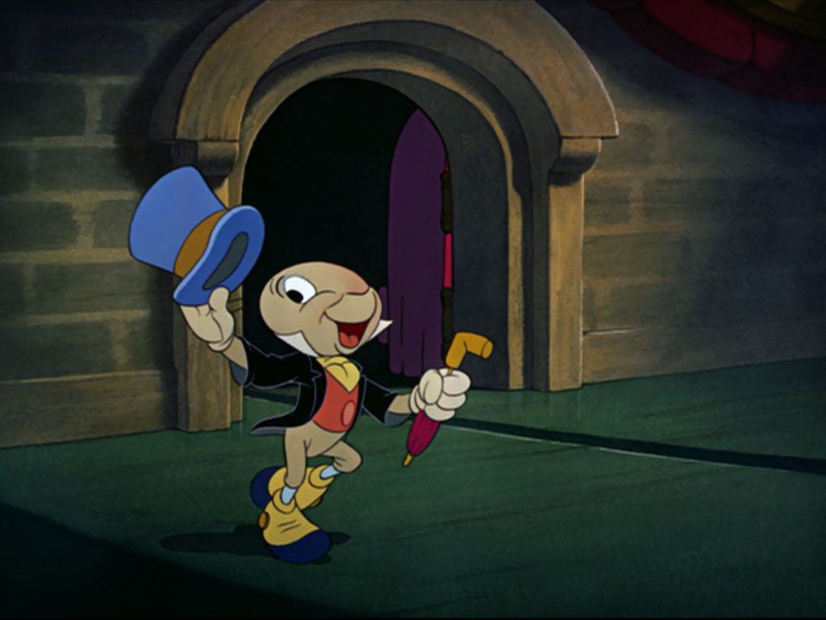
Narrative Voice

Slide 22
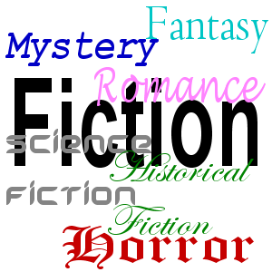
Genre

Slide 23
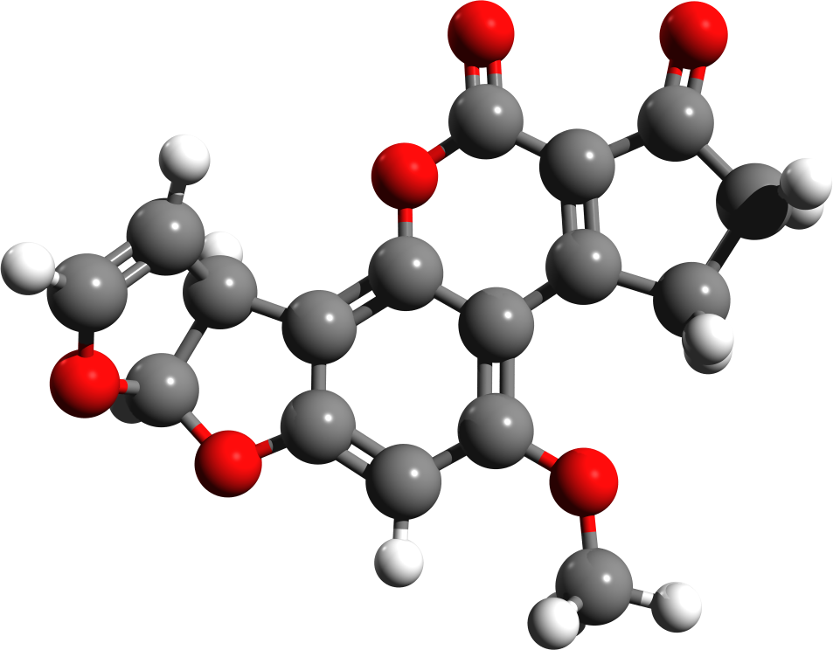
Structure

Slide 24

Dialogue

Slide 25
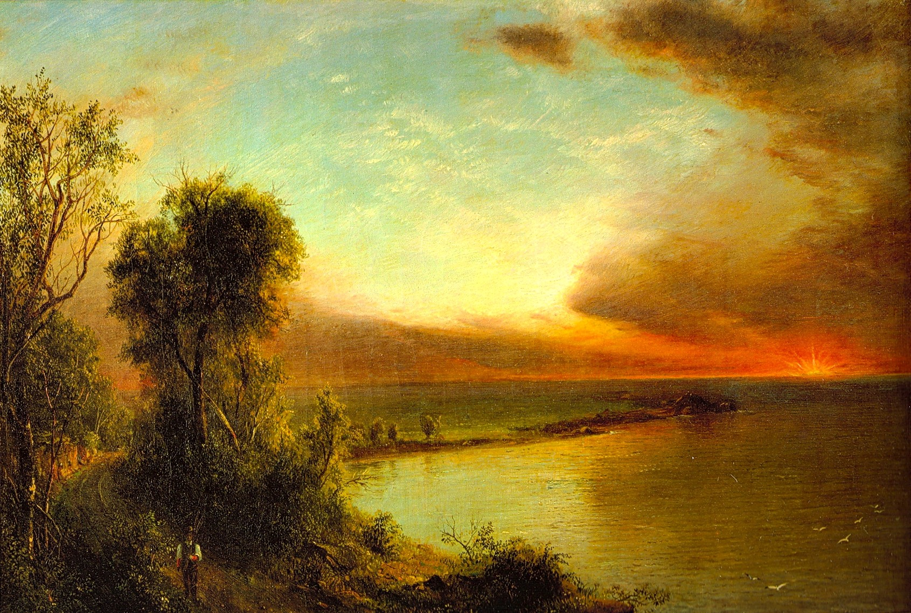
Setting

Slide 26
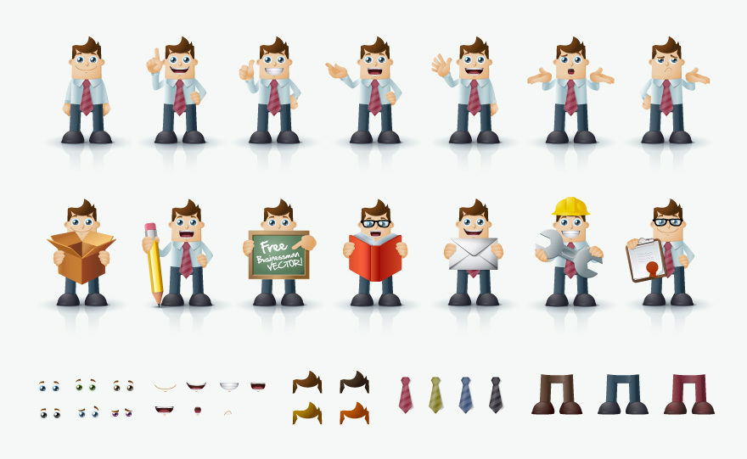
Characters

Slide 27
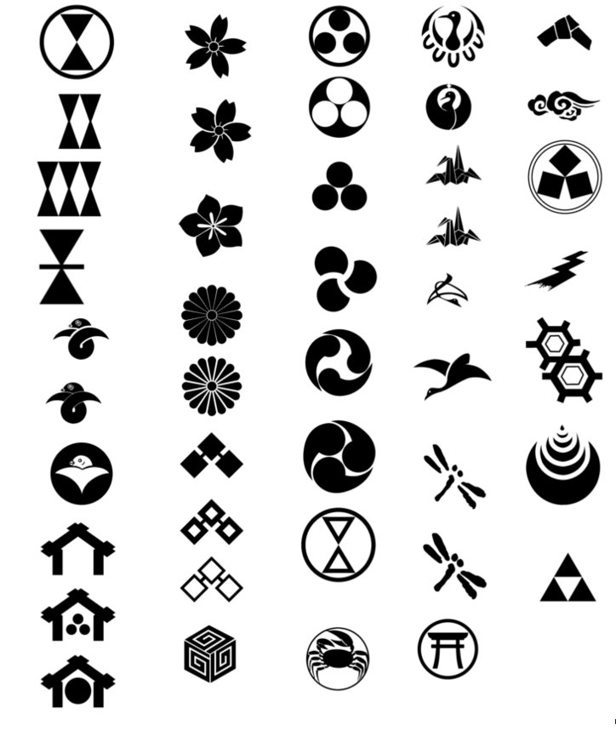
Symbol and motif

