Slide 1
The American Dream
By Alice and Maya

Slide 2
The belief
The American Dream is the belief that anyone, regardless of where they were born or what class they were born into, can attain their own version of success in a society where upward mobility is possible for everyone. The American Dream is achieved through sacrifice, risk-taking, and hard work, rather than by chance
James Truslow Adams in 1931 said "life should be better and richer and fuller for everyone, with opportunity for each according to ability or achievement" regardless of social class or circumstances of birth.
American Dream was to have a perfect family, a secure job, and a perfect house in the suburbs.

Slide 3
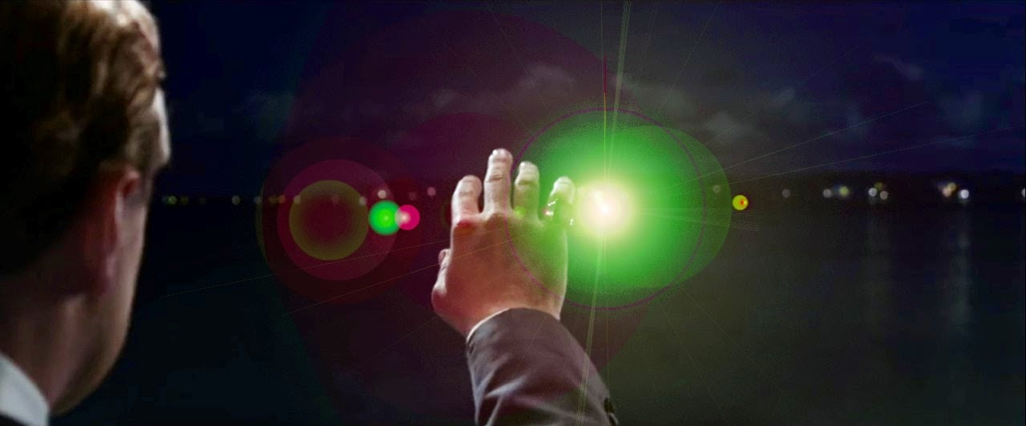
Linking to Gatsby
The green light in the Great Gatsby symbolises Gatsby’s hopes and dreams for a life with Daisy
The Valley of the Ashes is also representative of the ugly consequences of America’s obsession with wealth, and those who fail to attain the ‘American Dream’.

