Slide 1
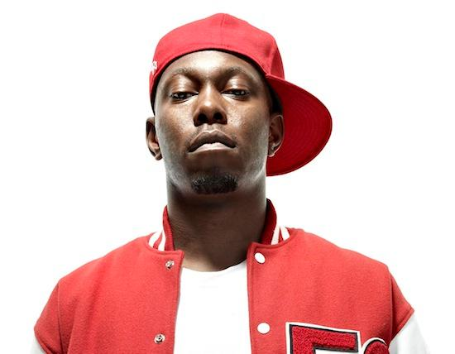
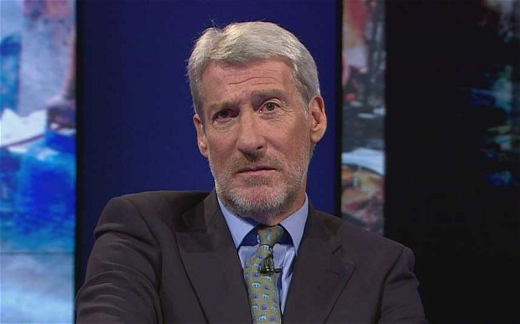
Dizzee Rascal
And Jeremy Paxman
And Valerie Amos
Notes:
Introduction. Aims and objectives: to revise the approaches that we might take in order to analyse a piece from the anthology; to closely examine the lexis of formality and informality; to analyse the interview between Paxman and Rascal and Amos in terms of context, lexis, syntax and interactional, conversational features; to complete a piece of creative writing that transforms the balance of power or the lexis of formality. 5 mins Open with watching the interview with no sound: what do they notice about the body language of the interviewer and interviewee? 10 mins

Slide 2
Some terms for you
Locutionary act: what we say (“Isn’t it cold in here?”)
Illocutionary act: implying something in what we say (“Shut the window”)
Perlocutionary act: what happens in response to what we say (ie what is understood) (The window is shut)
Notes:
Discussion about the difference between what is being said and what is being implied (discussion about other terms with which they might be more familiar… sarcasm, subtext?) 5 mins

Slide 3
How might you sort this list of words and phrases?
I think, know what
Yeah, man
If you believe you can achieve
Innit
Social dynamic at work
Built on the possibility of achievement
Founded on the idea of betterment
Less cynical
Truly aspirational
You know what I mean
Gonna say what they say
But like
Notes:
In pairs or individually, to sort these in terms of either informality and informality, Latinate v idiomatic lexis. Discussion about the features of informal speech: abbreviations, elliptical sentences, hedges, fillers, tag questions. Can they decide who is responsible for which phrases? Amos, Rascal or Paxman: note the convergence between Paxman and Amos. 10 mins

Slide 4
Your task is to look at either:
C -CONTEXT: who wrote or spoke the text you are studying? When was it written/aired? For what purpose? What is the genre of the text? G – Genre – what type of text is it? A – Audience – who is it written for/targeted at (specifically)? Is the text/transcript trying to appeal to men and women, old or young etc? S – Subject – what is the text about? If it is an article, what is the subject and will that have an effect on the language used? P– Purpose – what is it trying to do overall, to instruct, advise, persuade, or does it do several of these? OR
L – LEXIS AND SYNTAX: if you are looking at spoken mode, think of the contrasts between the speakers: what type of sentences are used (simple, compound, complex, minor, elliptical? Why? In both written and spoken: are there any lexical repetitions, (tripling) or lexical clusters? What grammar, syntax, imagery, lexical choices etc. support your assessment of the genre, audience and purpose of the text? You could look at noun types, adjective form, pronoun use, monosyllabic/polysyllabic lexis; imperative/declarative/interrogative/exclamatory sentence mood, register, use of idiom or cliché, pre-modification/post-modification, hyperbole, litotes, field -specific lexis, archaic lexis , collocations OR
I – INTERACTIONAL FEATURES: When analysing spoken mode: look for spoken features; for turn taking strategies; for power indicators; for contrasts in formal and informal language and what that reveals about the relationship between the speakers; for the illocutionary/perlocutionary acts; for convergence. OR
Notes:
Read the extract. 10 mins Work in groups on one of the above. 20 mins Feedback to the class. Pool ideas on the board. 20 mins

Slide 5
Creative Writing: your task
Either:
Re-write Amos’ response to emulate the idiolect of Rascal’s speech
Re-write the first six turns in this extract to change the power dynamic between Paxman and Rascal.
Prompt words: Latinate vocabulary, hedges, fillers, interruptions, turn allocation, formal discourse markers, repetition, incomplete minor sentences, shorter grammatical units (simple and compound sentences), use of slang or informal lexical choices, tag questions, agenda setting, false starts, self-correction.
Notes:
Students can work in groups or pairs to produce a short piece of creative writing, in order to consolidate the observations they have made about the contrasting speech styles illustrated in this extract, and the reasons for adopting those speech styles. 20 mins. Read/act out their responses to the class, (thinking about what non-verbal actions might influence the balance of power). The class note down two aspects that indicate an idiolect, or that are features of the language of power. Feedback after each piece of creative writing. (20 mins)

