Slide 1
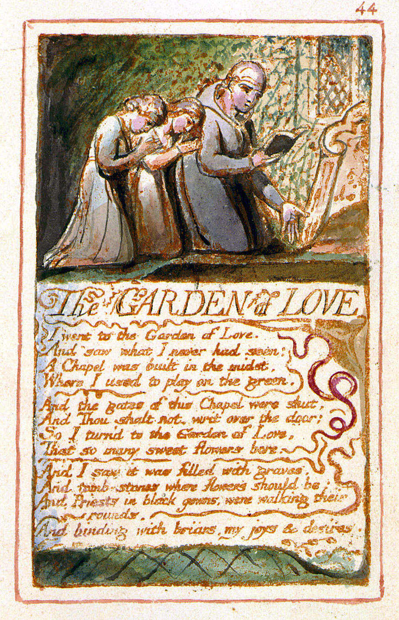
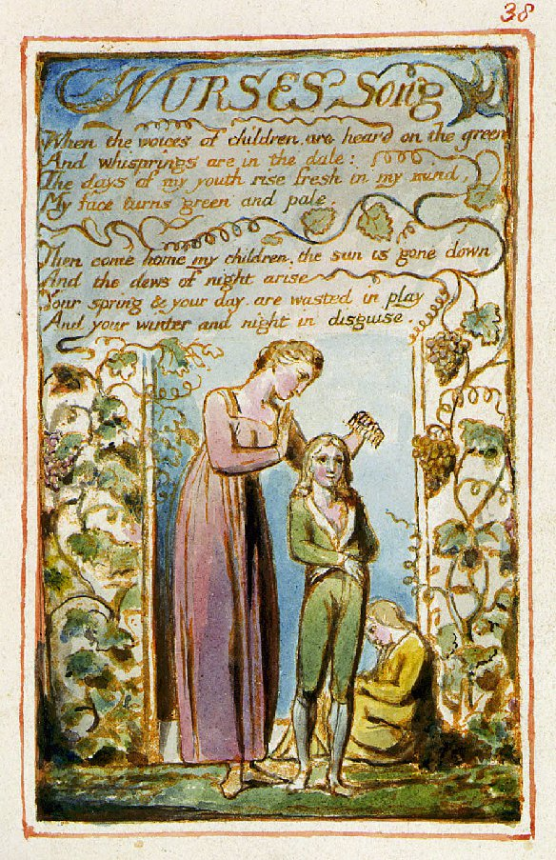
Blake
Making Connections
Notes:
Introduction: aims and objectives; to revise the connections between the poems – links created predominantly through theme, but also between poetic techniques for example. Revision of Jerusalem in terms of what is covered in the answer, and in terms of what others would say given a specific focus and a specific extract.

Slide 2
Question: presentation of freedom and control in “The Garden of Love”
Key points on core text:
Voice: first person, expressing a set of experiences of freedom and control; deviation in Stanza two with use of direct speech (“Thou shalt not”)
Hymn-like form seeming to offer security and certainty – at odds with the despair of the loss of freedom
Contrasts in lexis: restriction v freedom of thought and action; child v adult, past v present
Rhyme: full end-rhymes up to where the repression is foregrounded by the loss of rhyme in lines 2 and 4; internal rhyme of “gown” and “rounds” emphasising the power – the never-ending circles, the homogenised dark uniform
Wider literary and cultural context: Isaac Watt’s hymn forms distorted here to express alternative view of Christianity; Biblical allusion to the Garden of Eden; reference to the encircling briars of the engraving
Notes:
How would I do it? Model for the task they are about to plan: up to five point observation – leading to ideas as to what to compare ….

Slide 3
Possible comparative texts
“Nurse’s Song” (Innocence)
“Nurse’s Song” (Experience)
“Human Abstract”

Slide 4
Reflection on Points of Connection
Connection between “Garden of Love” and both Nurse’s Songs through ideas of playing, freedom, (Innocence), control, authority (Experience)
Link between use of rhyme in “Human Abstract” – in tension with content – authority perverting notions of pity and mercy to their own ends. The external tyranny of an authority that perpetuates economic inequality and exploitation in the name of religion. Natural imagery, transformed – similar to end of “Garden of Love” (“briars”)
Notes:
Leading to … points of connection tied to the question

Slide 5
Your turn
pick a theme: e.g. childhood, industrialisation, innocence, creativity, adulthood, nature, care, religion, humanity,
Choose a poem as your core text
write no more than five bullet points that sum up its relevance (poetic devices, stylistic analysis, context)
Find a second poem
Find no more than five points of comparison between the two texts
Write the opening paragraph
Notes:
Only to do opening paragraph if time…. to be peer marked

Slide 6
The fifteen poems:
“Introduction” (I), “
The Lamb” (I),
“Nurses Song” (I),
“The Eccoing Green” (I),
“Holy Thursday” (I),
“The Divine Image” (I),
“The Chimney-Sweeper” (I),
“The Clod and the Pebble” (E),
“Holy Thursday” (E),
“The Chimney Sweeper” (E),
“Nurse’s Song” (E),
“The Tyger” (E),
“The Garden of Love” (E),
“London” (E),
“The Human Abstract” (E).
Notes:
Alternatively – or if time: the students write the titles on Post-It sized pieces of paper – each title on a separate piece – and their create different pairings, providing three connections between them each time – and writing down or photographing their connections. Compare groupings – “pitching” your choice of poem over another pair’s choice of poem.

Slide 7
Share your connecting poems
What choices did you make?
How did you connect the poems?
Reflect on which other poems you might have chosen.

Slide 8
Drama overview
Individually: open Jerusalem at random – and select an extract of about 30 lines
Write two or three sentences to highlight key points of your extract (Literary and dramatic features, stylistics, language levels, context)
Take it in turns with the person sitting next to you, to explain the relevance of your extract.
Notes:
Refer to next slide if they need further prompting…

Slide 9
Your Guidance
Literary and dramatic features (form and structure – structural development, division into acts and sciences, development of plot and sub-plot. Dramatic techniques: stage directions, exits/entrances, dramatic irony, dialogue, monologue, soliloquy, metatheatrical references, proxemics, lighting, pace etc.)
Stylistics (foregrounding of theme/preoccupation through repetition (lexical, structural, figurative) parallelism (grammatical, syntactical) or deviation)
Language levels (kinds of lexis e.g. concrete or abstract nouns, contrasts, repetitions, clusters etc. Discourse e.g. types of utterances, conversation analysis, register and style of language, naming and terms of address. Grammar e.g. syntax, sentence types, verbs, moods and tenses, parallelism) Pragmatics (implied meanings, subtext, meanings in context)
Context: (dramatic context, e.g. relationship of the extract to the rest of the play, dramatic tradition; adherence or breaking from sub-genre rules. Other contexts such as context of writing, performance and reception, including theatre reviews)

Slide 10
Your Task
Choose one of the three extracts on the board
Choose from one of the following: presentation of Johnny, function of Phaedra; role of Ginger; relationship between Johnny and Professor; relationship between council and Johnny; entrapment; genre of tragedy; genre of comedy, nature, myth; the establishment.
Individually write no more than five bullet points (dramatic, stylistic, discourse, context)
Compare ideas across the class

