Slide 1
Jerusalem
Comedic Conventions

Slide 2
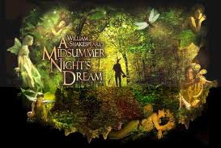
The Green World

Slide 5
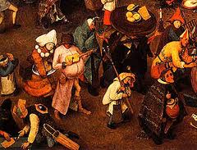
The Carnivalesque

Slide 6
The Carnivalesque

Slide 7
The Carnivalesque….
brings unlikely people together, encouraging interaction
welcomes usually unacceptable behavior
The freedom allows everything that may normally be separated to reunite
Allows normally unacceptable events to occur without the need for punishment.

Slide 8
The Lord of Misrule

Slide 9
The Lord of Misrule

Slide 10
Lord of Misrule …
This figure orchestrated the entertainment
…was given permission to rule
… to take charge of the society for a limited period
his period in charge was one of misrule, of subversive freedom and topsy-turvyness.

Slide 11
Relief theory

Slide 12
Superiority theory

Slide 13
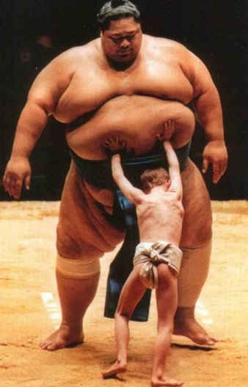
Incongruity Theory

Slide 14
What’s so funny?
Whiz. Wangers. Sick beats. Tasty birds. Rum n’ Ribena. Benilyn ‘n’ brandy…. Birds are going bats for it. Banging it back. Then, right. Then. Right. Then. (He cracks up.) Then. Right. Then. (Laughs) Then. Right. Rooster. Right. (Cracks up. He says it. He’s laughing so hard, you can’t understand it.)

Slide 15
What’s so funny?
GINGER: So what’s your Red Indian spirit name then, Lee?
JOHNNY: “Burns his Smurfs”
GINGER: “Flies to Australia and Comes Straight Back.”

Slide 16
What’s so funny?
TANYA: They should put him in the town square. Next to King Arthur.
PEA: His arm round King Arthur and a fucking great spliff on the go.
LEE: “Johnny Byron. Wiltshire’s Biggest Bullshitter.”

Slide 17
Comedic Language Features
Hyperbole (exaggeration)
Litotes (understatement)
Incongruous juxtapositions (things put together that don’t naturally go together)
Paronomasia (puns or word play)
Parody of other styles
Allusion to other texts
Repetition
Euphemism

Slide 18
Comedic Language Features
Incongruous juxtaposition: “foldy chairs” and “go beserk” – (the practical juxtaposed with an extreme emotion that suggests a lack of control)
Allusion to Greek myth etc. “snakes on their neck” – incongruity of all encompassing Greek myth with the villagers in the hall
Hyperbole: “weeping with rage. Tearing their hair out.” followed by litotes “Everyone gets very red in the face”
Incongruous juxtaposition: “I swear to Christ I was shagging her…” (the sacred and the profane)
Repetition: “I painted her house”, “skirting boards seeing to” “sixteen coats” “those houses’ll need painting” “red in the face”, “red in the face” “lot redder in the face” – delayed resolution
Euphemisms: “seeing to” “sixteen coats” contrasts with the overtly taboo language that Johnny usually uses.
Parody of Kelly Wetherley in the use of the direct speech: “Johnny Byron is a filthy menace. Johnny Byron is a disgrace to Flintock.”

Slide 19
Comedic language….
Language turned on its head.
Used subversively to disorientate us: we laugh at Johnny’s adultery, we laugh at the villagers’ anger.
“Giddy language” according to Keirnan Ryan: “the dialogue is free to dance, however dark and painful the realities that lie beneath it.”

Slide 20
Your Task:
You are responsible for one page (allocated to you)
You should identify the central quote on your page, analysing it from a
Stylistic perspective
Dramatic perspective
In terms of your contextual knowledge about comedic conventions and language
Its relevance to the play as a whole. (thematic focus)

